Slide 1

Proof Systems
Chaya Ganesh
CSA, IISc
ACM India Summer School, IITB Trust Lab
June 2024

Slide 2


Knowledge
$$G∈HAM$$
$$G∈HAM$$
Valid coloring exists, but...
Do you know it?
✓

Slide 3
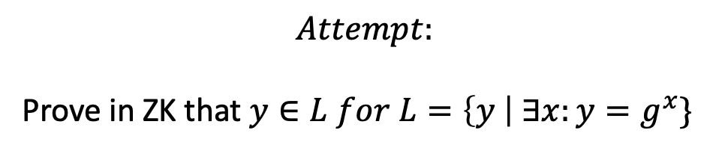

Knowledge
$$Proving identity$$
This is true for all group elements...
Problem:
ZK is trivial: Just send YES
Does one need to “know” the witness to prove a true statement?
✓
$For public key y=g^{x}$in a group where discrete logarithm is hard, prove that $“I know x”$
$$Attempt:$$
Prove in ZK that $y∈L for L=\left\{y \right| ∃x:y=g^{x}\}$

Slide 4
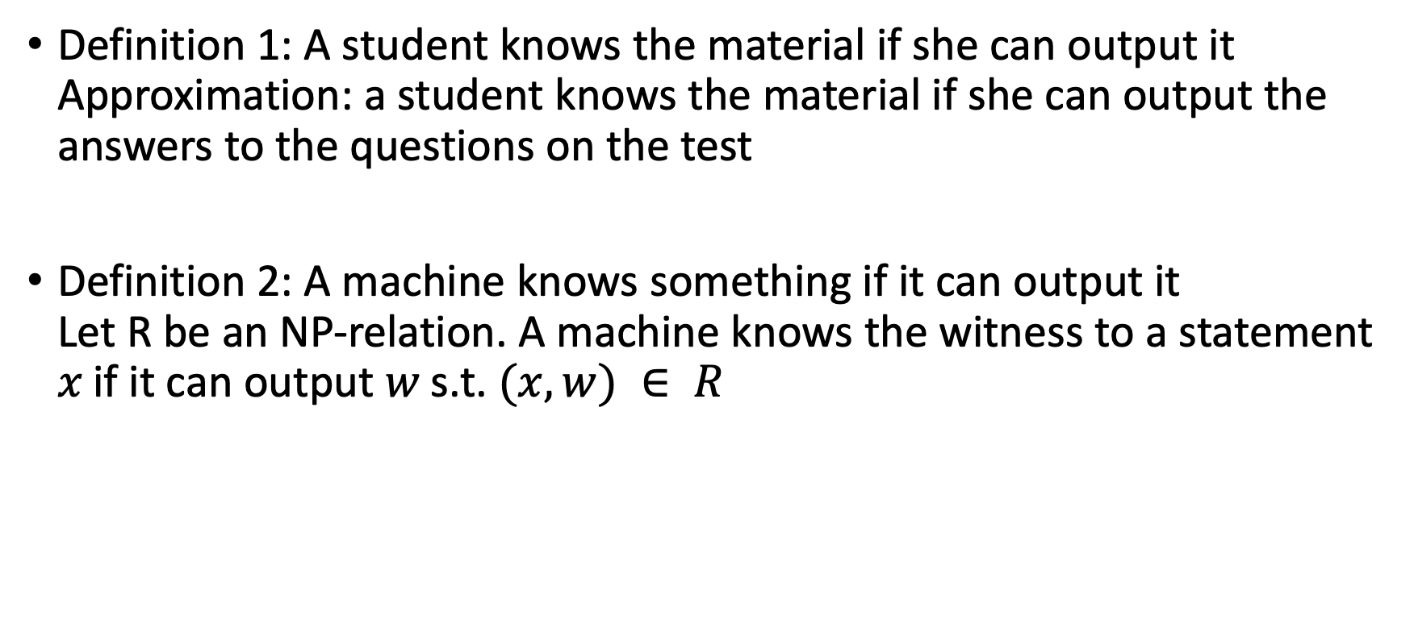
What is knowledge?
Definition 1: A student knows the material if she can output it
Approximation: a student knows the material if she can output the answers to the questions on the test
Definition 2: A machine knows something if it can output it
Let R be an NP‐relation. A machine knows the witness to a statement 𝑥 if it can output 𝑤 s.t. $(x,w) ∈ R$
What does it mean for a machine to be able to output it?

Slide 5
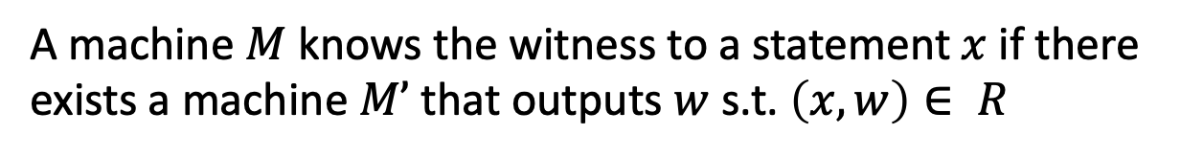
Formalizing knowledge
Attempt 1
A machine $M$ knows the witness to a statement $x$if there exists a machine $M’$ that outputs $w$ s.t. $\left(x,w\right)∈ R$
Problems:
Is not related to the machine providing a proof
Relation to M and M’? Does M know it if M’ outputs it?

Slide 6
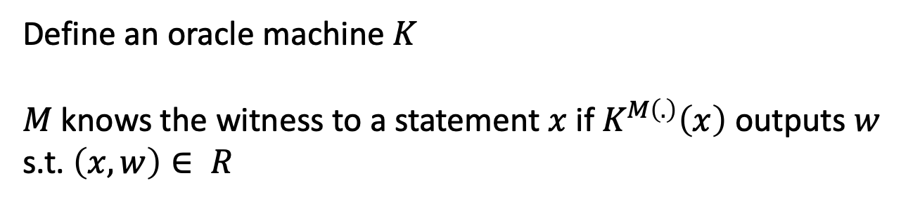
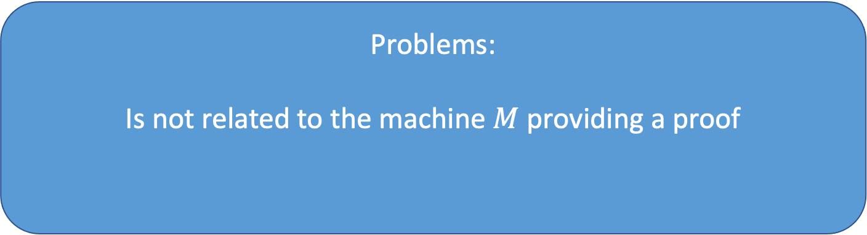
Formalizing knowledge
Attempt 2
Define an oracle machine $K$
$M$ knows the witness to a statement $x$if $K^{M\left(.\right)}\left(x\right)$ outputs $w$ s.t. $\left(x,w\right)∈ R$
Problems:
Is not related to the machine $M$providing a proof

Slide 7
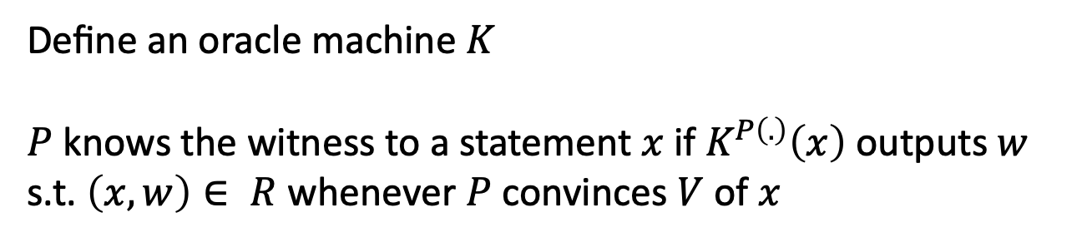
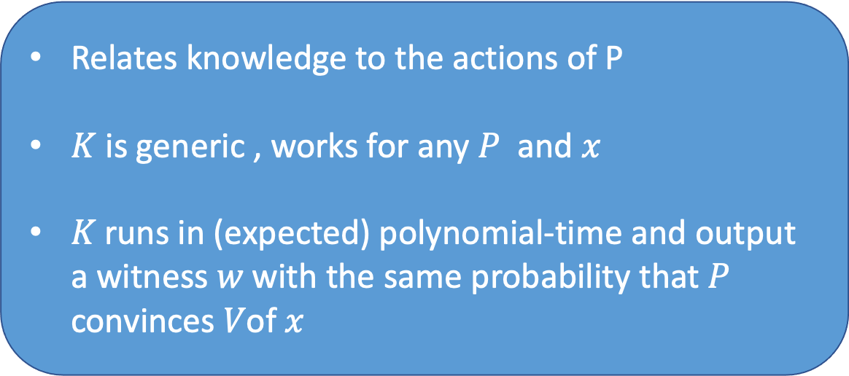
Formalizing knowledge
Attempt 3
Define an oracle machine $K$
$P$ knows the witness to a statement $x$if $K^{P\left(.\right)}\left(x\right)$ outputs $w$ s.t. $\left(x,w\right)∈ R$ whenever $P$ convinces $V$ of $x$
Relates knowledge to the actions of P
$K$ is generic , works for any $P$ and $x$
𝐾 runs in (expected) polynomial‐time and output a witness 𝑤 with the same probability that 𝑃 convinces 𝑉of 𝑥

Slide 8
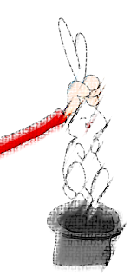
Formalizing knowledge
Knowledge soundness:
Existence of an Extractor
Extractor (Machine K) can pull out the witness
from the prover!

Slide 9
Formalizing knowledge
Attempt 3
Define an oracle machine $K$
$P$ knows the witness to a statement $x$if $K^{P\left(.\right)}\left(x\right)$ outputs $w$ s.t. $\left(x,w\right)∈ R$ whenever $P$ convinces $V$ of $x$
Relates knowledge to the actions of P
$K$ is generic , works for any $P$ and $x$
𝐾 runs in (expected) polynomial‐time and output a witness 𝑤 with the same probability that 𝑃 convinces 𝑉of 𝑥
One can always prove in ZK without “knowing”, with negligible prob!
run the ZK simulator and hope that the verifier’s queries in the result match the real queries

Slide 10
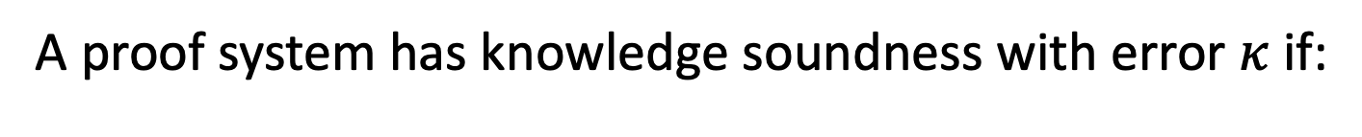
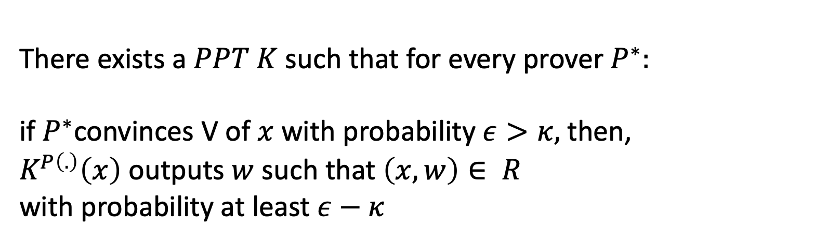
Knowledge Soundness
A proof system has knowledge soundness with error $κ$if:
There exists a $PPT K$such that for every prover $P^{∗}:$
if $P^{∗}$convinces V of $x$ with probability $ε>κ,$then,
$K^{P\left(.\right)}\left(x\right)$ outputs $w$ such that $\left(x,w\right)∈ R$
with probability at least $ε−κ$

Slide 11
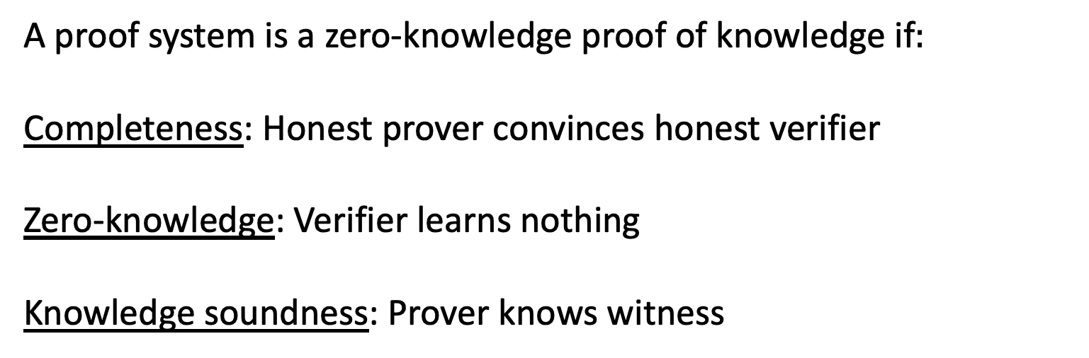
ZKPoK
A proof system is a zero-knowledge proof of knowledge if$:$
Completeness: Honest prover convinces honest verifier
Zero-knowledge: Verifier learns nothing
Knowledge soundness: Prover knows witness

Slide 12

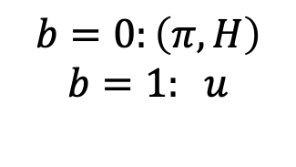
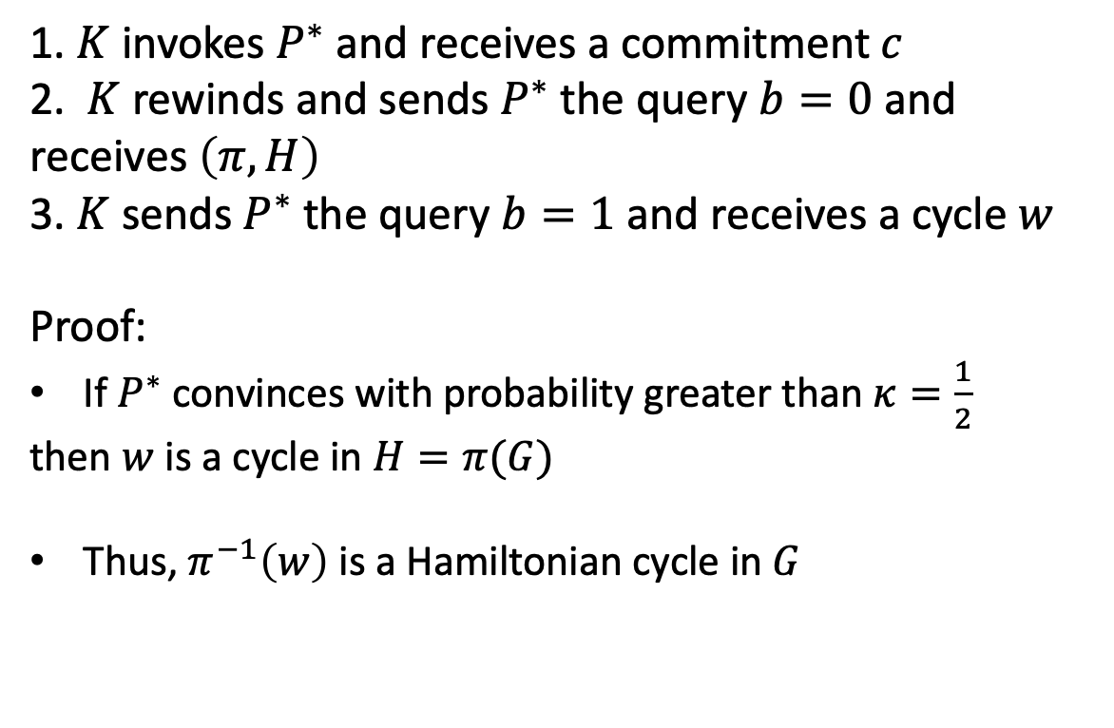





ZKPoK for NP
1. $K$ invokes $P^{∗}$ and receives a commitment $c$
2. $K$ rewinds and sends $P^{∗}$ the query $b=0$ and
receives $\left(π,H\right)$
3. $K$ sends $P^{∗}$ the query $b=1$ and receives a cycle $w$
Proof:
If $P^{∗}$ convinces with probability greater than $κ=\frac{1}{2}$
then $w$ is a cycle in $H=π(G)$
Thus, $π^{−1}\left(w\right)$ is a Hamiltonian cycle in $G$
$$Ham cycle w$$
$$c=Com(H)$$
$$H=π(G)$$
$$b∈\{0,1\}$$
$$b$$
$$u=π(w)$$
$$b=0:\left(π,H\right)$$
$$b=1: u$$

Slide 13
Why ZKPoK?
Non-oblivious encryption: Send an encryption and prove that one knows what is encrypted
Applications:
  Guarantee non‐malleability: did not take a previous ciphertext and maul
  Prevent copying, in auctions

Slide 14
Practical ZK Protocols

Slide 15
Sigma protocols
Restricted set of languages
A way to obtain efficient ZK for interesting languages in practice
Ideas starting point for constructing proofs for circuits

Slide 16



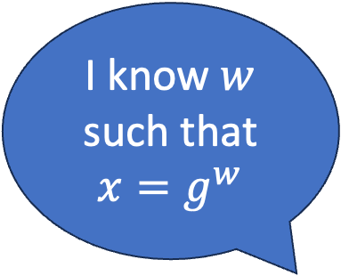

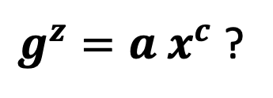
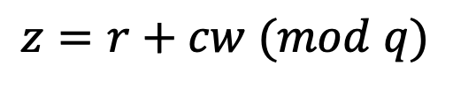
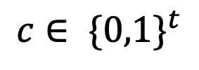
Schnorr’s protocol for discrete log
I know $w$ such that $x=g^{w}$
$G$ Group of order q
generator $g$
$$w,x$$
$$x$$
$${a=g}^{r}$$
$$c∈ {\{0,1\}}^{t}$$
$$r←Z_{q}$$
$$z=r+cw (mod q)$$
$g^{z}=a x^{c}$ ?

Slide 17
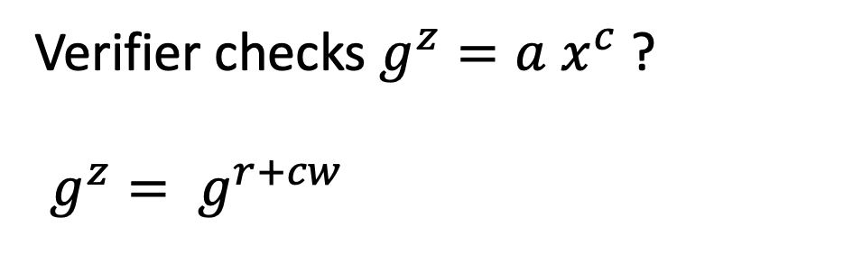
$${w, x=g}^{w}$$
$$x$$
$${a=g}^{r}$$
Completeness
$$c∈ {\{0,1\}}^{t}$$
$$z=r+cw (mod q)$$
$g^{z}=a x^{c}$?
Verifier checks $g^{z}=a x^{c}$ ?
$$g^{z}= g^{r+cw}= g^{r} {\left(g^{w}\right)}^{c}=a x^{c}$$

Slide 18
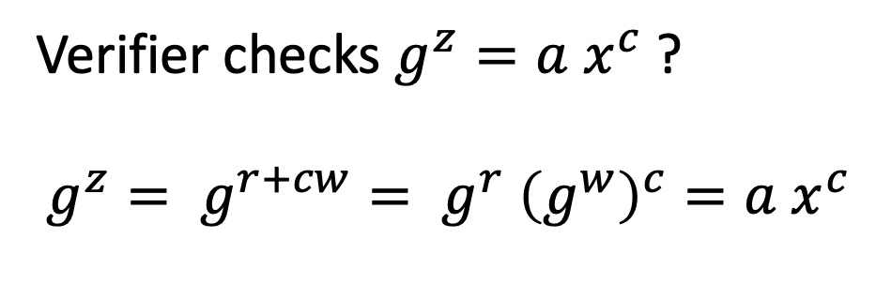
$${w, x=g}^{w}$$
$$x$$
$${a=g}^{r}$$
Completeness
$$c∈ {\{0,1\}}^{t}$$
$$z=r+cw (mod q)$$
$g^{z}=a x^{c}$?
Verifier checks $g^{z}=a x^{c}$ ?
$$g^{z}= g^{r+cw}= g^{r} {\left(g^{w}\right)}^{c}=a x^{c}$$

Slide 19
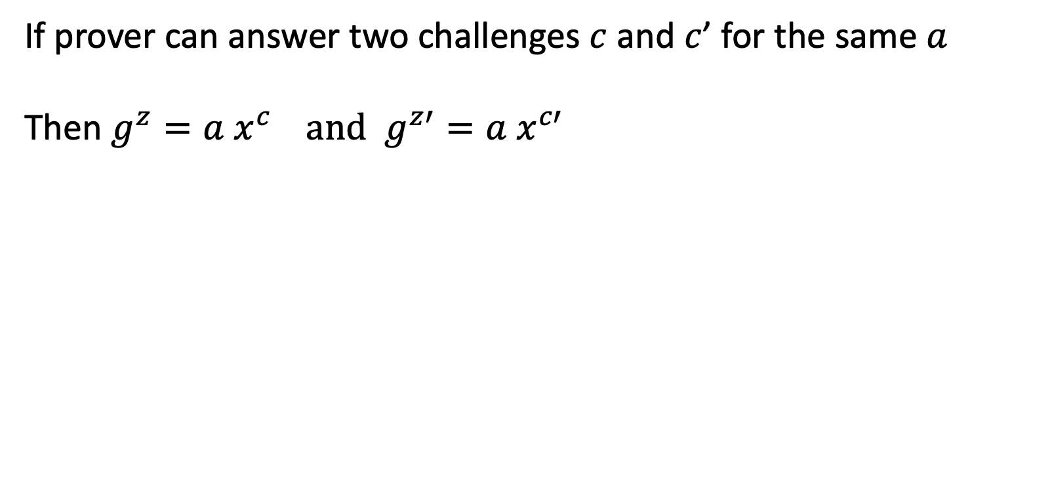
$${w, x=g}^{w}$$
$$x$$
$${a=g}^{r}$$
Soundness
$$c∈ {\{0,1\}}^{t}$$
$$z=r+cw (mod q)$$
If prover can answer two challenges $c$ and $c$’ for the same $a$
Then $g^{z}=a x^{c} and$ $g^{z′}=a x^{c′}$
Dividing the two equations:
$$g^{z−z′}= x^{c−c′}$$
$$x = g^{{z−z′}/{c−c′}}$$
$g^{z}=a x^{c}$?

Slide 20
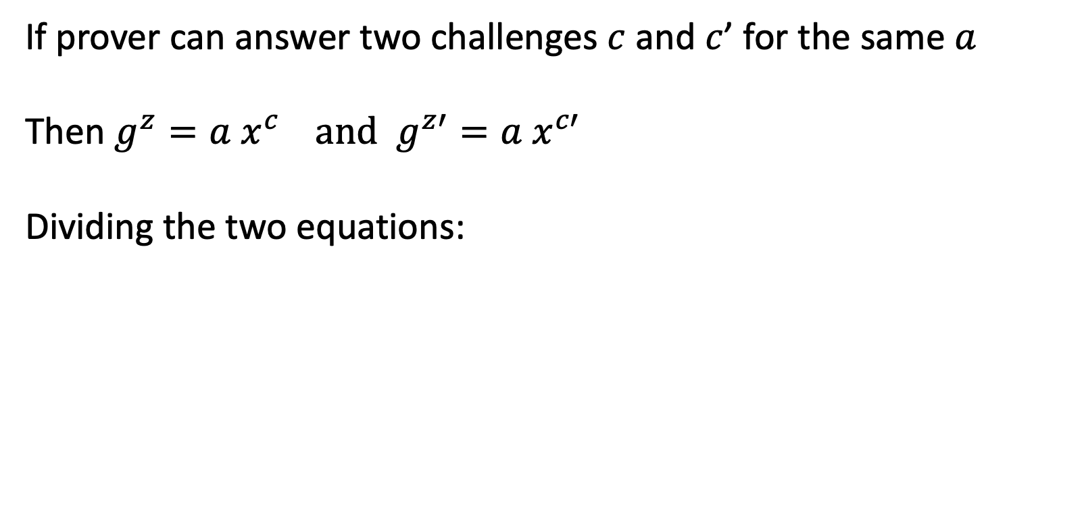
$${w, x=g}^{w}$$
$$x$$
$${a=g}^{r}$$
Soundness
$$c∈ {\{0,1\}}^{t}$$
$$z=r+cw (mod q)$$
If prover can answer two challenges $c$ and $c$’ for the same $a$
Then $g^{z}=a x^{c} and$ $g^{z′}=a x^{c′}$
Dividing the two equations:
$$g^{z−z′}= x^{c−c′}$$
$$x = g^{{z−z′}/{c−c′}}$$
$g^{z}=a x^{c}$?

Slide 21
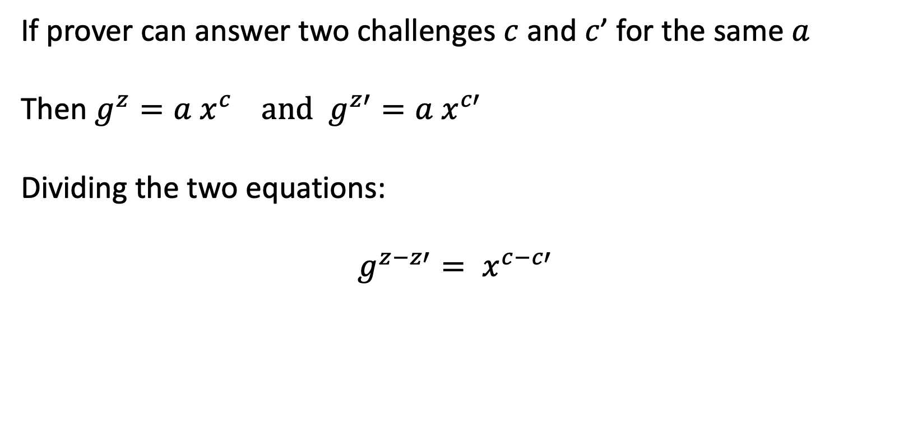
$${w, x=g}^{w}$$
$$x$$
$${a=g}^{r}$$
Soundness
$$c∈ {\{0,1\}}^{t}$$
$$z=r+cw (mod q)$$
If prover can answer two challenges $c$ and $c$’ for the same $a$
Then $g^{z}=a x^{c} and$ $g^{z′}=a x^{c′}$
Dividing the two equations:
$$g^{z−z′}= x^{c−c′}$$
$$x = g^{{z−z′}/{c−c′}}$$
$g^{z}=a x^{c}$?

Slide 22
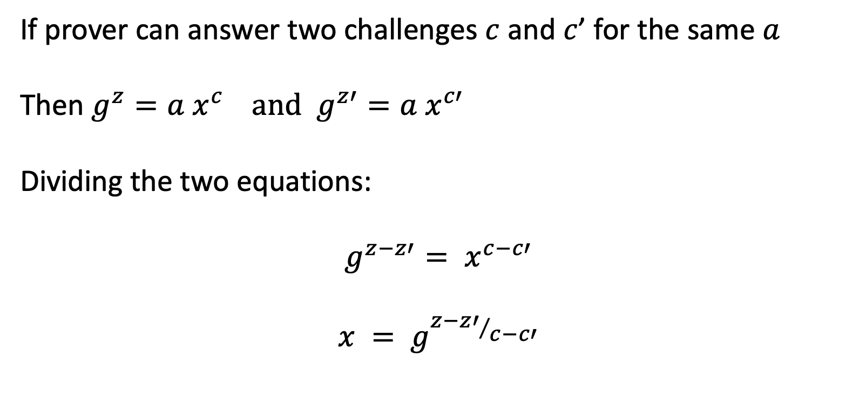
$${w, x=g}^{w}$$
$$x$$
$${a=g}^{r}$$
Soundness
$$c∈ {\{0,1\}}^{t}$$
$$z=r+cw (mod q)$$
If prover can answer two challenges $c$ and $c$’ for the same $a$
Then $g^{z}=a x^{c} and$ $g^{z′}=a x^{c′}$
Dividing the two equations:
$$g^{z−z′}= x^{c−c′}$$
$$x = g^{{z−z′}/{c−c′}}$$
$g^{z}=a x^{c}$?

Slide 23
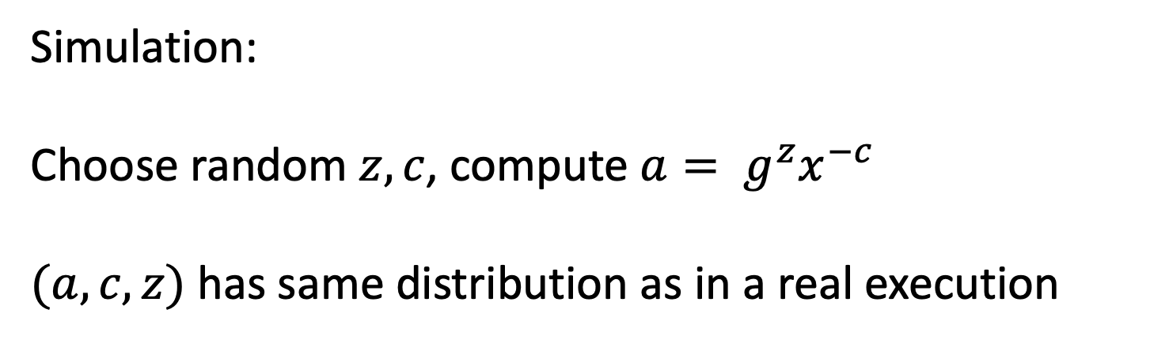
$${w, x=g}^{w}$$
$$x$$
$${a=g}^{r}$$
Honest verifier zero-knowledge
$$c∈ {\{0,1\}}^{t}$$
$$z=r+cw (mod q)$$
$g^{z}=a x^{c}$?
Simulation:
Choose random $z, c$, compute $a= g^{z}x^{−c}$
$(a,c,z)$has same distribution as in a real execution
Notes:
HVZK

Slide 24
$${w, x=g}^{w}$$
$$x$$
$${a=g}^{r}$$
Sigma protocol template
$$c∈ {\{0,1\}}^{t}$$
$$z=r+cw (mod q)$$
  P sends a message $a$
  V sends a random t bit string $c$
  P sends a response $z$
  V accepts/rejects based on transcript $(x,a,c,z)$
$g^{z}=a x^{c}$?

Slide 25
$${w, x=g}^{w}$$
$$x$$
$${a=g}^{r}$$
Sigma protocol properties
$$c∈ {\{0,1\}}^{t}$$
$$z=r+cw (mod q)$$
  Completeness
  Special soundness:
    Efficient extractor that given $x$, and transcripts $(a,c,z)$ and $(a,c′,z′)$ for $c ≠c’$ outputs $w$ s.t $(x,w) ∈R$
  Special HVZK:
    Efficient simulator that given $x$ and $c$ outputs an accepting transcript distributed similar to real execution
$g^{z}=a x^{c}$?

Slide 26
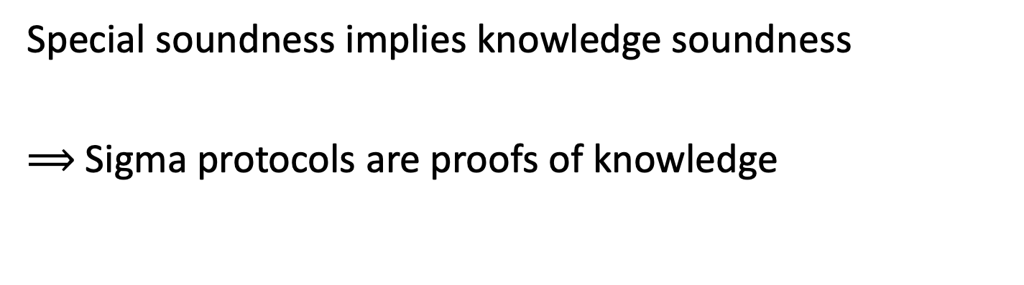
Special soundness implies knowledge soundness
$⟹$Sigma protocols are proofs of knowledge

Slide 27
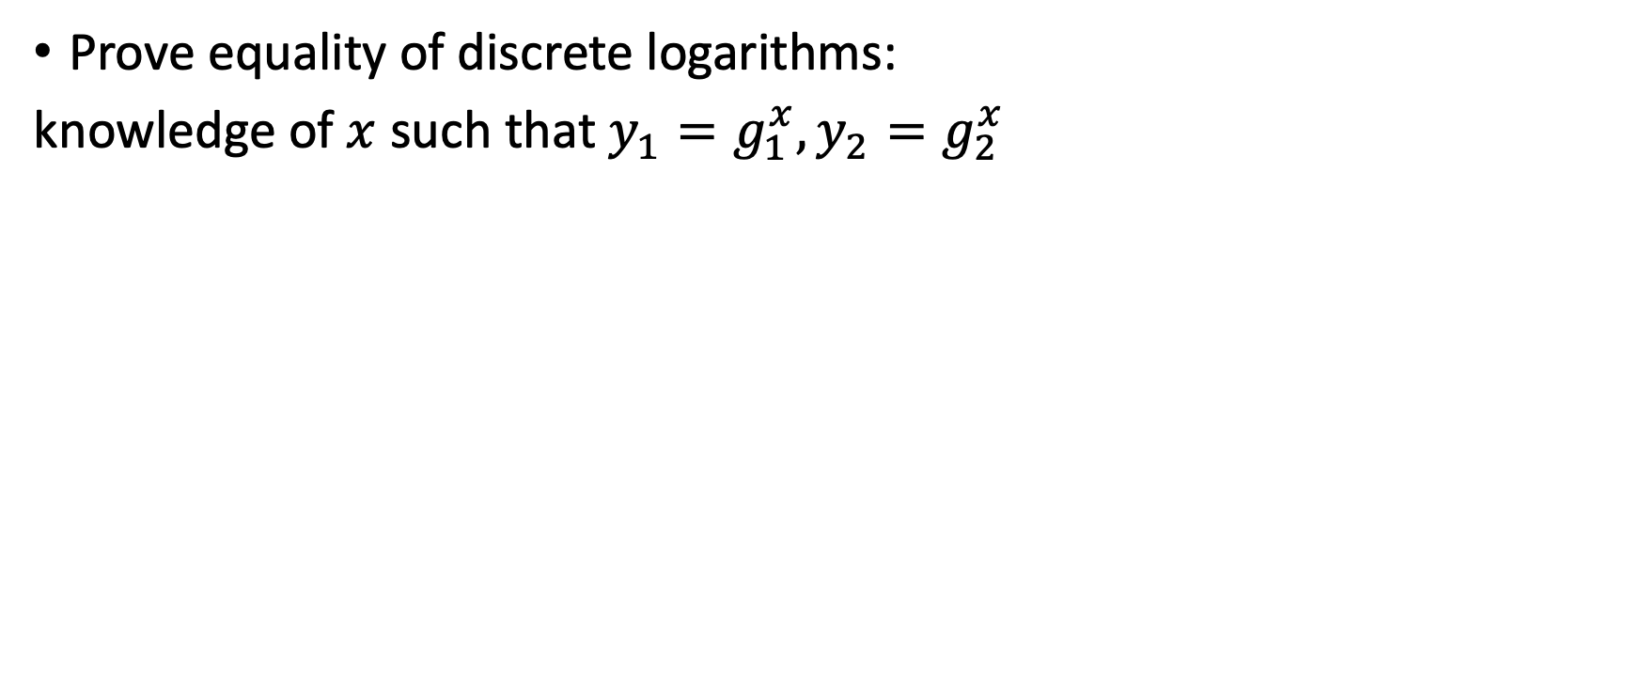
Sigma protocols for other languages
Prove equality of discrete logarithms:
knowledge of $x$ such that $y_{1}=g_{1}^{x}, y_{2}=g_{2}^{x}$
Prove knowledge of opening of a Pedersen commitment scheme:
knowledge of $m,r$ such that $c=g^{m}h^{r}$

Slide 28
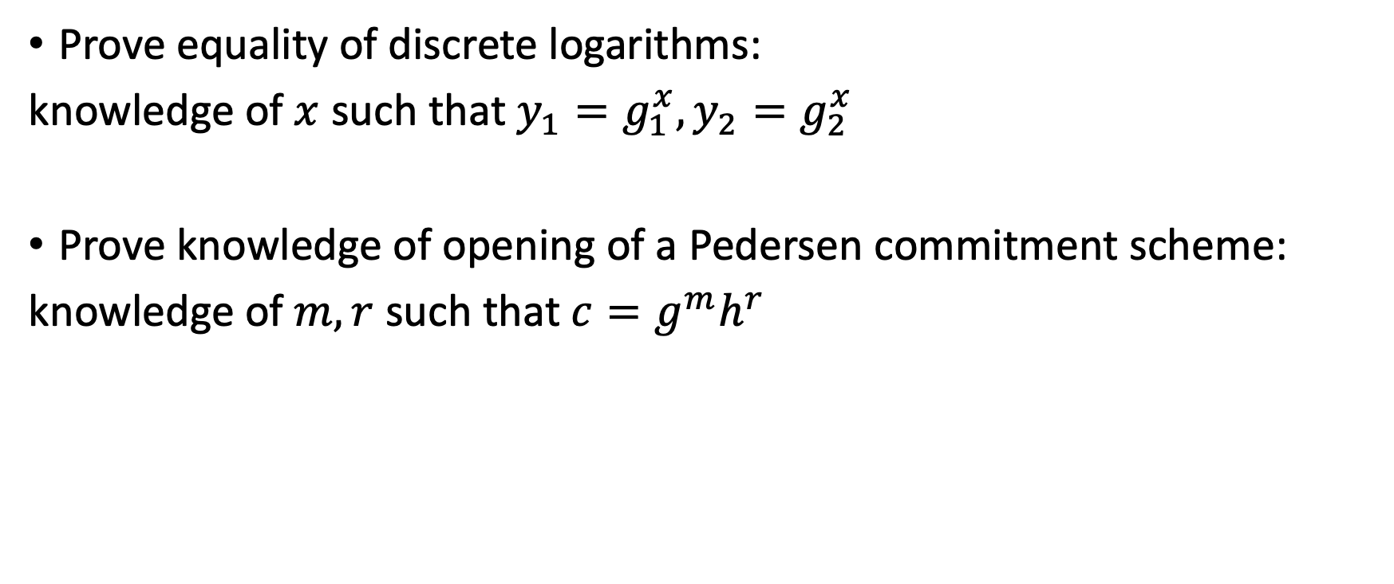
Sigma protocols for other languages
Prove equality of discrete logarithms:
knowledge of $x$ such that $y_{1}=g_{1}^{x}, y_{2}=g_{2}^{x}$
Prove knowledge of opening of a Pedersen commitment scheme:
knowledge of $m,r$ such that $c=g^{m}h^{r}$

Slide 29
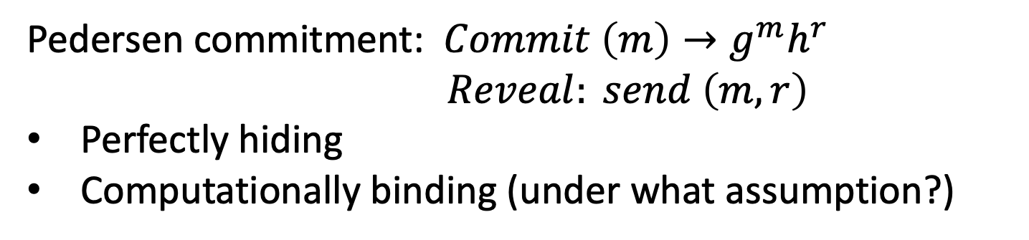
Sigma protocols for other languages
Prove equality of discrete logarithms:
knowledge of $x$ such that $y_{1}=g_{1}^{x}, y_{2}=g_{2}^{x}$
Prove knowledge of opening of a Pedersen commitment scheme:
knowledge of $m,r$ such that $c=g^{m}h^{r}$
Pedersen commitment: $Commit \left(m\right)→g^{m}h^{r}$
$$Reveal: send \left(m,r\right)$$
Perfectly hiding
Computationally binding (under what assumption?)

Slide 30
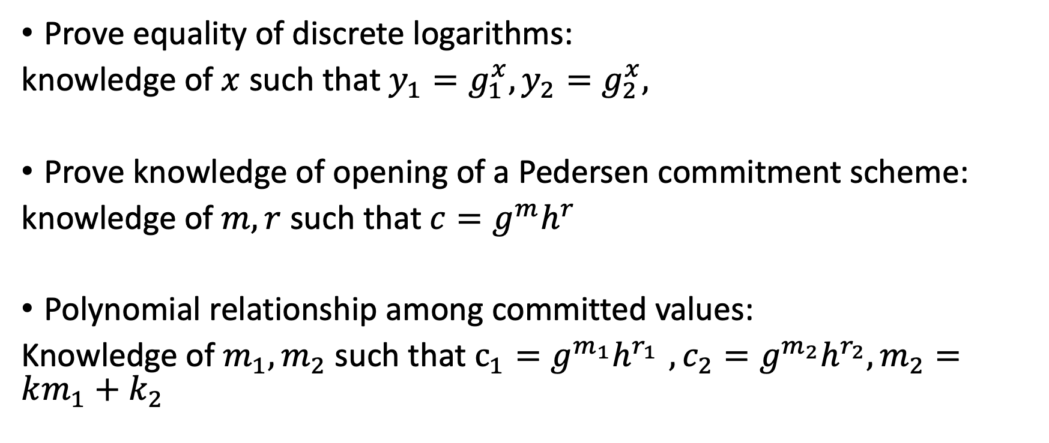
Sigma protocols for other languages
Prove equality of discrete logarithms:
knowledge of $x$ such that $y_{1}=g_{1}^{x}, y_{2}=g_{2}^{x},$
Prove knowledge of opening of a Pedersen commitment scheme:
knowledge of $m,r$ such that $c=g^{m}h^{r}$
Polynomial relationship among committed values:
Knowledge of $m_{1},m_{2}$ such that $c_{1}=g^{m_{1}}h^{r_{1} }, c_{2}=g^{m_{2}}h^{r_{2}}, m_{2}=km_{1}+k_{2}$

Slide 31
What can we do with Sigma protocols
Prove compound statements: AND, OR, subset
ZK from Sigma
ZKPoK from Sigma

Slide 32
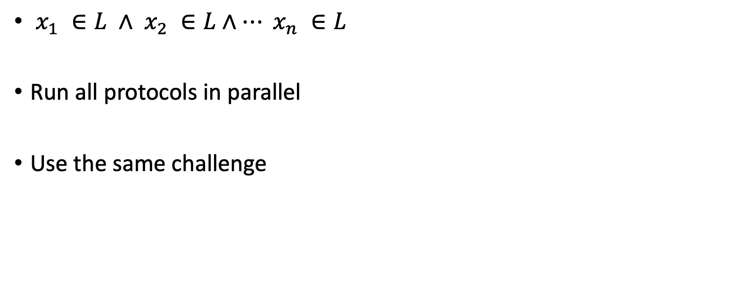
AND of Sigma protocols
$x_{1} ∈L ∧$ $x_{2} ∈L∧… x_{n} ∈L$
Run all protocols in parallel
Use the same challenge

Slide 33
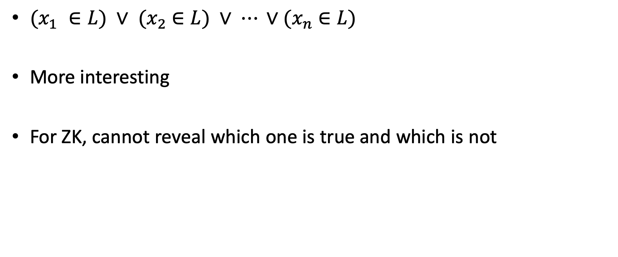
OR of Sigma protocols
$(x_{1} ∈L) ∨$ ${(x}_{2} ∈L) ∨ ⋯ ∨{(x}_{n} ∈L)$
More interesting
For ZK, cannot reveal which one is true and which is not

Slide 34

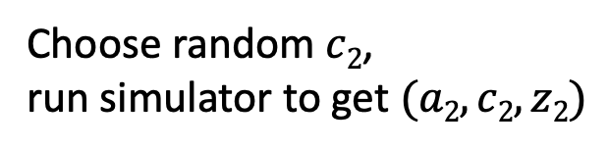
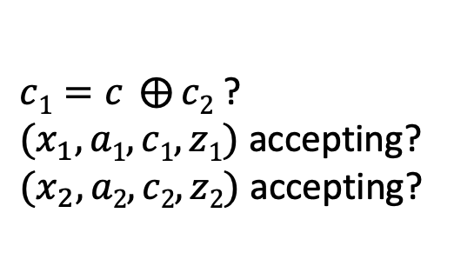
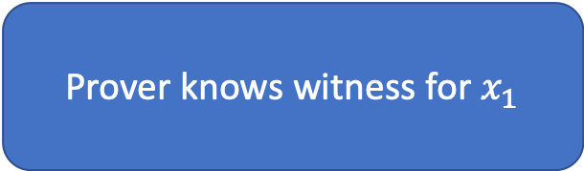
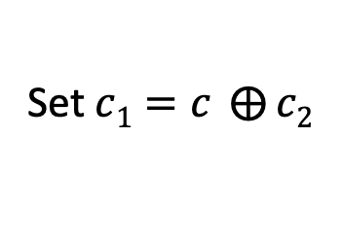



OR Transform (CDS94)
Prover knows witness for $x_{1}$
$(x_{1} ∈L) ∨$ ${(x}_{2} ∈L)$
Choose random $c2$,
run simulator to get $(a2,c2,z2)$
$$a_{1, }a_{2}$$
$$c∈ {\{0,1\}}^{t}$$
$${c_{1},c_{2}, z}_{1},z_{2}$$
$c1=c ⨁{c2}$ ?
$(x_{1},a1,c1,z1)$ accepting?
$(x_{2},a2,c2,z2)$ accepting?
Can do OR of different statements
for different protocols.
Set $c1=c ⨁{c2}$

Slide 35
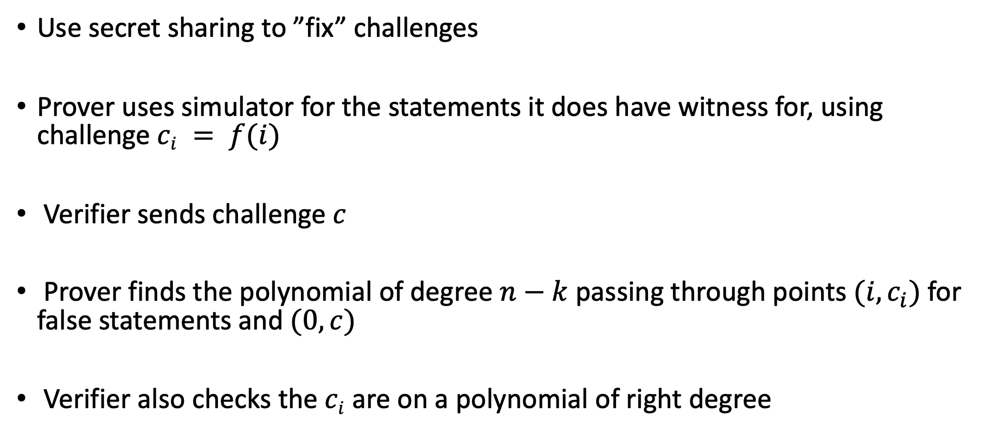
k-out-of-n OR
Use secret sharing to ”fix” challenges
Prover uses simulator for the statements it does have witness for, using challenge $ci = f(i)$
Verifier sends challenge $c$
Prover finds the polynomial of degree $n−k$ passing through points $(i,c_{i})$for false statements and $(0,c)$
Verifier also checks the $ci$ are on a polynomial of right degree

Slide 36
ZK from Sigma protocols?
Verifier not honest: how to simulate c?

Slide 37
ZK from Sigma protocols?
Verifier not honest: how to simulate c?
Idea:
Verifier commits to the challenge beforehand

Slide 38







$$Com(c)$$
$${w, x=g}^{w}$$
$$x$$
$$a$$
$$Open c$$
$$z$$
Check opening
Verify $(x,a,c,z)$
Can simulate
Proof of knowledge?

Slide 39
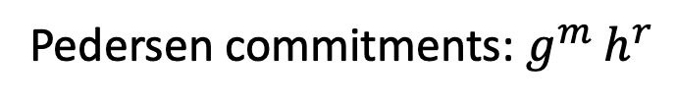

Pedersen commitments: $g^{m} h^{r}$
$$Com(c)$$
$${w, x=g}^{w}$$
$$x$$
$$a$$
$$Open c$$
$$z$$
$z$, trapdoor
Check opening
Verify $(x,a,c,z)$
Check trapdoor
Can simulate
Proof of knowledge?
Notes:
C cannot depend on a. how to simulate? Learn the challenge, then rewind.
PoK? Prover might choose a to depend on com. Trapdoor com. Pedersen has this property

Slide 40
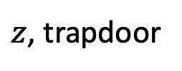
Pedersen commitments: $g^{m} h^{r}$
$$Com(c)$$
$${w, x=g}^{w}$$
$$x$$
$$a$$
$$Open c$$
$z$, trapdoor
Check opening
Verify $(x,a,c,z)$
Check trapdoor
Gives Extraction back: extractor can learn the trapdoor and
equivocate commitment to a different challenge

Slide 41
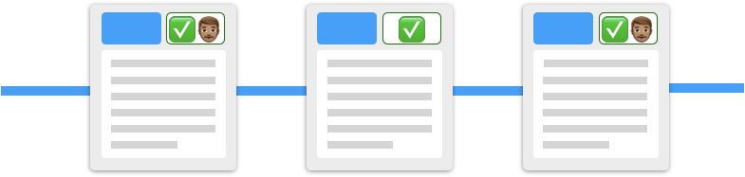
Interactive proofs:
How can everyone in the system verify a proof?
Non-interactive proofs:
Proofs posted on chain, everyone can verify

Slide 42
Non-interactive?
We showed impossibility! (you did as homework ☺ )
Around the impossibility:
Under assumptions
Existence of Setup

Slide 43



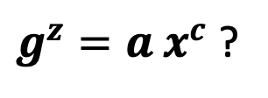
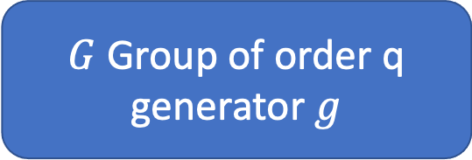


Schnorr’s protocol for discrete log
$G$ Group of order q
generator $g$
$${w, x=g}^{w}$$
$$x$$
$${a=g}^{r}$$
$$c∈ {\{0,1\}}^{t}$$
$$z=r+cw (mod q)$$
$g^{z}=a x^{c}$ ?
Verifier’s message:
uniformly random
from some challenge space

Slide 44
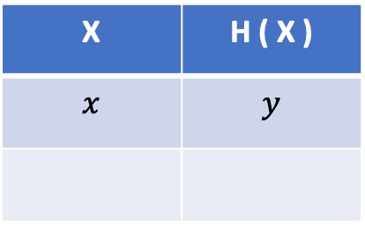
Random Oracle
X | H ( X )
$$x$$ | $$y$$
H
Random function in the sky
x
y
Output is “random”
Random oracle model (ROM) is a heuristic model

Slide 45
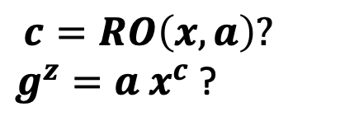
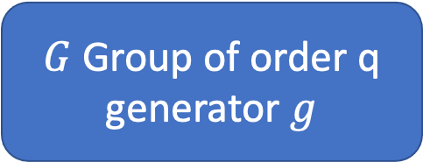





NIZK from Schnorr’s protocol
Random Oracle
$G$ Group of order q
generator $g$
$${w, x=g}^{w}$$
$$x$$
$$a,$$
$$c,$$
$$z$$
$$c=RO(x,a)$$
$$c=RO\left(x,a\right)?$$
$g^{z}=a x^{c}$ ?

Slide 46
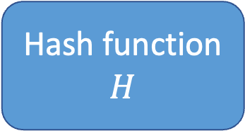
NIZK from Schnorr’s protocol
Hash function
$$H$$
$G$ Group of order q
generator $g$
$${w, x=g}^{w}$$
$$x$$
$$a,$$
$$c,$$
$$z$$
$$c=RO(x,a)$$
$$c=RO\left(x,a\right)?$$
$g^{z}=a x^{c}$ ?
Heuristic: NIZK when H is a Random Oracle – H behaves ideally, like a random function

Slide 47
Fiat-Shamir Transform

Slide 48










The Fiat-Shamir Transform (FS86)
Public coin interactive argument
Non-interactive argument
$$a_{1}$$
$$a_{1}$$
$${, a}_{2}$$
. . .
FS
FS
$$c_{1}$$
$$c_{1}=H(x,a_{1})$$
$$a_{2}$$
$$c_{2}=H(x,a_{1},a_{2})$$
$$c_{2}$$
$$a_{3}$$
.
.
.
Compile log-round public coin protocols into NIZKs in the ROM

Slide 49
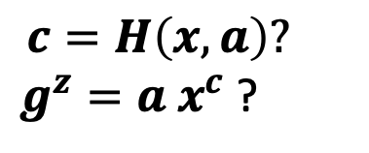
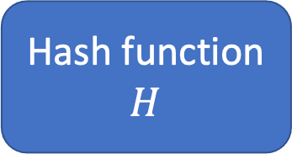
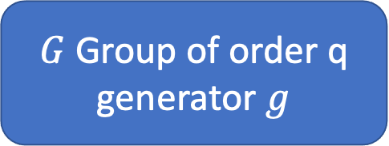




NIZK from Schnorr’s protocol
$G$ Group of order q
generator $g$
Hash function
$$H$$
$${w, x=g}^{w}$$
$$x$$
$$a,$$
$$c,$$
$$z$$
$$c=H\left(x,a\right)?$$
$g^{z}=a x^{c}$ ?
$$c=H(x,a)$$
FS-compiled Sigma protocols are knowledge sound
(even simulation extractable) ☺

Slide 50
Another road to NIZK
Common Reference String Model
  Random string, structured string
Random Oracle Model
  Heuristically compile public coin protocols

Slide 51



NIZK in CRS Model
Common Reference String
$$x, w$$
$$x$$
$$π$$
NIZK: Triple of algorithms (setup, Prove, Verify)

Slide 52
Compile sigma into NIZK in the RO
  public coin: derive verifier challenge as output of RO
Specific languages
  knowledge of discrete logarithm, roots, polynomial relationship
  knowledge of preimage of one-way homomorphism (Cramer97, Maurer09)
Go beyond?
  Sigma protocol ideas as starting point for succinct arguments

Slide 53

Computational integrity:
Succinct arguments

Slide 54

Integrity
Integrity is doing the right thing,
even when no one is watching.
-- C. S. Lewis

Slide 55
Computational Integrity
How do we guarantee computational integrity?
Computation
$$f$$
Computation
$$f$$
$${state}_{0}$$
$${state}_{1}$$
$${state}_{n}$$
. . .
Trust that ${state}_{n}$ is the output of the right computation?
Naïve solution: recompute

Slide 56
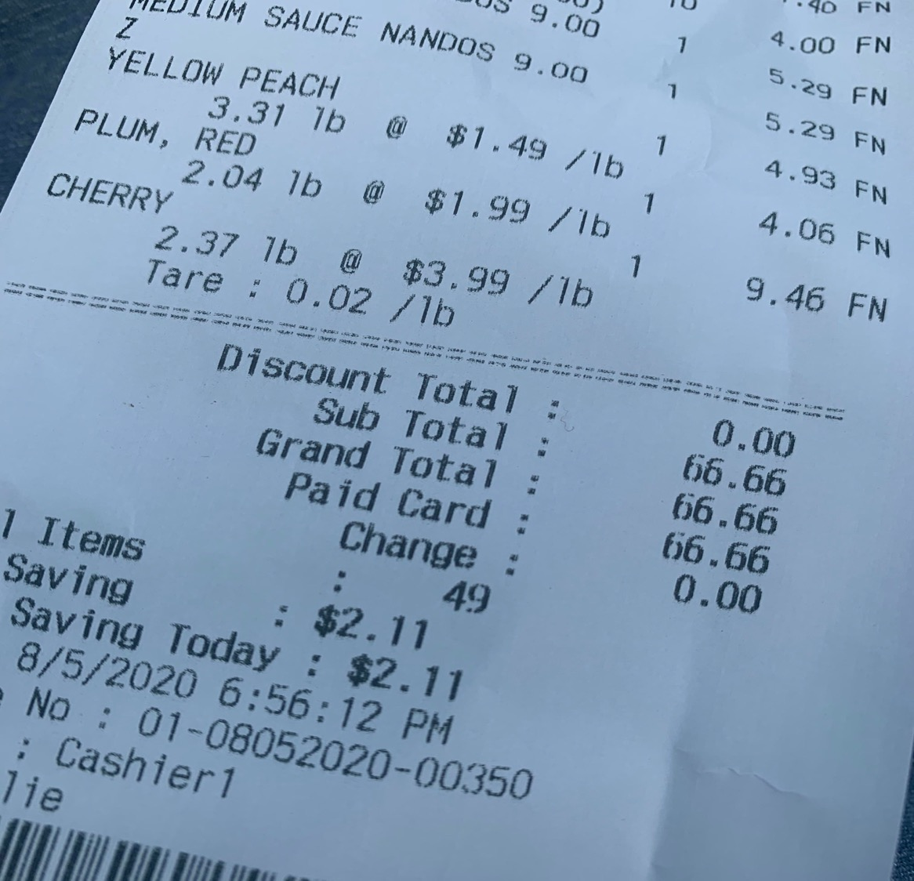
Recompute the sum
✅

Slide 57
Everyone in the system has to repeat computation!

Slide 58
Computational Integrity
Trust
  Defeats decentralization
Recompute
  Scalability – does not scale with number of users and size of computation
  Privacy – might not be able to recompute due to secrets involved in the computation

Slide 59
What did we gain from interaction?
Expressivity
  IP much larger class than NP
Succinctness
  Even for NP statements, interaction allows proving a statement with communication complexity less than $\left|w\right|$
Privacy
  Enable zero-knowledge: verifier learns nothing beyond $x∈L$

Slide 60

I know $w$such that
$$F\left(w\right)=y$$
$F, y$
$F$ function
$y$claimed output
$w$private input
Succinctness: Verification runs in time logarithmic in size of statement and witness

Slide 61

Succinct arguments

Slide 62
Argument: computational soundness

Slide 63
Homework
Show that succinct proofs (soundness against unbounded adversaries) are not possible

Slide 64
zkSNARK for NP
I know $w$such that
$$F\left(w\right)=y$$
$F, y$
proof
$F$ function
$y$claimed output
$w$private input
Argument
  computational soundness
Proof of knowledge
  existence of extractor
Zero-knowledge
Succinct
Non-interactive
ARgument
of Knowledge

Slide 65
zkSNARK
I know $x$s.t.
$$F\left(x\right)=y$$
within T time steps
Setup
Prover
  $F$ function
  $y$ output
  T time bound
  $x$ input
Public parameters
Verifier
  $F$ function
  $y$ output
  T time bound
$${poly}_{λ} (\log{T })$$
$${poly}_{λ} (\left|F\right|+\left|y\right|+T )$$
$${poly}_{λ} (\left|F\right|+\left|y\right|+\log{T })$$

Slide 66
Modular approach
NP relation R(x,w)
Boolean/arithmetic circuit,
Quadratic arithmetic program, R1CS …
Intermediate
representation
Probabilistically Checkable Proof (PCP), LPCP, IOP, AHP
Information-theoretic proof
Cryptographic compiler
Cryptographic assumptions/Idealized models
Argument system

Slide 67
Modular approach
NP relation R(x,w)
Boolean/arithmetic circuit,
Quadratic arithmetic program, R1CS …
Intermediate
representation
Probabilistically Checkable Proof (PCP), LPCP, IOP, AHP
Information-theoretic proof
Cryptographic compiler
Cryptographic assumptions/Idealized models
Argument system

Slide 68
Probabilistically Checkable Proofs (PCP)
[BFLS91,FGLSS96,
AS92,ALMSS92]
I know $x$s.t.
$$F\left(x\right)=y$$
within T time steps
Prover
  $F$ function
  $y$ output
  T time bound
  $x$ input
$$O(1)$$
Verifier
  $F$ function
  $y$ output
  T time bound
Query
Decide
$${poly}_{λ} (\left|F\right|+\left|y\right|+T )$$
$${poly}_{λ} (T)$$
$${poly}_{λ} (\left|F\right|+\left|y\right|+\log{T })$$

Slide 69
Probabilistically Checkable Proofs (PCP)
P is an all-powerful prover, V is a PPT oracle algorithm. $\left(P,V\right)$ is a PCP system for $L$if:
Completeness:
$$∀x∈L, π=P(x)$$
$$\operatorname{Pr}{ [ V^{π}\left(x;ρ\right) ]=1}≥1−negl$$

Slide 70
Probabilistically Checkable Proofs (PCP)
P is an all-powerful prover, V is a PPT oracle algorithm. $\left(P,V\right)$ is a PCP system for $L$if:
Completeness:
$$∀x∈L, π=P(x)$$
$$\operatorname{Pr}{ [ V^{π}\left(x;ρ\right) ]=1}≥1−negl$$
Soundness: $∀x∉L, ∀ π^{∗}$
$$\operatorname{Pr}{ [ V^{π^{∗}}\left(x;ρ\right) ]=1}≤negl$$

Slide 71
Probabilistically Checkable Proofs (PCP)
P is an all-powerful prover, V is a PPT oracle algorithm. $\left(P,V\right)$ is a PCP system for $L$if:
Completeness:
$$∀x∈L, π=P(x)$$
$$\operatorname{Pr}{ [ V^{π}\left(x;ρ\right) ]=1}≥1−negl$$
Soundness: $∀x∉L, ∀ π^{∗}$
$$\operatorname{Pr}{ [ V^{π^{∗}}\left(x;ρ\right) ]=1}≤negl$$

Slide 72
Probabilistically Checkable Proofs (PCP)
[BFLS91,FGLSS96,
AS92,ALMSS92]
I know $x$s.t.
$$F\left(x\right)=y$$
within T time steps
Is this a SNARG already ?
Prover
  $F$ function
  $y$ output
  T time bound
  $x$ input
$$O(1)$$
Verifier
  $F$ function
  $y$ output
  T time bound
Query
Decide
$${poly}_{λ} (\left|F\right|+\left|y\right|+T )$$
$${poly}_{λ} (T)$$
$${poly}_{λ} (\left|F\right|+\left|y\right|+\log{T })$$

Slide 73
Probabilistically Checkable Proofs (PCP)
I know $x$s.t.
$$F\left(x\right)=y$$
PCP $≠$ SNARG
within T time steps
Insecure to ask the prover to answer queries correctly
Prover
  $F$ function
  $y$ output
  T time bound
  $x$ input
$$O(1)$$
Verifier
  $F$ function
  $y$ output
  T time bound
Query
Decide
$${poly}_{λ} (\left|F\right|+\left|y\right|+T )$$
$${poly}_{λ} (T)$$
$${poly}_{λ} (\left|F\right|+\left|y\right|+\log{T })$$
Notes:
.

Slide 74
PCP to SNARK
Prover not bound to the oracle, can choose $π$ based on the queries; PCP soundness does not hold anymore
  Need the prover to “commit” to the oracle
Commitment needs to be succinct and with a selective opening property
Merkle tree as a vector commitment

Slide 75
Merkle Tree Commitment
$$r=H(m_{5},m_{6})$$
$$m_{5}=H(m_{1},m_{2})$$
$$m_{6}=H(m_{3},m_{4})$$
$$m_{1}=H(x_{1},x_{2})$$
$$m_{2}=H(x_{3},x_{4})$$
$$m_{3}=H(x_{5},x_{6})$$
$$m_{4}=H(x_{7},x_{8})$$
$$x_{1}$$ | $$x_{2}$$
$$x_{3}$$ | $$x_{4}$$
$$x_{5}$$ | $$x_{6}$$
$$x_{7}$$ | $$x_{8}$$

Slide 76
Merkle Tree Commitment
Commitment to vector ${v= x}_{1}\left| x_{2} \right|…| x_{n}$is root $r$
To open an entry of $v$:
send all sibling nodes on root-to-leaf path

Slide 77
Merkle Tree Commitment
$$r=H(m_{5},m_{6})$$
$$m_{5}=H(m_{1},m_{2})$$
$$m_{6}=H(m_{3},m_{4})$$
$$m_{1}=H(x_{1},x_{2})$$
$$m_{2}=H(x_{3},x_{4})$$
$$m_{3}=H(x_{5},x_{6})$$
$$m_{4}=H(x_{7},x_{8})$$
$$x_{1}$$ | $$x_{2}$$
$$x_{3}$$ | $$x_{4}$$
$$x_{5}$$ | $$x_{6}$$
$$x_{7}$$ | $$x_{8}$$

Slide 78
Merkle Tree Commitment
$$r=H(m_{5},m_{6})$$
$$m_{5}=H(m_{1},m_{2})$$
$$m_{6}=H(m_{3},m_{4})$$
$$m_{1}=H(x_{1},x_{2})$$
$$m_{2}=H(x_{3},x_{4})$$
$$m_{3}=H(x_{5},x_{6})$$
$$m_{4}=H(x_{7},x_{8})$$
$$x_{1}$$ | $$x_{2}$$
$$x_{3}$$ | $$x_{4}$$
$$x_{5}$$ | $$x_{6}$$
$$x_{7}$$ | $$x_{8}$$

Slide 79
Merkle Tree Commitment
$$r=H(m_{5},m_{6})$$
$$m_{5}=H(m_{1},m_{2})$$
$$m_{6}=H(m_{3},m_{4})$$
$$m_{1}=H(x_{1},x_{2})$$
$$m_{2}=H(x_{3},x_{4})$$
$$m_{3}=H(x_{5},x_{6})$$
$$m_{4}=H(x_{7},x_{8})$$
$$x_{1}$$ | $$x_{2}$$
$$x_{3}$$ | $$x_{4}$$
$$x_{5}$$ | $$x_{6}$$
$$x_{7}$$ | $$x_{8}$$

Slide 80
Merkle Tree Commitment
$$r=H(m_{5},m_{6})$$
$$m_{5}=H(m_{1},m_{2})$$
$$m_{6}=H(m_{3},m_{4})$$
$$m_{1}=H(x_{1},x_{2})$$
$$m_{2}=H(x_{3},x_{4})$$
$$m_{3}=H(x_{5},x_{6})$$
$$m_{4}=H(x_{7},x_{8})$$
$$x_{1}$$ | $$x_{2}$$
$$x_{3}$$ | $$x_{4}$$
$$x_{5}$$ | $$x_{6}$$
$$x_{7}$$ | $$x_{8}$$

Slide 81
Merkle Tree Commitment
$$r=H(m_{5},m_{6})$$
$$m_{5}=H(m_{1},m_{2})$$
$$m_{6}=H(m_{3},m_{4})$$
$$m_{1}=H(x_{1},x_{2})$$
$$m_{2}=H(x_{3},x_{4})$$
$$m_{3}=H(x_{5},x_{6})$$
$$m_{4}=H(x_{7},x_{8})$$
$$x_{1}$$ | $$x_{2}$$
$$x_{3}$$ | $$x_{4}$$
$$x_{5}$$ | $$x_{6}$$
$$x_{7}$$ | $$x_{8}$$

Slide 82
Merkle Tree Commitment
Commitment to vector ${v= x}_{1}\left| x_{2} \right|…| x_{n}$is root $r$
To open an entry of $v$:
send all sibling nodes on root-to-leaf path
Verifier checks this is consistent with the root $r$ by recomputing the hashes
Opening proof size: $O(\log{n) }$

Slide 83
Merkle Tree Commitment
Binding?
Once the root is sent, committer is bound to a vector
Opening a leaf to two different values requires finding a hash collision

Slide 84
PCP to Succinct Arguments
Prover
Prover
Verifier
root
root
Query
Prover
$q_{1}$, $q_{2}$, $q_{3}$

Slide 85
PCP to Succinct Arguments
Prover
Prover
Verifier
root
root
Query
Prover
$q_{1}$, $q_{2}$, $q_{3}$

Slide 86
PCP to Succinct Arguments
Prover
Prover
Verifier
root
root
Query
Prover
$q_{1}$, $q_{2}$, $q_{3}$
Notes:
.

Slide 87
PCP to Succinct Arguments
Prover
Prover
Verifier
root
root
Query
Prover
$q_{1}$, $q_{2}$, $q_{3}$
$a_{1}$, $a_{2}$, $a_{3}$
Decide
auth paths: { }
Check auth paths

Slide 88
First zkSNARK (Micali 94)
I know $w$such that
Random Oracle
$$F\left(x,w\right)=y$$
$F, x,y$
proof
$F$ function
$y$claimed output
$w$private input
Apply Fiat-Shamir to Kilian

Slide 89
PCP to SNARK
= Random Oracle
Prover
Prover
Verifier
root
Check auth paths
Prover
root
Query
$${ a}_{1}$$
$${ a}_{2}$$
$$a_{3}$$
Decide
$$π$$
$$π=(root,a_{1}\text{, }a_{2}\text{, }a_{3}, path1,path2,path3)$$

Slide 90
zkSNARK for Circuits
L$et 𝔽=\{0,…,p−1\}$ is a finite field
Arithmetic circuit $C:𝔽^{n}→𝔽$ is a Directed Acyclic Graph (DAG)
Internal nodes labeled by +/ *
Input layer labeled by $x_{1}$,$…x_{n}$
$$\left|C\right|=\# gates in C$$
$${ x}_{1}$$
$${ x}_{2}$$
$${ x}_{3}$$
$${ x}_{4}$$

Slide 91
zkSNARK for Circuits
Public arithmetic circuit $C \left(x,w\right)→𝔽$
Public statement $x∈𝔽^{n}$
Secret witness $w∈𝔽^{m}$
Preprocessing (Setup) : $K\left(C\right)→(pk,vk)$
V has no time to read the circuit!
Prover
$$vk,x$$
$$pk,x,w$$
$$π$$
Verifier
Accept/reject

Slide 92
zkSNARK for Circuits
A preprocessing zkSNARK is a triple $\left(K,P,V\right)$
  $K\left(C\right)→\left(pk,vk\right)$ public parameters for proving and verification
  $P\left(pk,x,w\right)→π$ proof
  $V\left(vk,x,π\right)→0/1$ accept or reject
Length of proof: $\left|π\right|=O_{λ}\left(\log{ C } \right)$
Verification: $Time \left(V\right)=O_{λ}( \left|x\right|,\log{C) }$
V has no time to read the circuit!
A short “template” of C

Slide 93
Preprocessing zkSNARK
Circuit dependent/ Universal setup
Variants:
Dependence on F?
secret/public randomness
public/designated verifiability
Proving key
Verification key
Circuit $C$
proof
$y$claimed output
$w$private input
$F$ function
$y$output

Slide 94
Preprocessing zkSNARK
Trusted/Transparent setup
Variants:
Dependence on F?
secret/public randomness
public/designated verifiability
Proving key
Verification key
Circuit $C$
proof
$y$claimed output
$w$private input
$F$ function
$y$output

Slide 95
Modular approach
NP relation R(x,w)
Boolean/arithmetic circuit,
Quadratic arithmetic program, R1CS …
Intermediate
representation
Probabilistically Checkable Proof (PCP), LPCP, IOP, AHP
Information-theoretic proof
Cryptographic compiler
Information-theoretic proof
Cryptographic compiler
Information-theoretic proof
Cryptographic compiler
Cryptographic assumptions/Idealized models
Argument system

Slide 96
General paradigm
Information-theoretic object
Succinct argument
Functional commitment
Fiat-Shamir
SNARK

Slide 97
Functional commitment
A family of functions $ℱ=\{ f:𝒳→𝒴 \}$
$$f$$
$$f∈ℱ$$
$$x∈𝒳$$
$$f$$
$$y∈𝒴, proof π$$
Accept/reject
$$f\left(x\right)=y AND f∈ℱ$$

Slide 98
F-IOP (Interactive Oracle Proof)
$$f_{1}$$
Oracle
$$r_{1}$$
$$x$$
$$x,w$$
$$f_{2}$$
.
.
.
$r_{1}←𝔽$
$$f_{k}$$
$r_{2}←𝔽$
.
.
.
$V^{f_{1}, f_{2}, …f_{k}} \left(x,r_{1},…, r_{k}\right)→$Accept/reject

Slide 99
General Paradigm
Commit to $v=\left(v_{1},…, v_{n}\right)$ and open cells $f_{v}\left(i\right)=v_{i}$
Vector commitment
(Point) PCP
Commit to $v=\left(v_{1},…, v_{n}\right)$ and open inner products $f_{v}\left(u\right)=(u,v)$
Inner Product
commitment
Linear PCP
Commit to a univariate polynomial $g(X)$ and open evaluations $g\left(u\right)=z$
Polynomial
commitment
Polynomial
IOP

Slide 100
Many approaches to practical zkSNARK
Linear PCP: Gro10, Lip12, GGPR13, ….
Interactive proofs: GKR08, WTSTW18, XZZPS19, ZXZS20, …
MPC in the head: IKOS07, GMO16, AHIV17, KKW18, …
Discrete logarithm based: From Sigma protocols
$⋮$
Different tradeoffs,
different assumptions, suited for different applications
No one ring to rule them all!

