Slide 1


Introduction to Symmetric-Key Cryptography (Part-4)
ACM India Summer School 2024 (Day 3, Session-3)
Sikhar Patranabis (IBM Research India)
sikhar.patranabis@ibm.com
https://research.ibm.com/people/sikhar-patranabis
IITB Trust Lab 4th June 2024

Slide 2
Outline
Message Authentication Codes (MACs)
MAC construction and domain extension
Authenticated encryption
IND-CCA security
Generic composition

Slide 3
Outline
Message Authentication Codes (MACs)
MAC construction and domain extension
Authenticated encryption
IND-CCA security
Generic composition

Slide 4
Message Authentication Codes (MACs)

Slide 5



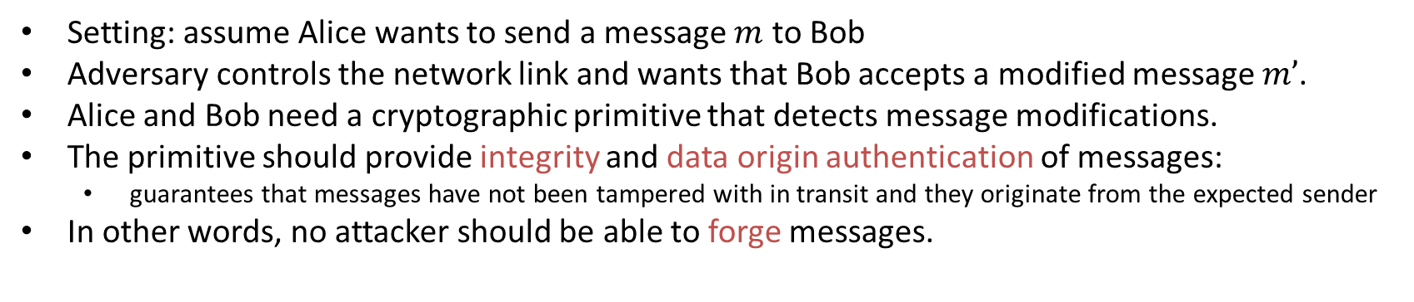

Introducing Message Authentication Codes (MACs)
Setting: assume Alice wants to send a message $m$ to Bob
Adversary controls the network link and wants that Bob accepts a modified message $m’$.
Alice and Bob need a cryptographic primitive that detects message modifications.
The primitive should provide integrity and data origin authentication of messages:
  guarantees that messages have not been tampered with in transit and they originate from the expected sender
In other words, no attacker should be able to forge messages.
$$m$$

Slide 6
Introducing MACs
m
m’
An attacker does not need to have nation-state resources to redirect and manipulate traffic, nor does it need to own the network infrastructure (ISP).
For example, an attacker can use ARP spoofing in the local LAN, impersonate a public WiFi access point, or spoof DNS domain name resolution to redirect traffic and to manipulate it.

Slide 7
Introducing MACs
But it helps if they do have NSA-level capabilities:
“Quantum Insert is useful for getting at machines that can’t be reached through phishing attacks. It works by hijacking a browser as it’s trying to access web pages and forcing it to visit a malicious web page, rather than the page the target intend to visit. The attackers can then surreptitiously download malware onto the target’s machine from the rogue web page.”
https://www.wired.com/2015/04/researchers-uncover-method-detect-nsa-quantum-insert-hacks/

Slide 8


Introducing MACs
$$m, H(m)$$
$$m’, H(m’)$$
Why does sending a simple hash of the message along not help?

Slide 9




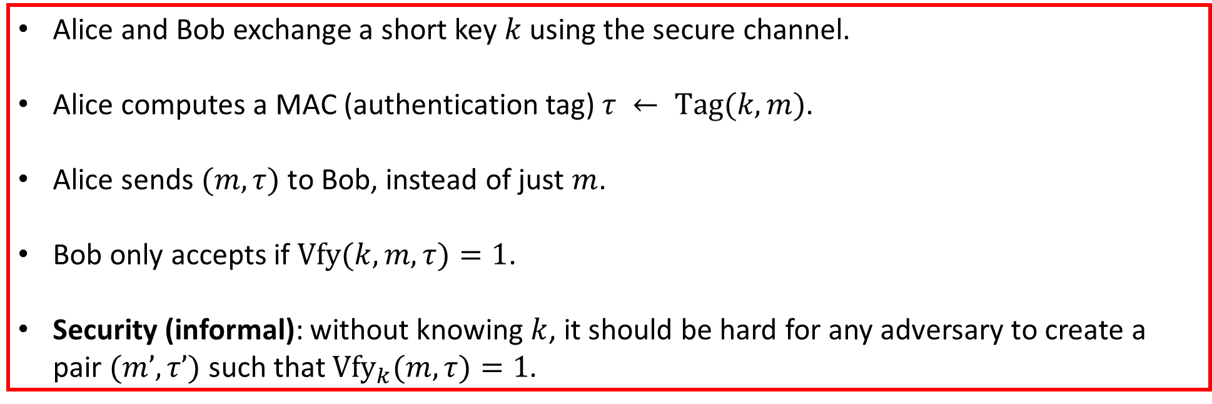
Setting
Secure channel
Insecure channel
Alice and Bob exchange a short key $k$ using the secure channel.
Alice computes a MAC (authentication tag) $τ ← Tag(k,m)$.
Alice sends $(m,τ)$ to Bob, instead of just $m$.
Bob only accepts if $Vfy(k,m,τ)=1$.
Security (informal): without knowing $k$, it should be hard for any adversary to create a pair $(m’,τ’)$ such that ${Vfy}_{k}(m,τ)=1$.

Slide 10
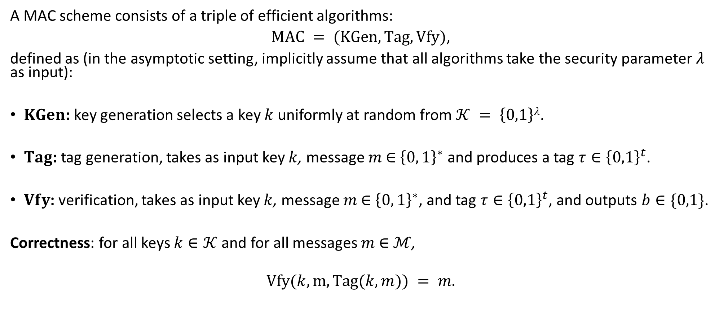
Defining MACs formally
A MAC scheme consists of a triple of efficient algorithms:
$MAC = (KGen, Tag, Vfy)$,
defined as (in the asymptotic setting, implicitly assume that all algorithms take the security parameter $λ$ as input):
$KGen$: key generation selects a key $k$ uniformly at random from $𝒦 = \left\{0,1\right\}λ$.
$Tag$: tag generation, takes as input key $k$, message $m$ ∈ ${\left\{0, 1\right\}}^{∗}$ and produces a tag $τ∈{\left\{0,1\right\}}^{t}$.
$Vfy$: verification, takes as input key $k$, message $m$ ∈ ${\left\{0, 1\right\}}^{∗}$, and tag $τ∈{\left\{0,1\right\}}^{t}$, and outputs $b∈\{0,1\}$.
Correctness: for all keys $k∈𝒦$ and for all messages $m$ ∈ $ℳ$,
$$Vfy(k,m,Tag(k,m)) = m.$$

Slide 11
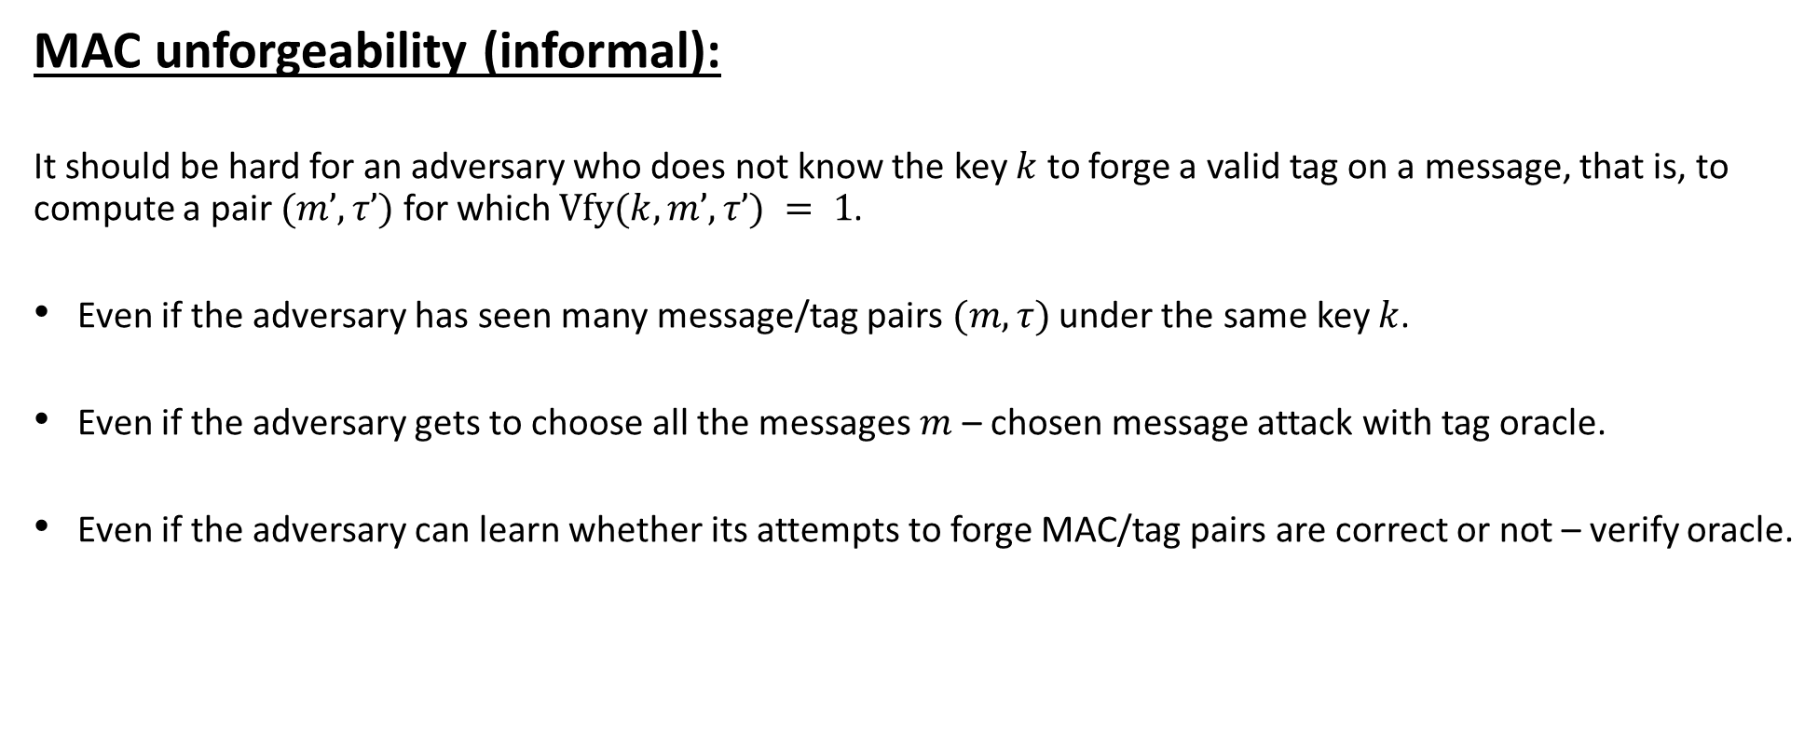
Security for MACs
MAC unforgeability (informal):
It should be hard for an adversary who does not know the key $k$ to forge a valid tag on a message, that is, to compute a pair $(m’,τ’)$ for which $Vfy(k,m’,τ’) = 1$.
Even if the adversary has seen many message/tag pairs $(m,τ)$ under the same key $k$.
Even if the adversary gets to choose all the messages $m$ – chosen message attack with tag oracle.
Even if the adversary can learn whether its attempts to forge MAC/tag pairs are correct or not – verify oracle.

Slide 12
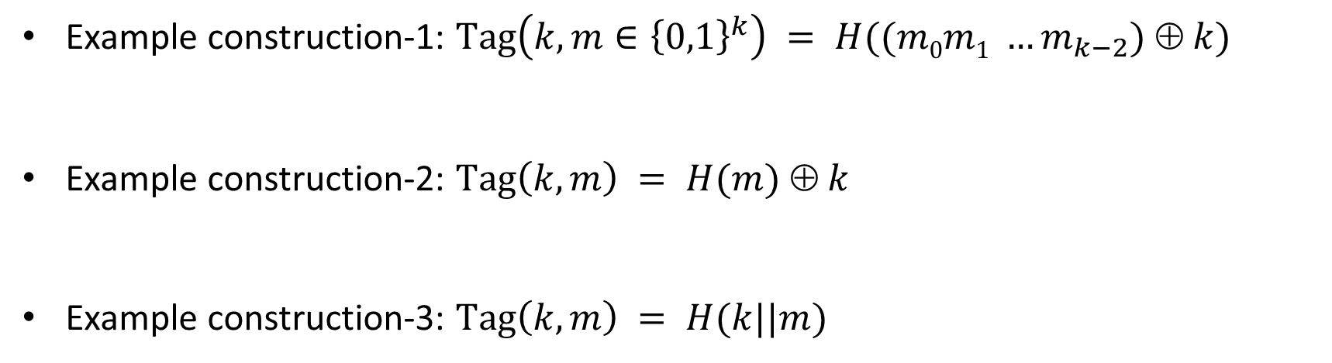
Security for MACs
Example construction-1: $Tag\left(k,m∈{\left\{0,1\right\}}^{k}\right) = H((m0m1 …m_{k−2}) ⊕ k)$
Example construction-2: $Tag\left(k,m\right) = H(m) ⊕ k$
Example construction-3: $Tag\left(k,m\right) = H(k||m)$

Slide 13



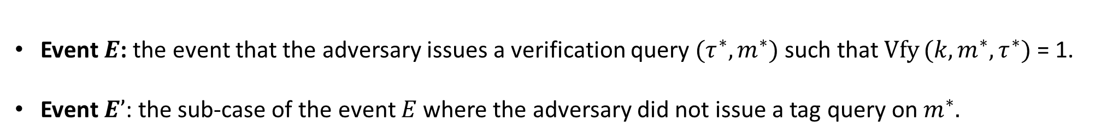




MAC security game in a picture
Adversary $A$
Challenger
$$k ← KGen$$
$$m$$
$$τ$$
$$τ= Tag (k,m)$$
$$(m′,τ′)$$
b
$$b= Vfy (k,m′,τ′)$$
Restriction: the adversary cannot issue a verification query on $(m,τ)$ if it received $τ$ in response to querying the tag oracle with $m$.
Event $E$: the event that the adversary issues a verification query $(τ^{∗},m^{∗})$ such that $Vfy (k,m^{∗},τ^{∗})$ = 1.
Event $E’$: the sub-case of the event $E$ where the adversary did not issue a tag query on $m^{∗}.$

Slide 14
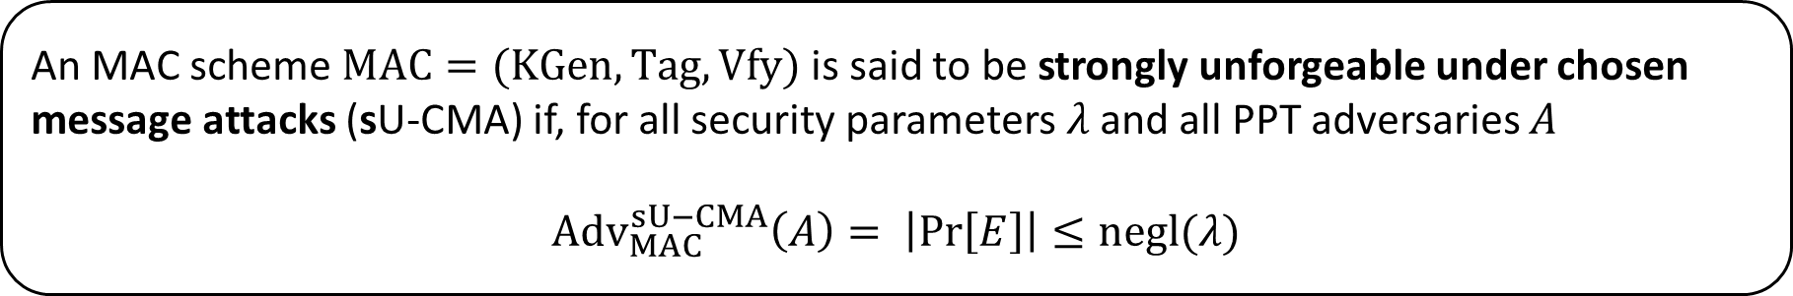
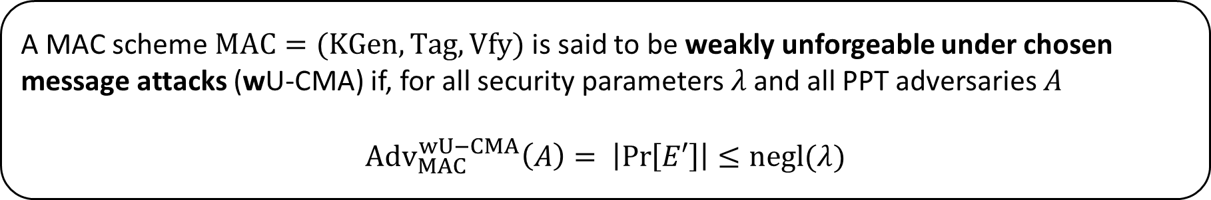
Formalizing MAC unforgeability
Definition (weak MAC unforgeability)
A MAC scheme $MAC=(KGen,Tag,Vfy)$ is said to be weakly unforgeable under chosen message attacks (wU-CMA) if, for all security parameters $λ$ and all PPT adversaries $A$
$${Adv}_{MAC}^{wU−CMA}\left(A\right)= \left|\operatorname{Pr}\left[E′\right]\right|≤negl(λ)$$
Definition (strong MAC unforgeability)
An MAC scheme $MAC=(KGen,Tag,Vfy)$ is said to be strongly unforgeable under chosen message attacks (sU-CMA) if, for all security parameters $λ$ and all PPT adversaries $A$
$${Adv}_{MAC}^{sU−CMA}\left(A\right)= \left|\operatorname{Pr}\left[E\right]\right|≤negl(λ)$$

Slide 15
wUF-CMA vs sUF-CMA security
Claim-1: Any MAC scheme with deterministic tag generation that is wUF-CMA-secure is also sUF-CMA-secure.
Claim-2: There exists a MAC scheme that is wUF-CMA-secure but not sUF-CMA-secure.

Slide 16
Attacks that MACs do not prevent
MACs do not ensure integrity natively.
  MACs cannot detect message deletion, replay, or reordering attacks.
  Can be handled by attaching sequence numbers with messages.
MACs do not ensure data origin authentication natively.
  An adversary can “reflect” Alice’s message to Bob, back to Alice.
  Can be handled by attaching directionality indicators with messages.
MACs do not provide confidentiality.
  In a vanilla MAC, the message is public.
  Need combination of SKE and MACs for both confidentiality and authentication.

Slide 17
Outline
Message Authentication Codes (MACs)
MAC construction and domain extension
Authenticated encryption
IND-CCA security
Generic composition

Slide 18
MACs from PRFs

Slide 19



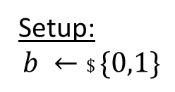
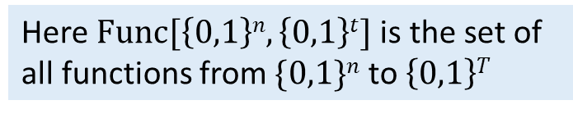

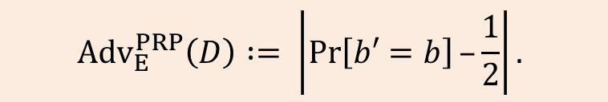

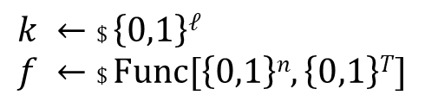

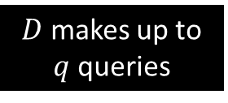


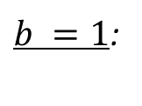

Quick recap: PRF-security
Setup:
$$b ←\$ \{0,1\}$$
Here $Func[\left\{0,1\right\}n,\left\{0,1\right\}t]$is the set of all functions from $\{0,1\}n$ to $\left\{0,1\right\}T$
$$k ←\$ \left\{0,1\right\}ℓ$$
$$f ←\$ Func[\left\{0,1\right\}n,\left\{0,1\right\}T]$$
$b =0$:
Distinguisher $D$
$$x1$$
$$yi =E(k,xi)$$
$$y1$$
$$x2$$
$$y2$$
$b =1$:
$$yi =f(x_{i})$$
$$b′$$
$D$ makes up to $q$ queries
$${Adv}_{E}^{PRP}\left(D\right) := \left|\operatorname{Pr}\left[b′=b\right]–\frac{1}{2}\right|.$$

Slide 20
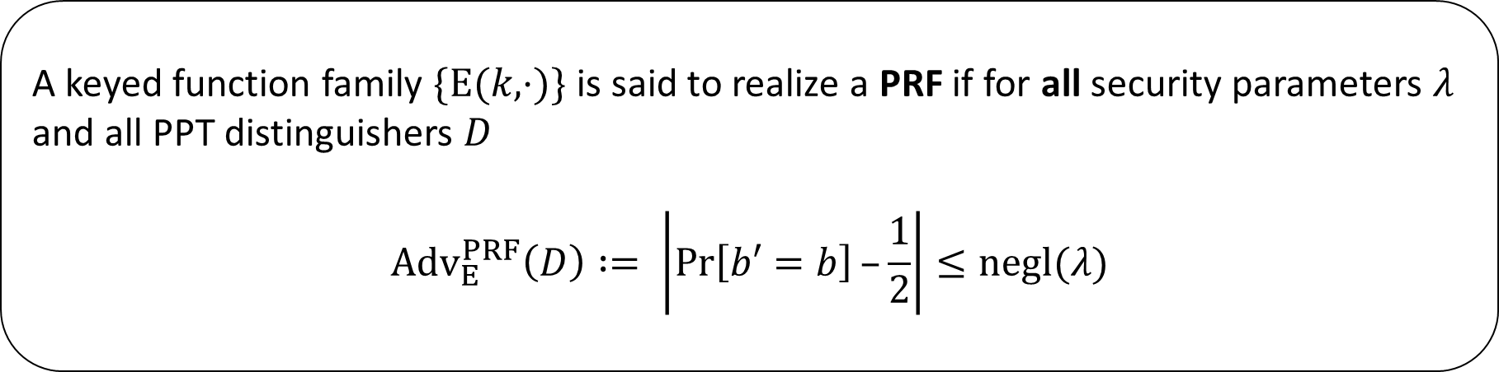
Quick recap: PRF-security
Definition (asymptotic)
A keyed function family $\{E(k,⋅)\}$ is said to realize a PRF if for all security parameters $λ$ and all PPT distinguishers $D$
$${Adv}_{E}^{PRF}\left(D\right) := \left|\operatorname{Pr}\left[b′=b\right]–\frac{1}{2}\right|≤negl(λ)$$

Slide 21
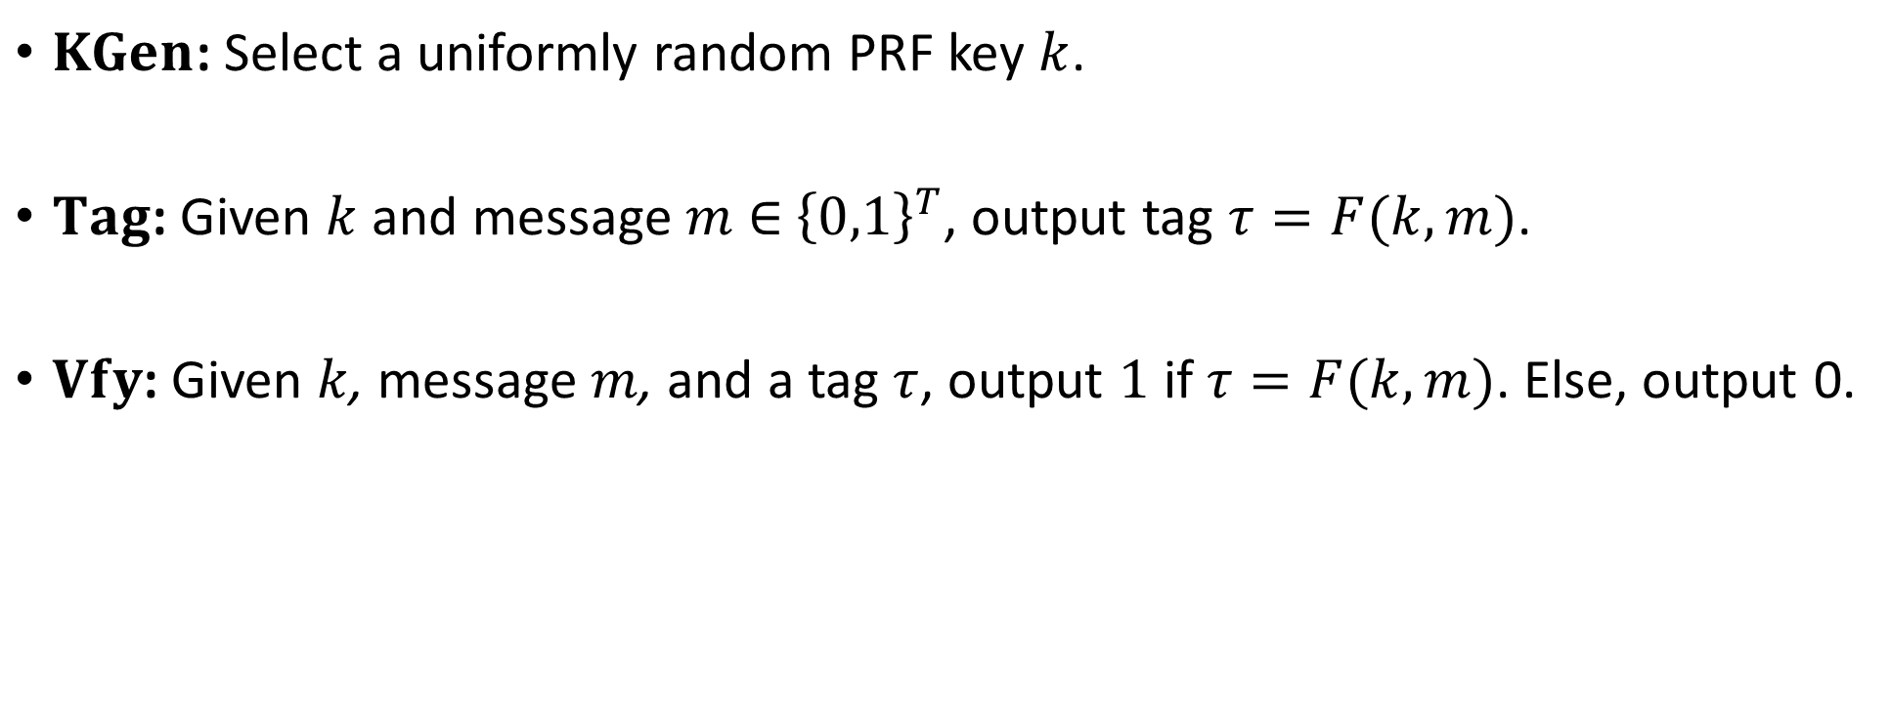

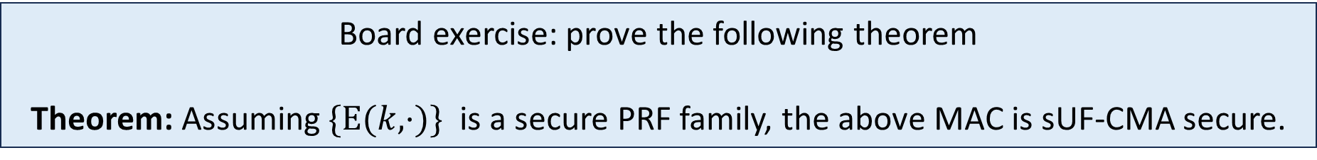
MAC from PRF family $\{E(k,⋅)\}$
$KGen$: Select a uniformly random PRF key $k$.
$Tag$: Given $k$ and message $m$ ∈ ${\left\{0,1\right\}}^{T}$, output tag $τ=F(k,m)$.
$Vfy$: Given $k$, message $m$, and a tag $τ$, output $1$ if $τ=F(k,m)$. Else, output 0.
Board exercise: prove the following theorem
Theorem: Assuming $\{E(k,⋅)\}$ is a secure PRF family, the above MAC is sUF-CMA secure.

Slide 22
MAC domain extension from collision-resistant hash

Slide 23
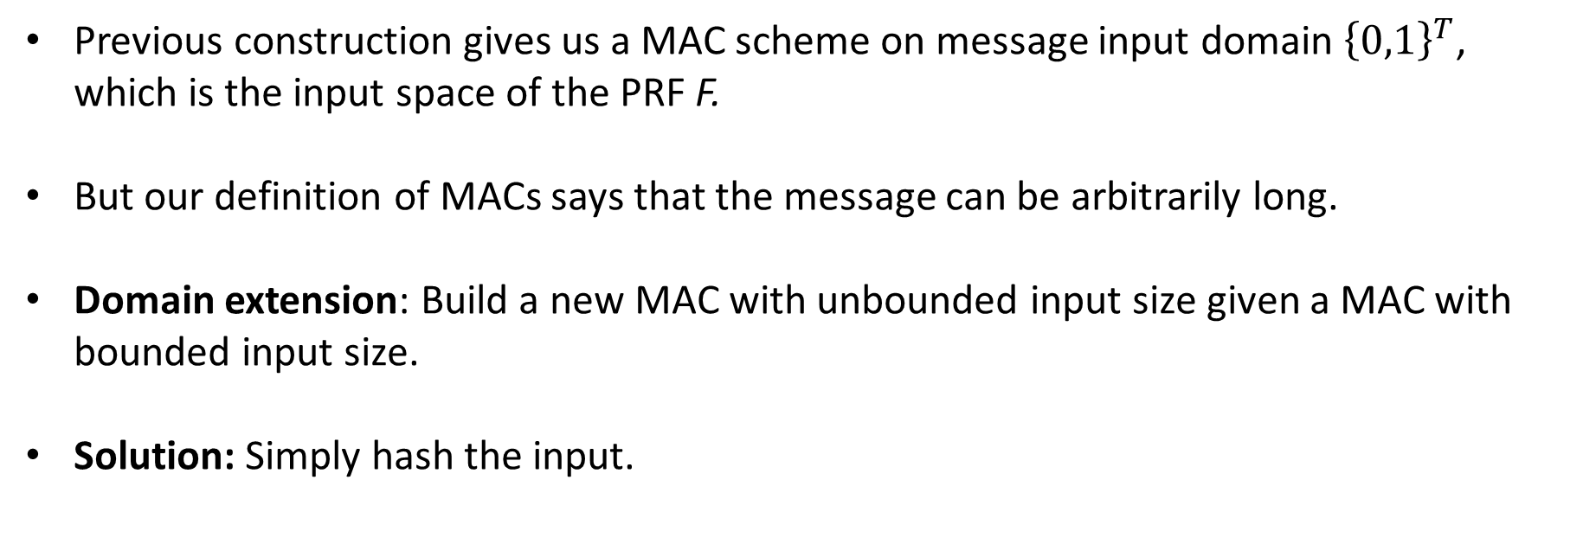
MAC domain extension from CR hashing
Previous construction gives us a MAC scheme on message input domain ${\left\{0,1\right\}}^{T}$, which is the input space of the PRF F.
But our definition of MACs says that the message can be arbitrarily long.
Domain extension: Build a new MAC with unbounded input size given a MAC with bounded input size.
Solution: Simply hash the input.

Slide 24
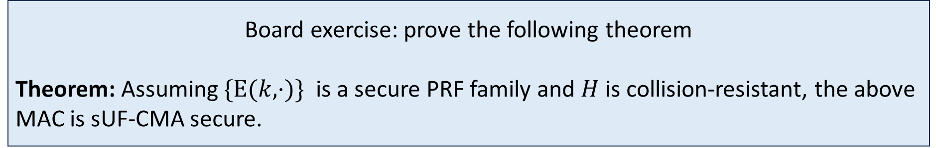
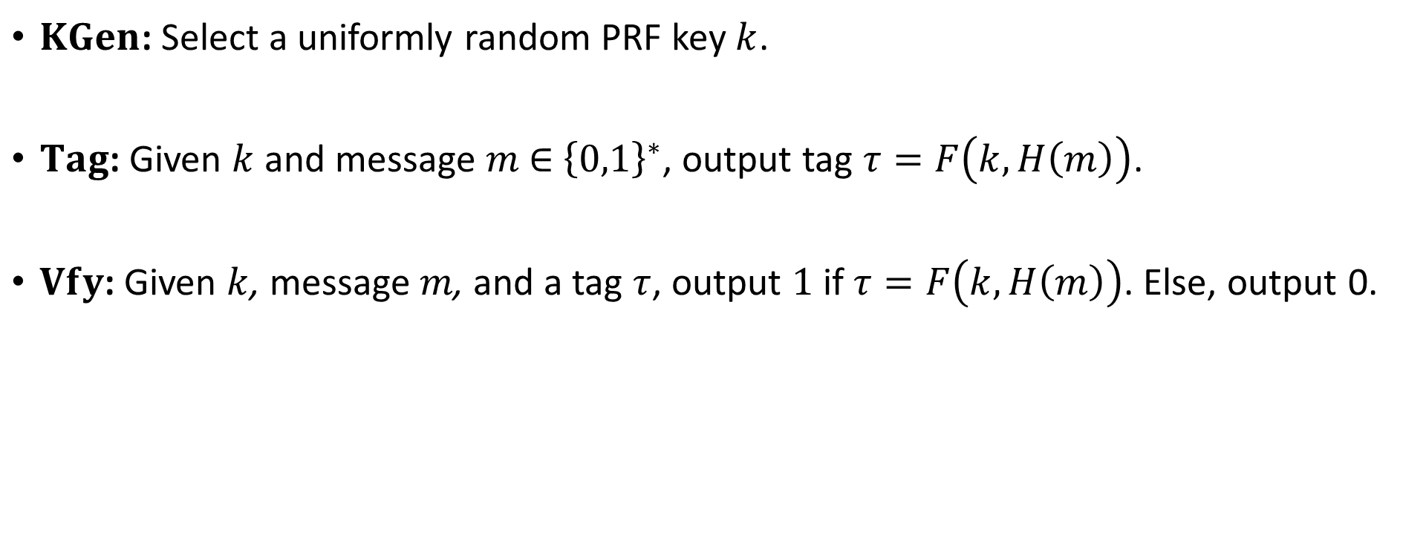
MAC from PRF + collision resistant hash
$KGen$: Select a uniformly random PRF key $k$.
$Tag$: Given $k$ and message $m$ ∈ ${\left\{0,1\right\}}^{∗}$, output tag $τ=F\left(k,H\left(m\right)\right)$.
$Vfy$: Given $k$, message $m$, and a tag $τ$, output $1$ if $τ=F\left(k,H\left(m\right)\right)$. Else, output 0.
Board exercise: prove the following theorem
Theorem: Assuming $\{E(k,⋅)\}$ is a secure PRF family and $H$ is collision-resistant, the above MAC is sUF-CMA secure.

Slide 25
Outline
Message Authentication Codes (MACs)
MAC construction and domain extension
Authenticated encryption
IND-CCA security
Generic composition

Slide 26
Authenticated Encryption

Slide 27
Secure communication: security goals
m₁
m₂
Goals: confidentiality, authenticity, integrity
Adversarial capabilities:
  Adversary can arbitrarily delete, reorder, modify, etc, bits on the network.
  Adversary can mount chosen plaintext and chosen ciphertext attacks – formalised via encryption and decryption oracles (coming up soon).
Tools: SKE, MAC

Slide 28
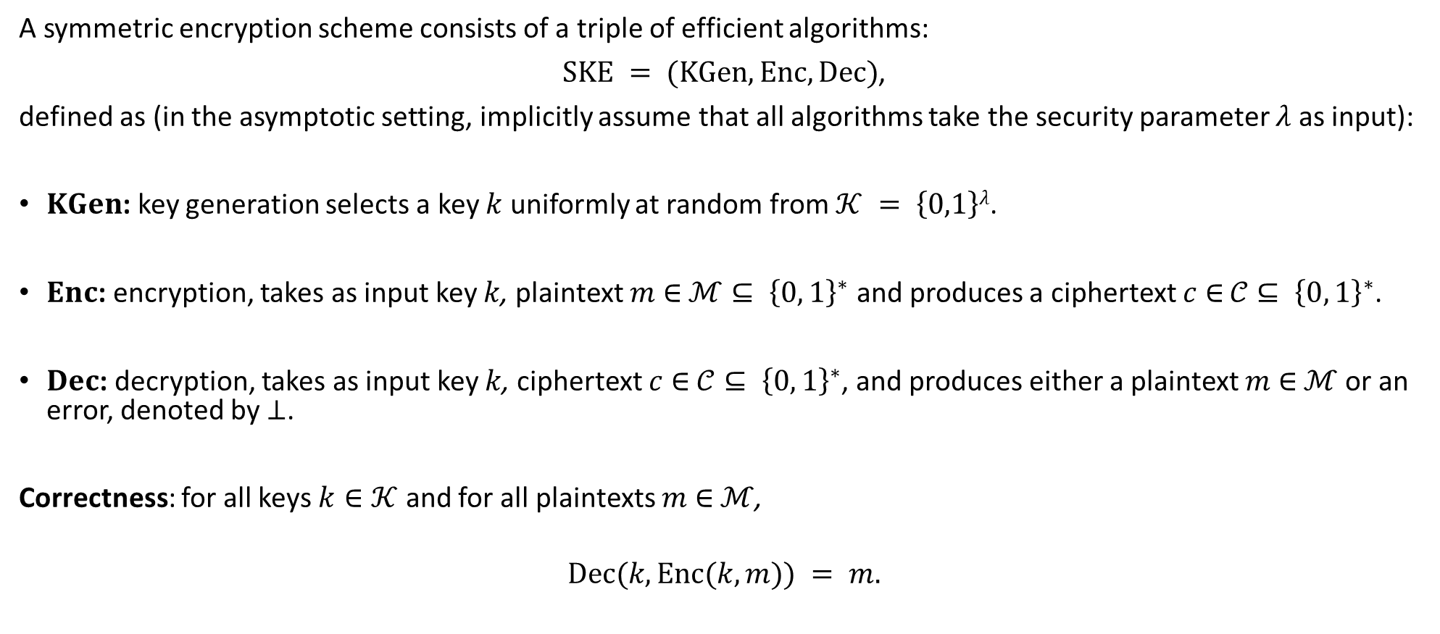
Recap: SKE
A symmetric encryption scheme consists of a triple of efficient algorithms:
$SKE = (KGen, Enc, Dec)$,
defined as (in the asymptotic setting, implicitly assume that all algorithms take the security parameter $λ$ as input):
$KGen$: key generation selects a key $k$ uniformly at random from $𝒦 = \left\{0,1\right\}λ$.
$Enc$: encryption, takes as input key $k$, plaintext $m$ ∈ $ℳ⊆ {\left\{0, 1\right\}}^{∗}$ and produces a ciphertext $c$ ∈ $𝒞⊆ {\left\{0, 1\right\}}^{∗}$.
$Dec$: decryption, takes as input key $k$, ciphertext $c$ ∈ $𝒞⊆ {\left\{0, 1\right\}}^{∗}$, and produces either a plaintext $m$ ∈ $ℳ$or an error, denoted by $⊥$.
Correctness: for all keys $k∈𝒦$ and for all plaintexts $m$ ∈ $ℳ$,
$$Dec(k,Enc(k,m)) = m.$$

Slide 29






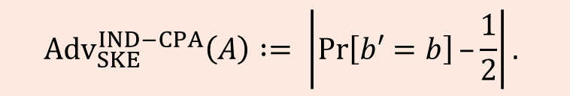

IND-CPA security for Symmetric Encryption
Recap: IND-CPA security of SKE
Adversary $A$
Challenger
$$b ←\$\{0,1\}$$
$$k ← KGen$$
$$(m0 ,m1)$$
LoR oracle
c
$$c = Enc(k,mb)$$
$A$ makes up to $q$ queries
$$b′$$
$${Adv}_{SKE}^{IND−CPA}\left(A\right) := \left|\operatorname{Pr}\left[b′=b\right]–\frac{1}{2}\right|.$$

Slide 30
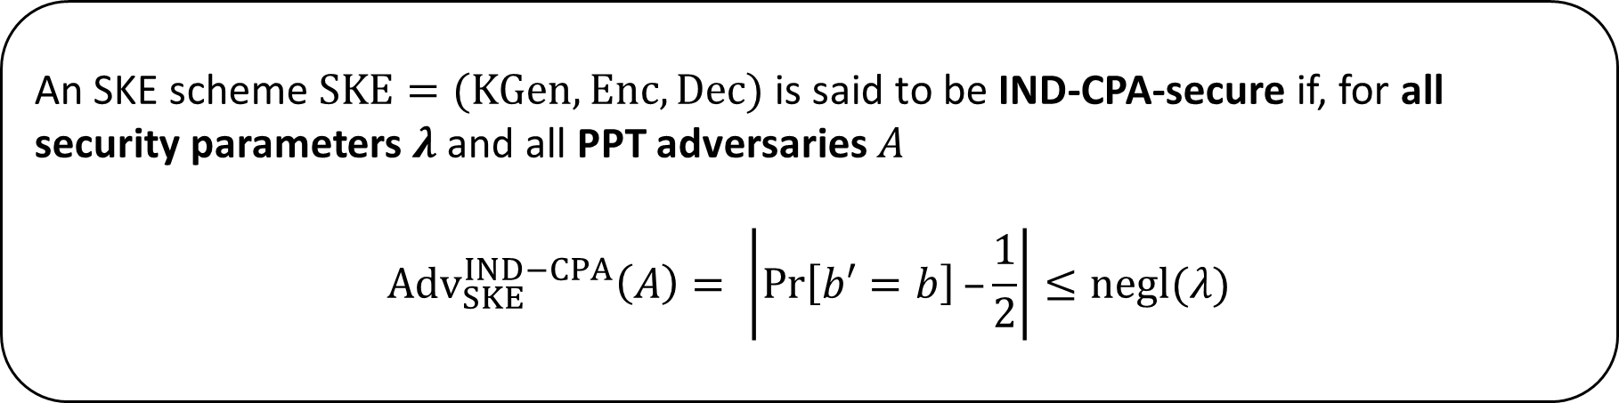
Recap: IND-CPA security of SKE
Definition (asymptotic)
An SKE scheme $SKE=(KGen,Enc,Dec)$ is said to be IND-CPA-secure if, for all security parameters $λ$ and all PPT adversaries $A$
$${Adv}_{SKE}^{IND−CPA}\left(A\right)= \left|\operatorname{Pr}\left[b′=b\right]–\frac{1}{2}\right|≤negl(λ)$$
The adversary has access to an encryption oracle.

Slide 31
Recap: IND-CPA security of SKE
Definition (asymptotic)
An SKE scheme $SKE=(KGen,Enc,Dec)$ is said to be IND-CPA-secure if, for all security parameters $λ$ and all PPT adversaries $A$
$${Adv}_{SKE}^{IND−CPA}\left(A\right)= \left|\operatorname{Pr}\left[b′=b\right]–\frac{1}{2}\right|≤negl(λ)$$
The adversary has access to an encryption oracle.
Does not ensure integrity (equivalently, “non-malleability”) of plaintexts and ciphertexts.

Slide 32

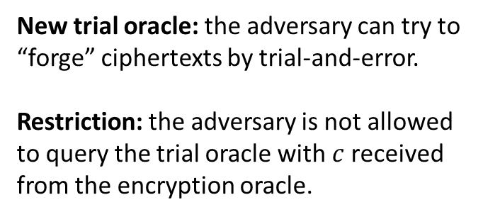






IND-CPA security for Symmetric Encryption
Modeling Ciphertext Integrity
Adversary $A$
Challenger
$$k ← KGen$$
$$m$$
New trial oracle: the adversary can try to “forge” ciphertexts by trial-and-error.
Restriction: the adversary is not allowed to query the trial oracle with $c$ received from the encryption oracle.
$$c = Enc(k,m)$$
$$c$$
$$try(c^{∗})$$
$$m^{∗}/⊥=Dec(k, c^{∗})$$
$E_{0}:$ the event that the adversary queries the trial oracle with $c^{∗}$ such that $Dec\left(k, c^{∗}\right)≠⊥$

Slide 33
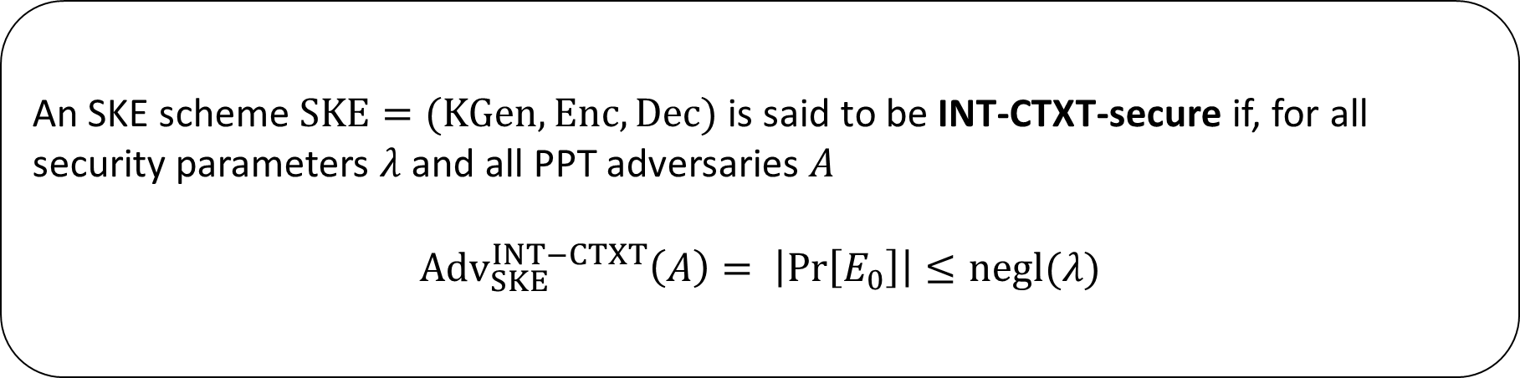
Formalizing Ciphertext Integrity
Definition (asymptotic)
An SKE scheme $SKE=(KGen,Enc,Dec)$ is said to be INT-CTXT-secure if, for all security parameters $λ$ and all PPT adversaries $A$
$${Adv}_{SKE}^{INT−CTXT}\left(A\right)= \left|\operatorname{Pr}\left[E_{0}\right]\right|≤negl(λ)$$

Slide 34
IND-CPA security for Symmetric Encryption
Modeling Plaintext Integrity
Adversary $A$
Challenger
$$k ← KGen$$
$$m$$
New trial oracle: the adversary can try to “forge” ciphertexts by trial-and-error.
Restriction: the adversary is not allowed to query the trial oracle with $c$ received from the encryption oracle.
$$c = Enc(k,m)$$
$$c$$
$$try(c^{∗})$$
$$m^{∗}/⊥=Dec(k, c^{∗})$$
$E_{1}:$ the event that the adversary queries the trial oracle with $c^{∗}$ such that $Dec\left(k, c^{∗}\right)≠m^{∗}$,
where $m^{∗}$ is “new” (has not been queried to the encryption oracle).

Slide 35
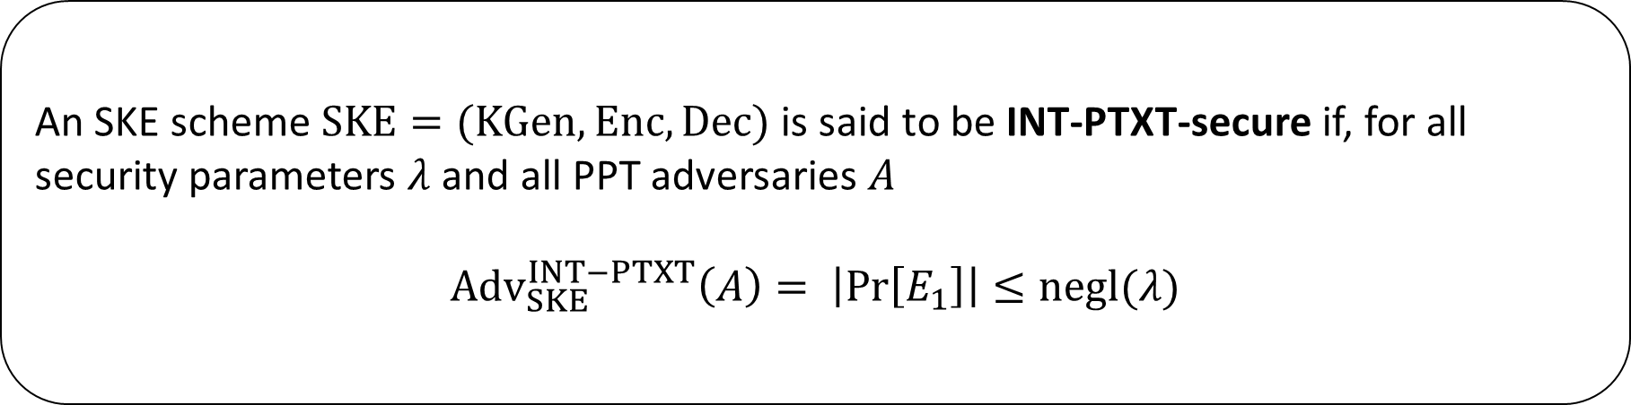
Formalizing Plaintext Integrity
Definition (asymptotic)
An SKE scheme $SKE=(KGen,Enc,Dec)$ is said to be INT-PTXT-secure if, for all security parameters $λ$ and all PPT adversaries $A$
$${Adv}_{SKE}^{INT−PTXT}\left(A\right)= \left|\operatorname{Pr}\left[E_{1}\right]\right|≤negl(λ)$$

Slide 36
Formalizing Plaintext Integrity
Definition (asymptotic)
An SKE scheme $SKE=(KGen,Enc,Dec)$ is said to be INT-PTXT-secure if, for all security parameters $λ$ and all PPT adversaries $A$
$${Adv}_{SKE}^{INT−PTXT}\left(A\right)= \left|\operatorname{Pr}\left[E_{1}\right]\right|≤negl(λ)$$
Claim: INT-CTXT-security implies INT-PTXT security.

Slide 37
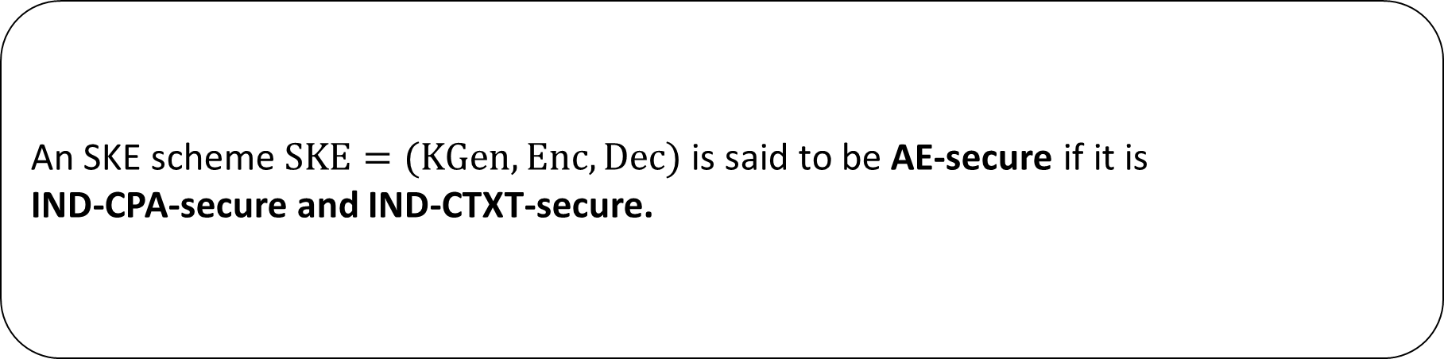
Formalizing Authenticated Encryption (AE) security
Definition
An SKE scheme $SKE=(KGen,Enc,Dec)$ is said to be AE-secure if it is
IND-CPA-secure and IND-CTXT-secure.

Slide 38
Outline
Message Authentication Codes (MACs)
MAC construction and domain extension
Authenticated encryption
IND-CCA security
Generic composition

Slide 39
IND-CCA security of SKE

Slide 40
IND-CCA security of SKE
We are also interested in security of SKE against chosen ciphertext attacks.
  Here the adversary has access to both an LoR encryption oracle and a decryption oracle.
  Cannot submit output of encryption oracle to decryption oracle (otherwise trivial win).
  Leading to the IND-CCA security notion.
In practice, the adversary may only have access to something weaker than a full decryption oracle.
  Partial information about the decryption process might leak, for example, error messages, timing information, etc.
But, as usual, we are conservative in our approach:
  We give the adversary as much power as we can.
  Subject to us being able to efficiently achieve our target security notions.

Slide 41



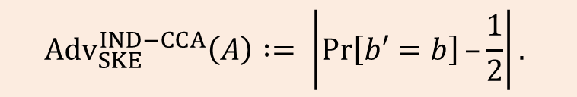
IND-CPA security for Symmetric Encryption
Formalizing IND-CCA security
Adversary $A$
Challenger
$$b ←\$\{0,1\}$$
$$k ← KGen$$
$$(m0 ,m1)$$
LoR oracle
c
$$c = Enc(k,mb)$$
$$c′$$
Dec oracle
$$m^{′}/⊥$$
$$m^{′}/⊥=Dec(k, c′)$$
$$b′$$
$${Adv}_{SKE}^{IND−CCA}\left(A\right) := \left|\operatorname{Pr}\left[b′=b\right]–\frac{1}{2}\right|.$$

Slide 42
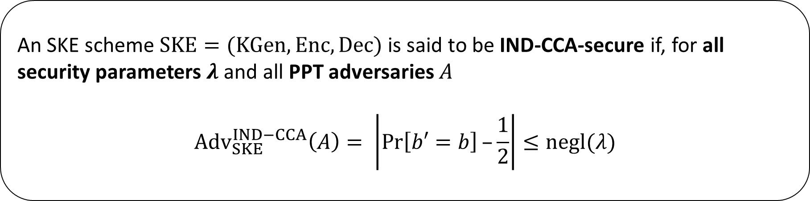
Formalizing IND-CCA security
Definition (asymptotic)
An SKE scheme $SKE=(KGen,Enc,Dec)$ is said to be IND-CCA-secure if, for all security parameters $λ$ and all PPT adversaries $A$
$${Adv}_{SKE}^{IND−CCA}\left(A\right)= \left|\operatorname{Pr}\left[b′=b\right]–\frac{1}{2}\right|≤negl(λ)$$
The adversary has access to an encryption oracle and a decryption oracle.

Slide 43
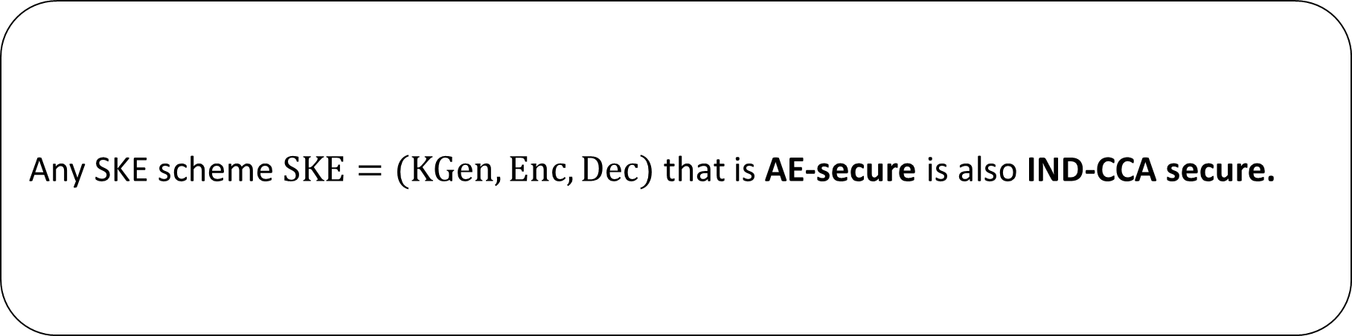
Relating AE security and IND-CCA security
Claim
Any SKE scheme $SKE=(KGen,Enc,Dec)$ that is AE-secure is also IND-CCA secure.

Slide 44
Relations between security notions for symmetric encryption
Relating all of the security notions for SKE
AE:
IND-CPA + INT-CTXT
IND-CCA
IND-CPA
+ INT-PTXT
IND-CPA
INT-PTXT
Notes:
Example for separation of AE and IND-CCA: take an IND-CCA scheme SE, add a leading bit to its ciphertexts, and then modify decryption so that everything beginning "0" decrypts as normal and everything beginning "1" decrypts to "0". The scheme is still correct, it's trivial to break INT-CTXT, but that does not help in breaking IND-CCA security.
IND-CCA separation from IND-CPA + INT-PTXT: there are schemes (Desai) where every bit-string is a valid ciphertext, but where schemes are still IND-CCA secure; hence no integrity at all; forgery capability does not help break ind property of encryption. Concretely, think about an SPRP with 2k-bit domain and in which first k bits of input to SPRP are set to a random string (to get IND-CPA security) – every 2k-bit string is a valid ciphertext, but no decryption oracle query distinct from an output of enc() will tell adversary anything useful.
For reverse separation: take, e.g. MtE in which E is IND-CPA but then given a redundant bit – will still have INT-PTXT due to MAC on plaintext, and IND-CPA follows from ”E”, but clearly not CCA secure (as we can bit flip in the redundant bit).

Slide 45
Summary
AE security implies IND-CCA security and INT-PTXT security.
  So, AE security has emerged as the natural target security notion for symmetric encryption.
However, it’s not the end of the story…
  In many applications we want to integrity protect some data and provide confidentiality for the remainder – AE with Associated Data, AEAD.
  AE security does not protect against attacks on secure channels based on reordering or deletion of ciphertexts.
  The “AE implies IND-CCA” proof only works if there is a single possible error message.
    See: Boldyreva, Degabrielem Paterson, Stam: On Symmetric Encryption with Distinguishable Decryption Failures. FSE 2o13: 367-390

Slide 46
Generic Composition

Slide 47
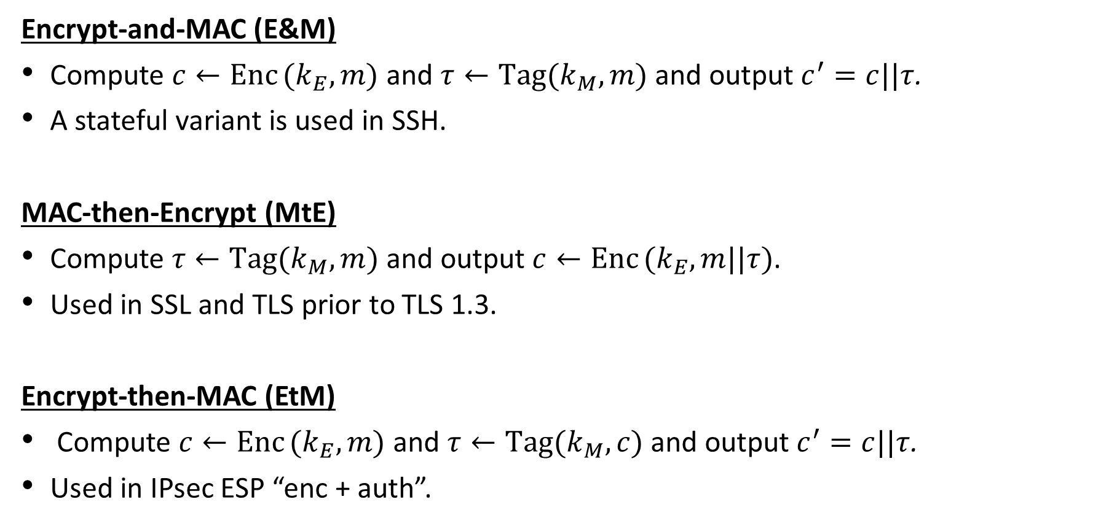
Generic composition of SKE and MAC for AE
Encrypt-and-MAC (E&M)
Compute $c←Enc (k_{E},m)$ and $τ←Tag(k_{M},m)$ and output $c^{′}=c||τ$.
A stateful variant is used in SSH.
MAC-then-Encrypt (MtE)
Compute $τ←Tag(k_{M},m)$ and output $c←Enc (k_{E},m||τ)$.
Used in SSL and TLS prior to TLS 1.3.
Encrypt-then-MAC (EtM)
Compute $c←Enc (k_{E},m)$ and $τ←Tag(k_{M},c)$ and output $c^{′}=c||τ$.
Used in IPsec ESP “enc + auth”.

Slide 48
Generic composition of SKE and MAC for AE
Claim-1: E&M is not AE-secure
The resulting scheme from E&M is not AE-secure.
Claim-2: MtE is not AE-secure
The resulting scheme from MtE is not AE-secure.
Claim-3: EtM is AE-secure
If SKE is IND-CPA secure and MAC is sUF-CMA secure, then the resulting scheme from EtM is AE-secure.

