Slide 1


Introduction to Symmetric-Key Cryptography (Part-3)
ACM India Summer School 2024 (Day 3, Session-2)
Sikhar Patranabis (IBM Research India)
sikhar.patranabis@ibm.com
https://research.ibm.com/people/sikhar-patranabis
IITB Trust Lab 4th June 2024

Slide 2
Outline
Cryptographic hash functions
Generic attacks
Design paradigms
Application: password hashing

Slide 3
Outline
Cryptographic hash functions
Generic attacks
Design paradigms
Application: password hashing

Slide 4
Cryptographic hash functions

Slide 5
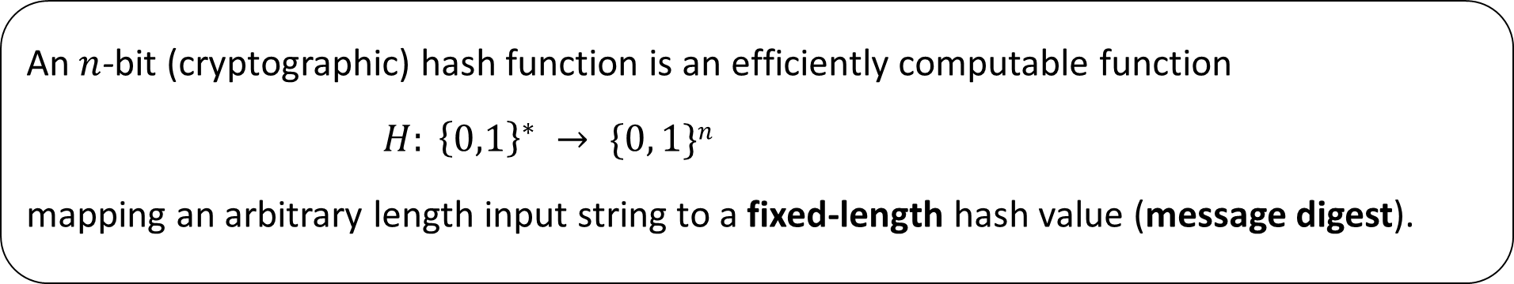
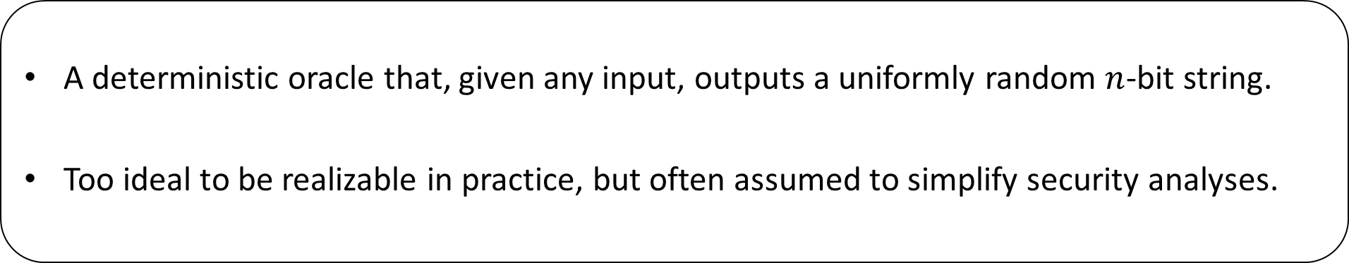
Say hello to cryptographic hash functions!
Syntax
An $n$-bit (cryptographic) hash function is an efficiently computable function
$H: {\left\{0,1\right\}}^{∗} → \{0, 1\}n$
mapping an arbitrary length input string to a fixed-length hash value (message digest).
Ideal visualization: Random oracle
A deterministic oracle that, given any input, outputs a uniformly random $n$-bit string.
Too ideal to be realizable in practice, but often assumed to simplify security analyses.

Slide 6
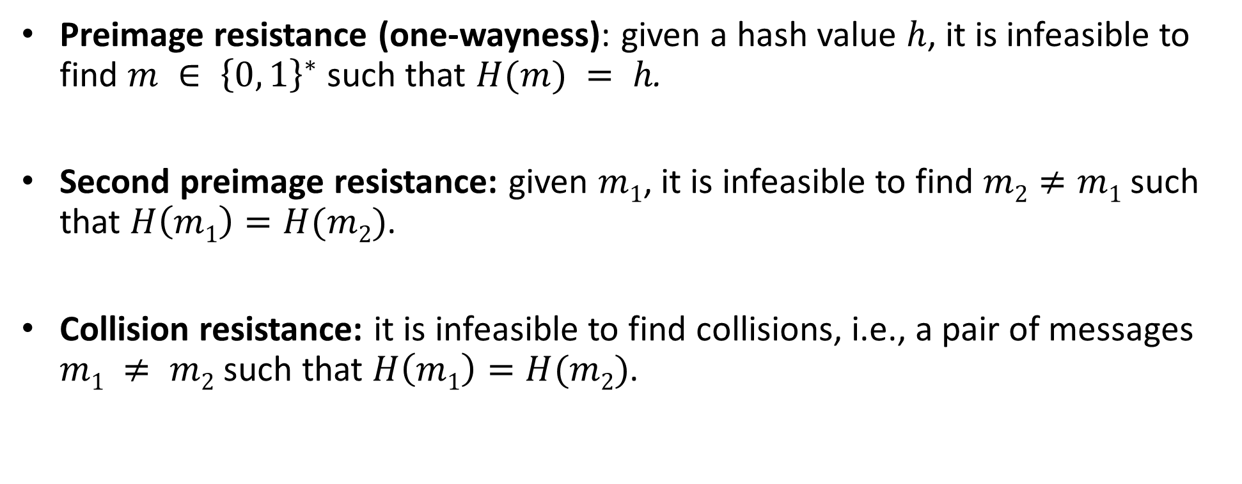
Primary security goals for hash functions (informal)
Preimage resistance (one-wayness): given a hash value $h$, it is infeasible to find $m ∈ {\left\{0, 1\right\}}^{∗}$ such that $H(m) = h$.
Second preimage resistance: given $m1$, it is infeasible to find $m2≠m1$ such that $H\left(m1\right)=H(m2)$.
Collision resistance: it is infeasible to find collisions, i.e., a pair of messages $m1 ≠ m2$ such that $H\left(m1\right)=H(m2)$.

Slide 7
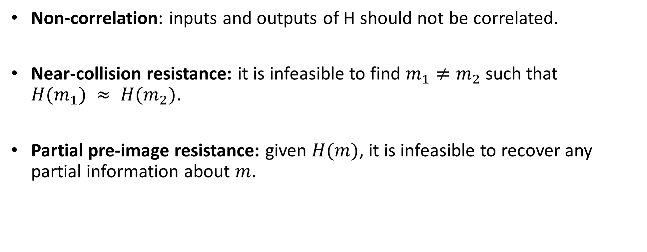
Secondary security goals for hash functions (informal)
Non-correlation: inputs and outputs of H should not be correlated.
Near-collision resistance: it is infeasible to find $m_{1}≠m_{2}$ such that $H(m_{1}) ≈ H(m_{2})$.
Partial pre-image resistance: given $H(m)$, it is infeasible to recover any partial information about $m$.

Slide 8
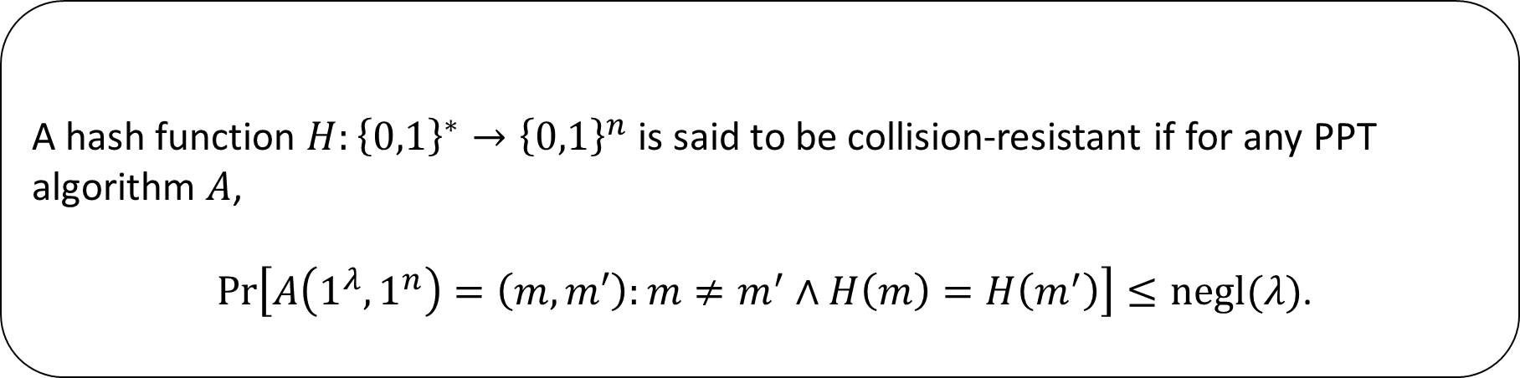
Defining collision-resistance: Attempt-1
Definition: Attempt-1
A hash function $H:{\left\{0,1\right\}}^{∗}→{\left\{0,1\right\}}^{n}$ is said to be collision-resistant if for any PPT algorithm $A$,
$\operatorname{Pr}\left[A\left(1^{λ},1^{n}\right)=\left(m,m′\right):m≠m^{′}∧H\left(m\right)=H\left(m^{′}\right)\right]≤negl(λ)$.
Inherently flawed

Slide 9
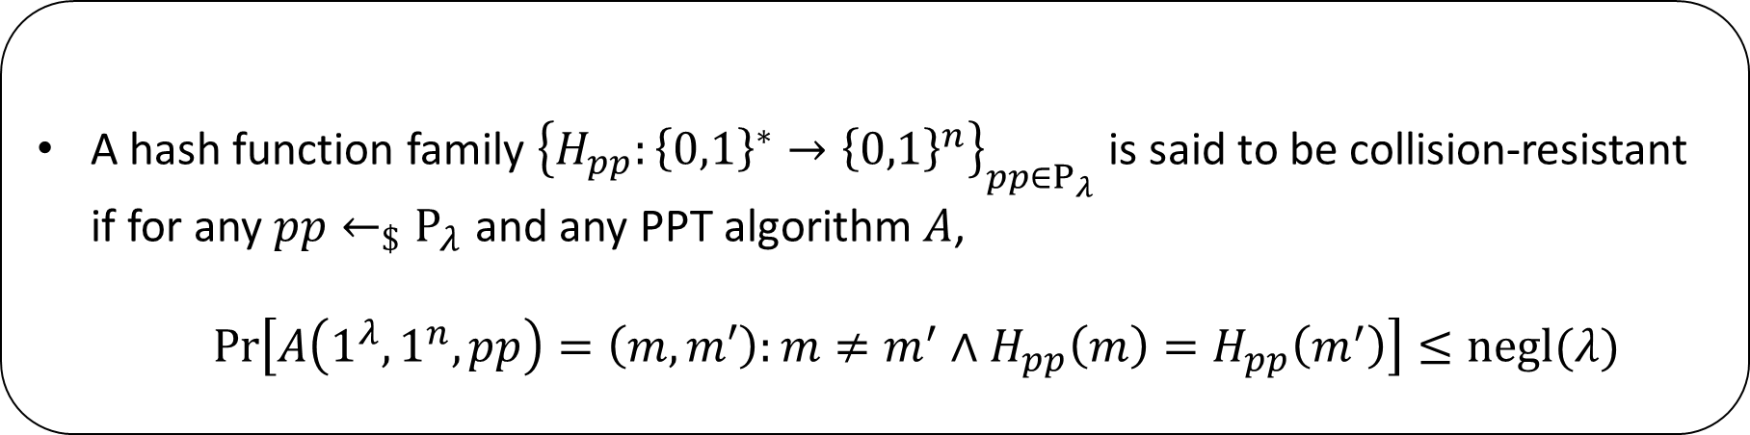
Defining collision-resistance: Attempt-2
Definition: Attempt-2
A hash function family ${\left\{H_{pp}:{\left\{0,1\right\}}^{∗}→{\left\{0,1\right\}}^{n}\right\}}_{pp∈P_{λ}}$ is said to be collision-resistant if for any $pp←_{\$}P_{λ}$ and any PPT algorithm $A$,
  $\operatorname{Pr}\left[A\left(1^{λ},1^{n},pp\right)=\left(m,m′\right):{m≠m^{′}∧H}_{pp}\left(m\right)=H_{pp}\left(m^{′}\right)\right]≤negl(λ)$

Slide 10
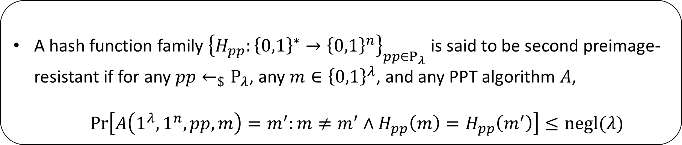
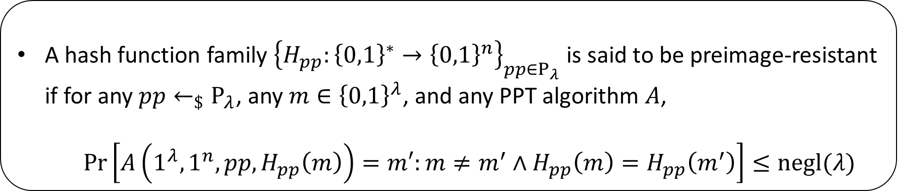
Defining other properties
Definition (preimage resistance)
A hash function family ${\left\{H_{pp}:{\left\{0,1\right\}}^{∗}→{\left\{0,1\right\}}^{n}\right\}}_{pp∈P_{λ}}$ is said to be preimage-resistant if for any $pp←_{\$}P_{λ}$, any $m∈{\left\{0,1\right\}}^{λ}$, and any PPT algorithm $A$,
  $\operatorname{Pr}\left[A\left(1^{λ},1^{n},pp,H_{pp}\left(m\right)\right)=m′:{m≠m^{′}∧H}_{pp}\left(m\right)=H_{pp}\left(m^{′}\right)\right]≤negl(λ)$
Definition (second preimage resistance)
A hash function family ${\left\{H_{pp}:{\left\{0,1\right\}}^{∗}→{\left\{0,1\right\}}^{n}\right\}}_{pp∈P_{λ}}$ is said to be second preimage-resistant if for any $pp←_{\$}P_{λ}$, any $m∈{\left\{0,1\right\}}^{λ}$, and any PPT algorithm $A$,
  $\operatorname{Pr}\left[A\left(1^{λ},1^{n},pp,m\right)=m^{′}:m≠m^{′}∧H_{pp}\left(m\right)=H_{pp}\left(m^{′}\right)\right]≤negl(λ)$

Slide 11
Relationships between security goals
True or False:
Claim-1: Any hash function family that is collision-resistant is also second pre-image resistant.
Claim-2: Any hash function family that is collision-resistant is also preimage-resistant.

Slide 12
Outline
Cryptographic hash functions
Generic attacks
Design paradigms
Application: password hashing

Slide 13
Generic attacks on cryptographic hash functions

Slide 14
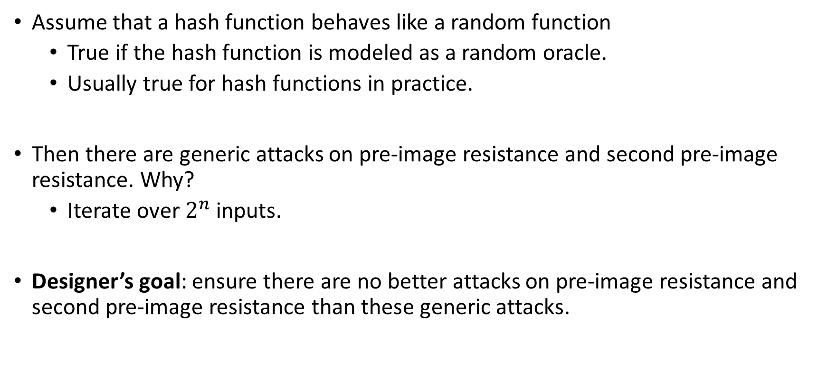
Generic attacks on hash functions
Assume that a hash function behaves like a random function
  True if the hash function is modeled as a random oracle.
  Usually true for hash functions in practice.
Then there are generic attacks on pre-image resistance and second pre-image resistance. Why?
  Iterate over $2^{n}$ inputs.
Designer’s goal: ensure there are no better attacks on pre-image resistance and second pre-image resistance than these generic attacks.

Slide 15
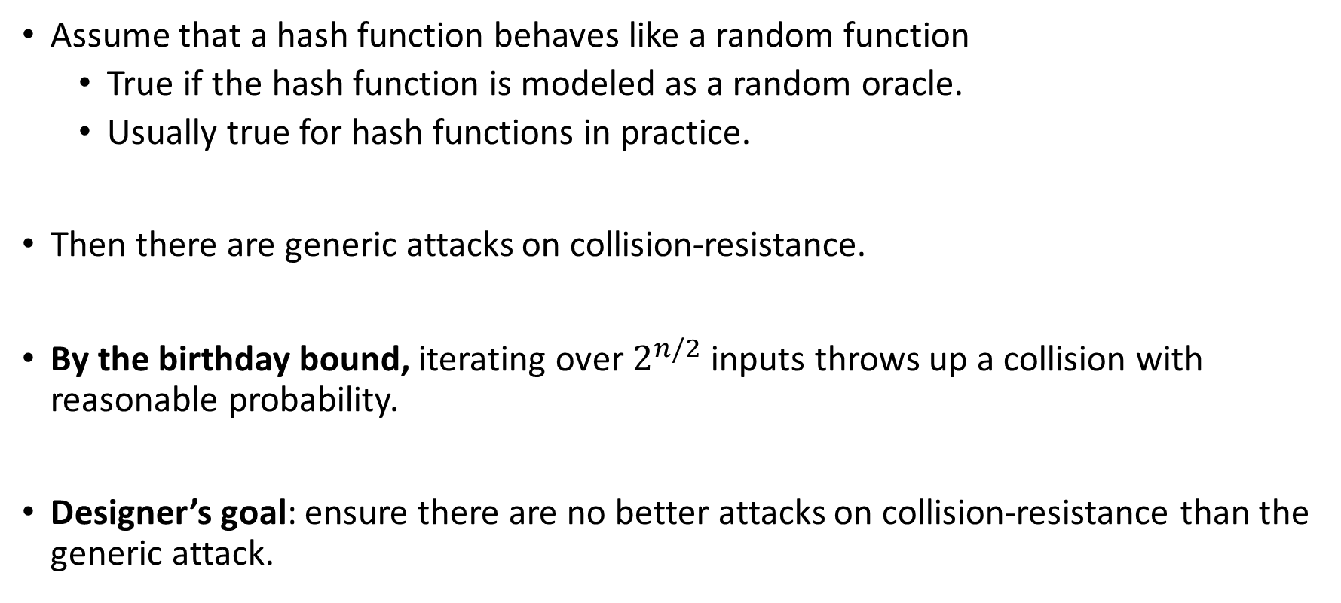
Generic attacks on collision-resistance of hash functions
Assume that a hash function behaves like a random function
  True if the hash function is modeled as a random oracle.
  Usually true for hash functions in practice.
Then there are generic attacks on collision-resistance.
By the birthday bound, iterating over $2^{n/2}$ inputs throws up a collision with reasonable probability.
Designer’s goal: ensure there are no better attacks on collision-resistance than the generic attack.

Slide 16
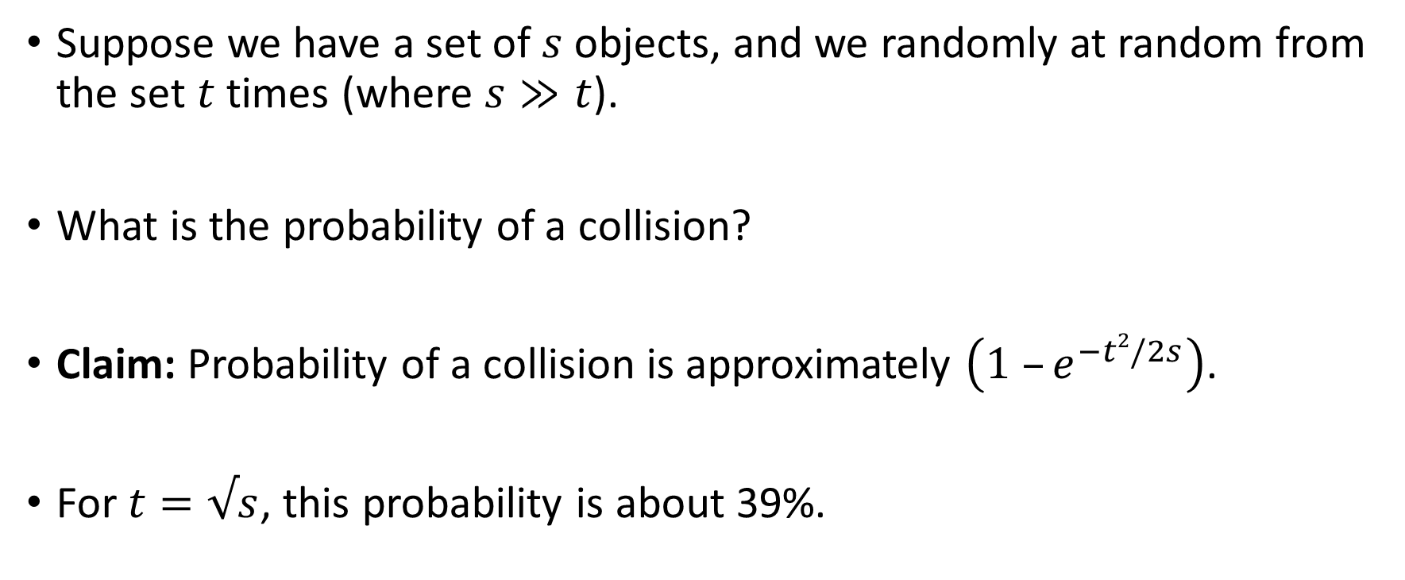
Analyzing the birthday bound
Suppose we have a set of $s$ objects, and we randomly at random from the set $t$ times (where $s≫t$).
What is the probability of a collision?
Claim: Probability of a collision is approximately $\left(1 –e^{−t2/2s}\right)$.
For $t=√s$, this probability is about 39%.

Slide 17
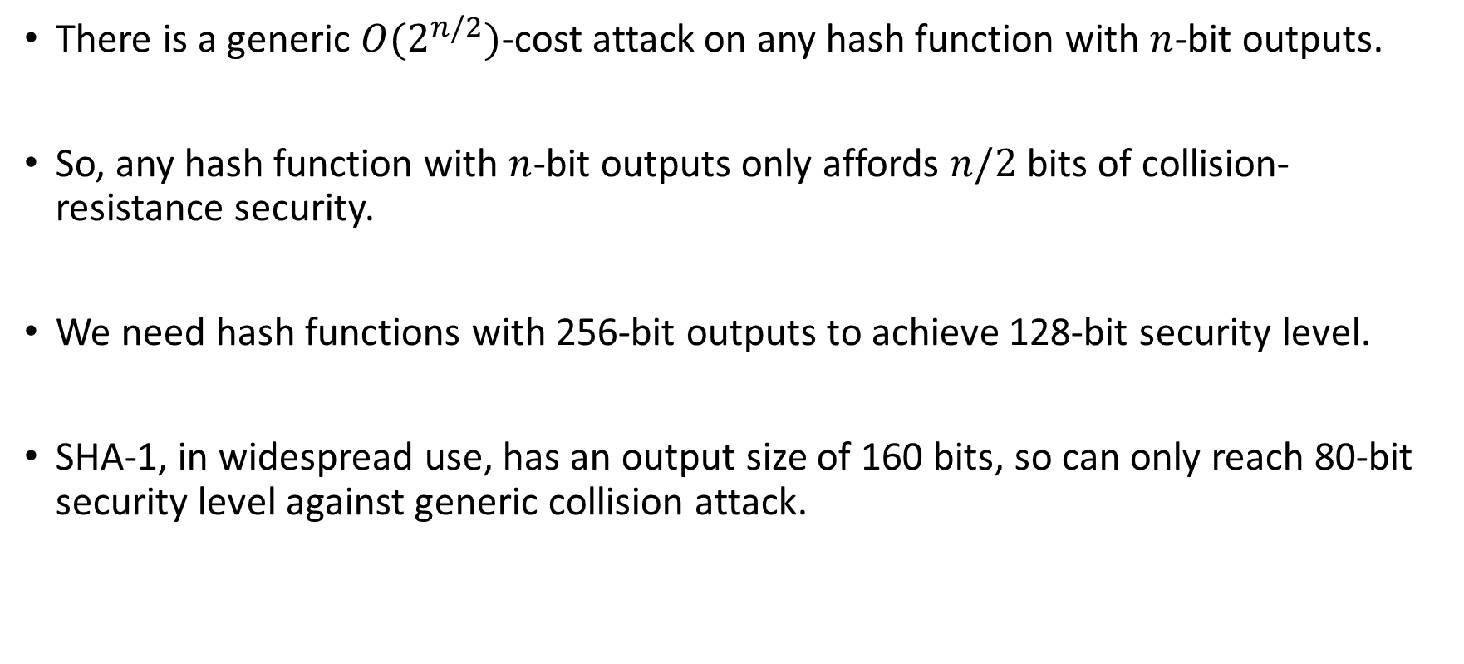
Conclusions from birthday bound analysis
There is a generic ${O(2}^{n/2})$-cost attack on any hash function with $n$-bit outputs.
So, any hash function with $n$-bit outputs only affords $n/2$ bits of collision-resistance security.
We need hash functions with 256-bit outputs to achieve 128-bit security level.
SHA-1, in widespread use, has an output size of 160 bits, so can only reach 80-bit security level against generic collision attack.

Slide 18
Outline
Cryptographic hash functions
Generic attacks
Design paradigms
Application: password hashing

Slide 19
Designing cryptographic hash functions

Slide 20
Standards for hash functions
NIST
  SHA-1 (until 2010)
  SHA-2 (includes SHA-224, SHA-256, SHA-384, SHA-512)
  SHA-3 (Keccak)
NESSIE
  SHA-256, SHA-384, SHA-512
  WHIRLPOOL
CRYPTREC
  SHA-256, SHA-384, SHA-512

Slide 21
Hash Function Designs
Several design paradigms:
  Based on block ciphers.
  Dedicated designs.
Must be able to process arbitrary length messages.
  Leads naturally to the idea of an iterative design.

Slide 22
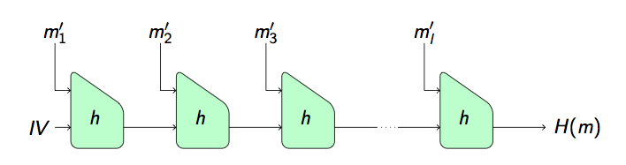
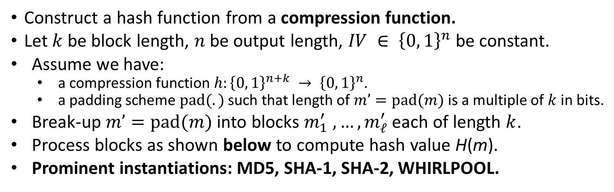
Merkle-Damgård (MD) iterated hashing
Construct a hash function from a compression function.
Let $k$ be block length, $n$ be output length, $IV ∈ {\left\{0, 1\right\}}^{n}$ be constant.
Assume we have:
  a compression function $h:{\left\{0, 1\right\}}^{n+k} → {\left\{0, 1\right\}}^{n}$.
  a padding scheme $pad(.)$ such that length of $m’=pad(m)$ is a multiple of $k$ in bits.
Break-up $m’=pad(m)$ into blocks $m_{1}^{′} ,…,m_{ℓ}^{′}$ each of length $k$.
Process blocks as shown below to compute hash value H(m).
Prominent instantiations: MD5, SHA-1, SHA-2, WHIRLPOOL.

Slide 23
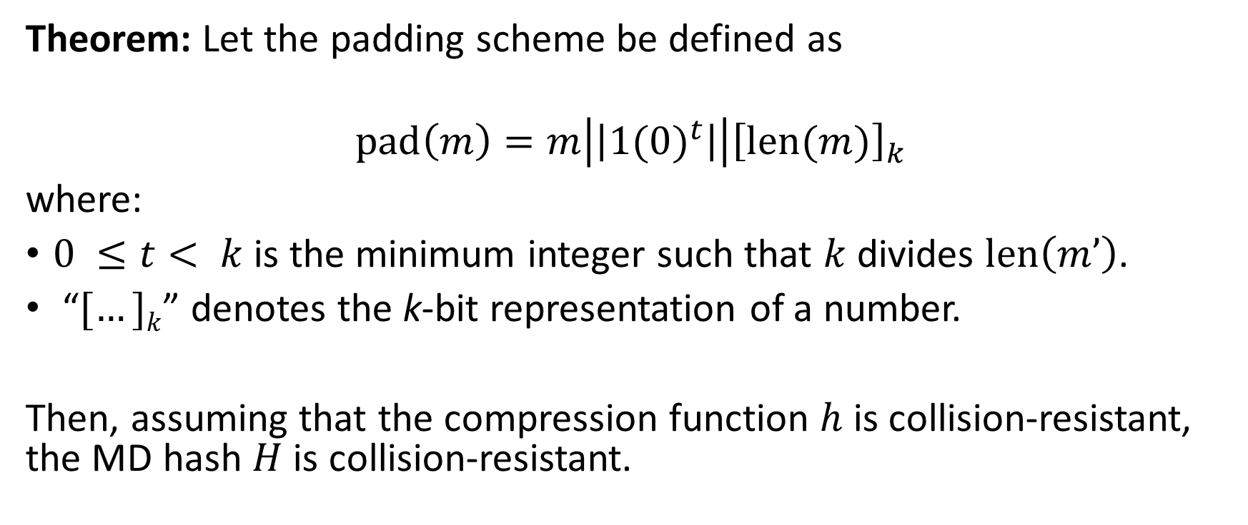
Collision-resistance of MD iterated hashing
Theorem: Let the padding scheme be defined as
$$pad\left(m\right)=m\left|\left|{1(0)}^{t}\right|\right|{\left[len(m)\right]}_{k}$$
where:
$0 ≤t< k$ is the minimum integer such that $k$ divides $len\left(m’\right)$.
“$[…]k$” denotes the k-bit representation of a number.
Then, assuming that the compression function $h$ is collision-resistant, the MD hash $H$ is collision-resistant.

Slide 24
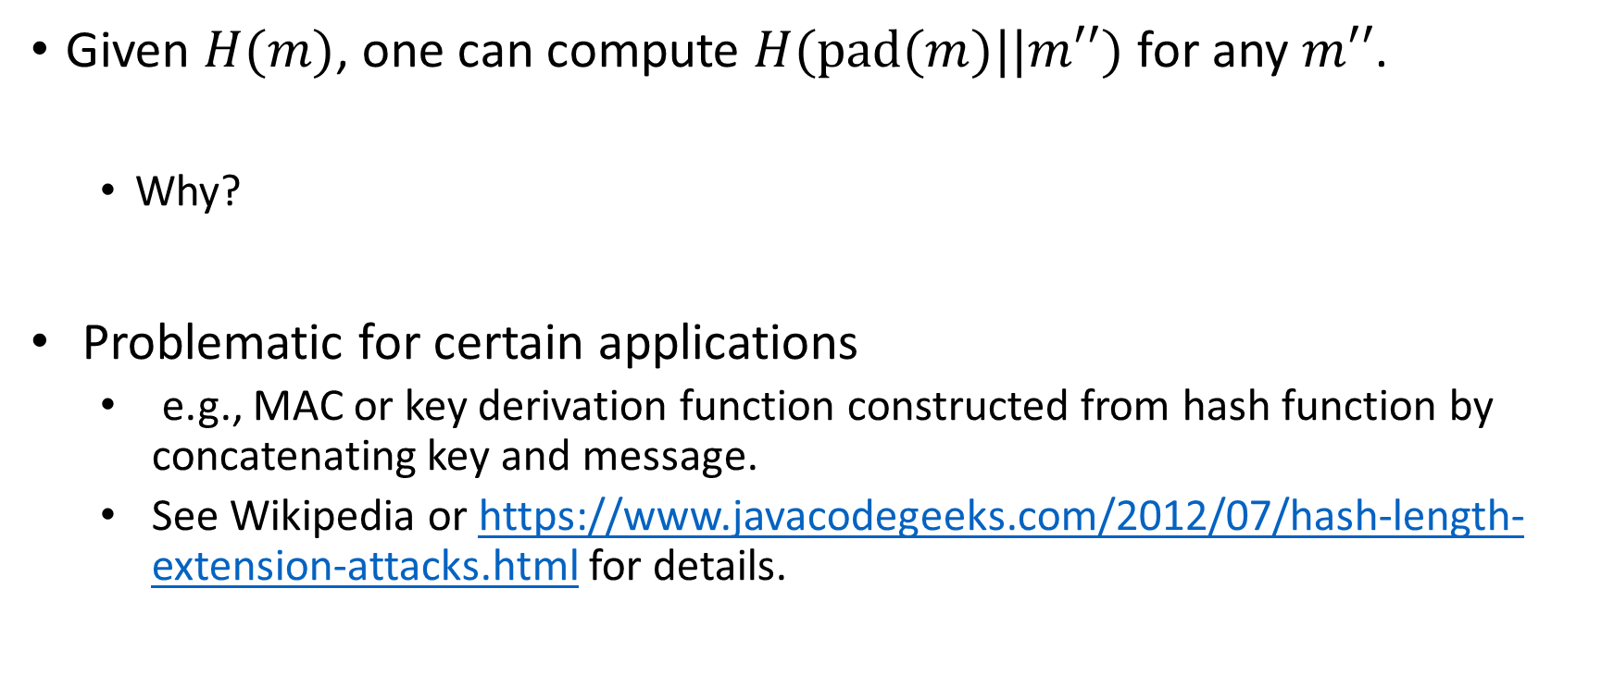
Length extension attack on MD hashing
Given $H(m)$, one can compute $H(pad(m)||m′′)$ for any $m′′$.
  Why?
Problematic for certain applications
  e.g., MAC or key derivation function constructed from hash function by concatenating key and message.
  See Wikipedia or https://www.javacodegeeks.com/2012/07/hash-length-extension-attacks.html for details.

Slide 25
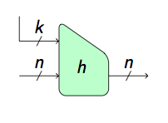
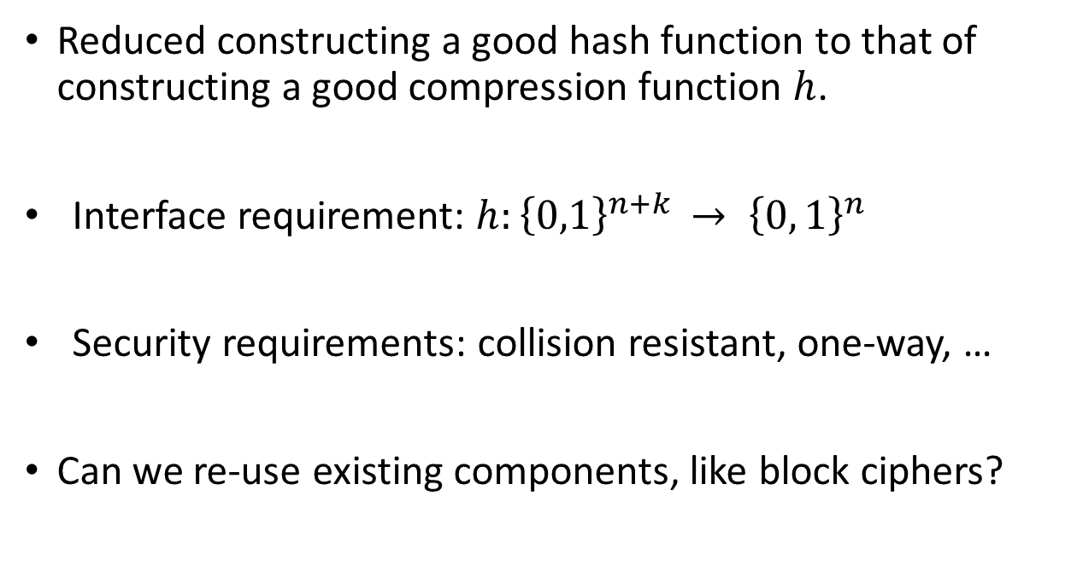
Construction of compression functions
Reduced constructing a good hash function to that of constructing a good compression function $h$.
Interface requirement: $h:{\left\{0,1\right\}}^{n+k} → {\left\{0, 1\right\}}^{n}$
Security requirements: collision resistant, one-way, …
Can we re-use existing components, like block ciphers?

Slide 26
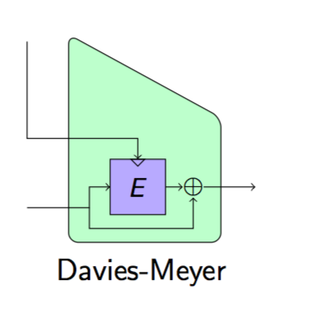



Construction of compression functions from block ciphers
Constructions from block ciphers.
  Davies-Meyer, Matyas-Meyer-Oseas, Miyaguchi-Preneel.
Claim: if E is an ideal cipher, then Davies-Meyer gives a collision-resistant compression function.
  May need additional key processing to map input to key space.
Main issue: hash output size = block cipher block size
  Need specialized (large block) block cipher to avoid birthday attack.
Secondary issue: message blocks are used to set key
  Rekeying of block cipher needs to be fast.
$$mi$$
$$ti$$
$$t_{i−1}$$

Slide 27
Dedicated Hash Functions: Examples
MD5 (replacing MD4)
  128-bit hash , designed by Ron Rivest in 1991, specified in RFC 1321.
SHA-1 (replacing SHA-0)
  Tweak of SHA-0, 160-bit hash, designed by NSA, standardised by NIST in FIPS PUB 180-1 (1995).
  Used extensively in TLS/SSL, PGP, SSH, S/MIME, IPSec
SHA-2 family (SHA224, SHA256, SHA384, SHA512)
  Designed by NSA, standardised by NIST in FIPS PUB 180-2 (2002), recommended for US government use.
  SHA-256 very commonly used, other options less so (output size, speed).
SHA-3
  Public design, standardised by NIST in FIPS PUB 202 (2015), complementary to SHA-2 family (not a replacement).
Whirlpool
  512-bit hash (based on modified AES).
  Used in TrueCrypt (open-source encryption toolkit).
(RIPEMD) RIPEMD-160, BLAKE, BLAKE2…

Slide 28
Dedicated Hash Functions: the MDx-family
MDx-family:
  Derived from an early design from Ron Rivest in the early 1990s.
  Very efficient and particularly suited to software implementation on 32-bit machines.
  Further motivation for custom-made hash functions: ban on export of cryptographic algorithms in the 1980s and 1990s (no ban for hash functions).
  MD4, MD5, SHA-1, SHA-2.
  NIST and ISO/IEC 10118-3 standards.
  Despite wide range of choices and security issues, SHA-1 still remains widely used today, e.g. IPSec, SSL/TLS, SSH.
  However, this should now (slowly) change…

Slide 29
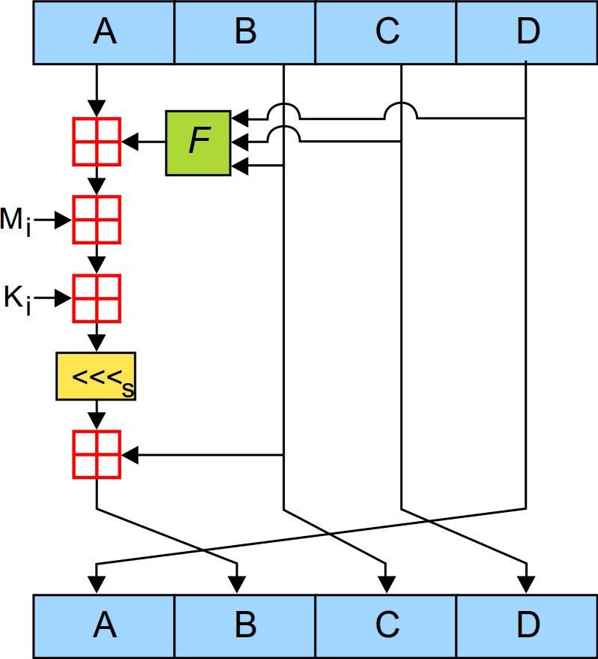
MD5
  Merkle-Damgård hash with output size n = 128.
  Compression function uses (implicitly) a special block cipher in Davis-Meyer mode, k =512.
  Recall DM: hash message blocks → block cipher key; hash chaining variable → block cipher message.
  MD5 block cipher has a round function operating on 4 x 32-bit words.
  Round function is iterated 64 times; uses mod 2³² additions, bit shifts, other simple bit operations (F functions).
  M_{i} are 16 x 32-bit message subblocks making up 512-bit message block; K_{i} are round constants (not keys).
  Each M_{i} is processed 4 times in 4 different rounds, each time with a different F function.
"MD5" by Surachit - self-made SVG, based on [1] by User:Matt Crypto. Licensed under CC BY-SA 3.0 via Commons - https://commons.wikimedia.org/wiki/File:MD5.svg#/media/File:MD5.svg

Slide 30
Insecurity of MD5
1991: MD5 introduced to replace weak MD4.
1993,1996: researchers identify initial flaws in MD5, recommend replacement.
2004: researchers show that MD5 is not collision-resistant; proof by example: everybody can reproduce the collisions!
2005: researchers generate X.509 certificates with different keys but matching MD5 hash; very practical and serious security threat.
2008: researchers obtain fake MD5-based certificate from Verisign.
2012: flame malware uses fake certificate issued by Microsoft, exploiting MD5 collisions.
Today: it’s possible to produce MD5 collisions in seconds on a laptop.

Slide 31
Insecurity of MD5
Question: Why does it take so long to phase out a broken cryptographic algorithm?
Possible answers:
Once deployed, hard to phase out, especially in systems without cryptographic agility.
Desire to maintain backwards compatibility with older software.
Practitioners seem to require practical demonstration of attack (less conservative than cryptographers; this seems to be slowly improving).
Lack of understanding of how attacks evolve outside narrow circle of crypto experts (attacks really do only get stronger!; also now improving).
Attacks only on collision-resistance, do not break all security properties (e.g. one wayness), so MD5 maybe still ok in some applications, leading to confusion about status.
  Example: best pre-image attack on MD5 still requires 2^{123.4} effort.

Slide 32
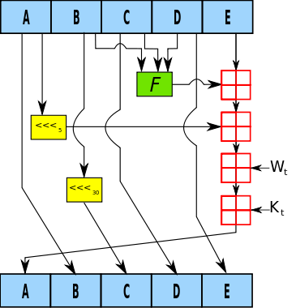
SHA-1
  MD hash with output size n equal to 160 (20-byte output).
  Designed to provide 2⁸⁰ security against collision attacks.
  Compression function uses (implicitly) a special block cipher in Davis-Meyer mode, k = 512.
  Recall DM: hash message blocks → block cipher key; hash chaining variable → block cipher message.
  Block cipher has a round function operating on 5 x 32-bit words.
  Round function iterated 80 times.
  Use mod 2³² additions, bit shifts, other simple bit operations.
"SHA-1". Licensed under CC BY-SA 2.5 via Commons –
https://commons.wikimedia.org/wiki/File:SHA-1.svg#/media/File:SHA-1.svg

Slide 33
Compressed timeline of security of SHA-1
1995: Initial analysis of SHA-0; design tweak produces SHA-1.
2005: First attacks on SHA-1 (Wang et al.).
2005 – 2015: More analysis, collisions in around 2⁶¹ compression function evaluations; no full-fledged attacks but collisions for up to 77 rounds out of 80.
2012: NIST starts to retire SHA-1, but then (2015) relaxes policy https://csrc.nist.gov/projects/hash-functions/nist-policy-on-hash-functions
Late 2014: Google and others start to penalize sites using SHA-1 certificates.
October 2015: freestart collision attack on full SHA-1. (https://sites.google.com/site/itstheshappening/).
February 2017: concrete collision on full SHA-1 (https://shattered.it/).
January 2020: chosen-prefix collision on full SHA-1 (https://eprint.iacr.org/2020/014; consequences for certificate forgeries).

Slide 34
The SHAppening [Stevens, Karpman, Peyrin]
Freestart collision is significantly weaker attack than full collision.
Attacker gets to choose two different IVs in MD construction.
  In reality, the IVs are fixed to a single value!
Attack used 64 GPUs and took a few days.
’
’
’
’
’
’

Slide 35

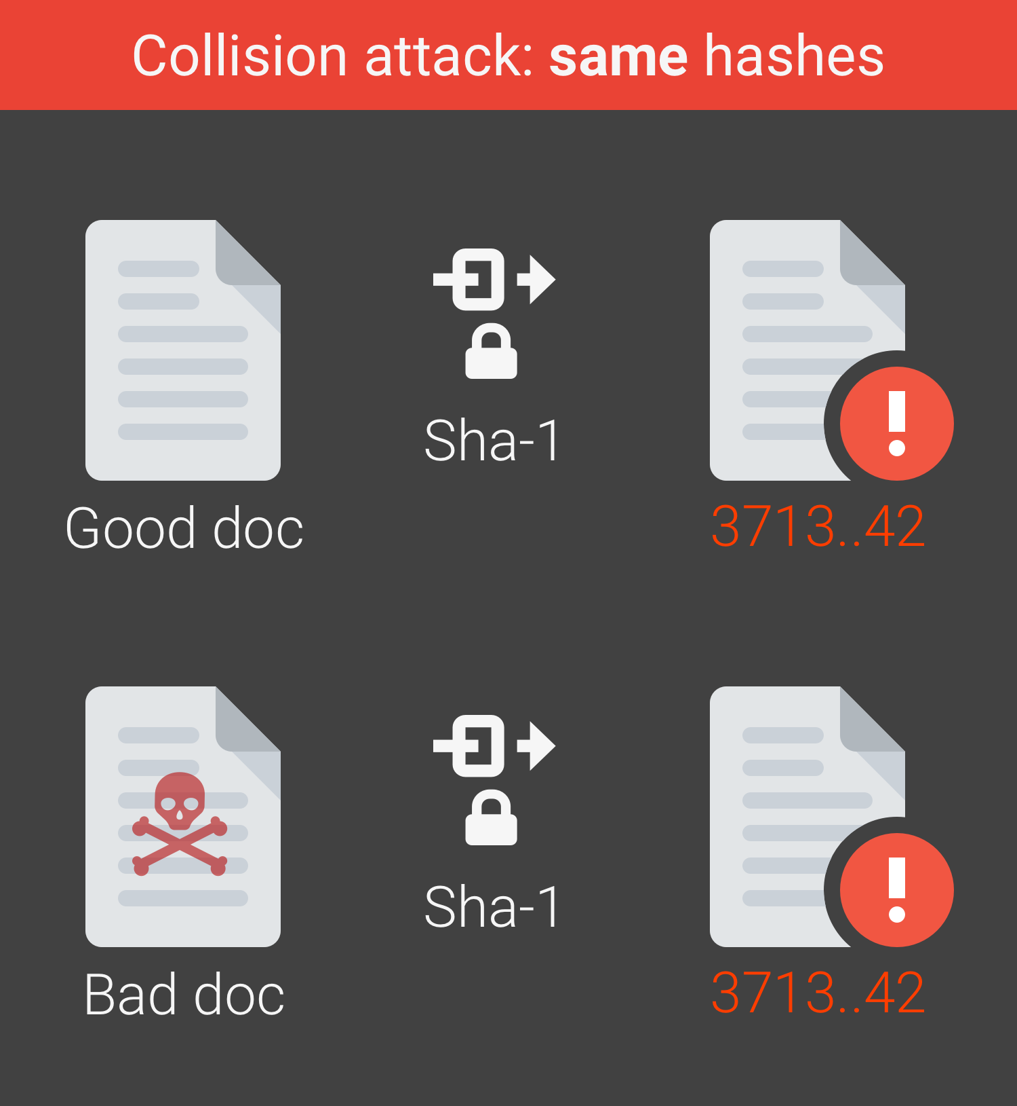
Full collision on SHA-1 by Stevens & Karpman from CWI, Bursztein, Albertini & Markov from Google, Feb. 2017.
Builds on freestart collision by Stevens, Karpman & Peyrin, 2015.
Required 2⁶³ SHA-1 computations, ≈ 6500 CPU-years + 100 GPU-years.
Allowed creation of pdf documents having colliding hash values.
Estimated cost of full collision attack on SHA-1: 100k-500k USD.
from https://shattered.it

Slide 36
SHA-2 family
SHA-256: similar in design to SHA-1, but now using 256-bit block cipher (SHACAL-2) in Davies-Meyer mode to build compression function.
  So, n = 256, k = 512.
  64 rounds, operating on 8 x 32-bit words using simple operations.
  About twice as slow as SHA-1 for long messages (see https://en.wikipedia.org/wiki/SHA-3#Comparison_of_SHA_functions).
  Lots of cryptanalysis since introduction in 2001, but no attack faster for collision finding than generic birthday attack (2¹²⁸) currently known.
SHA-224, SHA-384 and SHA-512 also available (but less widely deployed/used).

Slide 37
SHA-3
In 2007, NIST launched an AES-style competition to design new hash functions.
The closure of the call period was at the end of 2008.
63 submissions were received, 51 were selected for first round.
Two conferences to discuss candidates were held.
14 semi-finalists were selected for further analysis.
5 finalists were selected at the end of 2010.
Keccak* was announced as winner in 2012.
NIST standard finally published in 2015 (FIPS 202).
*pronounced “Ketchak”

Slide 38
SHA-3
Keccak was designed by industry-based researchers from STMicroelectronics and NXP, including Joan Daemen (AES co-designer).
Based on a new design approach (a “sponge” construction), unrelated to MD4, MD5, SHA-1, SHA-2 families.
  Uses a “giant bit permutation” as a key element in the construction.
  Permits variable length output.
  Has variable throughput, allowing efficiency/security trade-offs.
Chosen for elegance, security margins, performance and flexibility.
  Intended to complement, not replace, SHA-2: a back-up algorithm.
SHA3-256 a bit (10-15%) slower than SHA-256.

Slide 39


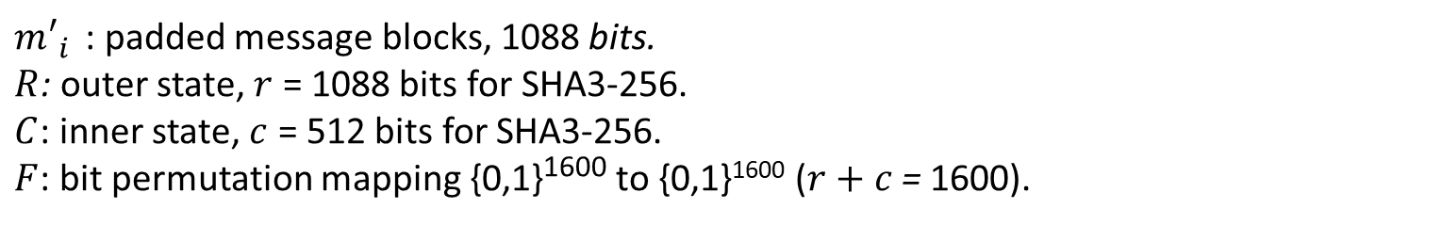

SHA3: Sponge construction – absorbing phase
$$m_{1}^{′}$$
$$m_{2}^{′}$$
$$m_{ℓ}^{′}$$
0^{r}
⊕
R
R
⊕
R
R
⊕
R
R
F
….
F
F
0^{c}
C
C
C
C
C
C
$m′_{i}$: padded message blocks, 1088 bits.
$R$: outer state, $r$ = 1088 bits for SHA3-256.
$C$: inner state, $c$ = 512 bits for SHA3-256.
$F$: bit permutation mapping {0,1}¹⁶⁰⁰ to {0,1}¹⁶⁰⁰ ($r+c$ = 1600).

Slide 40



SHA3: Sponge construction – squeezing phase
$$out1$$
$$out2$$
$$out3$$
R
R
R
…..
F
F
F
C
C
C
$$SHA−3(m) = out1 || out2 || out3…$$

Slide 41
Outline
Cryptographic hash functions
Generic attacks
Design paradigms
Application: password hashing

Slide 42
Password hashing

Slide 43


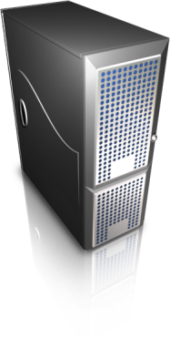
Password hashing
Setting: users want to remotely authenticate to server using password.
In naïve implementation: server has database with all passwords in clear.
Security threats?
Username | Password
Alice | password
Bob | 123456
… | …
username, password
access granted/denied

Slide 44
Password hashing
Threat: attacker breaks into the server and steals this database to impersonate users.
  This is a very realistic threat.
  Example: RockYou, Adobe, Experian,…
  http://www.informationisbeautiful.net/visualizations/worlds-biggest-data-breaches-hacks/
Solution: store only password hashes in database.
  For each user, store Hash(password) instead of password.
  Server now hashes received password and compares to table.
  Intuition: attacker has to reverse hash to recover the password.
Username | Password hashes
Alice | AB1134F3DF
Bob | A76642E3CD
… | …

Slide 45
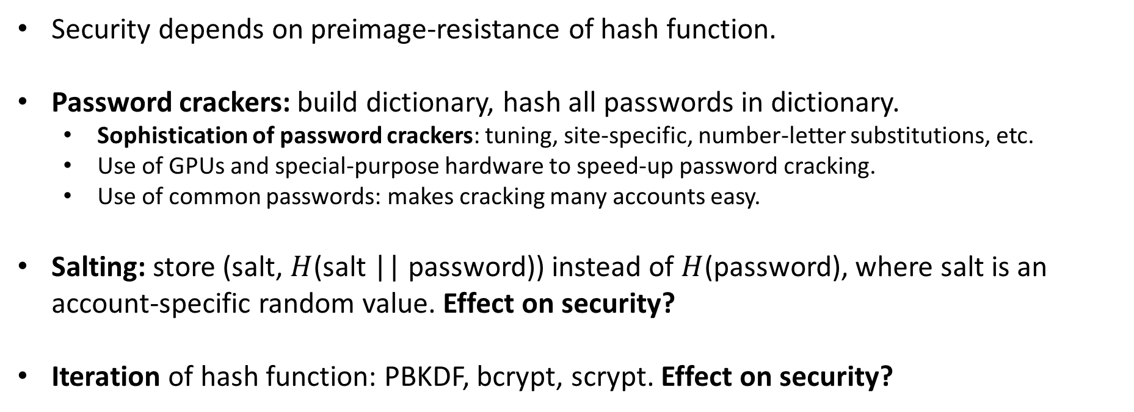
Password hashing: discussion points
Security depends on preimage-resistance of hash function.
Password crackers: build dictionary, hash all passwords in dictionary.
  Sophistication of password crackers: tuning, site-specific, number-letter substitutions, etc.
  Use of GPUs and special-purpose hardware to speed-up password cracking.
  Use of common passwords: makes cracking many accounts easy.
Salting: store (salt, $H$(salt || password)) instead of $H$(password), where salt is an account-specific random value. Effect on security?
Iteration of hash function: PBKDF, bcrypt, scrypt. Effect on security?

Slide 46
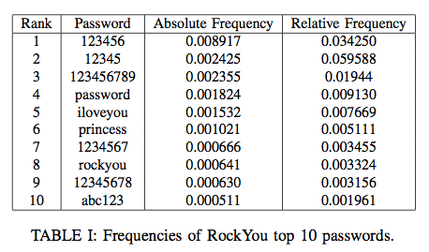
Common passwords in RockYou breach
23 million accounts, 14 million unique passwords
Absolute frequency: fraction amongst all accounts.
Relative frequency: fraction amongst passwords of the same length.
Note presence of site-specific passwords, e.g “rockyou” > 0.5%

Slide 47
Salting
Add a random, account-specific value, called a salt, in each hash calculation.
Each account has to be attacked individually (via password hashing).
Store the salt values as a field in the database of usernames and password hashes.
64 bits of salt is typical.
  Enough to prevent collisions in random choices of salt values (birthday bound again).
  Devalues pre-computation by an attacker.

Slide 48
Hash iteration
Slow down password cracking via dictionaries by iterating the hashing.
Choose an iteration method that makes parallelization of attacks hard.
Proposals:
  scrypt (RFC 7914)
  Argon2 (winner of the Password Hashing Competition, see https://password-hashing.net).
Obtain a trade-off between security and performance of authentication system.
  Think about Facebook scale operations.
Typical iteration count: 10,000.

Slide 49
Encryption instead of hashing?
Why not just encrypt the passwords?
  Server decrypts entry from database and compares to password sent by user.
Careful selection of encryption method
  (cf. Adobe’s use of ECB mode https://xkcd.com/1286/)
Careful key management.
  Key needs to be always available and yet heavily protected.
  Use special purpose Hardware Security Module (HSM) to store key.
  HSMs are expensive to buy, complex to manage.

Slide 50
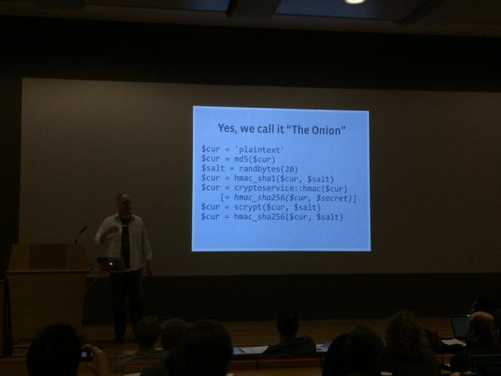
Facebook password onion
  Alec Muffet from Facebook explained their approach to password protection at IACR RWC 2015.
  Facebook have multiple layers of protection, mostly for legacy reasons.
  MD5 + HMAC_SHA1 + Encryption + scrypt + HMAC_SHA256!

Slide 51
Further reading
http://arstechnica.com/security/2013/05/how-crackers-make-minced-meat-out-of-your-passwords/
http://www.informationisbeautiful.net/visualizations/worlds-biggest-data-breaches-hacks/
https://en.wikipedia.org/wiki/PBKDF2
http://www.tarsnap.com/scrypt.html
https://password-hashing.net/

