Slide 1


Introduction to Symmetric-Key Cryptography (Part-2)
ACM India Summer School 2024 (Day 3, Session-1)
Sikhar Patranabis (IBM Research India)
sikhar.patranabis@ibm.com
https://research.ibm.com/people/sikhar-patranabis
IITB Trust Lab 4th June 2024

Slide 2
Outline
Block ciphers and PRPs/PRFs
Symmetric-key encryption (SKE)
SKE from PRF
SKE in practice: block cipher modes of operation
CRT mode yields IND-CPA-secure SKE: PRP-PRF switching lemma

Slide 3
Outline
Block ciphers and PRPs/PRFs
Symmetric-key encryption (SKE)
SKE from PRF
SKE in practice: block cipher modes of operation
CRT mode yields IND-CPA-secure SKE: PRP-PRF switching lemma

Slide 4
Block Ciphers and Pseudorandom Permutations

Slide 5


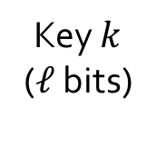
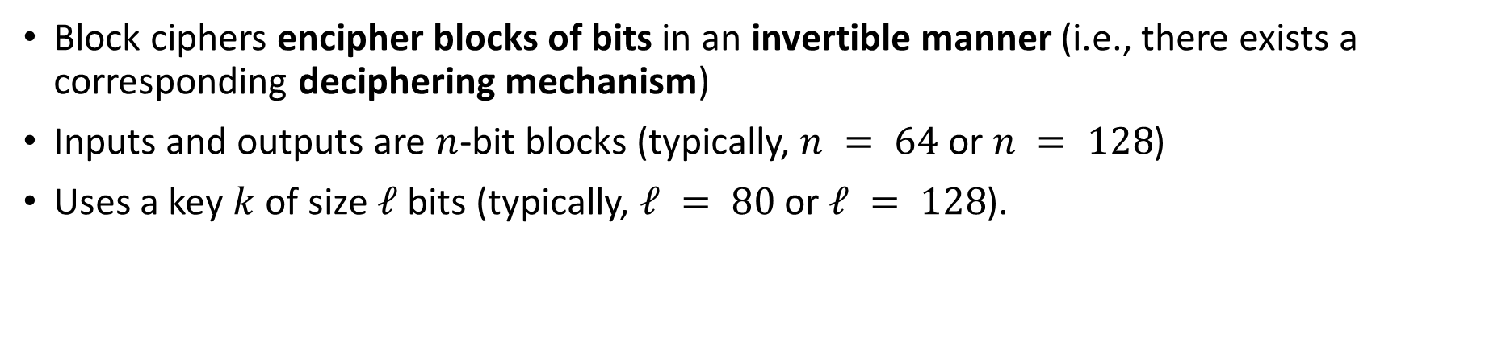


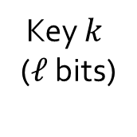
Block Ciphers
Block ciphers encipher blocks of bits in an invertible manner (i.e., there exists a corresponding deciphering mechanism)
Inputs and outputs are $n$-bit blocks (typically, $n = 64$ or $n = 128$)
Uses a key $k$ of size $ℓ$ bits (typically, $ℓ = 80$or $ℓ = 128$).
Input $P$ ($n$ bits)
Output $C$ ($n$ bits)
Key $k$
($ℓ$ bits)
Key $k$
($ℓ$ bits)
Block
cipher
Inverse
block cipher
Output $C$ ($n$ bits)
Input $P$ ($n$ bits)

Slide 6
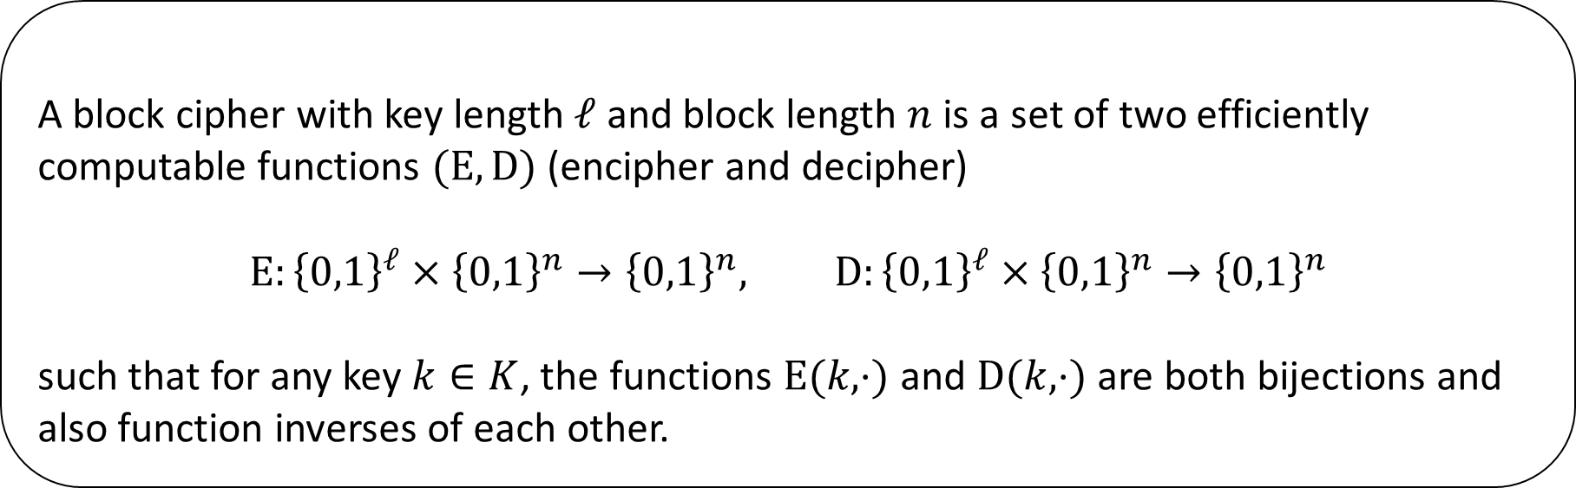
Defining a block cipher
Definition
A block cipher with key length $ℓ$ and block length $n$ is a set of two efficiently computable functions $(E,D)$ (encipher and decipher)
$$E:{\left\{0,1\right\}}^{ℓ}×{\left\{0,1\right\}}^{n}→{\left\{0,1\right\}}^{n}, D:{\left\{0,1\right\}}^{ℓ}×{\left\{0,1\right\}}^{n}→{\left\{0,1\right\}}^{n}$$
such that for any key $k∈K$, the functions $E(k,⋅)$ and $D(k,⋅)$are both bijections and also function inverses of each other.

Slide 7
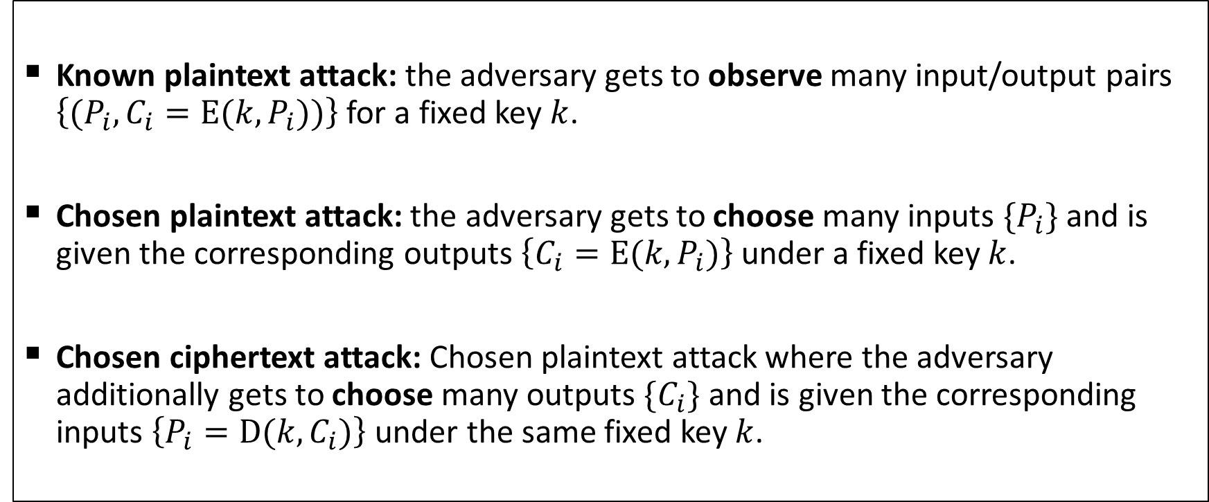
Security of a block cipher
Security against key-recovery attacks
Known plaintext attack: the adversary gets to observe many input/output pairs $\left\{(P_{i},C_{i}=E(k,P_{i}))\right\}$ for a fixed key $k$.
Chosen plaintext attack: the adversary gets to choose many inputs $\{P_{i}\}$ and is given the corresponding outputs $\left\{C_{i}=E(k,P_{i})\right\}$ under a fixed key $k$.
Chosen ciphertext attack: Chosen plaintext attack where the adversary additionally gets to choose many outputs $\{C_{i}\}$ and is given the corresponding inputs $\left\{P_{i}=D(k,C_{i})\right\}$ under the same fixed key $k$.

Slide 8
Security of a block cipher
How realistic are these attack models in practice?
Known plaintext attack is practical:
  Consider the IPSec protocol, where block ciphers are used as part of a larger protocol to encrypt IP datagrams and/or their payloads. A network adversary observes many output blocks, but also knows the inputs to certain blocks (many fields in IP/TCP/UDP packets are fixed).
Chosen plaintext attack is practical:
  Consider the TLS protocol, where block ciphers are used as part of a larger protocol to encrypt application layer data and transport it over TCP. An adversary can use remotely-delivered malicious JavaScript running in a victim’s browser to arrange for arbitrary input blocks to be enciphered, and then observe the corresponding output blocks.
Chosen ciphertext attack is practical:
  Back to the IPSec protocol, where the adversary can actually inject arbitrary IPSec packets containing chosen outputs, and then observe the deciphered inputs in some special cases (e.g., ICMP error messages may carry the deciphered inputs).

Slide 9
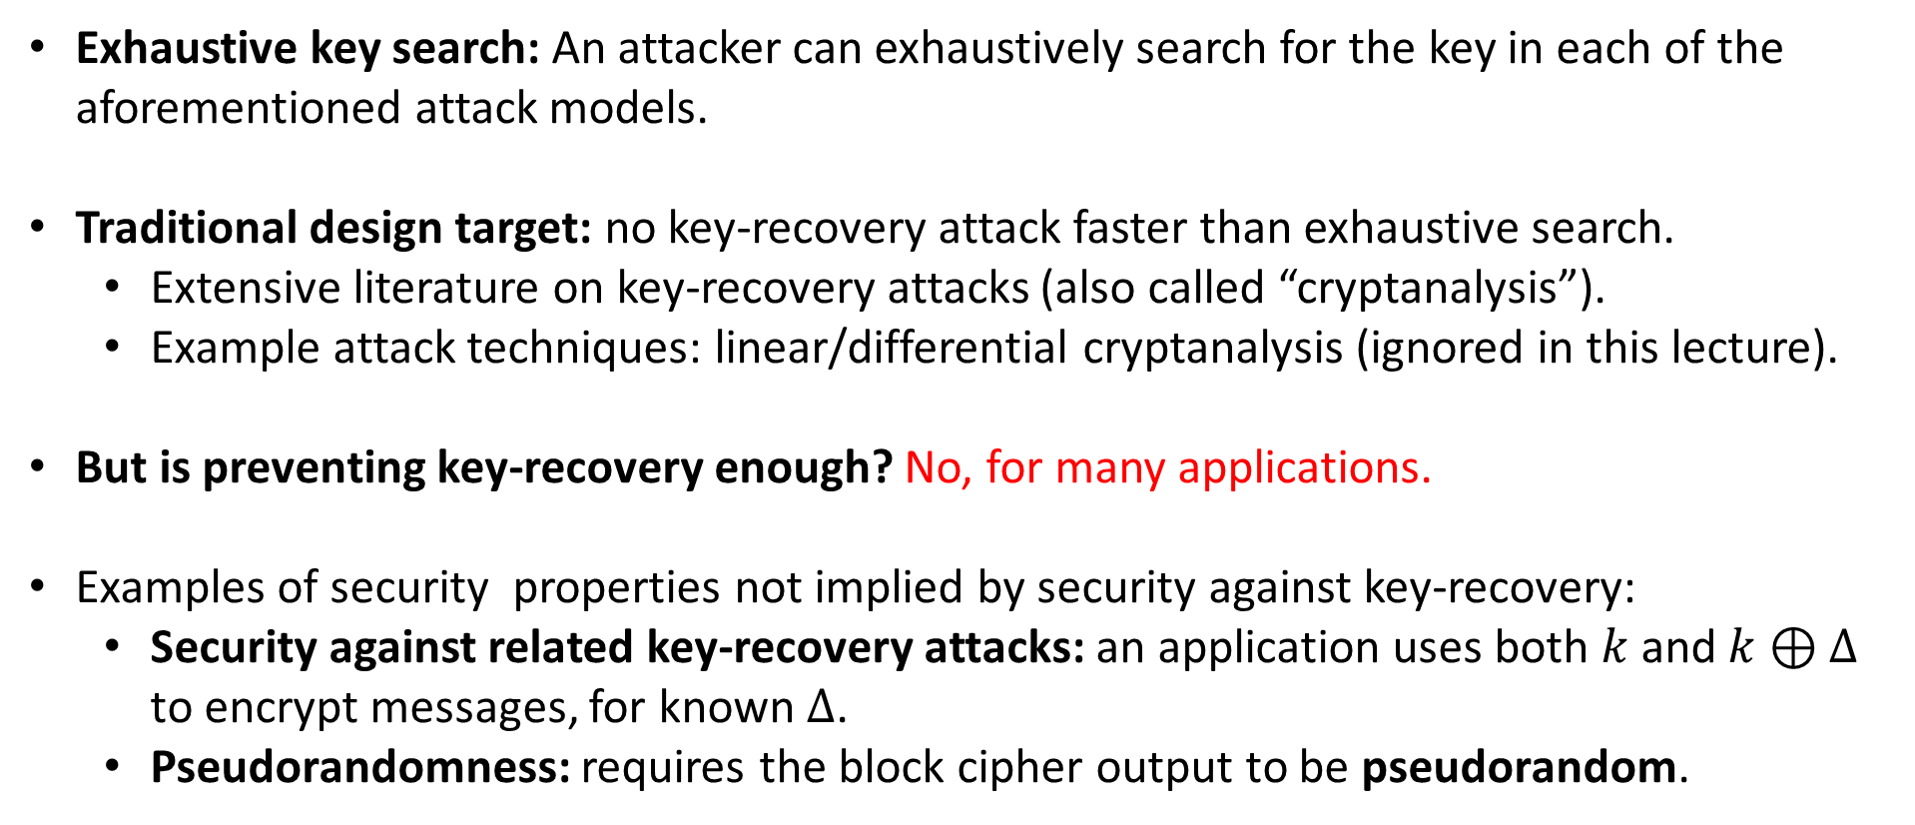
Security of a block cipher
Exhaustive key search: An attacker can exhaustively search for the key in each of the aforementioned attack models.
Traditional design target: no key-recovery attack faster than exhaustive search.
  Extensive literature on key-recovery attacks (also called “cryptanalysis”).
  Example attack techniques: linear/differential cryptanalysis (ignored in this lecture).
But is preventing key-recovery enough? No, for many applications.
Examples of security properties not implied by security against key-recovery:
  Security against related key-recovery attacks: an application uses both $k$ and $k⊕Δ$ to encrypt messages, for known $Δ$.
  Pseudorandomness: requires the block cipher output to be pseudorandom.

Slide 10
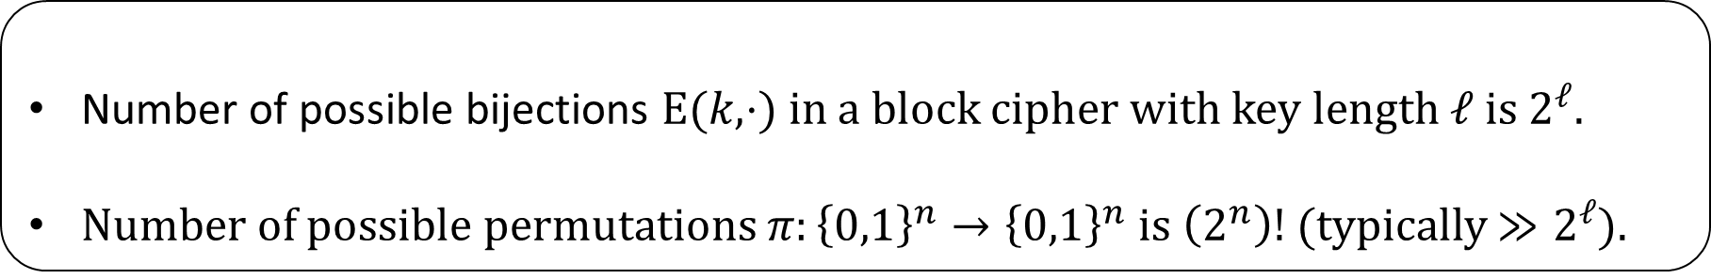
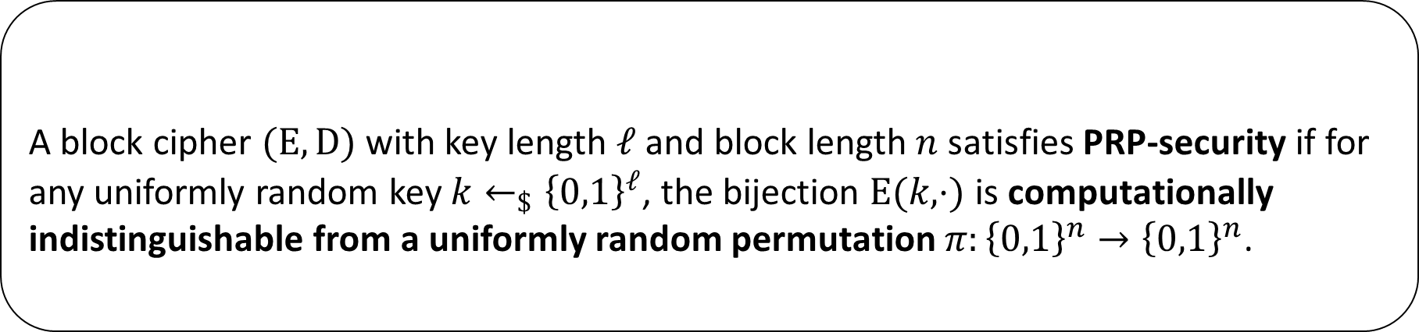
Pseudorandom Permutation (PRP)-security of a block cipher
Definition (informal)
A block cipher $(E,D)$ with key length $ℓ$ and block length $n$ satisfies PRP-security if for any uniformly random key $k←_{\$}{\left\{0,1\right\}}^{ℓ}$, the bijection $E(k,⋅)$ is computationally indistinguishable from a uniformly random permutation $π:{\left\{0,1\right\}}^{n}→{\left\{0,1\right\}}^{n}$.
Some observations
Number of possible bijections $E(k,⋅)$ in a block cipher with key length $ℓ$ is $2^{ℓ}$.
Number of possible permutations $π:{\left\{0,1\right\}}^{n}→{\left\{0,1\right\}}^{n}$ is $\left(2^{n}\right)!$ (typically $≫2^{ℓ}$).

Slide 11




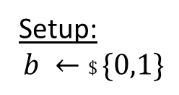
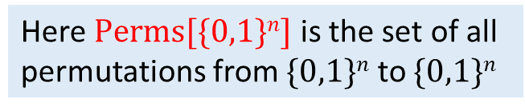

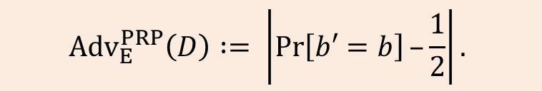

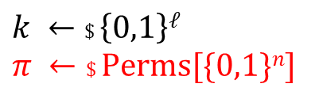

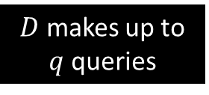


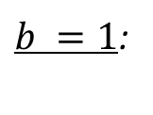

PRP-security of a block cipher
Setup:
$$b ←\$ \{0,1\}$$
Here $Perms[\{0,1\}n]$ is the set of all permutations from $\{0,1\}n$ to $\{0,1\}n$
$$k ←\$ \left\{0,1\right\}ℓ$$
$$π ←\$ Perms[\{0,1\}n]$$
$b =0$:
Distinguisher $D$
$$x1$$
$$yi =E(k,xi)$$
$$y1$$
$$x2$$
$$y2$$
$b =1$:
$$yi = π(xi)$$
$$b′$$
$D$ makes up to $q$ queries
$${Adv}_{E}^{PRP}\left(D\right) := \left|\operatorname{Pr}\left[b′=b\right]–\frac{1}{2}\right|.$$

Slide 12
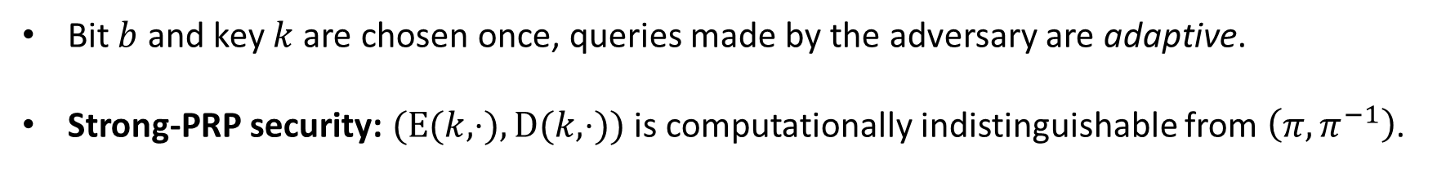
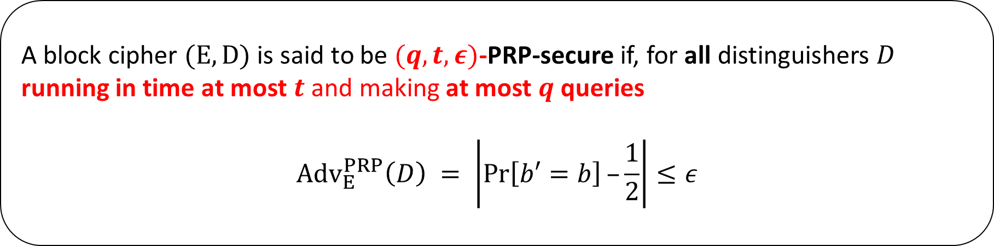
PRP-security of a block cipher
Definition (concrete)
A block cipher $(E,D)$ is said to be $(q,t,ε)$-PRP-secure if, for all distinguishers $D$ running in time at most $t$ and making at most $q$ queries
$${Adv}_{E}^{PRP}\left(D\right) = \left|\operatorname{Pr}\left[b′=b\right]–\frac{1}{2}\right|≤ε$$
Bit $b$ and key $k$ are chosen once, queries made by the adversary are adaptive.
Strong-PRP security: $(E(k,⋅),D(k,⋅))$ is computationally indistinguishable from $\left(π,π^{−1}\right)$.

Slide 13
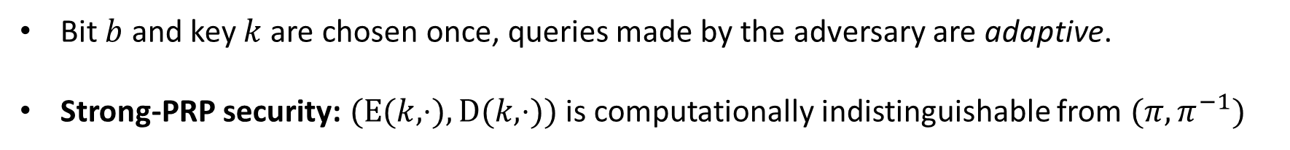
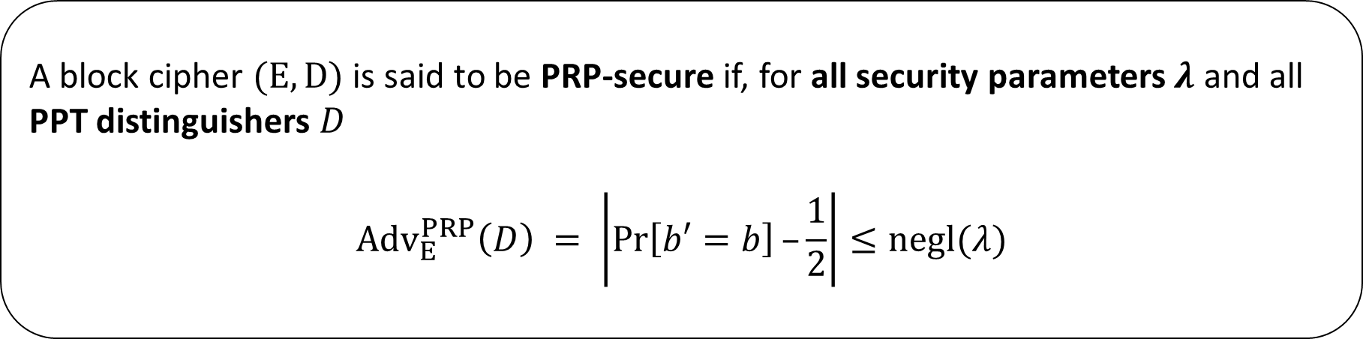
PRP-security of a block cipher
Definition (asymptotic)
A block cipher $(E,D)$ is said to be PRP-secure if, for all security parameters $λ$ and all PPT distinguishers $D$
$${Adv}_{E}^{PRP}\left(D\right) = \left|\operatorname{Pr}\left[b′=b\right]–\frac{1}{2}\right|≤negl(λ)$$
Bit $b$ and key $k$ are chosen once, queries made by the adversary are adaptive.
Strong-PRP security: $(E(k,⋅),D(k,⋅))$ is computationally indistinguishable from $(π,π^{−1})$

Slide 14
Quick detour: PRP vs PRF

Slide 15
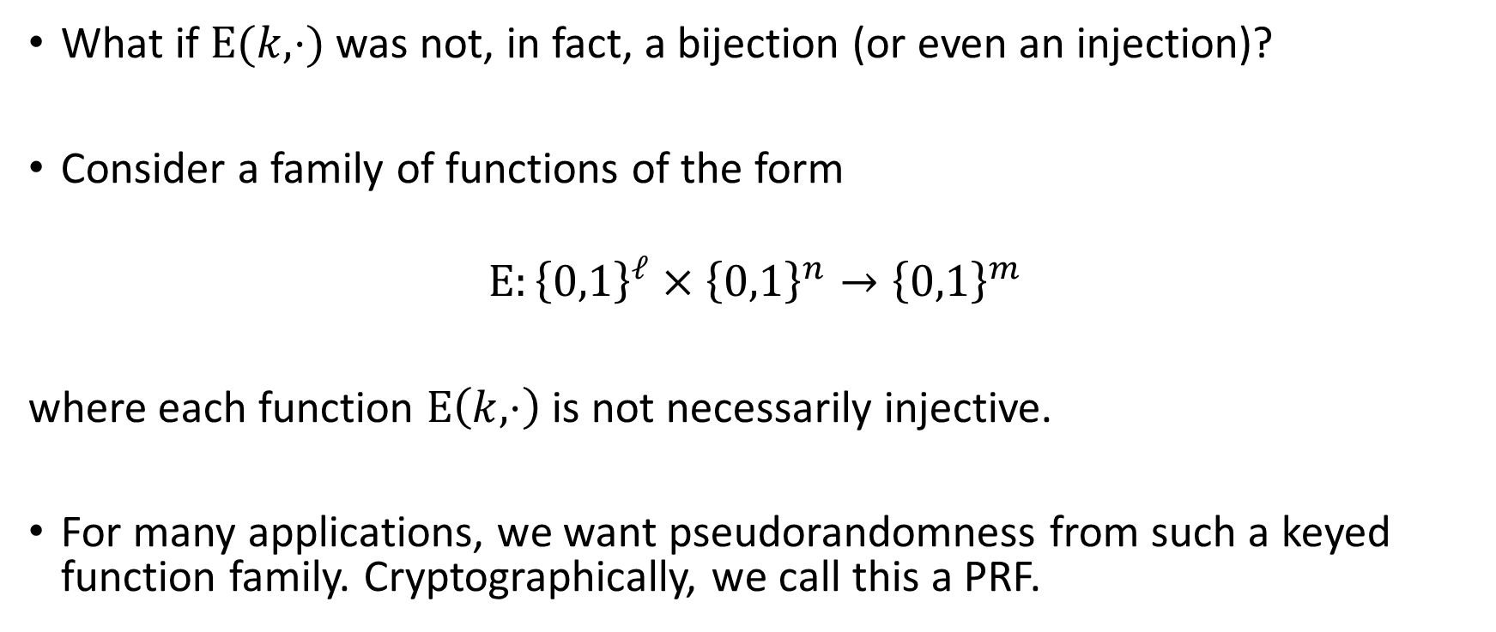
Pseudorandom Function (PRF)
What if $E(k,⋅)$ was not, in fact, a bijection (or even an injection)?
Consider a family of functions of the form
$$E:{\left\{0,1\right\}}^{ℓ}×{\left\{0,1\right\}}^{n}→{\left\{0,1\right\}}^{m}$$
where each function $E\left(k,⋅\right)$ is not necessarily injective.
For many applications, we want pseudorandomness from such a keyed function family. Cryptographically, we call this a PRF.

Slide 16
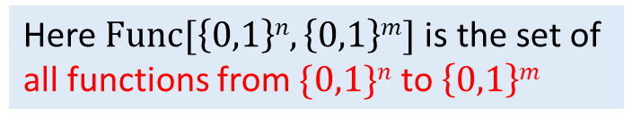
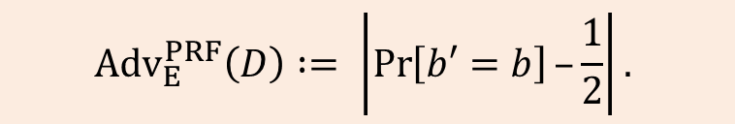
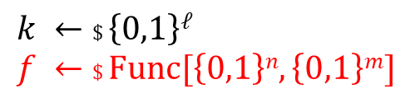

PRF-security
Setup:
$$b ←\$ \{0,1\}$$
Here $Func[\left\{0,1\right\}n,\left\{0,1\right\}m]$is the set of all functions from $\{0,1\}n$ to $\left\{0,1\right\}m$
$$k ←\$ \left\{0,1\right\}ℓ$$
$$f ←\$ Func[\left\{0,1\right\}n,\left\{0,1\right\}m]$$
$b =0$:
Distinguisher $D$
$$x1$$
$$yi =E(k,xi)$$
$$y1$$
$$x2$$
$$y2$$
$b =1$:
$$yi =f(x_{i})$$
$$b′$$
$D$ makes up to $q$ queries
$${Adv}_{E}^{PRF}\left(D\right) := \left|\operatorname{Pr}\left[b′=b\right]–\frac{1}{2}\right|.$$

Slide 17
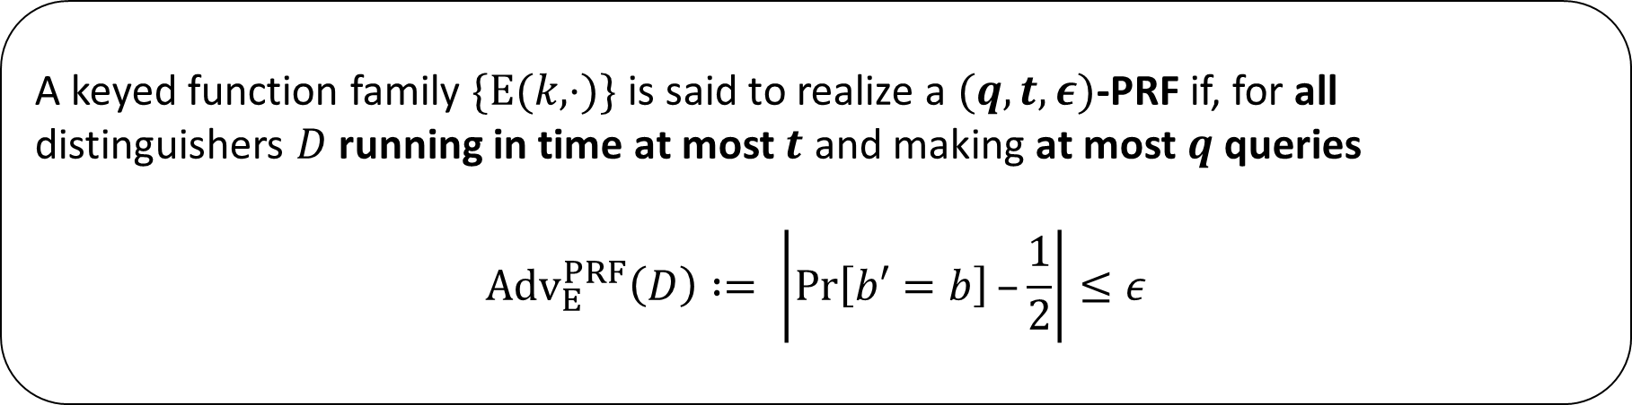
PRF-security of a keyed function family
Definition (concrete)
A keyed function family $\{E(k,⋅)\}$ is said to realize a $(q,t,ε)$-PRF if, for all distinguishers $D$ running in time at most $t$ and making at most $q$ queries
$${Adv}_{E}^{PRF}\left(D\right) := \left|\operatorname{Pr}\left[b′=b\right]–\frac{1}{2}\right|≤ε$$

Slide 18
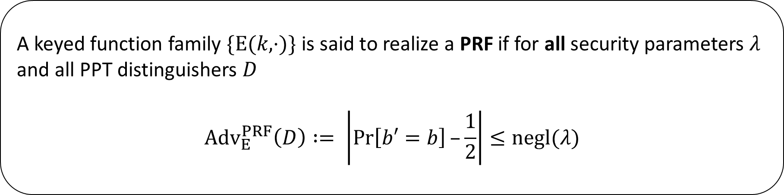
PRF-security of a keyed function family
Definition (asymptotic)
A keyed function family $\{E(k,⋅)\}$ is said to realize a PRF if for all security parameters $λ$ and all PPT distinguishers $D$
$${Adv}_{E}^{PRF}\left(D\right) := \left|\operatorname{Pr}\left[b′=b\right]–\frac{1}{2}\right|≤negl(λ)$$

Slide 19
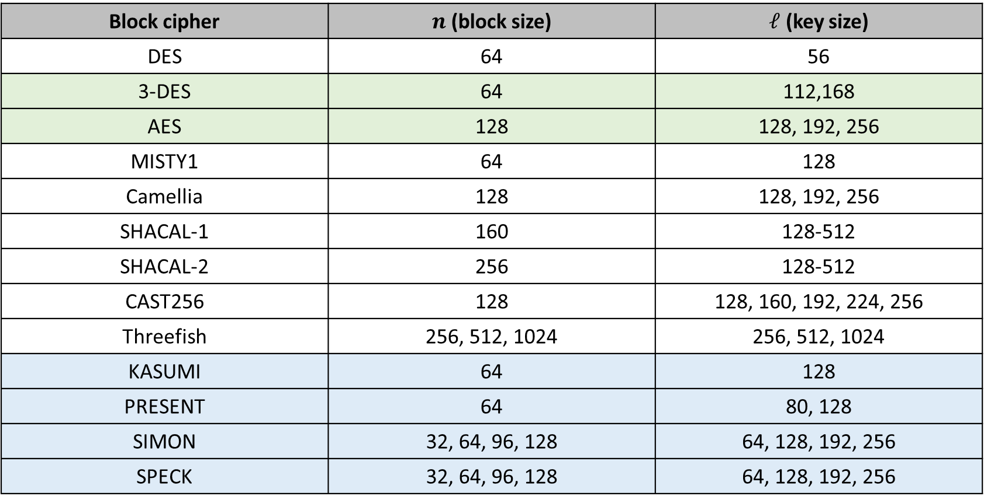
Existing block ciphers are only heuristically (strong-)PRP-secure
Block cipher | $n$ (block size) | $ℓ$ (key size)
DES | 64 | 56
3-DES | 64 | 112,168
AES | 128 | 128, 192, 256
MISTY1 | 64 | 128
Camellia | 128 | 128, 192, 256
SHACAL-1 | 160 | 128-512
SHACAL-2 | 256 | 128-512
CAST256 | 128 | 128, 160, 192, 224, 256
Threefish | 256, 512, 1024 | 256, 512, 1024
KASUMI | 64 | 128
PRESENT | 64 | 80, 128
SIMON | 32, 64, 96, 128 | 64, 128, 192, 256
SPECK | 32, 64, 96, 128 | 64, 128, 192, 256

Slide 20
Standards for block ciphers
NIST (US National Institute for Standards and Technology):
AES, 3-DES, Skipjack
NESSIE (New European Schemes for Signatures, Integrity and Encryption, EU project):
AES, MISTY1, Camellia, SHACAL-2
Cryptrec (Japan):
AES, 3DES, Camellia

Slide 21
Block cipher construction methods
There are a few very popular construction paradigms for block ciphers.
Iteration of a simpler, keyed round function is almost universal.
  Gain cryptographic strength through iteration – more rounds = stronger algorithm/
  Try to trade off speed and security.
Feistel cipher: splits block into two halves of n/2 bits each, and uses a particular method for operating on the halves to build the round function.
  Example: DES
Substitution-Permutation network: each round function is built from a substitution step followed by a permutation step.
  Directly implements Shannon’s confusion and diffusion principles.
  Example: AES

Slide 22
Block cipher example-1: Data Encryption Standard (DES)
DES has existed for more than 40 years.
Very widely used block cipher.
  3-DES variant (very popularly used in the financial sector).
DES is essentially unbroken.
  But DES exhaustive key search (k=56) has become feasible.
  And DES block size (n=64) is too small for comfort in many applications (e.g. https://sweet32.info/).
However, DES techniques have served as the basis for many other block ciphers.

Slide 23
Birth of DES
May 1973: NBS Call for proposals
  NBS: National Bureau of Standards (→ NIST).
  Results disappointing.
August 1974: Second call for proposals
  IBM submission based on Lucifer, lead designer Horst Feistel.
March 1975: Algorithm published.
August 1976: Draft standard published.
January 1977: FIPS 46 published.
As a US government Federal standard, DES then became very widely used.
A de facto global standard.

Slide 24
History of DES
DES was re-affirmed as US federal standard.
  1988 as FIPS 46-1, 1993 as FIPS 46-2, 1999 as FIPS 46-3.
  https://csrc.nist.gov/csrc/media/publications/fips/46/3/archive/1999-10-25/documents/fips46-3.pdf
Withdrawal of DES
  1988 NSA withdraws endorsement of DES.
  1998 DES was not re-affirmed by NIST.
  2004 withdrawn by NIST.
DES incorporated into other standards.
  ANSI X3.92 and ISO 10126-2.
  DES called Data Encryption Algorithm (DEA).

Slide 25
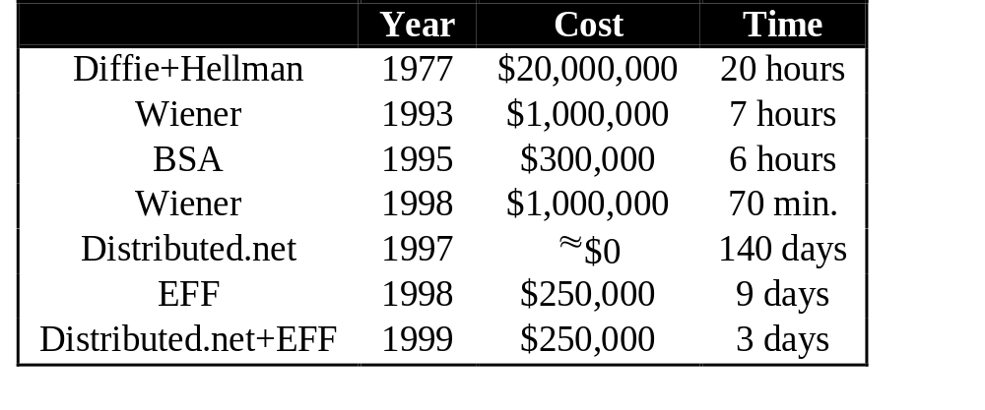
Cryptanalysis of DES
Many specific attacks on DES and weaknesses in DES have been found.
But the main issue from the very start was the small key size: 56 bits.
Not enough security, even in the 1970s.
Exhaustive key search requires, on average 2⁵⁵ block cipher operations.
Estimated costs of exhaustive key search have decreased over time:

Slide 26
DES cracker
Eventually, the Electronic Frontier Foundation (EFF) built a DES cracker to implement exhaustive key search.
  37,000 specially designed search units.
  Development cost estimate in 1993 was $500,000.
  DES cracker tests around 92 × 10⁹ keys/sec.
1999 DES search effort using DES cracker:
  Combined effort for the 1999 effort tested keys at the rate of 245 × 10⁹ keys/sec.
  Around (245-92)/245 = 62% of computational effort came from the Internet.
Today?
  My laptop can ”only” do about 2^{23.3} DES encryptions per second, so 108 years for an exhaustive search on average.
  This reflects DES’s general unsuitability for software.
  Use FPGAs, crack keys in a few hours for a few k$ of hardware.
  Professional services are available…

Slide 27

DES cracking for fun and profit

Slide 28
The AES Process
A multi-year competition to search for a DES replacement was run by the US agency NIST, starting in 1998.
  The Advanced Encryption Standard (AES), to offer tangible enhancements over DES.
Provision of a single block cipher.
Available royalty-free worldwide.
Public and flexible design.
At least as secure and fast as two-key triple DES.
Fifteen submissions resulted in five finalists.
  Mars, RC6, Rijndael, Serpent, and Twofish.
  Rijndael chosen as the AES in 2000.
  AES published as FIPS 197 in November 2001.
  Modes of operation then published (next lecture).

Slide 29
AES Security
NSA reviewed AES
Approved for SECRET with any key length
Approved for TOP SECRET with 192 or 256 bit keys.
Cryptanalysis
AES has been subject to intense cryptanalysis.
Several attacks in related key setting or against reduced-round variants.
First key recovery attack in 2011: workload of 2^{126.1} against 128-bit key version.
Side-channel and fault-injection analysis
AES implementations have been rigorously analyzed for implementation-level vulnerabilities.
Bernstein (2005): remote timing analysis against AES implementation in OpenSSL
Tunstall-Ali-Mukhopadhyay (2011): differential fault analysis of AES with a single-fault injection
Subject of much ongoing research

Slide 30
AES Summary
AES design is very elegant.
  General performance profile is very good. Good performance in hardware.
  Very widely deployed in applications. There are numerous software and hardware implementations, including for low-cost, low-power environments such as RFID.
    AES instructions on modern Intel and AMD CPUs give impressive throughput with pipelining, becoming more common on ARM CPUs since ARMv8.
    No significant direct attacks known, but implementations may be vulnerable to side-channel attacks.

Slide 31
Outline
Block ciphers and PRPs/PRFs
Symmetric-key encryption (SKE)
SKE from PRF
SKE in practice: block cipher modes of operation
CRT mode yields IND-CPA-secure SKE: PRP-PRF switching lemma

Slide 32
Symmetric-Key Encryption

Slide 33
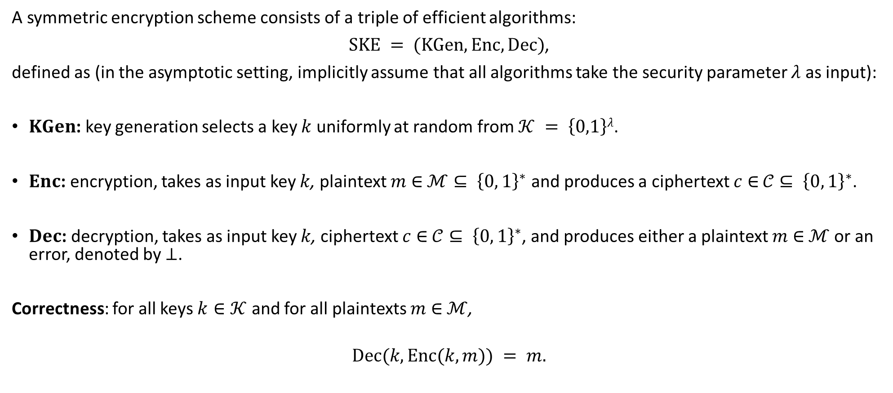
Formalizing Symmetric-Key Encryption (SKE)
A symmetric encryption scheme consists of a triple of efficient algorithms:
$SKE = (KGen, Enc, Dec)$,
defined as (in the asymptotic setting, implicitly assume that all algorithms take the security parameter $λ$ as input):
$KGen$: key generation selects a key $k$ uniformly at random from $𝒦 = \left\{0,1\right\}λ$.
$Enc$: encryption, takes as input key $k$, plaintext $m$ ∈ $ℳ⊆ {\left\{0, 1\right\}}^{∗}$ and produces a ciphertext $c$ ∈ $𝒞⊆ {\left\{0, 1\right\}}^{∗}$.
$Dec$: decryption, takes as input key $k$, ciphertext $c$ ∈ $𝒞⊆ {\left\{0, 1\right\}}^{∗}$, and produces either a plaintext $m$ ∈ $ℳ$or an error, denoted by $⊥$.
Correctness: for all keys $k∈𝒦$ and for all plaintexts $m$ ∈ $ℳ$,
$$Dec(k,Enc(k,m)) = m.$$

Slide 34
What kind of security do we want from SKE?
Minimum requirement: Security against key recovery attacks.
Reasonable requirement: Security against message recovery attacks.
Strongest requirement: every bit of the plaintext is hidden.

Slide 35





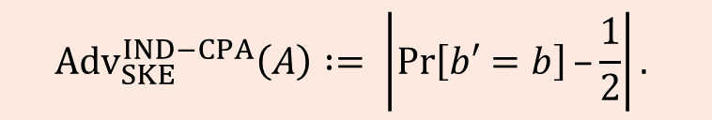



IND-CPA security for Symmetric Encryption
IND-CPA (ciphertext INDistinguishability under Chosen Plaintext Attacks)
Adversary $A$
Challenger
$$b ←\$\{0,1\}$$
$$k ← KGen$$
$$(m0 ,m1)$$
LoR oracle
$$c$$
$$c = Enc(k,mb)$$
$A$ makes up to $q$ queries
$$b′$$
$${Adv}_{SKE}^{IND−CPA}\left(A\right) := \left|\operatorname{Pr}\left[b′=b\right]–\frac{1}{2}\right|.$$

Slide 36
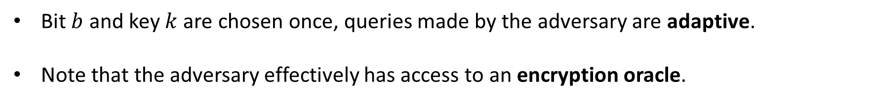
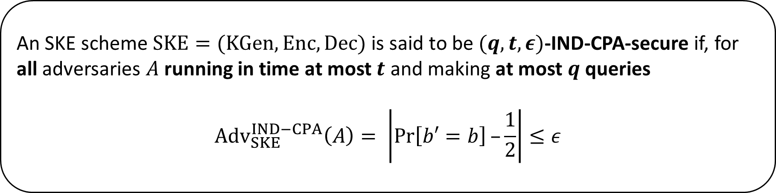
IND-CPA-security of SKE
Definition (concrete)
An SKE scheme $SKE=(KGen,Enc,Dec)$ is said to be $(q,t,ε)$-IND-CPA-secure if, for all adversaries $A$ running in time at most $t$ and making at most $q$ queries
$${Adv}_{SKE}^{IND−CPA}\left(A\right)= \left|\operatorname{Pr}\left[b′=b\right]–\frac{1}{2}\right|≤ε$$
Bit $b$ and key $k$ are chosen once, queries made by the adversary are adaptive.
Note that the adversary effectively has access to an encryption oracle.

Slide 37
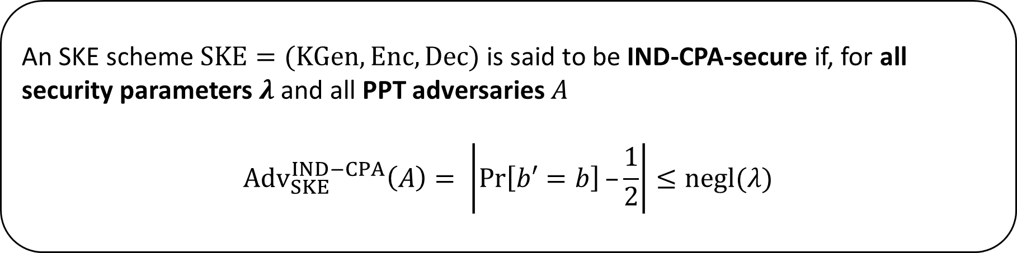
IND-CPA-security of SKE
Definition (asymptotic)
An SKE scheme $SKE=(KGen,Enc,Dec)$ is said to be IND-CPA-secure if, for all security parameters $λ$ and all PPT adversaries $A$
$${Adv}_{SKE}^{IND−CPA}\left(A\right)= \left|\operatorname{Pr}\left[b′=b\right]–\frac{1}{2}\right|≤negl(λ)$$
Bit $b$ and key $k$ are chosen once, queries made by the adversary are adaptive.
Note that the adversary effectively has access to an encryption oracle.

Slide 38
Quick mental exercises
IND-CPA security captures key recovery attacks.
IND-CPA security captures message recovery attacks.
IND-CPA security ensures that every bit of the plaintext is hidden.
Are deterministic encryption schemes IND-CPA secure?

Slide 39
But IND-CPA security is not always enough…
IND-CPA guarantees nothing when the messages in a pair do not have equal length.
Ciphertext length often leaks information about plaintext length.
Can be fatal in real-world applications.
Addressed various forms of padding, traffic shaping, etc.
The definition says nothing about integrity.
The definition does not give the adversary access to any kind of decryption capability: no chosen ciphertext attacks are modelled.
We will consider stronger definitions later.

Slide 40
Outline
Block ciphers and PRPs/PRFs
Symmetric-key encryption (SKE)
SKE from PRF
SKE in practice: block cipher modes of operation
CRT mode yields IND-CPA-secure SKE: PRP-PRF switching lemma

Slide 41
Realizing SKE from PRF

Slide 42
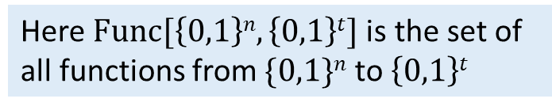
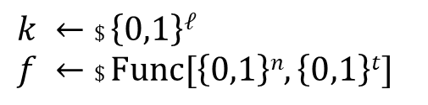
Quick recap: PRF-security
Setup:
$$b ←\$ \{0,1\}$$
Here $Func[\left\{0,1\right\}n,\left\{0,1\right\}t]$is the set of all functions from $\{0,1\}n$ to $\left\{0,1\right\}t$
$$k ←\$ \left\{0,1\right\}ℓ$$
$$f ←\$ Func[\left\{0,1\right\}n,\left\{0,1\right\}t]$$
$b =0$:
Distinguisher $D$
$$x1$$
$$yi =E(k,xi)$$
$$y1$$
$$x2$$
$$y2$$
$b =1$:
$$yi =f(x_{i})$$
$$b′$$
$D$ makes up to $q$ queries
$${Adv}_{E}^{PRP}\left(D\right) := \left|\operatorname{Pr}\left[b′=b\right]–\frac{1}{2}\right|.$$

Slide 43
Quick recap: PRF-security
Definition (concrete)
A keyed function family $\{E(k,⋅)\}$ is said to realize a $(q,t,ε)$-PRF if, for all distinguishers $D$ running in time at most $t$ and making at most $q$ queries
$${Adv}_{E}^{PRF}\left(D\right) := \left|\operatorname{Pr}\left[b′=b\right]–\frac{1}{2}\right|≤ε$$

Slide 44
Quick recap: PRF-security
Definition (asymptotic)
A keyed function family $\{E(k,⋅)\}$ is said to realize a PRF if for all security parameters $λ$ and all PPT distinguishers $D$
$${Adv}_{E}^{PRF}\left(D\right) := \left|\operatorname{Pr}\left[b′=b\right]–\frac{1}{2}\right|≤negl(λ)$$

Slide 45
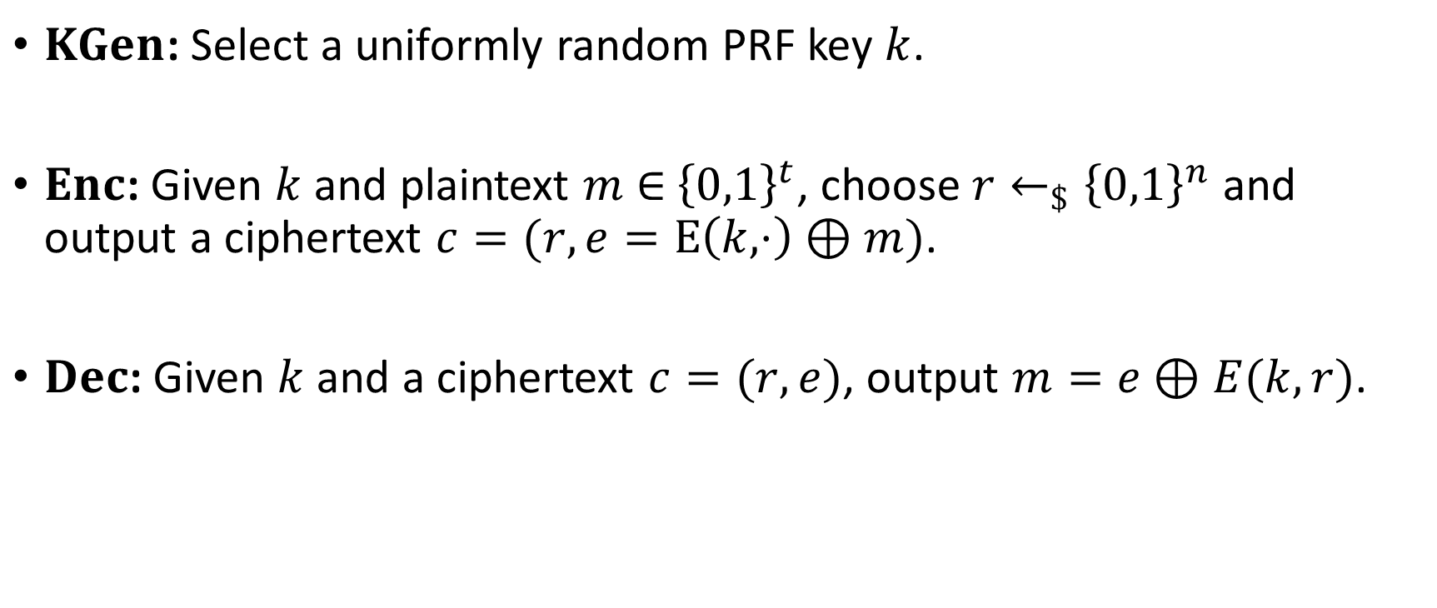

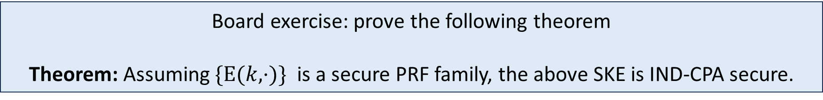
SKE from PRF family $\{E(k,⋅)\}$
$KGen$: Select a uniformly random PRF key $k$.
$Enc$: Given $k$ and plaintext $m$ ∈ ${\left\{0,1\right\}}^{t}$, choose $r←_{\$}{\left\{0,1\right\}}^{n}$ and output a ciphertext $c=(r,e=E\left(k,⋅\right)⊕m)$.
$Dec$: Given $k$ and a ciphertext $c=(r,e)$, output $m=e⊕E(k,r)$.
Board exercise: prove the following theorem
Theorem: Assuming $\{E(k,⋅)\}$ is a secure PRF family, the above SKE is IND-CPA secure.

Slide 46
Outline
Block ciphers and PRPs/PRFs
Symmetric-key encryption (SKE)
SKE from PRF
SKE in practice: block cipher modes of operation
CRT mode yields IND-CPA-secure SKE: PRP-PRF switching lemma

Slide 47
SKE in practice: return to block ciphers

Slide 48
Motivation for modes of operation
A block cipher enciphers a message of exactly n bits.
  How do we encrypt if the message is not a multiple of n bits?
  What if the message is not of a fixed length but actually a TCP-like stream?
Modes of operation
  Allow using a block cipher to encrypt flexible amounts of data.
  Different performance characteristics.
  Different error-propagation properties.
  Different suitability for different applications.

Slide 49
Main modes of operation
NIST SP 800-38A specifies 5 modes
  ECB - Electronic Code Book.
  CBC - Cipher Block Chaining.
  CFB - Cipher Feedback.
  OFB - Output Feedback.
  CTR – Counter Mode.
NIST SP 800-38C and NIST SP 800-38D
  Authenticated Encryption modes: AES-CCM and AES-GCM.
Most common modes now in use: CBC mode, CTR mode, AES-GCM.
Details: https://csrc.nist.gov/projects/block-cipher-techniques/bcm/current-modes

Slide 50
ECB mode

Slide 51



Electronic Code Book (ECB)
ECB is the simplest way to use a block cipher to encrypt longer messages.
Split message into blocks, may need to pad last block.
Encryption can be parallelized.
Localizes effect of error in a ciphertext block.
$$E\left(k,⋅\right)$$
$$E\left(k,⋅\right)$$
….
$$E\left(k,⋅\right)$$

Slide 52
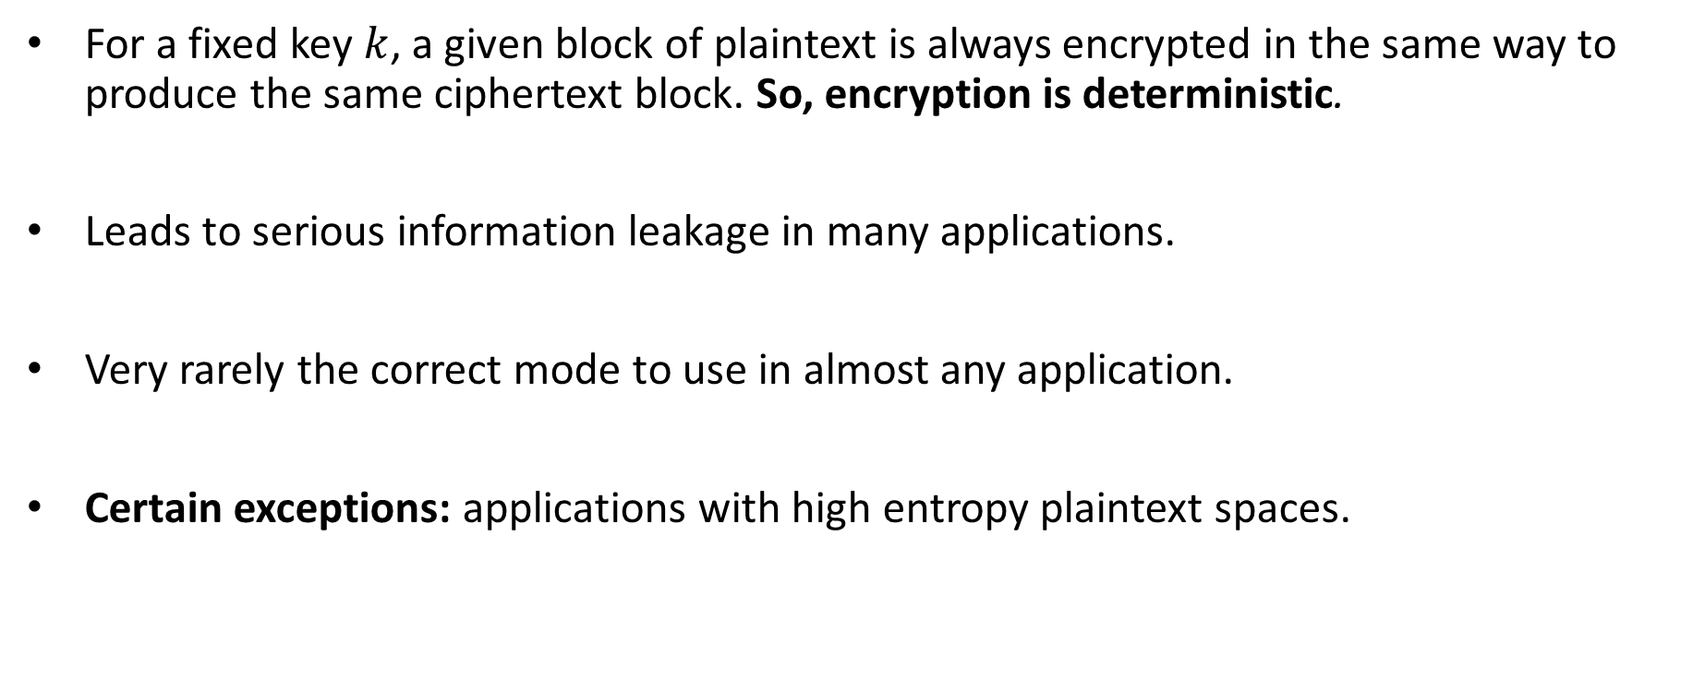
ECB information leakage
For a fixed key $k$, a given block of plaintext is always encrypted in the same way to produce the same ciphertext block. So, encryption is deterministic.
Leads to serious information leakage in many applications.
Very rarely the correct mode to use in almost any application.
Certain exceptions: applications with high entropy plaintext spaces.

Slide 53
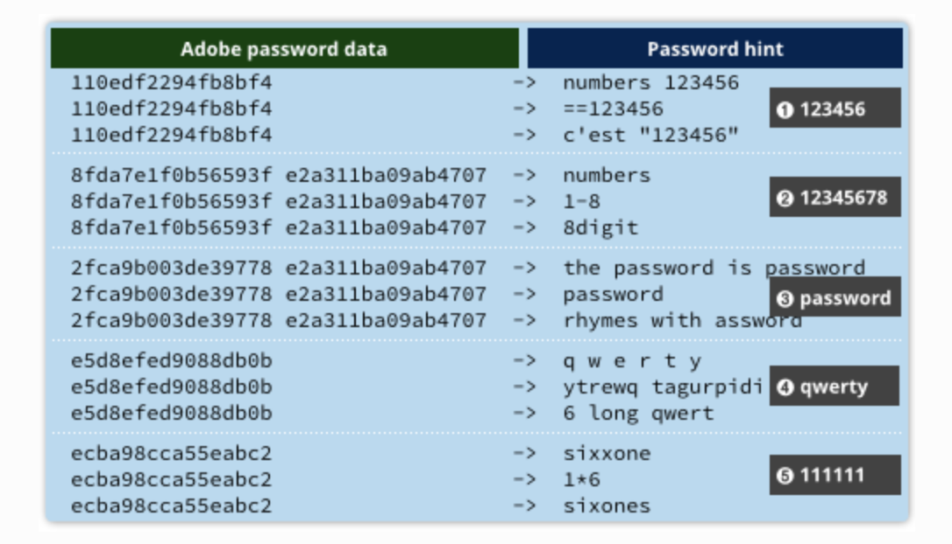
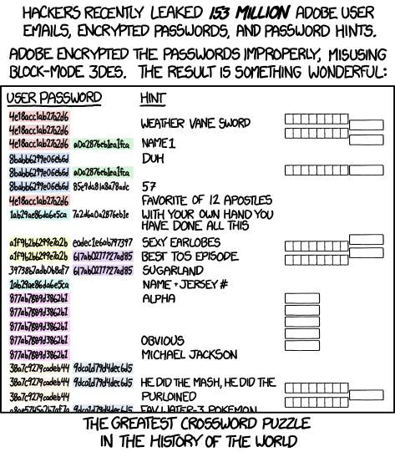
ECB information leakage
Sources:
https://xkcd.com/1286/
https://nakedsecurity.sophos.com/2013/11/04/anatomy-of-a-password-disaster-adobes-giant-sized-cryptographic-blunder/

Slide 54


ECB information leakage
DON’T USE ECB
Tux the Penguin, the Linux mascot. Created in 1996 by Larry Ewing with The GIMP. lewing@isc.tamu.edu
ECB-Tux

Slide 55
CBC mode

Slide 56
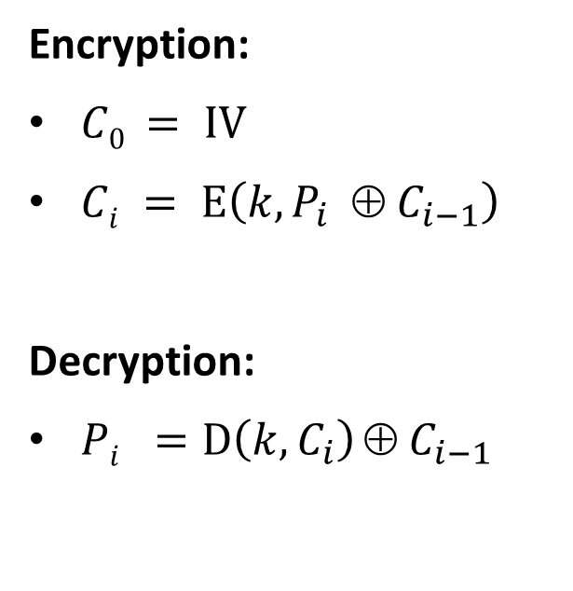









Cipher Block Chaining (CBC) mode
Encryption
Decryption
Encryption:
$C0 = IV$
$Ci = E\left(k,P_{i} ⊕ C_{i−1}\right)$
Decryption:
$Pi =D\left(k, C_{i}\right) ⊕{ C}_{i−1}$
$$P1$$
$$P2$$
C₁
C₂
$$IV$$
⊕
⊕
$$D\left(k,⋅\right)$$
$$D\left(k,⋅\right)$$
$$E\left(k,⋅\right)$$
$$E\left(k,⋅\right)$$
IV
⊕
⊕
$$C1$$
$$C2$$
P₁
P₂
Aims to hinder information leakage of ECB mode.
Uses previous ciphertext block (or IV for first block) to randomise the input to the block cipher at each application.
Not easily parallelizable.

Slide 57













Error propagation in CBC
Suppose an error arises in ciphertext block $C2: Ci → Ci  Δ$.
$$C1$$
$$C2$$
$$C3$$
$$C4$$
$$D\left(k,⋅\right)$$
$$D\left(k,⋅\right)$$
$$D\left(k,⋅\right)$$
$$D\left(k,⋅\right)$$
IV
⊕
⊕
⊕
⊕
$$P1$$
$$P2$$
$$P3$$
$$P4$$
The error propagates to $P3$ , and $P2$ becomes garbage.

Slide 58
Further remarks on CBC mode
IV is needed for decryption so must be included as part of ciphertext.
Often written as C₀ to emphasize this.
Ciphertext expansion: ciphertext will be at least one block larger than plaintext.
IV should be uniformly random for each message encrypted (requires a good source of randomness).
  Use of non-random IVs leads to practical attacks.
Padding is needed to make plaintext bit-length a multiple of the block size n.
  Improper handling of padding leads to practical attacks (padding oracle attacks).

Slide 59
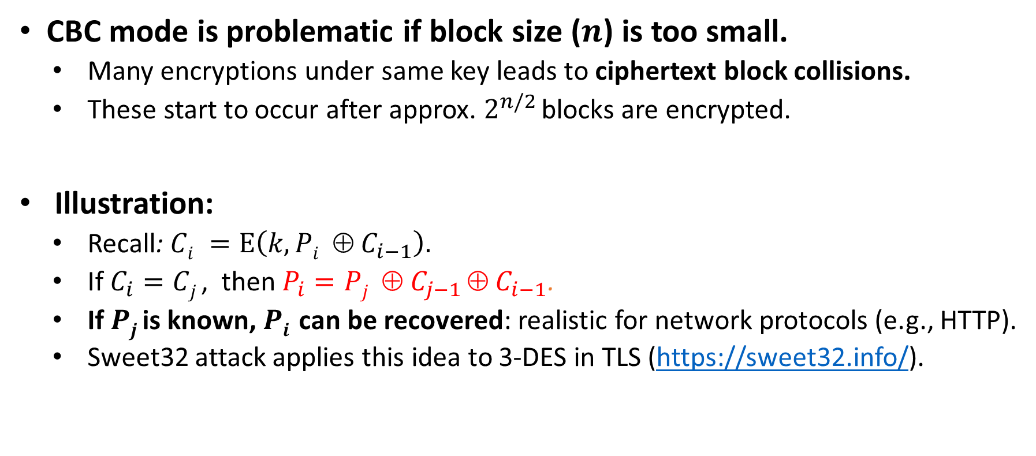
Further remarks on CBC mode
CBC mode is problematic if block size ($n$) is too small.
  Many encryptions under same key leads to ciphertext block collisions.
  These start to occur after approx. $2^{n/2}$ blocks are encrypted.
Illustration:
  Recall: $Ci =E\left(k,Pi ⊕ C_{i−1}\right).$
  If $C_{i}=Cj$, then $P_{i}=Pj  C_{j−1}  C_{i−1}$.
  If $Pj$ is known, $Pi$ can be recovered: realistic for network protocols (e.g., HTTP).
  Sweet32 attack applies this idea to 3-DES in TLS (https://sweet32.info/).

Slide 60
CTR mode

Slide 61



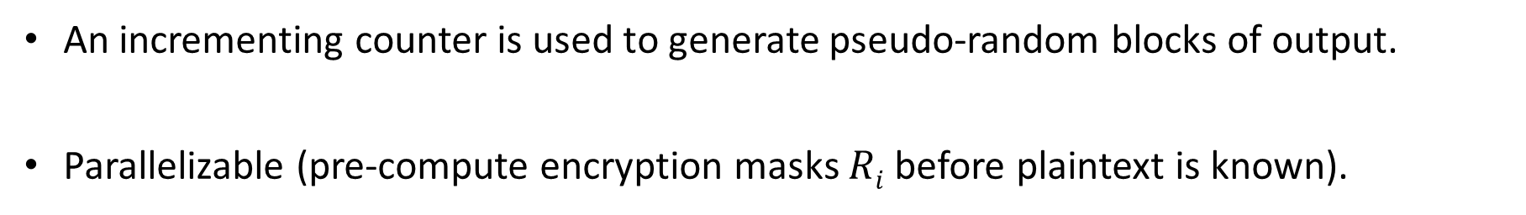












Counter (CTR) mode encryption
$$ctr$$
$$ctr+1$$
$$ctr+(ℓ−1)$$
$$E\left(k,⋅\right)$$
$$E\left(k,⋅\right)$$
…
$$E\left(k,⋅\right)$$
$$R_{0}$$
$$R_{1}$$
$$R_{ℓ−1}$$
$$P0$$
⊕
$$C0$$
$$P1$$
⊕
$$C1$$
$$P_{ℓ−1}$$
⊕
$$C_{ℓ−1}$$
An incrementing counter is used to generate pseudo-random blocks of output.
Parallelizable (pre-compute encryption masks $Ri$ before plaintext is known).

Slide 62
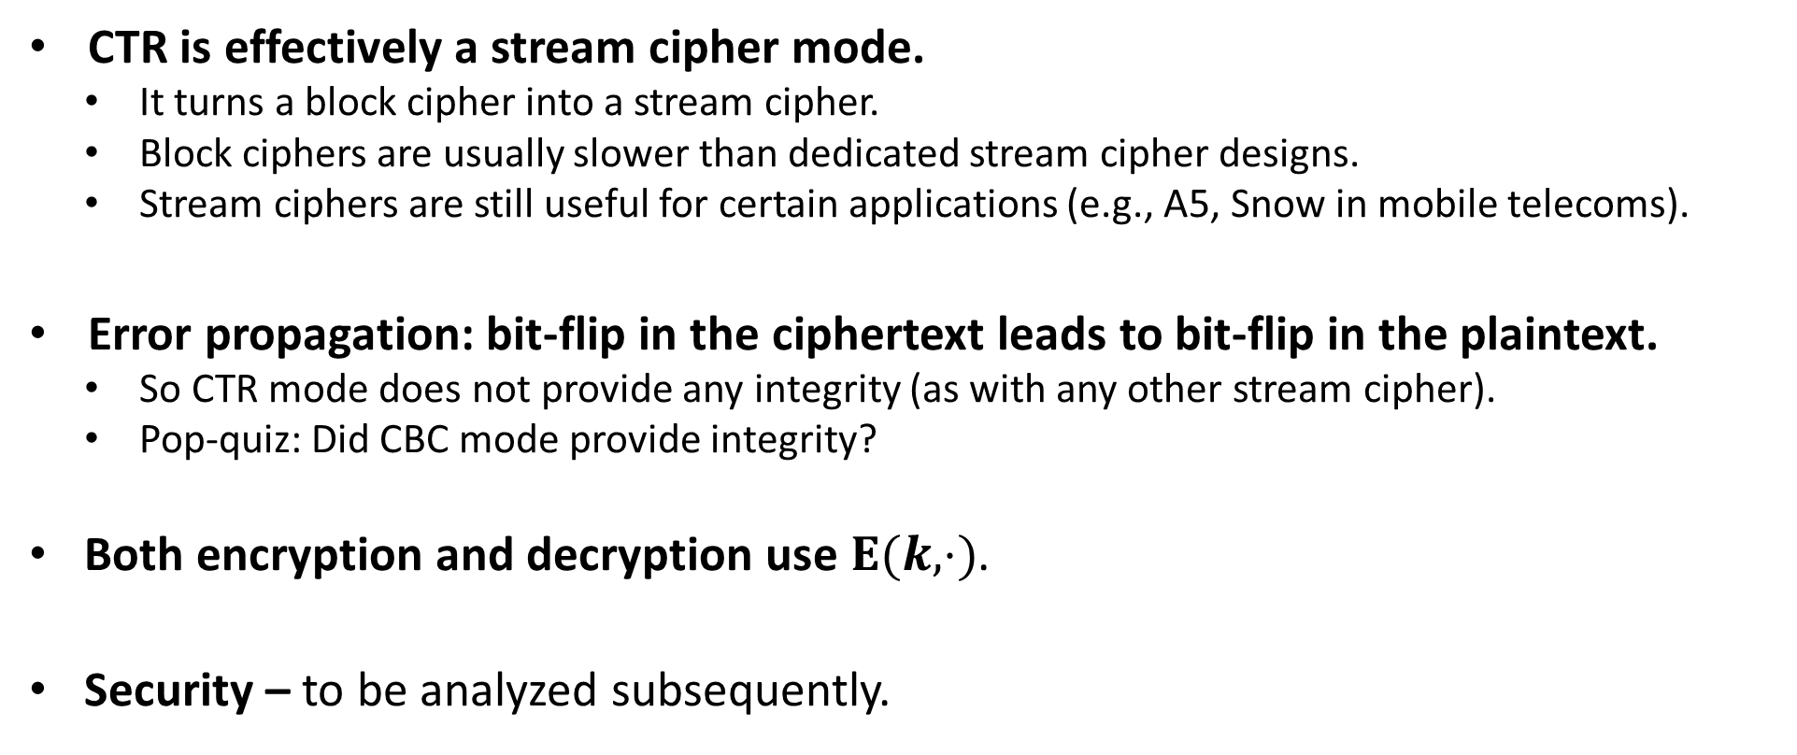
Some observations on the CTR mode
CTR is effectively a stream cipher mode.
  It turns a block cipher into a stream cipher.
  Block ciphers are usually slower than dedicated stream cipher designs.
  Stream ciphers are still useful for certain applications (e.g., A5, Snow in mobile telecoms).
Error propagation: bit-flip in the ciphertext leads to bit-flip in the plaintext.
  So CTR mode does not provide any integrity (as with any other stream cipher).
  Pop-quiz: Did CBC mode provide integrity?
Both encryption and decryption use $E(k,⋅)$.
Security – to be analyzed subsequently.

Slide 63
From practice to provable security
How do we prove that the above approaches yield IND-CPA secure SKE?
Does ECB mode yield IND-CPA secure SKE?
Does CTR mode yield IND-CPA secure SKE?

Slide 64
Outline
Block ciphers and PRPs/PRFs
Symmetric-key encryption (SKE)
SKE from PRF
SKE in practice: block cipher modes of operation
CRT mode yields IND-CPA-secure SKE: PRP-PRF switching lemma

Slide 65
CTR mode yields IND-CPA secure SKE

Slide 66
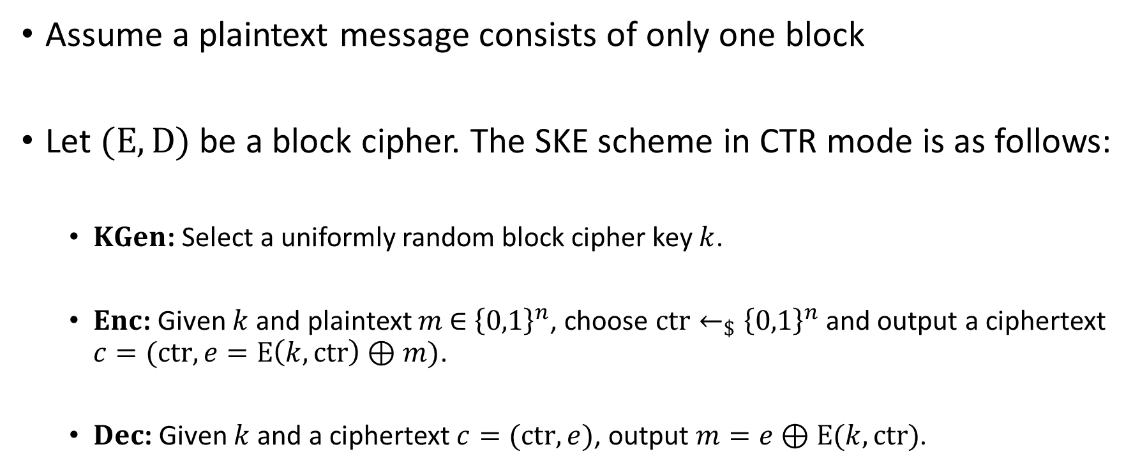
Take a simplified view of the CTR mode
Assume a plaintext message consists of only one block
Let $(E,D)$ be a block cipher. The SKE scheme in CTR mode is as follows:
  $KGen$: Select a uniformly random block cipher key $k$.
  $Enc$: Given $k$ and plaintext $m$ ∈ ${\left\{0,1\right\}}^{n}$, choose $ctr←_{\$}{\left\{0,1\right\}}^{n}$ and output a ciphertext $c=(ctr,e=E\left(k,ctr\right)⊕m)$.
  $Dec$: Given $k$ and a ciphertext $c=(ctr,e)$, output $m=e⊕E(k,ctr)$.

Slide 67
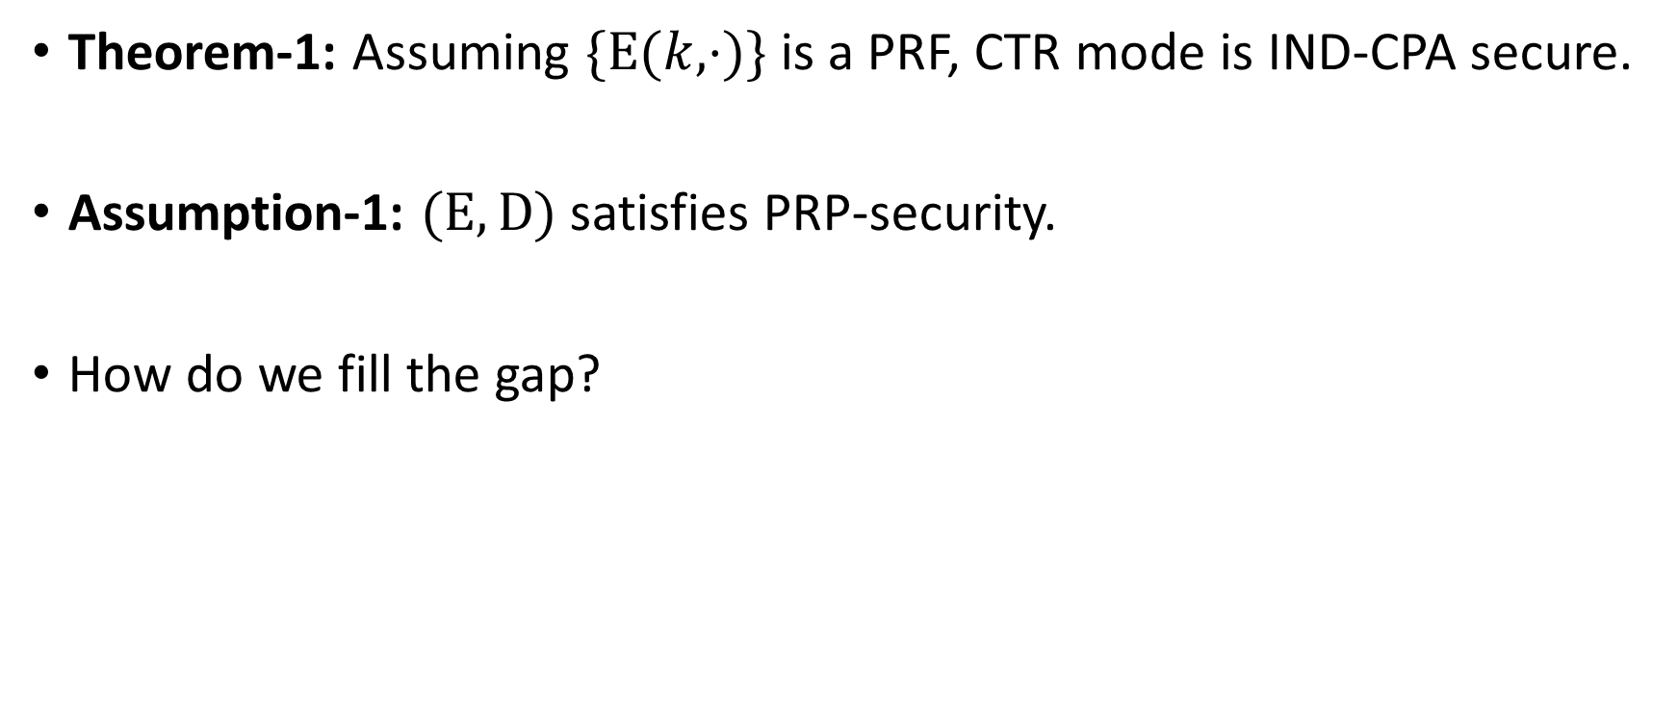
Theorems and Assumptions
Theorem-1: Assuming $\{E(k,⋅)\}$ is a PRF, CTR mode is IND-CPA secure.
Assumption-1: $(E,D)$ satisfies PRP-security.
How do we fill the gap?

Slide 68
PRP-PRF switching lemma

Slide 69
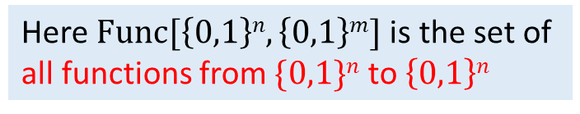
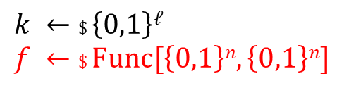


Recap: PRF-security for $\{E(k,⋅)\}$
Setup:
$$b ←\$ \{0,1\}$$
Here $Func[\left\{0,1\right\}n,\left\{0,1\right\}m]$is the set of all functions from $\{0,1\}n$ to $\left\{0,1\right\}n$
$$k ←\$ \left\{0,1\right\}ℓ$$
$$f ←\$ Func[\left\{0,1\right\}n,\left\{0,1\right\}n]$$
$b =0$:
Distinguisher $D$
$$x1$$
$$yi =E(k,xi)$$
$$y1$$
$$x2$$
$$y2$$
$b =1$:
$$yi =f(xi)$$
$$b′$$
$D$ makes up to $q$ queries
$${Adv}_{E}^{PRP}\left(D\right) := \left|\operatorname{Pr}\left[b′=b\right]–\frac{1}{2}\right|.$$

Slide 70
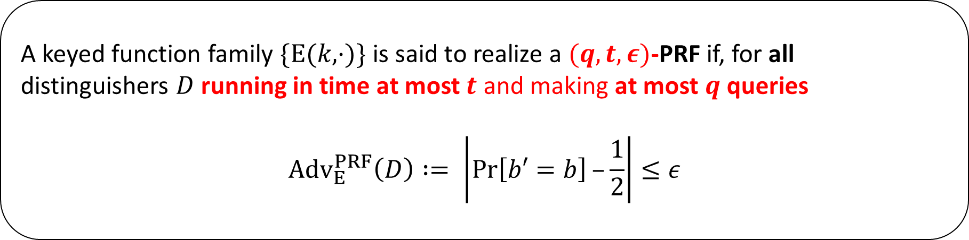
Recap: PRF-security for $\{E(k,⋅)\}$
Definition (concrete)
A keyed function family $\{E(k,⋅)\}$ is said to realize a $(q,t,ε)$-PRF if, for all distinguishers $D$ running in time at most $t$ and making at most $q$ queries
$${Adv}_{E}^{PRF}\left(D\right) := \left|\operatorname{Pr}\left[b′=b\right]–\frac{1}{2}\right|≤ε$$

Slide 71
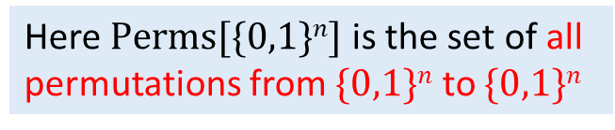

Recap: PRP-security of $(E,D)$
Setup:
$$b ←\$ \{0,1\}$$
Here $Perms[\{0,1\}n]$ is the set of all permutations from $\{0,1\}n$ to $\{0,1\}n$
$$k ←\$ \left\{0,1\right\}ℓ$$
$$π ←\$ Perms[\{0,1\}n]$$
$b =0$:
Distinguisher $D$
$$x1$$
$$yi =E(k,xi)$$
$$y1$$
$$x2$$
$$y2$$
$b =1$:
$$yi = π(xi)$$
$$b′$$
$D$ makes up to $q$ queries
$${Adv}_{E}^{PRP}\left(D\right) := \left|\operatorname{Pr}\left[b′=b\right]–\frac{1}{2}\right|.$$

Slide 72
Recap: PRP-security of $(E,D)$
Definition (concrete)
A block cipher $(E,D)$ is said to be $(q,t,ε)$-PRP-secure if, for all distinguishers $D$ running in time at most $t$ and making at most $q$ queries
$${Adv}_{E}^{PRP}\left(D\right) = \left|\operatorname{Pr}\left[b′=b\right]–\frac{1}{2}\right|≤ε$$

Slide 73
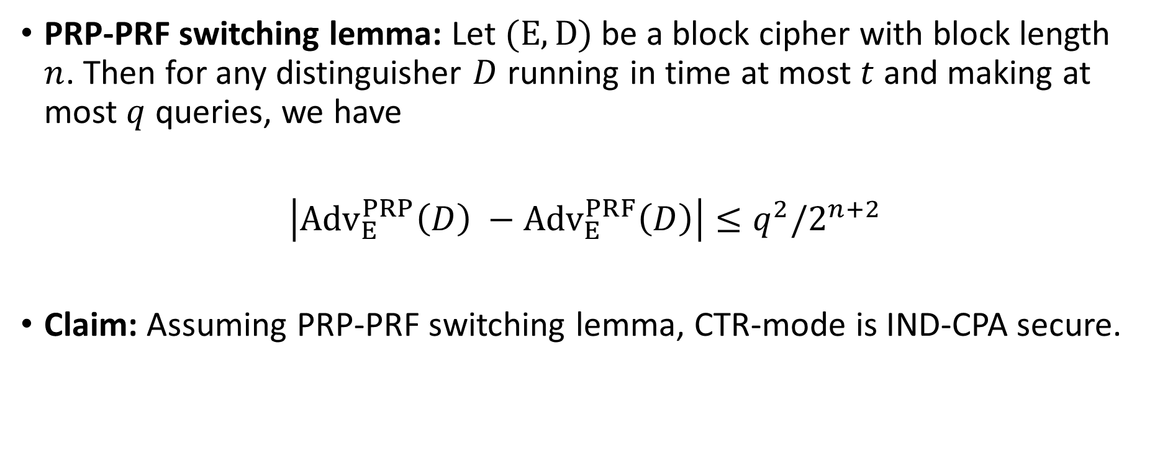
PRP-PRF switching lemma
PRP-PRF switching lemma: Let $(E,D)$ be a block cipher with block length $n$. Then for any distinguisher $D$ running in time at most $t$ and making at most $q$ queries, we have
$\left|{Adv}_{E}^{PRP}\left(D\right) −{Adv}_{E}^{PRF}\left(D\right)\right|≤q^{2}/2^{n+2}$
Claim: Assuming PRP-PRF switching lemma, CTR-mode is IND-CPA secure.

Slide 74
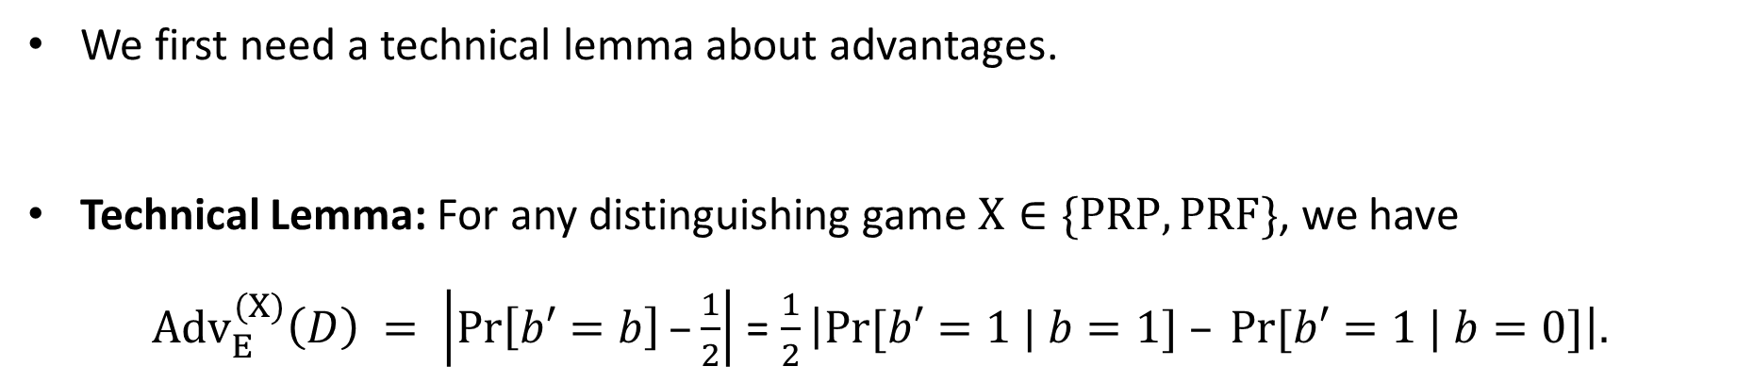
PRP-PRF switching lemma: proof
We first need a technical lemma about advantages.
Technical Lemma: For any distinguishing game $X∈\{PRP,PRF\}$, we have
${Adv}_{E}^{(X)}\left(D\right) = \left|\operatorname{Pr}\left[b′=b\right]–\frac{1}{2}\right|$ = $\frac{1}{2}\left|Pr⁡[b′=1 | b=1] – Pr⁡[b′=1 | b=0]\right|.$

Slide 75

PRP-PRF switching lemma: proof
Let $D$ be a $(q, t, ε)$ distinguisher; we will run $D$ in one of 3 games, each with a different challenger:
$G0$: The challenger uses $f := E (k,·)$, where $k ←\$ \left\{0,1\right\}ℓ$, to respond to $D$’s queries.
$G1$: The challenger uses $f ←\$ Perms\left[\left\{0,1\right\}n\right]$ to respond to $D$’s queries
$G2$: The challenger chooses $f ←\$ Func\left[\left\{0,1\right\}n\right]$ to respond to $D$’s queries.
Let W$i$ be the event that $D$ outputs $b′ = 1$ in game $Gi$. Set $pi =\operatorname{Pr}\left[W_{i}\right]$.
Note that:
$G0$ corresponds to the case “$b=0$” in both the PRP and PRF security games
$G1$ corresponds to the case “$b=1$” in the PRP security game.
$G2$ corresponds to the case “$b=1$” in the PRF security game.

Slide 76

PRP-PRF switching lemma: proof
Claims:
$| p1 – p0 | = 2{Adv}_{E}^{PRP}\left(D\right)$
$| p2 – p0 | = {2Adv}_{E}^{PRF}\left(D\right)$
$\left|{Adv}_{E}^{PRP}\left(D\right)−{Adv}_{E}^{PRF}\left(D\right)\right|≤\frac{1}{2}|p_{1}−p_{2}|$

Slide 77








$G1: f ←\$ Perms[\{0,1\}n]$
$G2: f ←\$ Funcs\left[\left\{0,1\right\}n, \left\{0,1\right\}n\right]$
If $xi = xj$ for some $j < i$
then $yi ← yj$
else
$yi ←\$ \{0,1\}n ∖ \{y0 , … , y_{i−1}\}$
Return $yi$
G₁
Distinguisher D
$$x1$$
y_{i} = f(x_{i})
$$y1$$
$$x2$$
If $xi = xj$ for some $j < i$
then $yi ← yj$
else
$yi ←\$ \{0,1\}n$
Return $yi$
$$y2$$
G₂
y_{i} = f(x_{i})
$$b′$$

Slide 78

$G1: f ←\$ Perms[\{0,1\}n]$
$G2: f ←\$ Funcs\left[\left\{0,1\right\}n, \left\{0,1\right\}n\right]$
If $xi = xj$ for some $j < i$
then $yi ← yj$
else
$yi ←\$ \{0,1\}n ∖ \{y0 , … , y_{i−1}\}$
Return $yi$
G₁
Distinguisher D
$$x1$$
y_{i} = f(x_{i})
$$y1$$
$$x2$$
If $xi = xj$ for some $j < i$
then $yi ← yj$
else
$yi ←\$ \{0,1\}n$
Return $yi$
$$y2$$
G₂
y_{i} = f(x_{i})
$$b′$$
Let $Z$ be the event that in $G_{2}$, $y_{i}=y_{j}$

Slide 79

PRP-PRF switching lemma: proof
Claims:
$| p1 – p0 | = 2{Adv}_{E}^{PRP}\left(D\right)$
$| p2 – p0 | = {2Adv}_{E}^{PRF}\left(D\right)$
$\left|{Adv}_{E}^{PRP}\left(D\right)−{Adv}_{E}^{PRF}\left(D\right)\right|≤\frac{1}{2}|p_{1}−p_{2}|$
$W_{1}∧¬Z⇔W_{2}∧¬Z⇒\left|p_{1}−p_{2}\right|≤Pr\left[Z\right]≤q^{2}/2^{n+1 }$

Slide 80

PRP-PRF switching lemma: proof
Claims:
$| p1 – p0 | = 2{Adv}_{E}^{PRP}\left(D\right)$
$| p2 – p0 | = {2Adv}_{E}^{PRF}\left(D\right)$
$\left|{Adv}_{E}^{PRP}\left(D\right)−{Adv}_{E}^{PRF}\left(D\right)\right|≤\frac{1}{2}|p_{1}−p_{2}|$
$W_{1}∧¬Z⇔W_{2}∧¬Z⇒\left|p_{1}−p_{2}\right|≤Pr\left[Z\right]≤q^{2}/2^{n+1 }$

Slide 81

PRP-PRF switching lemma: proof
Claims:
$| p1 – p0 | = 2{Adv}_{E}^{PRP}\left(D\right)$
$| p2 – p0 | = {2Adv}_{E}^{PRF}\left(D\right)$
$\left|{Adv}_{E}^{PRP}\left(D\right)−{Adv}_{E}^{PRF}\left(D\right)\right|≤\frac{1}{2}|p_{1}−p_{2}|$
$W_{1}∧¬Z⇔W_{2}∧¬Z⇒\left|p_{1}−p_{2}\right|≤Pr\left[Z\right]≤q^{2}/2^{n+1 }$

Slide 82

PRP-PRF switching lemma: proof
Claims:
$| p1 – p0 | = 2{Adv}_{E}^{PRP}\left(D\right)$
$| p2 – p0 | = {2Adv}_{E}^{PRF}\left(D\right)$
$\left|{Adv}_{E}^{PRP}\left(D\right)−{Adv}_{E}^{PRF}\left(D\right)\right|≤\frac{1}{2}\left|p_{1}−p_{2}\right|≤q^{2}/2^{n+2}$
$W_{1}∧¬Z⇔W_{2}∧¬Z⇒\left|p_{1}−p_{2}\right|≤Pr\left[Z\right]≤q^{2}/2^{n+1 }$

Slide 83
Recap
PRP-PRF switching lemma: Let $(E,D)$ be a block cipher with block length $n$. Then for any distinguisher $D$ running in time at most $t$ and making at most $q$ queries, we have
$\left|{Adv}_{E}^{PRP}\left(D\right) −{Adv}_{E}^{PRF}\left(D\right)\right|≤q^{2}/2^{n+2}$
Claim: Assuming PRP-PRF switching lemma, CTR-mode is IND-CPA secure.

Slide 84

Summary
Theorem-1: Assuming $\{E(k,⋅)\}$ is a PRF, CTR mode is IND-CPA secure.
Assumption-1: $(E,D)$ satisfies PRP-security.
PRP-PRF switching lemma (informal): Any block cipher family that satisfies PRP-security also satisfies PRF-security.
Claim: CTR-mode is IND-CPA secure.

