Slide 1


Introduction to Symmetric-Key Cryptography (Part-1)
ACM India Summer School 2024 (Day 2, Post-Lunch)
Sikhar Patranabis (IBM Research India)
sikhar.patranabis@ibm.com
https://research.ibm.com/people/sikhar-patranabis
IITB Trust Lab 4th June 2024

Slide 2
Scene setting
Cryptography: the art of secret writing.
Derived from the Greek:
  kryptos (meaning ``hidden'')
  grafo (meaning ``write‘’)
Used for centuries by parties wishing to communicate securely.
  Historically, associated with encryption (to provide confidentiality).
  Now a significant area at the intersection between CS, mathematics, and systems engineering, and plays a crucial role in information security.
  No longer limited to confidentiality, no longer limited to communications.

Slide 3

The world we used to live in…

Slide 4
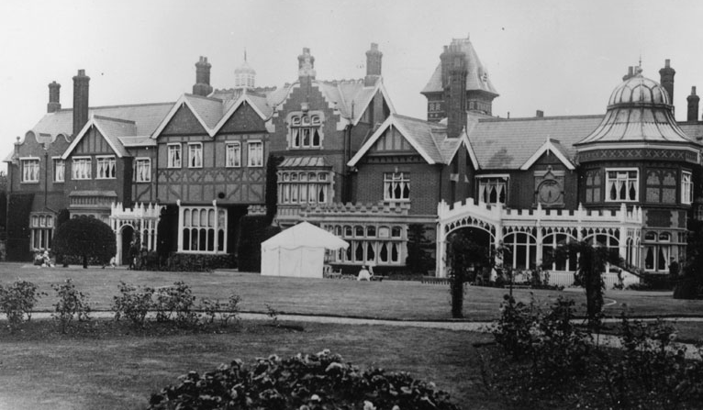

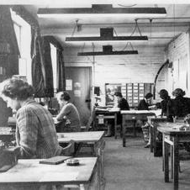
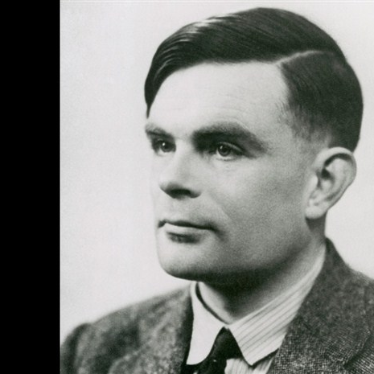
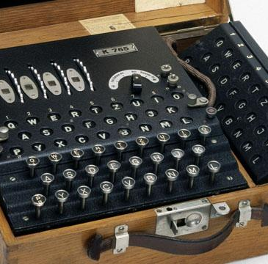
The world changed…

Slide 5
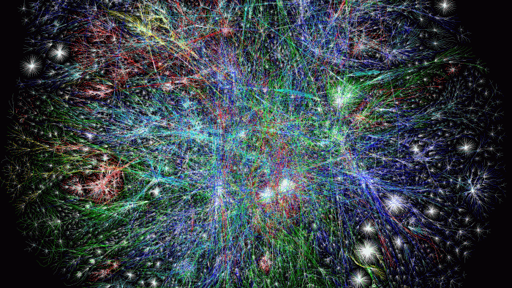
The world we live in now…

Slide 6
Outline
Some practical perspectives on cryptography
Secure communication
Computational cryptography – one-way functions
Pseudorandom generators (PRGs) and stream ciphers

Slide 7
Outline
Some practical perspectives on cryptography
Secure communication
Computational cryptography – one-way functions
Pseudorandom generators (PRGs) and stream ciphers

Slide 8
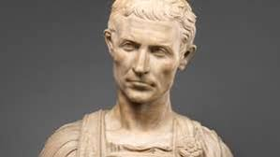
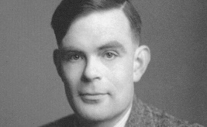
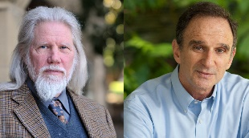
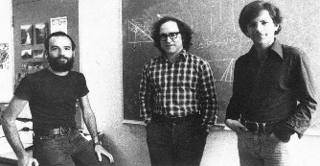

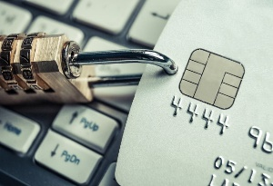
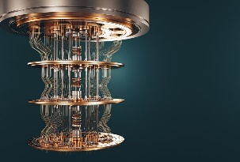
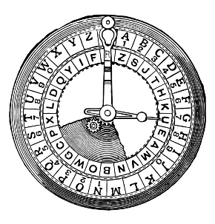
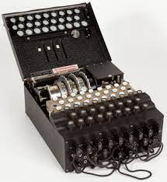
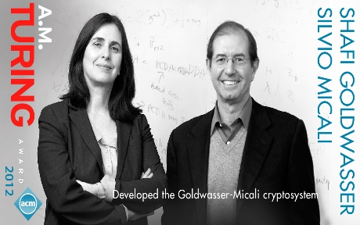
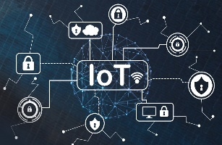

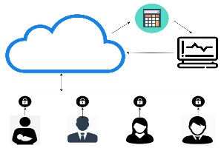
Cryptography – past, present, future
Art of
secure communication
New directions and formalizations
Engineering and
technology translation
Pre-1970
1970s and 1980s
Post-2000

Slide 9
Individual perspective
Cryptography makes our lives more convenient.
  Enables shopping online, communicating remotely with friends and family, interacting with government services online, working from home, etc.
Enables established human rights such as privacy and freedom of expression.
  In a free society, individuals should probably have the right to use cryptography in any way they see fit.
  Indeed, a stated commitment to this freedom is one indicator of a truly free society.

Slide 10
Business perspective
Cryptography enables new forms of business.
  Allows provisioning of security services.
  Ensures regulatory compliance for existing forms of business.
Cryptography may also bring new costs to a business.
  Moving business online may introduce new threats… which cryptography can only partially address, or which it does not address at all.
Cryptography will only be deployed if it makes business sense.
  Cost-effective, appropriate, compliant with regulations.

Slide 11
Government perspective
Conflicting requirements with respect to cryptography
Cryptography as an enabler
  Promotes a competitive and attractive business environment.
  Enables streamlining operations by moving services on-line.
Cryptography as a detractor
  Control crime and manage issues of national security.
  Limit the use of cryptography -- imposition of laws and regulations, promotion of weak cryptographic standards, or by other means.

Slide 12
Government perspective (example)
Our vision is for the UK in 2015 to derive huge economic and social value from a vibrant, resilient and secure cyberspace, where our actions, guided by our core values of liberty, fairness, transparency and the rule of law, enhance prosperity, national security and a strong society.
UK government cyber strategy, Nov 2011
https://www.gov.uk/government/uploads/system/uploads/attachment_data/file/60961/uk-cyber-security-strategy-final.pdf
Our vision for 2021 is that the UK is secure and resilient to cyber threats, prosperous and confident in the digital world.
UK government cyber strategy, 2016
https://assets.publishing.service.gov.uk/government/uploads/system/uploads/attachment_data/file/567242/national_cyber_security_strategy_2016.pdf

Slide 13
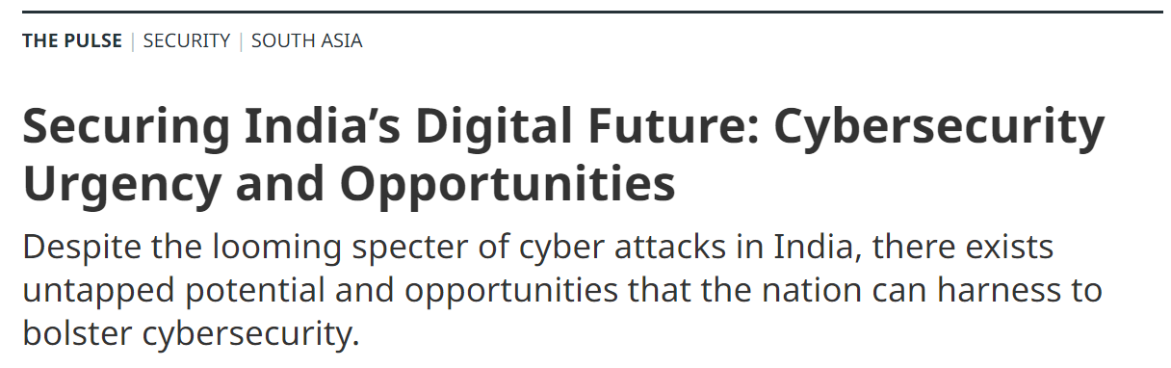

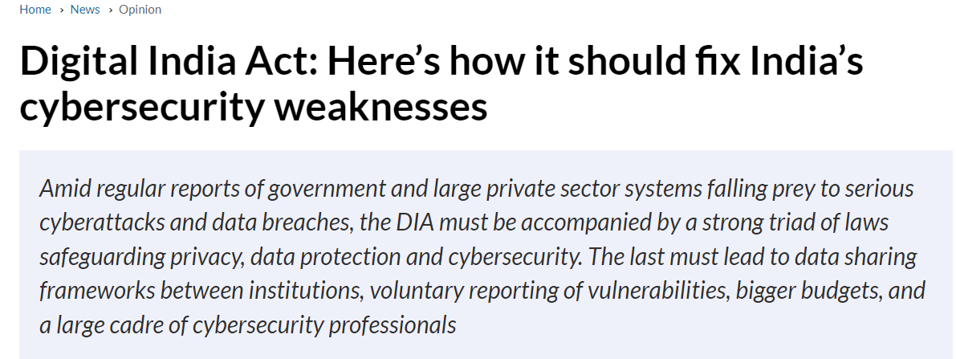
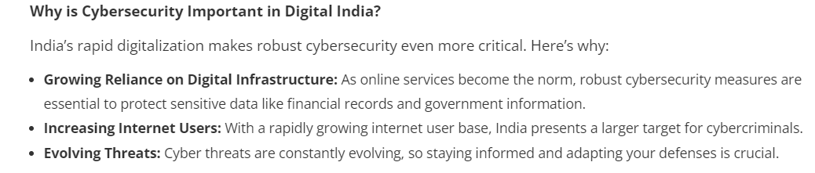
The Indian context

Slide 14
The importance of security infrastructure
Security infrastructure must support deployment of cryptographic solutions.
  Infrastructure: procedures, plans, policies, and management to ensure any deployment serves its intended purpose.
Cryptography on its own is not a magic bullet.
  Cryptography ⊉ cryptographic algorithms.
This is a principle worth keeping in mind throughout the course.

Slide 15


Modern approach to cryptography
Formal Security Model
Application
Define an adversarial model

Slide 16



Modern approach to cryptography
Cryptographic Solution
Formal Security Model
Application
Define an adversarial model

Slide 17

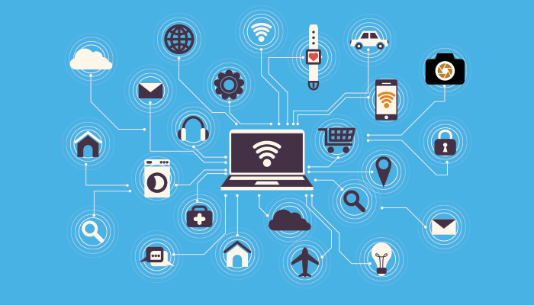
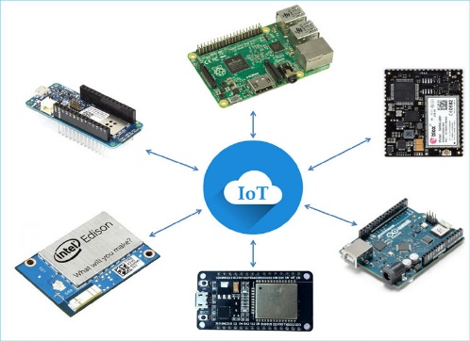
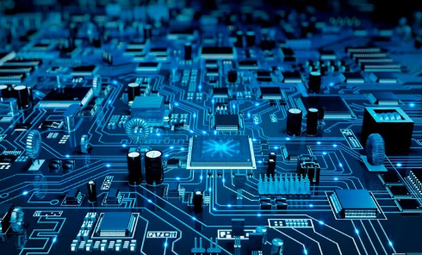
Cryptographic algorithms vs cryptographic implementations
Cryptographic Solution
Formal Security Model
Application
Define an adversarial model
Deploy on Real Systems (Software/Hardware)

Slide 18

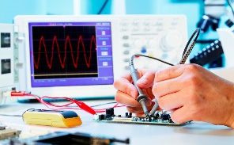


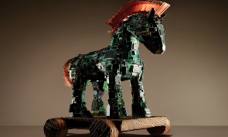
Cryptographic algorithms vs cryptographic implementations
Implementation-Level Threats and Attacks
Formal Security Model
Define an adversarial model
Often does not capture implementation-level attacks
Deploy on Real Systems (Software/Hardware)

Slide 19




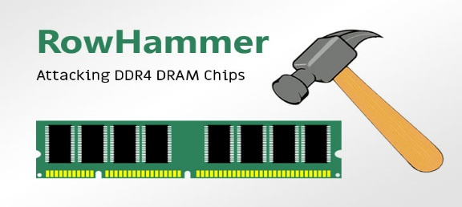


Cryptographic algorithms vs cryptographic implementations
Implementation-Level Threats and Attacks
Formal Security Model
Define an adversarial model
Target insecure implementations of provably secure cryptoprimitives
Deploy on Real Systems (Software/Hardware)

Slide 20
Cryptographic algorithms vs cryptographic implementations
Implementation-Level Threats and Attacks
Formal Security Model
Define an adversarial model
“Cryptographers rarely sleep well”
- Silvio Micali (A.M. Turing Award Laureate, 2013)
Target insecure implementations of provably secure cryptoprimitives
Deploy on Real Systems (Software/Hardware)

Slide 21
Modern approach to cryptography
Cryptographic Solution
Formal Security Model
Application
Define an adversarial model
For this series of lectures, suffices to restrict to cryptographic algorithms

Slide 22
Modern approach to cryptography
Cryptographic Solution
Formal Security Model
Application
Define an adversarial model
For this series of lectures, suffices to restrict to cryptographic algorithms
Application for next few lectures: secure communication

Slide 23
Outline
Some practical perspectives on cryptography
Secure communication
Computational cryptography – one-way functions
Pseudorandom generators (PRGs) and stream ciphers

Slide 24
Crypto ground-zero: secure communication

Slide 25


Secure communication
m₁
m₂
Two entities exchange messages over an insecure channel.
  Entities are often called Alice and Bob (but they need not be people).
The insecure channel will be provided by a communications network.
  Examples: wireless LAN, mobile phone network, “the Internet”, or a combination of these.
Use cryptography to build a secure channel on top of the insecure channel.

Slide 26
Secure communication
m₁
m₂
What should our security goals be?
What capabilities does the adversary (a.k.a. the attacker) have?
How can we use cryptography to achieve our goals in the face of this adversary?

Slide 27
Secure communication: (informal) security goals
m₁
m₂
Exchanged messages should remain confidential.
Alice and Bob can check the origin of the messages (hard for the adversary to inject messages if its own).
Alice and Bob can detect:
  when messages are deleted.
  when messages are reordered (possibly by the adversary, possibly by the network).

Slide 28
Secure communication: adversarial capabilities
m₁
m₂
Passive adversary:
  Can only observe all of the data being transferred on the network.
Active adversary:
  Has sufficient control over the network to delete, delay, modify, and reorder network packets at will.
  Can inject entirely new network packets (active adversary).
To what extent are these capabilities realistic?

Slide 29
Secure communication: adversarial capabilities
m₁
m₂
In cryptography, we assume even more powerful adversaries
  Can ask for chosen messages to be passed over the network (chosen plaintext attack).
  Can observe effects of injecting chosen network packets (chosen ciphertext attack).
    For example, error messages exchanged between the entities in response to injected packets may leak useful information.

Slide 30



Secure communication: channel assumptions
Secure channel
Insecure channel
Insecure channel
Symmetric-Key Cryptography
Public-Key Cryptography
Assume a “costly” secure channel
Do not assume a secure channel

Slide 31
Secure communication: coverage plan
For the next three sessions (rest of today and all of tomorrow):
Assume a “costly” secure channel (can only be used to exchange “short” messages, albeit infrequently).
Given this secure channel, design a secure channel for exchanging “arbitrarily long” messages very frequently.
Day-after tomorrow onwards: learn how to realize this costly secure channel
Secure channel
Insecure channel
Symmetric-Key Cryptography
Assume a “costly” secure channel

Slide 32
Secure communication: one-time pad
One-time pad: perfectly secure, but…
Need a secure channel to communicate the key (one-time pad) K
K needs to be as long as the message
K needs to be refreshed for each message to be communicated
Too costly to be practical
Secure channel
Insecure channel
Symmetric-Key Cryptography
Assume a “costly” secure channel

Slide 33
Secure communication: efficient one-time pad?
Practically efficient one-time pad
A “short” key K is transmitted over the secure channel such that:
  |K| is independent of message length.
  K can be used to derive arbitrarily many random bits.
  These random bits can then be used as effective one-time pads.
Too good to be true? Yes, for perfect security
Secure channel
Insecure channel
Symmetric-Key Cryptography
Assume a “costly” secure channel
Shannon [1949]

Slide 34
Secure communication: efficient one-time pad?
Practically efficient one-time pad
A “short” key K is transmitted over the secure channel such that:
  |K| is independent of message length.
  K can be used to derive arbitrarily many random bits.
  These random bits can then be used as effective one-time pads.
Too good to be true? Yes, for perfect security
Secure channel
Insecure channel
Symmetric-Key Cryptography
But what if the adversary is not all-powerful, but computationally bounded?
Assume a “costly” secure channel

Slide 35
Outline
Some practical perspectives on cryptography
Secure communication
Computational cryptography – one-way functions
Pseudorandom generators (PRGs) and stream ciphers

Slide 36
Computationally secure cryptography

Slide 37
Computational security
Certain cryptosystems may not be perfectly/unconditionally/statistically secure against unbounded adversaries, but may still be “hard” to break in practice.
Computational security: not unconditional, but holds against computationally bounded (equivalently, efficient) adversaries.
Note that a (computationally bounded) adversary can always break a cryptosystem with some “tiny” probability (e.g., by guessing a key), so any meaningful notion of computational security is probabilistic.

Slide 38
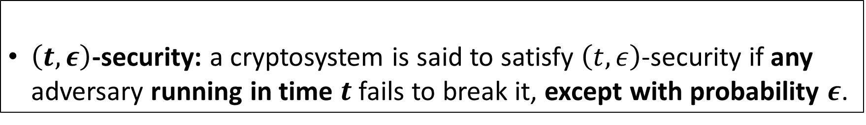
Computational security: concrete formulation
Concrete formulation
$\left(t,ε\right)$-security: a cryptosystem is said to satisfy $\left(t,ε\right)$-security if any adversary running in time $t$ fails to break it, except with probability $ε$.
Concrete formulation of computational security is mainstream in certain areas of cryptography, such as symmetric-key cryptography.
Does not generalize very well (dependent on model of computation, tends to be cumbersome for theoretical analyses).
Popular alternative: asymptotic formulation of computational security (next slide).

Slide 39
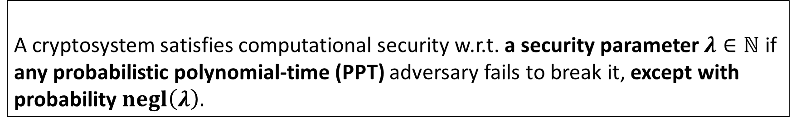
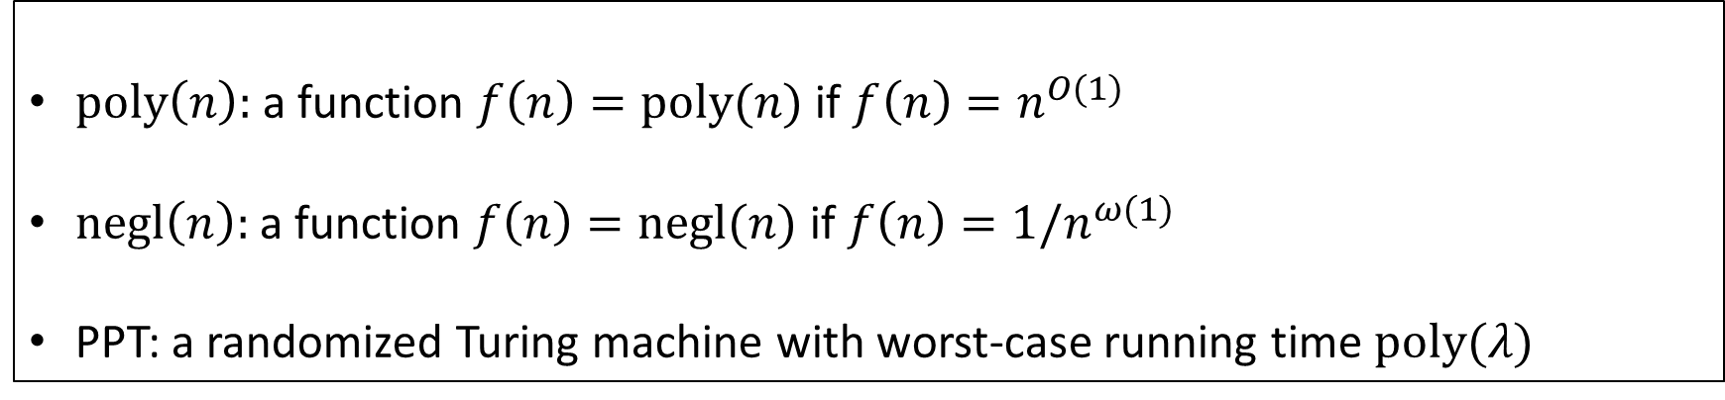
Computational security: asymptotic formulation
Asymptotic formulation (parameterized by security parameter $λ$)
A cryptosystem satisfies computational security w.r.t. a security parameter $λ∈ℕ$ if any probabilistic polynomial-time (PPT) adversary fails to break it, except with probability $negl\left(λ\right).$
Glossary
$poly\left(n\right):$ a function $f\left(n\right)=poly(n)$ if $f\left(n\right)=n^{O(1)}$
$negl\left(n\right):$ a function $f\left(n\right)=negl(n)$ if $f\left(n\right)=1/n^{ω(1)}$
PPT: a randomized Turing machine with worst-case running time $poly(λ)$

Slide 40
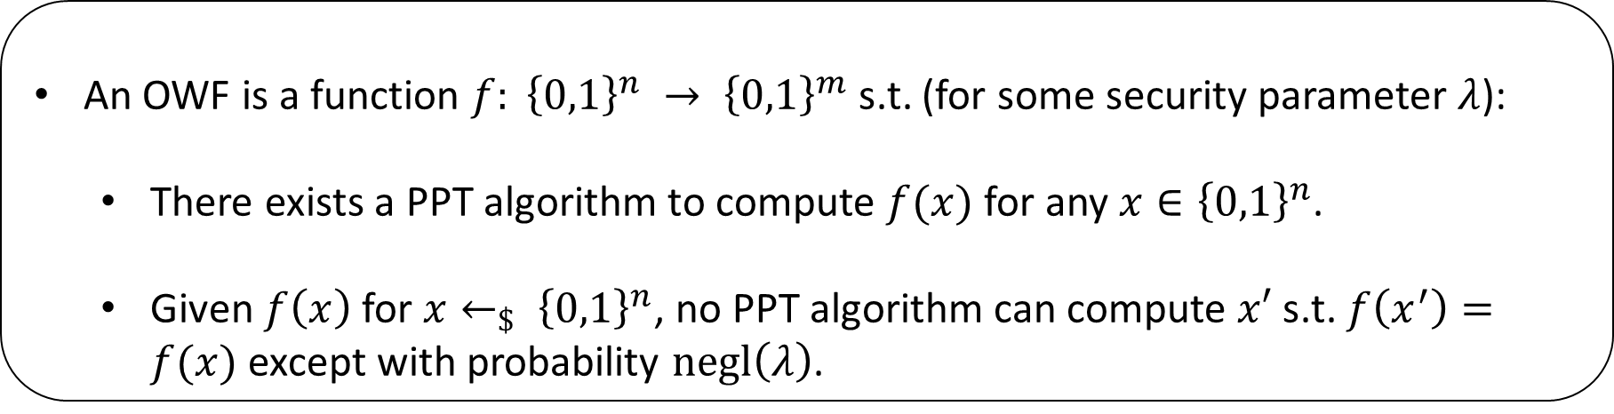
One-way function (OWF)
Definition (informal)
An OWF is an efficient, deterministic function that is efficiently computable but computationally hard to invert.
Definition (semi-formal)
An OWF is a function $f: {\left\{0,1\right\}}^{n} → {\left\{0,1\right\}}^{m}$ s.t. (for some security parameter $λ$):
  There exists a PPT algorithm to compute $f(x)$ for any $x∈{\left\{0,1\right\}}^{n}$.
  Given $f\left(x\right)$ for $x←_{\$} {\left\{0,1\right\}}^{n}$, no PPT algorithm can compute $x′$ s.t. $f\left(x^{′}\right)=f(x)$ except with probability $negl\left(λ\right)$.

Slide 41
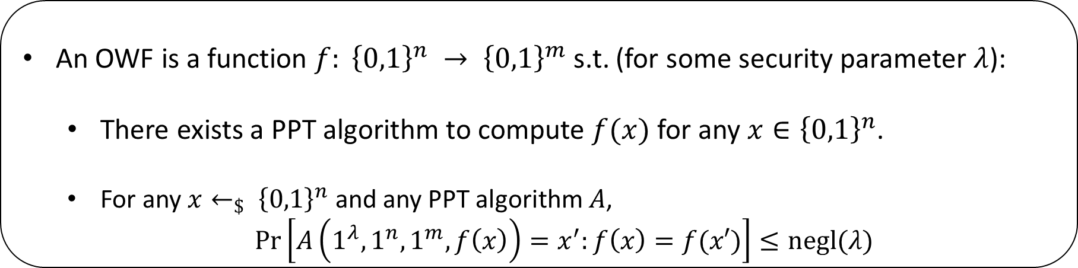
One-way function (OWF)
Definition (informal)
An OWF is a deterministic function that is efficiently computable but computationally hard to invert.
Definition (formal)
An OWF is a function $f: {\left\{0,1\right\}}^{n} → {\left\{0,1\right\}}^{m}$ s.t. (for some security parameter $λ$):
  There exists a PPT algorithm to compute $f(x)$ for any $x∈{\left\{0,1\right\}}^{n}$.
  For any $x←_{\$} {\left\{0,1\right\}}^{n}$ and any PPT algorithm $A$,
  $\operatorname{Pr}\left[A\left(1^{λ},1^{n},1^{m},f\left(x\right)\right)=x^{′}:f\left(x\right)=f(x′)\right]≤negl(λ)$

Slide 42
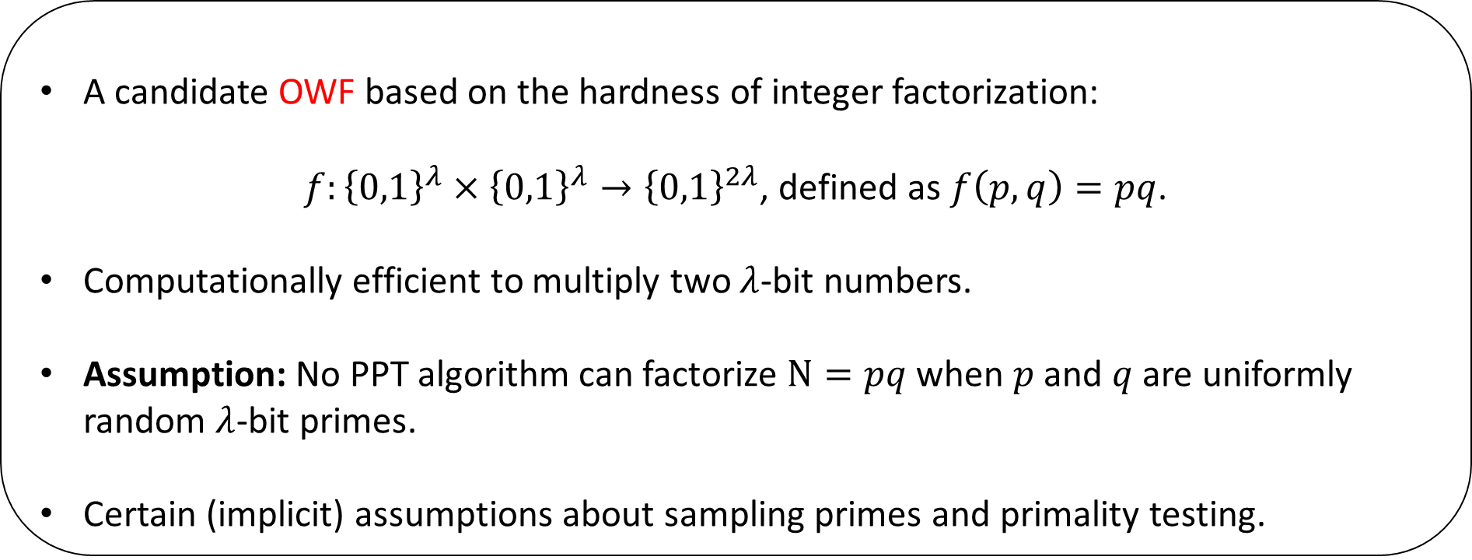
One-way function (OWF): Examples
Factorization
A candidate OWF based on the hardness of integer factorization:
$f:{\left\{0,1\right\}}^{λ}×{\left\{0,1\right\}}^{λ}→{\left\{0,1\right\}}^{2λ}$, defined as $f\left(p,q\right)=pq$.
Computationally efficient to multiply two $λ$-bit numbers.
Assumption: No PPT algorithm can factorize $N=pq$ when $p$ and $q$ are uniformly random $λ$-bit primes.
Certain (implicit) assumptions about sampling primes and primality testing.

Slide 43
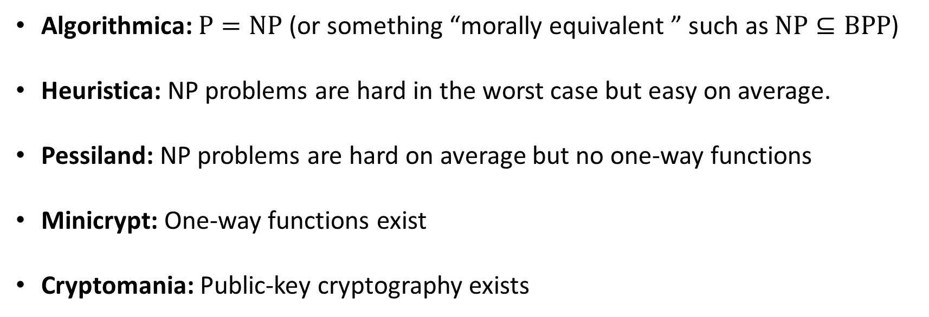
OWF: Complexity-theoretic perspective [Imp95]
Algorithmica: $P=NP$ (or something “morally equivalent ” such as $NP⊆BPP$)
Heuristica: NP problems are hard in the worst case but easy on average.
Pessiland: NP problems are hard on average but no one-way functions
Minicrypt: One-way functions exist
Cryptomania: Public-key cryptography exists

Slide 44
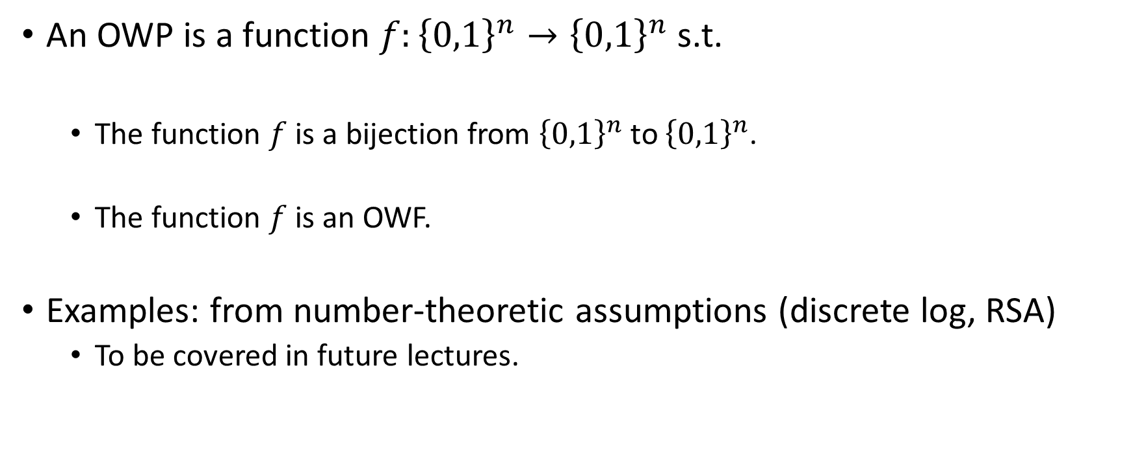
One-way permutation (OWP)
An OWP is a function $f:{\left\{0,1\right\}}^{n}→{\left\{0,1\right\}}^{n}$ s.t.
  The function $f$ is a bijection from ${\left\{0,1\right\}}^{n}$ to ${\left\{0,1\right\}}^{n}$.
  The function $f$ is an OWF.
Examples: from number-theoretic assumptions (discrete log, RSA)
  To be covered in future lectures.

Slide 45
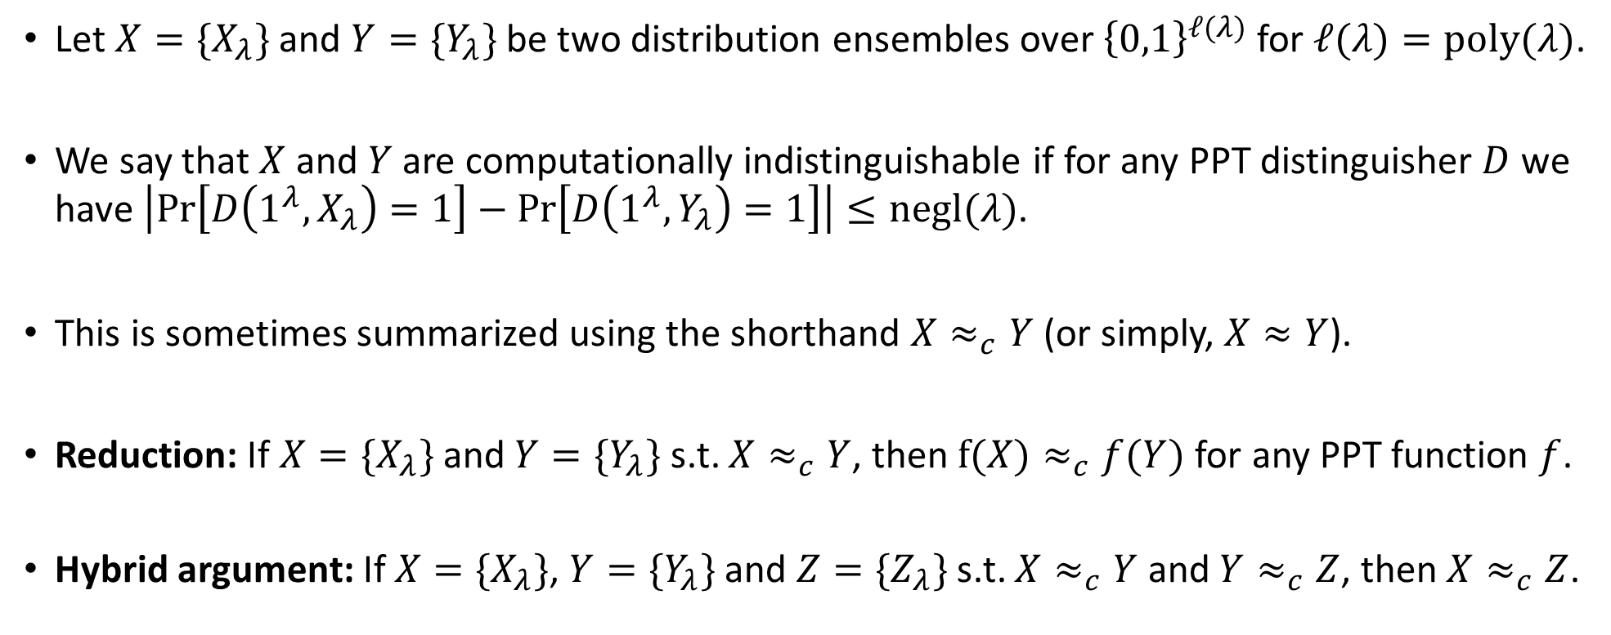
Computational Indistinguishability
Let $X=\{X_{λ}\}$ and $Y=\{Y_{λ}\}$ be two distribution ensembles over ${\left\{0,1\right\}}^{ℓ(λ)}$ for $ℓ(λ)=poly(λ)$.
We say that $X$ and $Y$ are computationally indistinguishable if for any PPT distinguisher $D$ we have $\left|\operatorname{Pr}\left[D\left(1^{λ},X_{λ}\right)=1\right]−\operatorname{Pr}\left[D\left(1^{λ},Y_{λ}\right)=1\right]\right|≤negl(λ)$.
This is sometimes summarized using the shorthand $X≈_{c}Y$ (or simply, $X≈Y$).
Reduction: If $X=\{X_{λ}\}$ and $Y=\{Y_{λ}\}$ s.t. $X≈_{c}Y$, then $f(X)≈_{c}f(Y)$ for any PPT function $f$.
Hybrid argument: If $X=\{X_{λ}\}$, $Y=\{Y_{λ}\}$ and $Z=\{Z_{λ}\}$ s.t. $X≈_{c}Y$ and $Y≈_{c}Z$, then $X≈_{c}Z$.

Slide 46
Outline
Some practical perspectives on cryptography
Secure communication
Computational cryptography – one-way functions
Pseudorandom generators (PRGs) and stream ciphers

Slide 47
Pseudorandom Generators (PRGs)

Slide 48
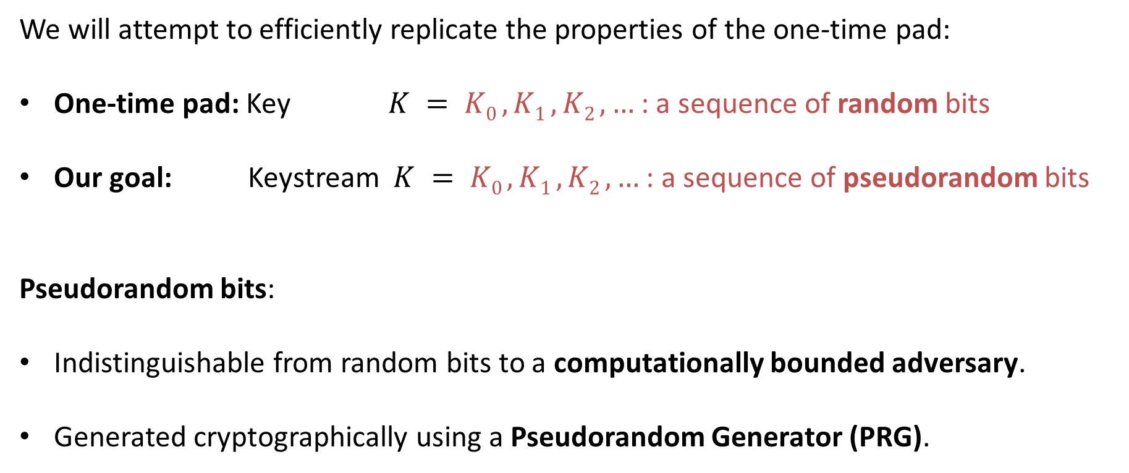
Efficient one-time pad
We will attempt to efficiently replicate the properties of the one-time pad:
One-time pad: Key $K = K0 , K1 , K2 ,…$ : a sequence of random bits
Our goal: Keystream $K = K0 , K1 , K2 ,…$ : a sequence of pseudorandom bits
Pseudorandom bits:
Indistinguishable from random bits to a computationally bounded adversary.
Generated cryptographically using a Pseudorandom Generator (PRG).

Slide 49
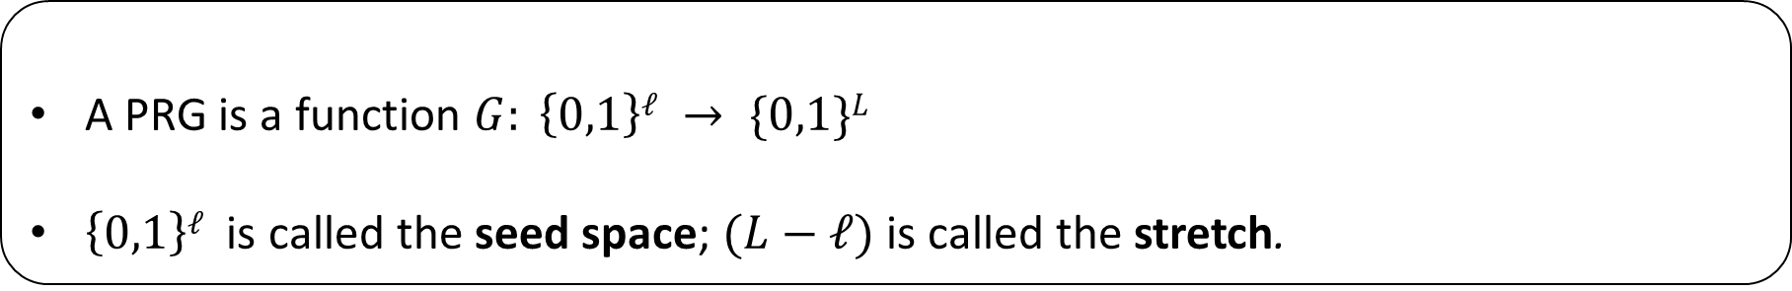
Pseudorandom Generator (PRG)
Definition (informal)
A PRG is an efficient, deterministic algorithm which takes as input a short “seed” and outputs a pseudorandom string.
The output is usually longer than the input, and the added length is called the “stretch” of the generator.
Formal syntax
A PRG is a function $G: \left\{0,1\right\}ℓ → \{0,1\}L$
$\left\{0,1\right\}ℓ$ is called the seed space; $(L−ℓ)$ is called the stretch.

Slide 50
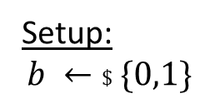




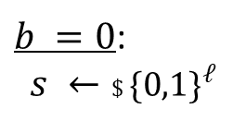

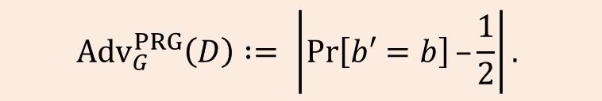

Security of PRG
PRG $G : \left\{0,1\right\}ℓ →\{0,1\}^{L}$
Setup:
$$b ←\$ \{0,1\}$$
$b =0$:
$$s ←\$ {\{0,1\}}^{ℓ}$$
Distinguisher $D$
$$r =G(s)$$
r
$b =1$:
$$r ←\$ {\{0,1\}}^{L}$$
$$b′$$
$${Adv}_{G}^{PRG}\left(D\right) := \left|\operatorname{Pr}\left[b′=b\right]–\frac{1}{2}\right|.$$

Slide 51
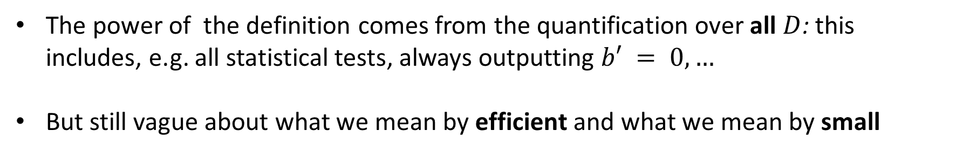
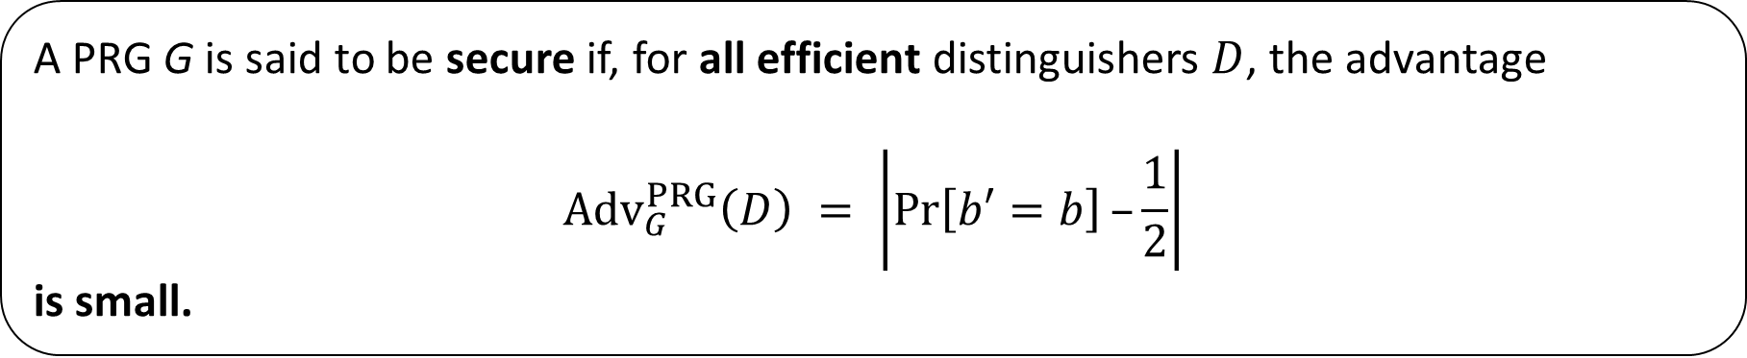
Security of PRG
Definition (informal)
A PRG G is said to be secure if, for all efficient distinguishers $D$, the advantage
$${Adv}_{G}^{PRG}\left(D\right) = \left|\operatorname{Pr}\left[b′=b\right]–\frac{1}{2}\right|$$
is small.
The power of the definition comes from the quantification over all $D$: this includes, e.g. all statistical tests, always outputting $b′ = 0,…$
But still vague about what we mean by efficient and what we mean by small

Slide 52
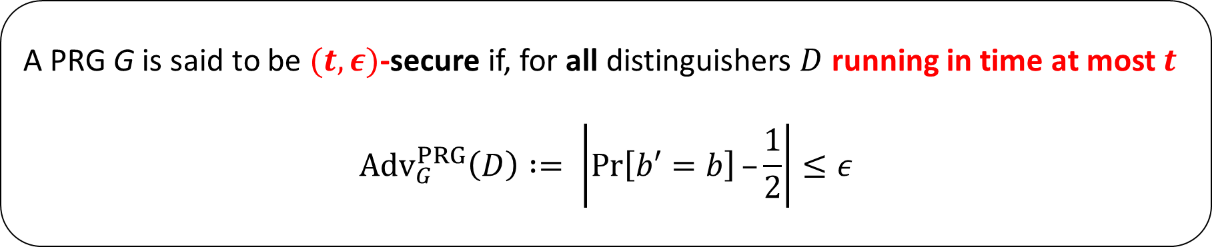
Security of PRG
Definition (concrete)
A PRG G is said to be $(t,ε)$-secure if, for all distinguishers $D$ running in time at most $t$
$${Adv}_{G}^{PRG}\left(D\right) := \left|\operatorname{Pr}\left[b′=b\right]–\frac{1}{2}\right|≤ε$$

Slide 53
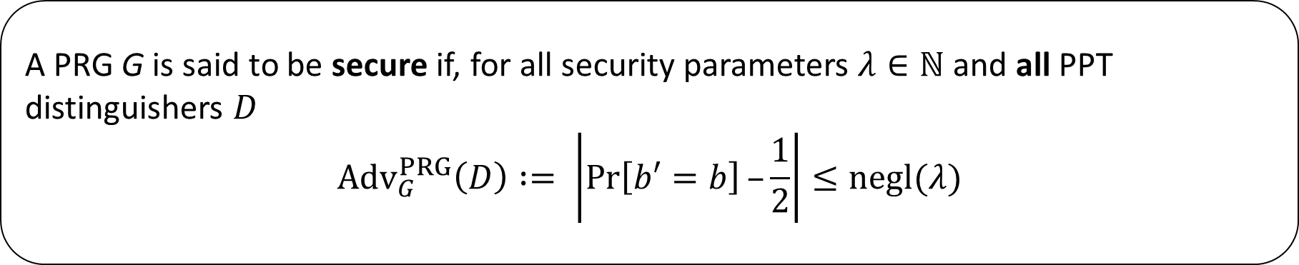
Security of PRG
Definition (asymptotic)
A PRG G is said to be secure if, for all security parameters $λ∈ℕ$ and all PPT distinguishers $D$
$${Adv}_{G}^{PRG}\left(D\right) := \left|\operatorname{Pr}\left[b′=b\right]–\frac{1}{2}\right|≤negl(λ)$$

Slide 54
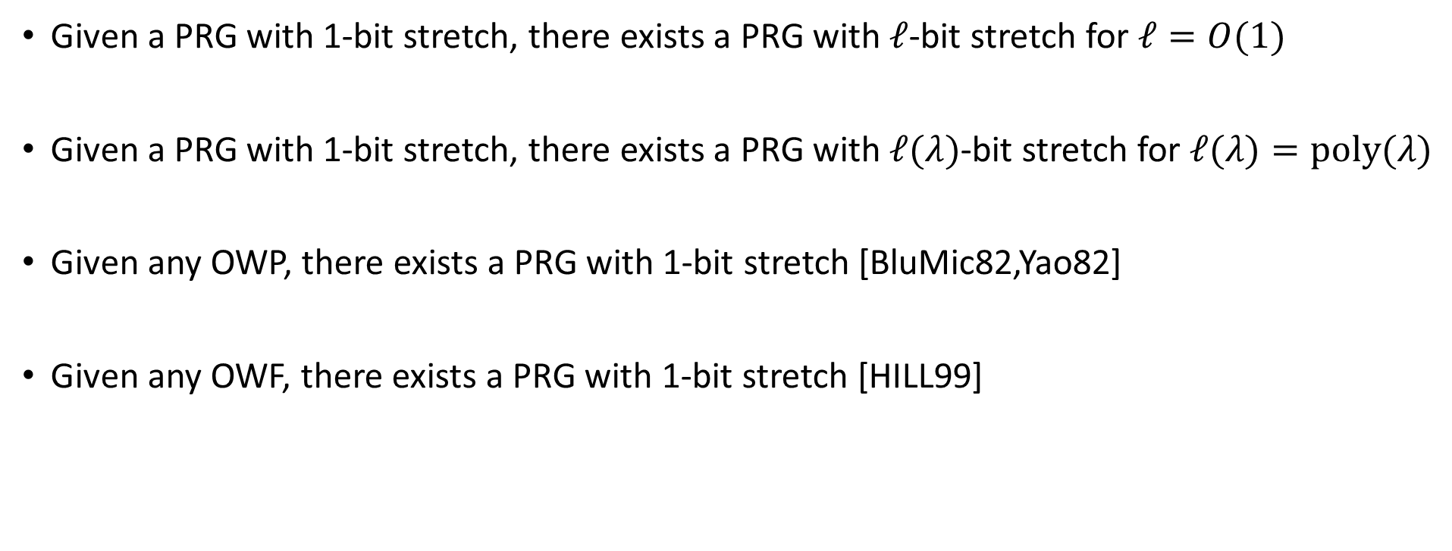
Some results about PRGs (some proofs on the board)
Given a PRG with 1-bit stretch, there exists a PRG with $ℓ$-bit stretch for $ℓ=O(1)$
Given a PRG with 1-bit stretch, there exists a PRG with $ℓ(λ)$-bit stretch for $ℓ(λ)=poly(λ)$
Given any OWP, there exists a PRG with 1-bit stretch [BluMic82,Yao82]
Given any OWF, there exists a PRG with 1-bit stretch [HILL99]

Slide 55


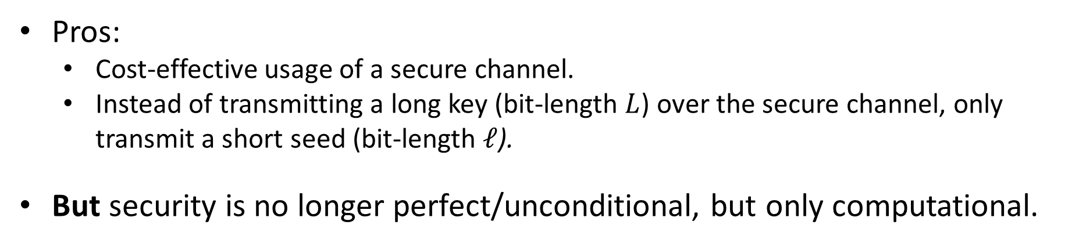



Using a PRG to realize efficient one-time pad
$s$ (length $ℓ$)
$$G$$
$$K0 , K1 ,…, K_{L−1}$$
⊕
$$P0 , P1 ,…, P_{L−1}$$
$$C0 , C1 ,…, C_{L−1}$$
Pros:
  Cost-effective usage of a secure channel.
  Instead of transmitting a long key (bit-length $L$) over the secure channel, only transmit a short seed (bit-length $ℓ$).
But security is no longer perfect/unconditional, but only computational.

Slide 56
Using a PRG to realize efficient one-time pad
$s$ (length $ℓ$)
$$G$$
$$K0 , K1 ,…, K_{L−1}$$
⊕
$$P0 , P1 ,…, P_{L−1}$$
$$C0 , C1 ,…, C_{L−1}$$
Board exercise: How to argue security of the efficient one-time pad?

Slide 57
PRGs in use: KeyStream Generators (KSGs)

Slide 58
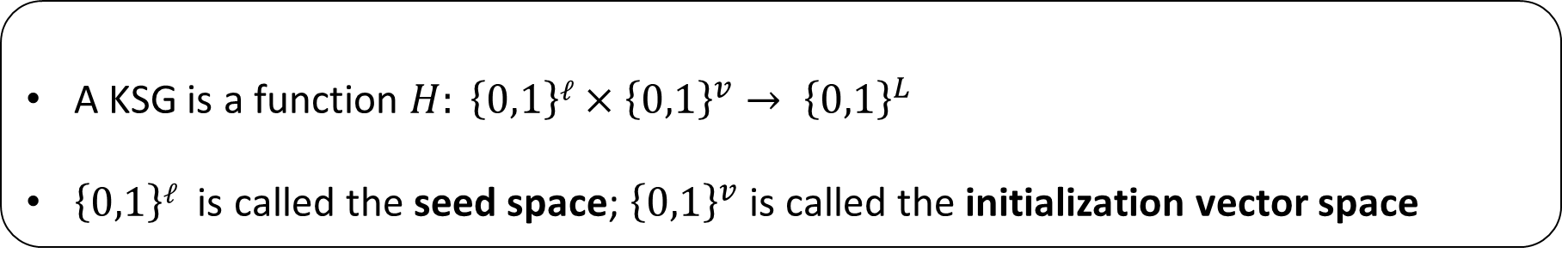
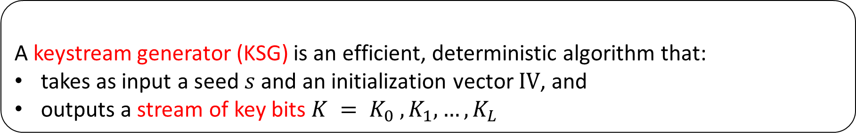
Keystream Generators
Keystream Generators
A keystream generator (KSG) is an efficient, deterministic algorithm that:
takes as input a seed $s$ and an initialization vector $IV$, and
outputs a stream of key bits $K = K_{0} , K_{1},…, K_{L}$
Formal syntax
A KSG is a function $H: \left\{0,1\right\}ℓ×{\left\{0,1\right\}}^{v}→ {\left\{0,1\right\}}^{L}$
$\left\{0,1\right\}ℓ$ is called the seed space; ${\left\{0,1\right\}}^{v}$ is called the initialization vector space
IV is typically set to be a counter in applications (need not be secret for security of KSG)

Slide 59
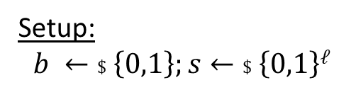
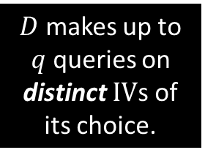









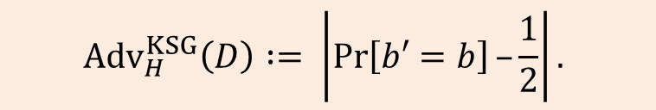
Security of KSG
KSG $H: \left\{0,1\right\}ℓ×\{0,1\}v → \{0,1\}L$
Setup:
$$b ←\$ \left\{0,1\right\};s←\$ \left\{0,1\right\}ℓ$$
$b =0$:
Distinguisher $D$
$$IV∈{\left\{0,1\right\}}^{v}$$
$$r =H(s,IV)$$
$$r∈{\left\{0,1\right\}}^{L}$$
$D$ makes up to $q$ queries on distinct $IV$s of its choice.
$b =1$:
$$r ←\$ {\{0,1\}}^{L}$$
$$b′$$
$${Adv}_{H}^{KSG}\left(D\right) := \left|\operatorname{Pr}\left[b′=b\right]–\frac{1}{2}\right|.$$

Slide 60


Security of KSG
Definition (concrete)
A KSG $H$ is said to be $(q,t,ε)$-secure if, for all distinguishers $D$ running in time at most $t$ and making at most $q$ queries on distinct $IV$s
$${Adv}_{H}^{KSG}\left(D\right) = \left|\operatorname{Pr}\left[b′=b\right]–\frac{1}{2}\right|≤ε$$
Bit $b$ and seed $s$ are chosen once, queries made by the adversary are adaptive.
Adversaries allowed to repeat IVs can trivially win the distinguishing game (why?)

Slide 61
KSG from PRGs
A KSG can be built from a PRG via careful design choices that combine the key and the seed of the KSG into the seed of the PRG.
Bad design choices can lead to catastrophic security vulnerabilities:
  Example: Wired Equivalent Privacy or WEP – an algorithm for 802.11 wireless networks, introduced as part of the IEEE 802.11 standard ratified in 1997).
In practice, use dedicated designs that mix key and IV together before producing the keystream.

Slide 62




Using a KSG to realize efficient one-time pad
$$s$$
$$IV$$
$$H$$
$$K0 , K1 ,…, K_{L−1}$$
⊕
$$P0 , P1 ,…, P_{L−1}$$
$$C0 , C1 ,…, C_{L−1}$$
Pros:
  Only transmit a short seed (bit-length $ℓ$).
  IV can be sent publicly over the insecure channel along with $C=(C_{0},…,C_{L−1})$
Again, security is not perfect/unconditional, but only computational.

Slide 63
Using a KSG to realize efficient one-time pad
$$s$$
$$IV$$
$$H$$
$$K0 , K1 ,…, K_{L−1}$$
⊕
$$P0 , P1 ,…, P_{L−1}$$
$$C0 , C1 ,…, C_{L−1}$$
Argument for security – similar to that for the PRG-based one-time pad

Slide 64
KSGs/PRGs in practice

Slide 65

Stream cipher
A stream cipher attempts to efficiently replicate the properties of the one-time pad:
One-time pad: Key $K = K0 , K1 , K2 ,…$ : a sequence of random bits
Stream cipher: Keystream $K = K0 , K1 , K2 ,…$ : a sequence of pseudorandom bits
Security (pseudorandom bits):
Indistinguishable from random bits to a computationally bounded adversary.
Based on practical variants of a PRG

Slide 66


Examples of stream ciphers: RC4
RC4 State
Byte permutation and indices i and j
RC4 Key scheduling
RC4 Keystream generation
MAC tag
MAC tag

Slide 67
Examples of stream ciphers: RC4
Designed by Ron Rivest in late 1980s, became public in 1994.
  A byte-oriented algorithm with a variable-length key.
  Elegant design, fast in software, very compact description, easy to implement in a few lines of ‘C’.
  Heuristic realization of a PRG rather than a KSG – input is a key K, and there is no IV.
Became very widely adopted in secure communications protocols:
  TLS, WEP, WPA/TKIP, Kerberos.
RC4 has serious security vulnerabilities and is now deprecated

Slide 68

Examples of stream ciphers: A5/1
Linear Feedback Shift Register (LFSR)-based design with stuttered clocking.
Usage: 1980s till present day.
Fast, low gate-count in hardware
  Throughput: 114 bits/4.615ms
Significant cryptanalysis.
  Now considered insecure
  Can recover key in a few seconds given a few hundred known plaintext bits.

Slide 69
Modern examples of stream ciphers
Stream ciphers standardized by NIST (US):
  AES in counter mode (in a few slides).
Stream ciphers with IV identified by eSTREAM (EU project, 2008):
  Profile 1 (“high throughput software applications”)
    HC-128, Rabbit, Salsa20/12, SOSEMANUK
  Profile 2 (“hardware applications with limited silicon area, power”)
    Grain , MICKEY, Trivium
Later development: ChaCha, a variant of Salsa, adopted by IETF for use in TLS.
    Also, the default cipher in OpenSSH since release 6.8.
    Also, used in Signal, Noise protocol framework, …

Slide 70
Security issues with stream ciphers in practice
Keystream reuse
Inherent weaknesses in generated keystream
Complete lack of integrity checks

Slide 71
Security issues with stream ciphers in practice
Keystream reuse
Inherent weaknesses in generated keystream
Complete lack of integrity checks

Slide 72

Keystream reuse
Suppose plaintexts $P1 , P2$ are encrypted with the same keystream $K$. So:
$C 1= P1  K, C2 = P2  K.$
Then, given $C1$ and $C2$ , the adversary obtains: $C 1  C2 = P1  P2$
From $P1  P2$, it may be possible to learn the individual plaintexts $P1$ and $P2$.
  Depends heavily on the plaintext distribution/statistics
  Possible for natural language, application protocols such as HTTP, etc.
  See Mason et al., “A Natural Language Approach to Automated Cryptanalysis of Two-time Pads” (https://www.cs.jhu.edu/~jason/papers/mason+al.ccs06.pdf).

Slide 73


Keystream reuse in practice: Example-1
Lorenz cipher: A stream cipher operating on 5-bit teletype characters (used by German high command in WWII for wireless communications).
August 1941: Operator error led to a repeated keystream
  Revealed by repeated IV “HQIBPEXEZMUG”.
British recovered $P1  P2$, then $P1$ and $P2$, then the keystream (John Tiltman), and eventually reconstructed the entire Lorenz cipher (William Tutte and others).
  Developed some of the first electronic computers to industrialise the breaking of Lorenz (Tommy Flowers and the Colossus).
… the British never saw an actual Lorenz machine.

Slide 74

Keystream reuse in practice: Example-2
WEP (as used in WLANs) uses the RC4 stream cipher with a 40-bit seed $s$ and a 24-bit initialization vector $IV$.
  IV and seed are concatenated to make the actual RC4 seed: $s’ = IV ||s$.
  The seed is typically set by the user once and left fixed forever.
  The IV is usually a counter (incremented for each frame sent on the network).
Every $2^{24}$ frames, the seed and IV used as input to RC4 will repeat.
  This results in repeated keystreams.
  WEP has worse problems: combination of seed and IV by concatenation leads to correlations between seed bytes and output bytes.

Slide 75
Security issues with stream ciphers in practice
Keystream reuse
Inherent weaknesses in generated keystream
Complete lack of integrity checks

Slide 76
Keystream biases: Example for RC4
For many stream ciphers, keystreams can be efficiently distinguished from random in practice using simple statistical tests.
Example (RC4):
  Mantin-Shamir (2001): Prob[second byte in RC4-generated keystream = 0x00] = 1/128 (ideally 1/256).
  Fluhrer-McGrew (2000) and Mantin (2005): multibyte biases in RC4-generated keystream.
  AlFardan-Bernstein-Paterson-Poettering-Schuldt (2013): for 128-bit seeds, all of the first 256 keystream bytes of RC4 are biased!
These biases can be exploited to produce near-practical attacks on RC4 in various applications, including TLS and WPA/TKIP (the successor to WEP).
  See for example https://www.usenix.org/conference/usenixsecurity13/technical-sessions/paper/alFardan

Slide 77
Security issues with stream ciphers in practice
Keystream reuse
Inherent weaknesses in generated keystream
Complete lack of integrity checks

Slide 78

Stream ciphers do not provide integrity
Stream ciphers provide no integrity (authorization checks) against active attackers.
Flipping a bit ($0→1$or $1→0$) in the ciphertext stream has the effect of producing a bit-flip in the plaintext stream in the same position:
$C i = P_{i}⊕ K_{i} ⇒ C_{i} ⊕1 =\left(P_{i}⊕1\right)⊕K_{i}$
Hence decryption algorithm will output $P_{i}⊕1$ instead of $Pi$.
  Undetectable plaintext modifications by active adversary.
  Highlights the general fact that encryption does not provide integrity.
  Can lead to practical attacks on real systems (more later).

