Slide 1


Applied MPC:
Practical Secure Machine Learning – Part 2
Nishanth Chandran
(Microsoft Research India)

Slide 2
Protocols to support?
Part 3: Crypto protocols
Addition
Multiplication
Matrix Multiplication
Convolutions
Truncations
ReLU, Derivative of ReLU
Maxpool, Averagepool
Transcendental (Splines)
Arithmetic Computation:
Beaver Triples based protocols
Before the break: FSS protocols for equality test and comparison
Boolean Computation (Many options):
Garbled Circuit (GC)
Secret Sharing
Function Secret Sharing
Now:
FSS protocols for splines (and ReLU)

Slide 3
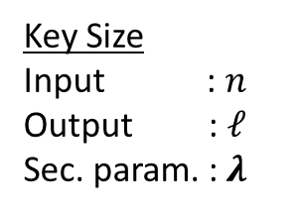
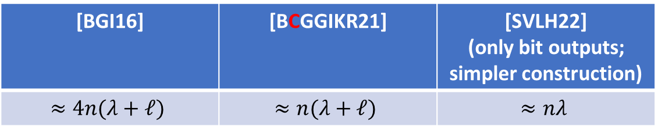
DCF [BGI16, BCGGIKR21, SVLH22]
Boyle, C, Gilboa, Gupta, Ishai, Kumar, Rathee;
“Function Secret Sharing for Mixed-Mode and Fixed-Point Secure Computation”, Eurocrypt 2021
Key Size
Input : $n$
Output : $ℓ$
Sec. param. : $λ$
[BGI16] | [BCGGIKR21] | [SVLH22] (only bit outputs; simpler construction)
$$≈4n(λ+ℓ)$$ | $$≈n(λ+ℓ)$$ | $$≈nλ$$

Slide 4
Why care about correlation size?

Slide 5
Effects of reducing correlation size
Part 3: Crypto protocols
Boolean Computations
FSS approach benefits:
FSS approach bottlenecked by:
Low online rounds
Low online communication
High correlated randomness size
Slow preprocessing phase
“Function Secret Sharing for Mixed-Mode and Fixed-Point Secure Computation”,
Boyle, C , Gilboa, Gupta, Ishai, Kumar, Rathee, EUROCRYPT 2021
Reduce correlation size for FSS
Faster preprocessing
Faster online phase (on GPUs)

Slide 6
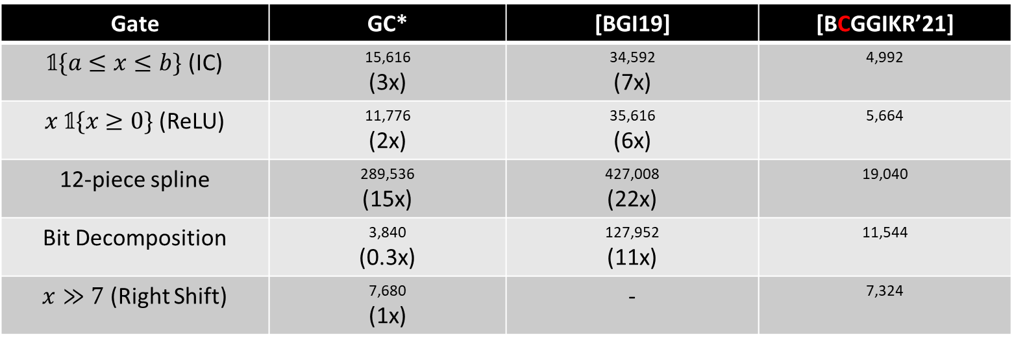

Example Correlation sizes
Part 3: Crypto protocols
Boolean Computations
Key size (correlation size)
#bits per gate; values in $ℤ_{2^{16}}$
Gate | GC* | [BGI19] | [BCGGIKR’21]
$\text{𝟙}\{a≤x≤b\}$ (IC) | 15,616 (3x) | 34,592 (7x) | 4,992
$x \text{𝟙}\{x≥0\}$ (ReLU) | 11,776 (2x) | 35,616 (6x) | 5,664
12-piece spline | 289,536 (15x) | 427,008 (22x) | 19,040
Bit Decomposition | 3,840 (0.3x) | 127,952 (11x) | 11,544
$x≫7$ (Right Shift) | 7,680 (1x) | - | 7,324

Slide 7
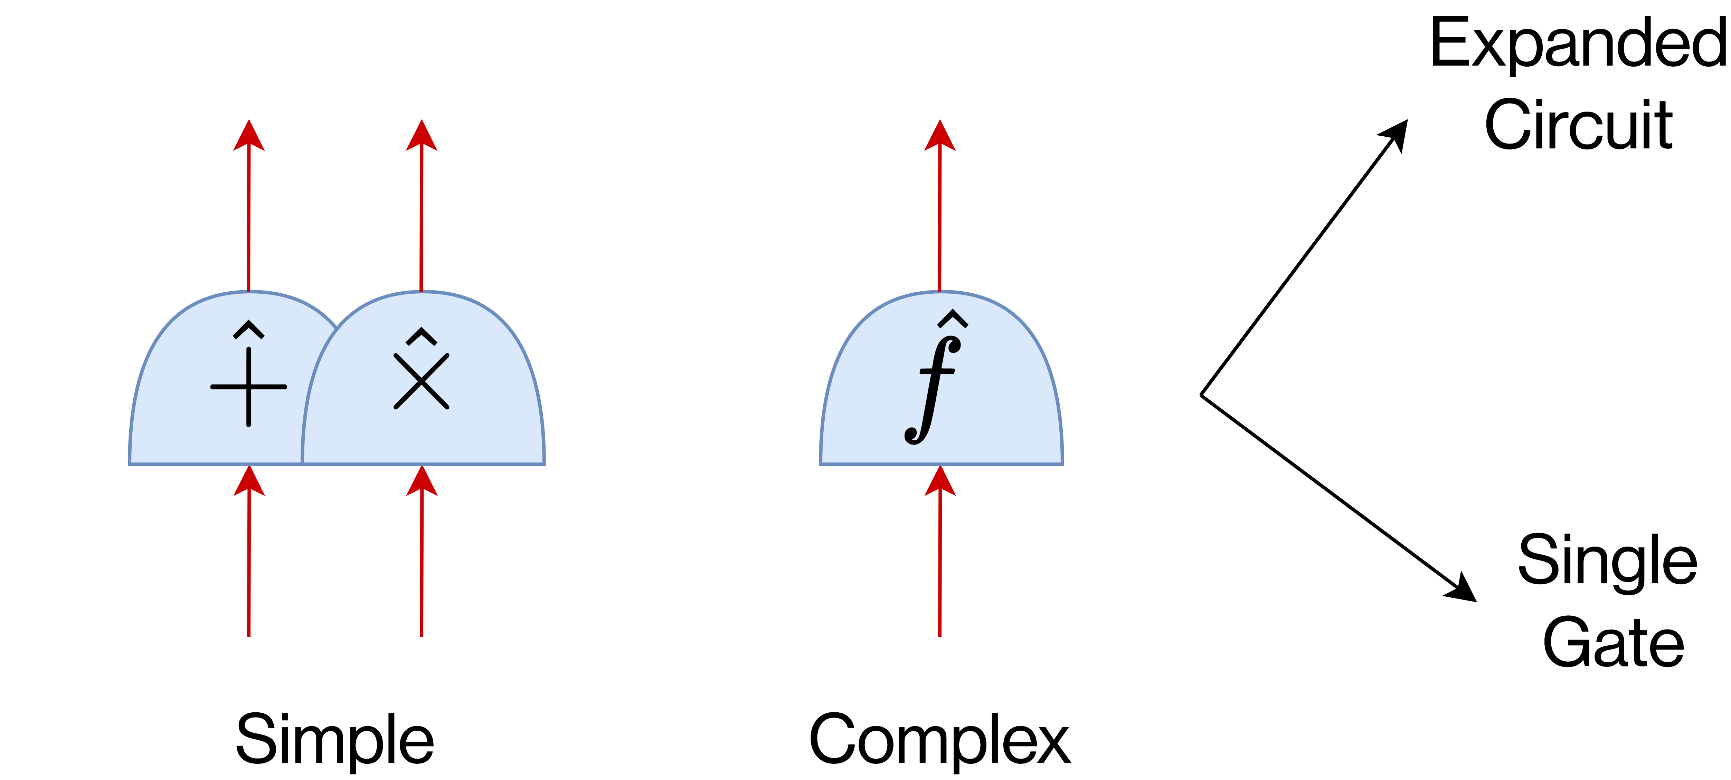
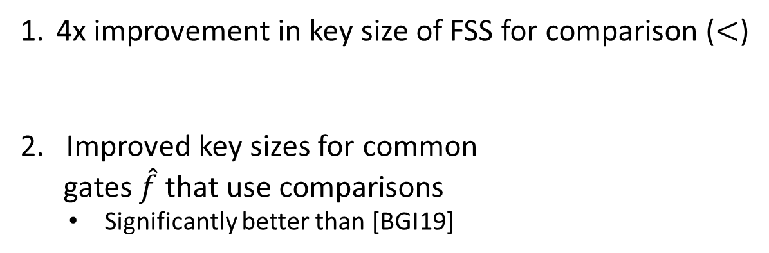
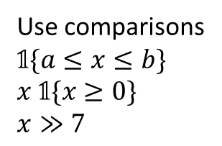
FSS protocols with improved key size
Part 3: Crypto protocols
Boolean Computations
4x improvement in key size of FSS for comparison ($<$)
2. Improved key sizes for common
gates $\hat{f}$ that use comparisons
  Significantly better than [BGI19]
Use comparisons
$$\text{𝟙}\{a≤x≤b\}$$
$x \text{𝟙}\{x≥0\}$
$x≫7$

Slide 8
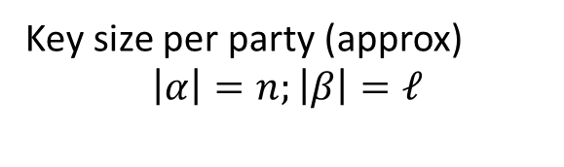
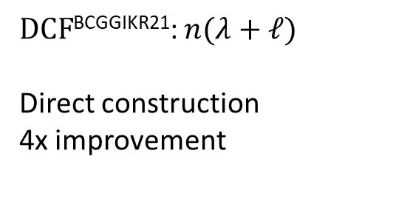
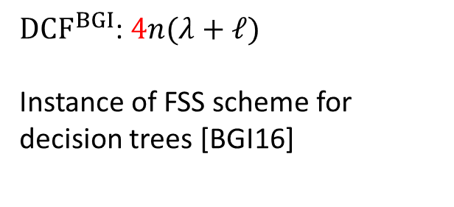
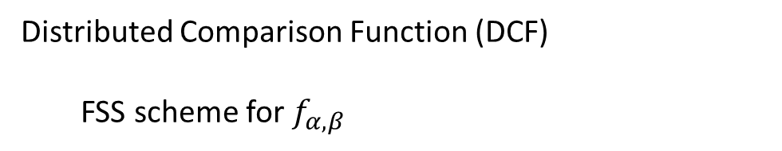
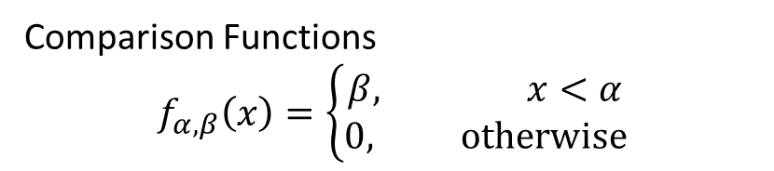
Improvement 1: DCF Key Size
Part 3: Crypto protocols
Boolean Computations
Distributed Comparison Function (DCF)
  FSS scheme for $f_{α, β}$
Comparison Functions
$$f_{α, β}\left(x\right)=\left\{\begin{aligned}β, x<α \\ &0, otherwise\end{aligned}\right.$$
Key size per party (approx)
$$\left|α\right|=n;\left|β\right|=ℓ$$
${DCF}^{BGI}$: $4n(λ+ℓ)$
Instance of FSS scheme for decision trees [BGI16]
$DCF$^{BCGGIKR21}: $n(λ+ℓ)$
Direct construction
4x improvement

Slide 9
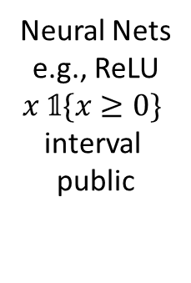
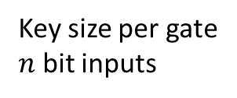
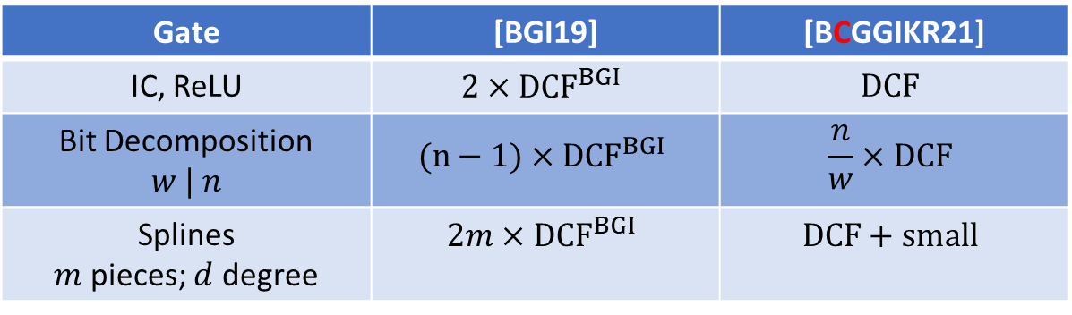
Improvement 2: # calls to DCF for Common Gates
Part 3: Crypto protocols
Boolean Computations
Key size per gate
$n$ bit inputs
Gate | [BGI19] | [BCGGIKR21]
IC, ReLU | $${2×DCF}^{BGI}$$ | $$DCF$$
Bit Decomposition $$w | n$$ | $${(n−1)×DCF}^{BGI}$$ | $$\frac{n}{w}×DCF$$
Splines $m$ pieces; $d$ degree | $${2m×DCF}^{BGI}$$ | $$DCF+small$$
Neural Nets
e.g., ReLU
$x \text{𝟙}\{x≥0\}$
interval
public
Secret intervals
Overkill
Public intervals
This leakage ok
function public
Unmasked world

Slide 10

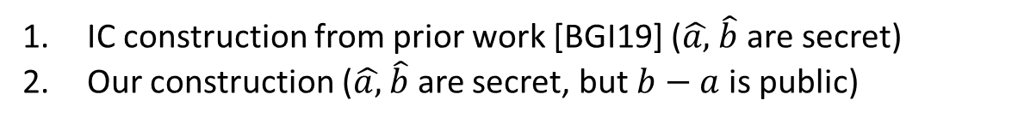

Overview
Part 3: Crypto protocols
Boolean Computations
public
unmasked $\text{𝟙}\{a≤x≤b\}$ IC
masked $\text{𝟙}\left\{\hat{a}≤x+r≤\hat{b}\right\}+s$
Secret
IC construction from prior work [BGI19] ($\hat{a,}$ $\hat{b}$ are secret)
Our construction ($\hat{a,}$ $\hat{b}$ are secret, but $b−a$ is public)

Slide 11
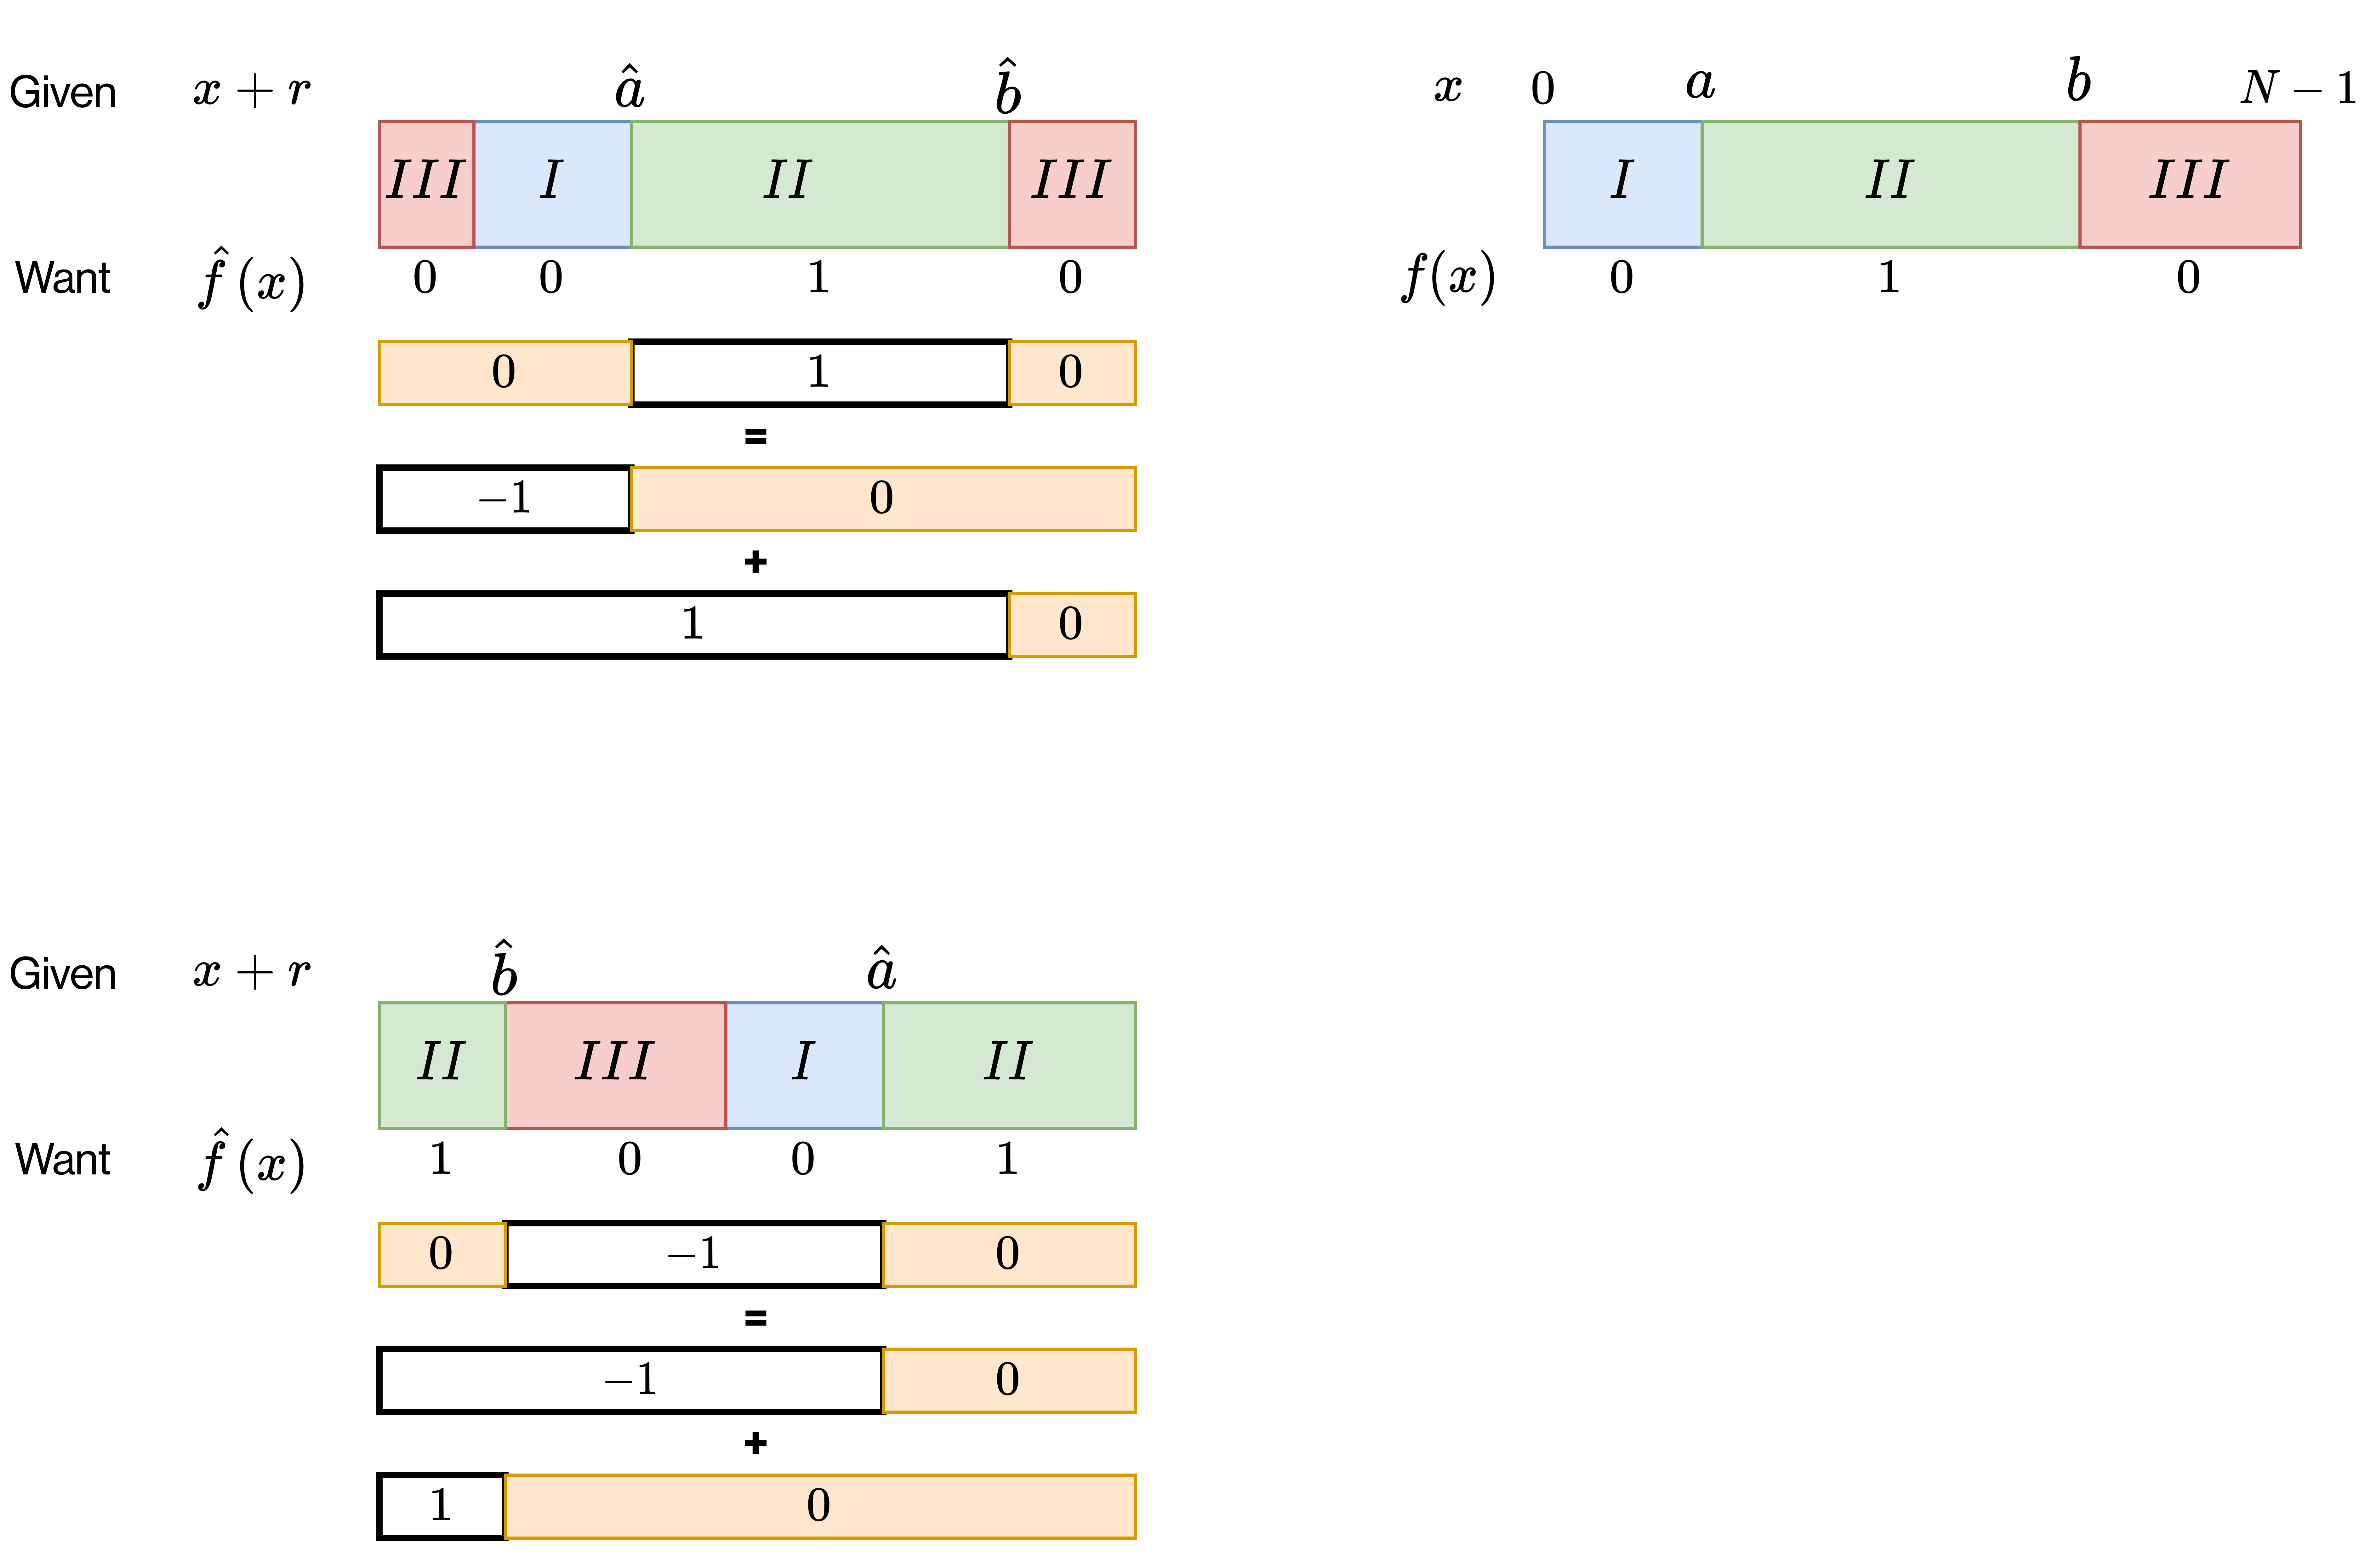





Part 3: Crypto protocols
Boolean Computations
IC FSS gate [BGI19]
Unmasked world
Masked world
$$\text{𝟙}\left\{a≤x≤b\right\}$$
Case 1
$DCF$for $\hat{a}$
$DCF$for $\hat{b}$
Correction of
0 or 1 based on case
Case 2
$DCF$for $\hat{a}$
$DCF$for $\hat{b}$

Slide 12
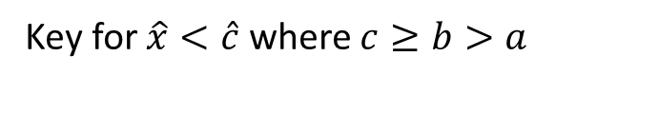
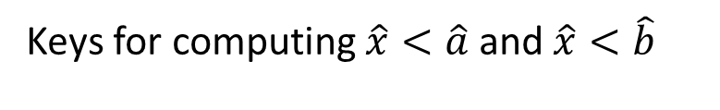
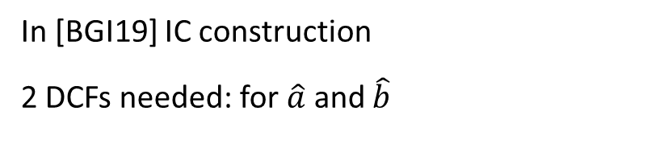
Main technical insight
Part 3: Crypto protocols
Boolean Computations
In [BGI19] IC construction
2 DCFs needed: for $\hat{a}$ and $\hat{b}$
Keys for computing $\hat{x}<\hat{a}$ and $\hat{x}<\hat{b}$
Key for $\hat{x}<\hat{c}$ where $c≥b>a$
+ some terms which don’t need DCF keys
A “universal” DCF Key
for any/all comparisons

Slide 13
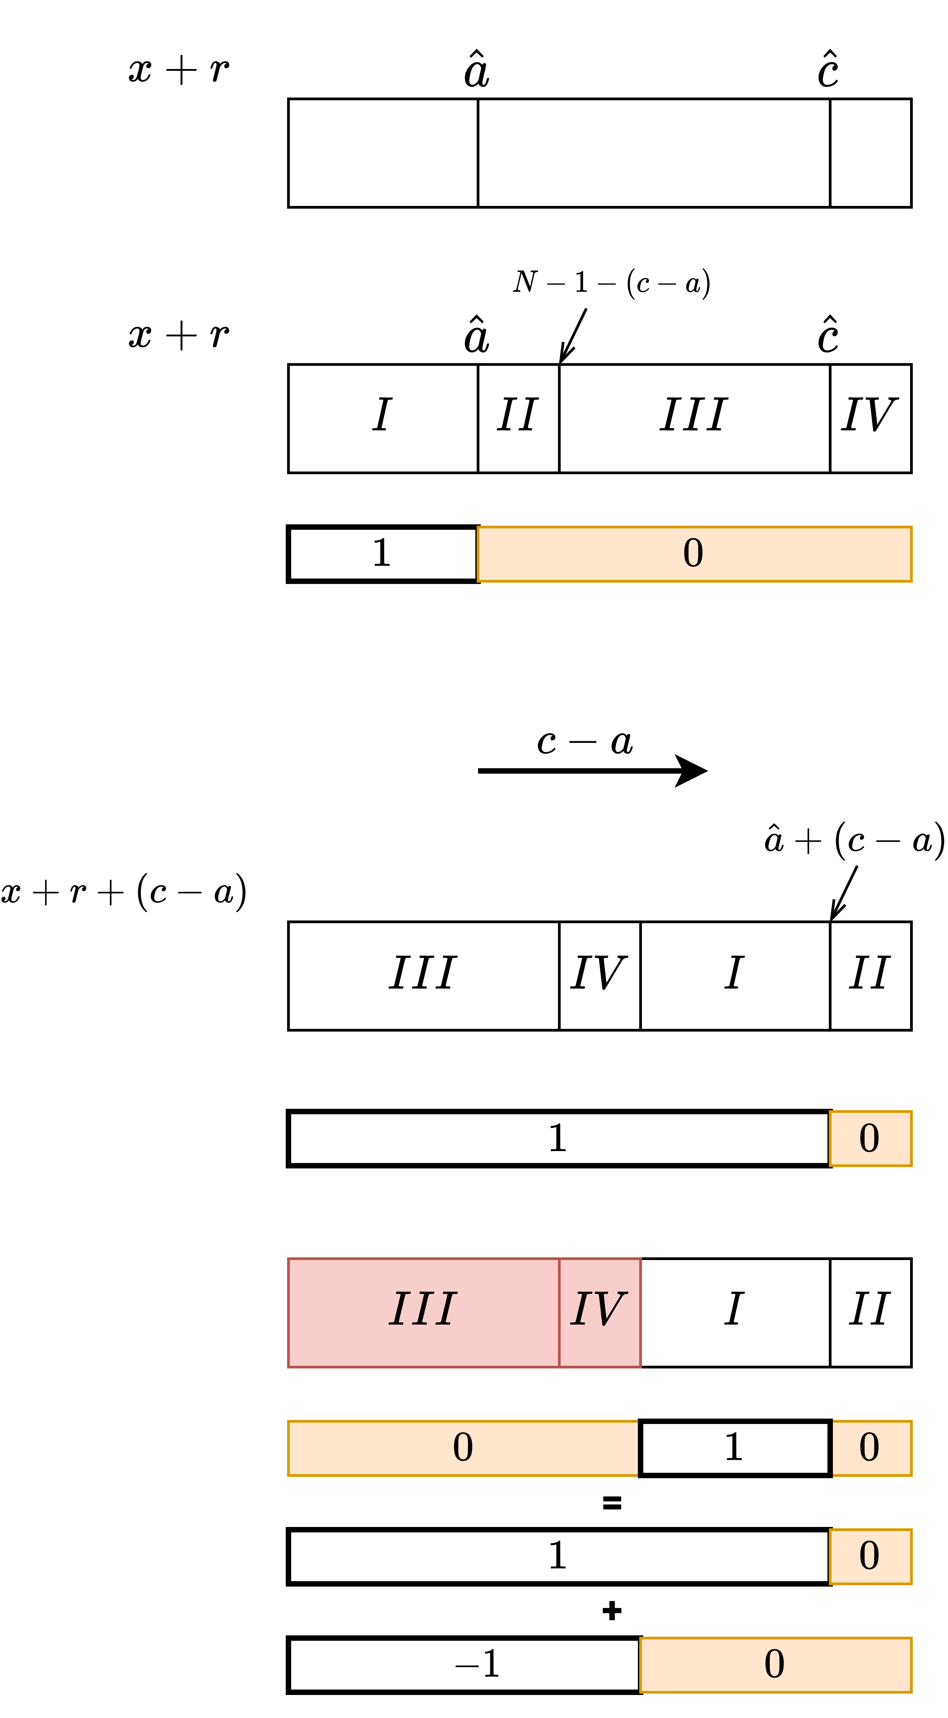
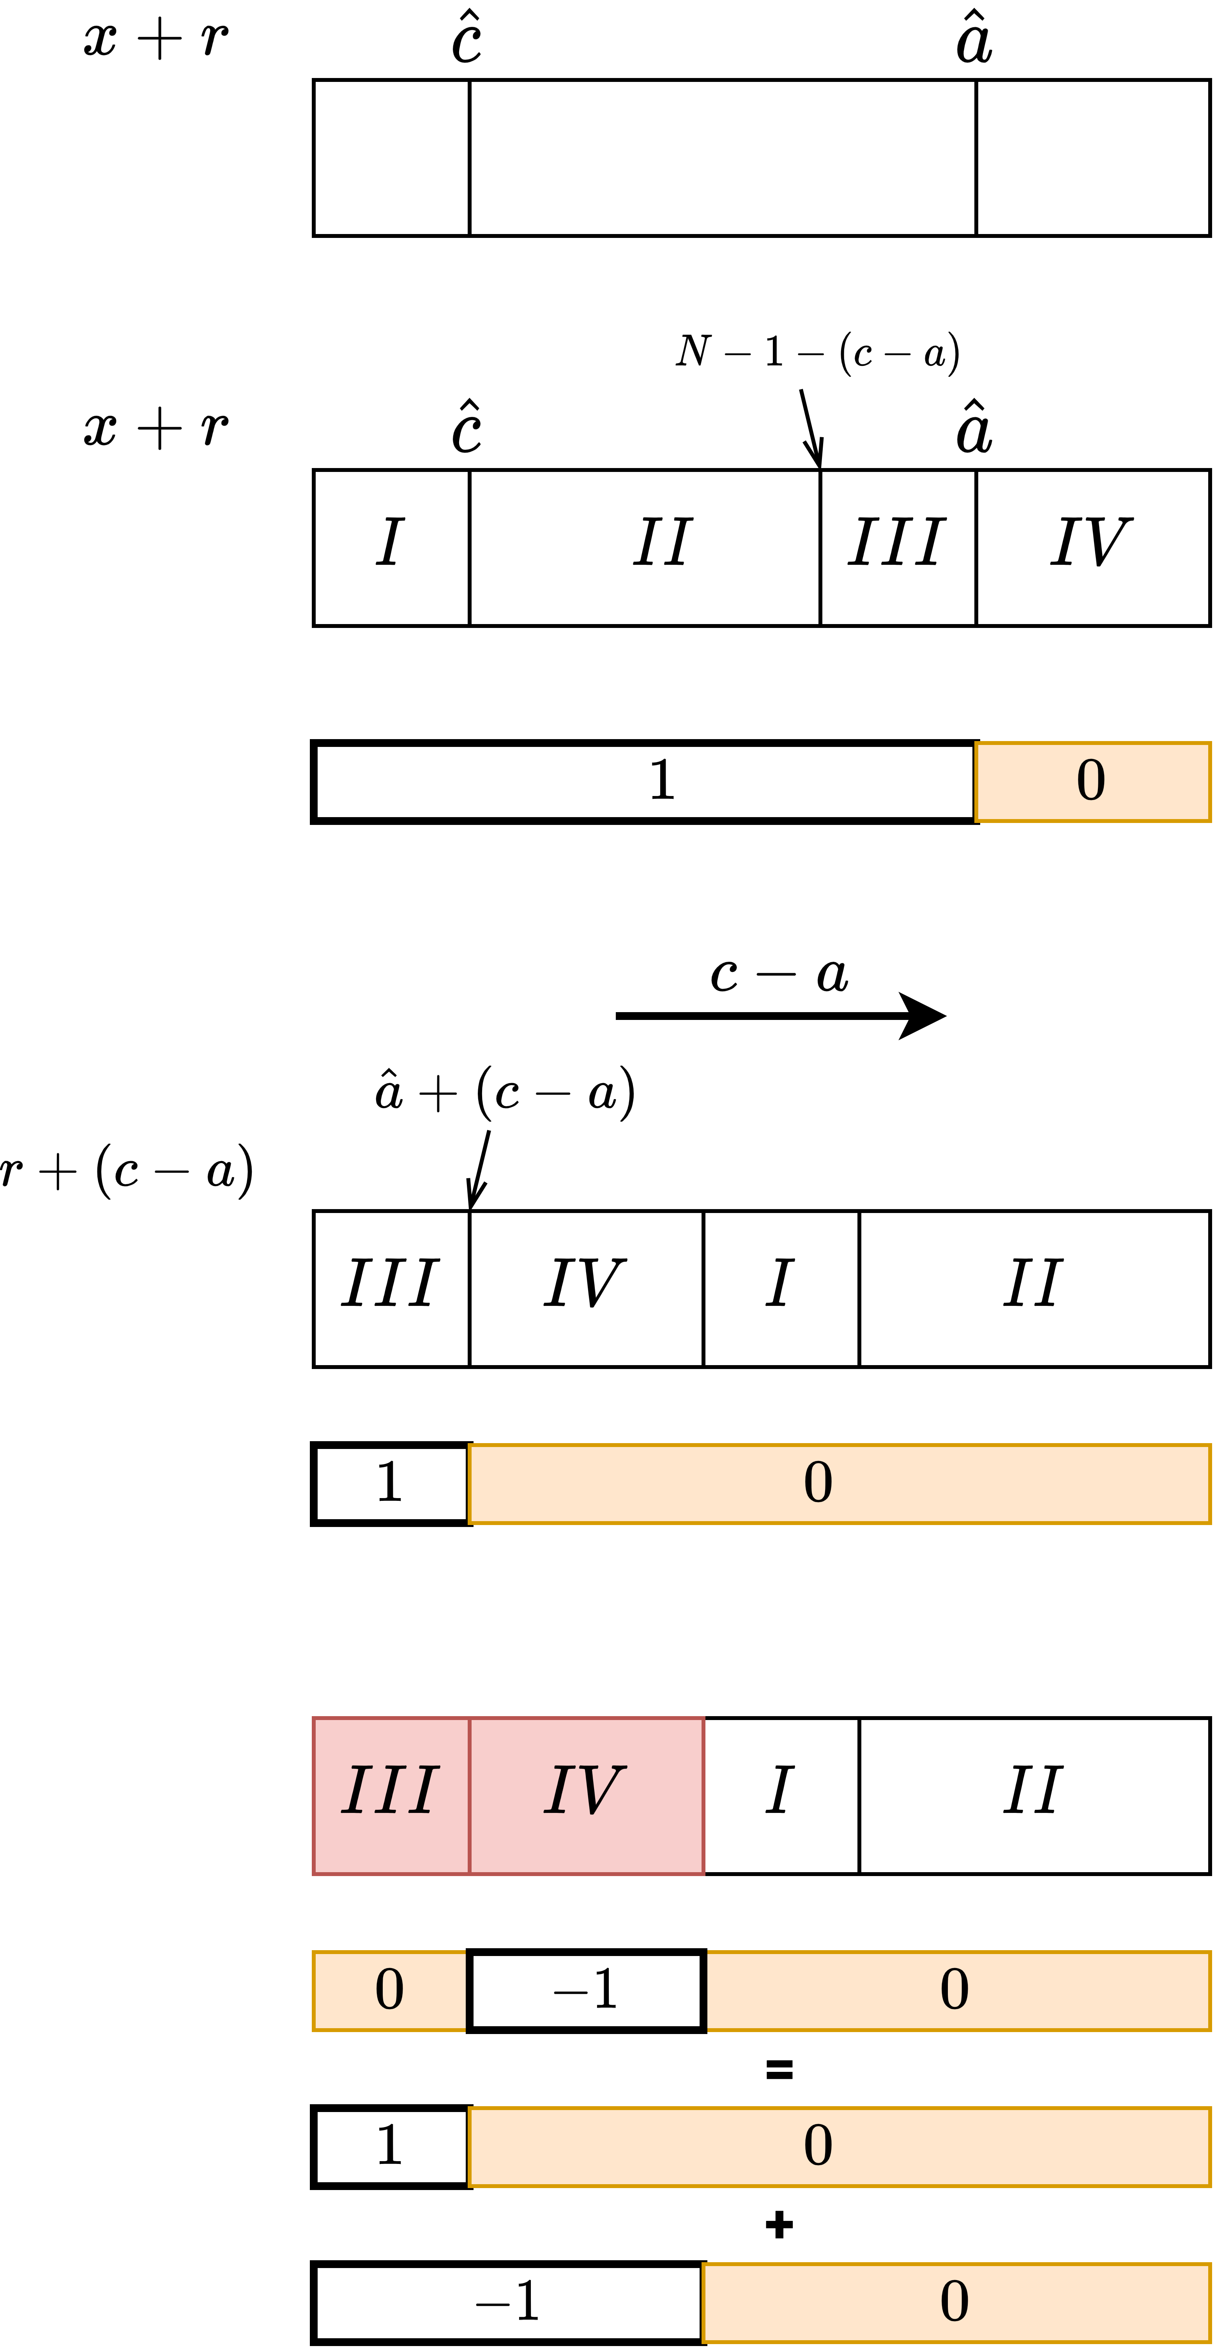

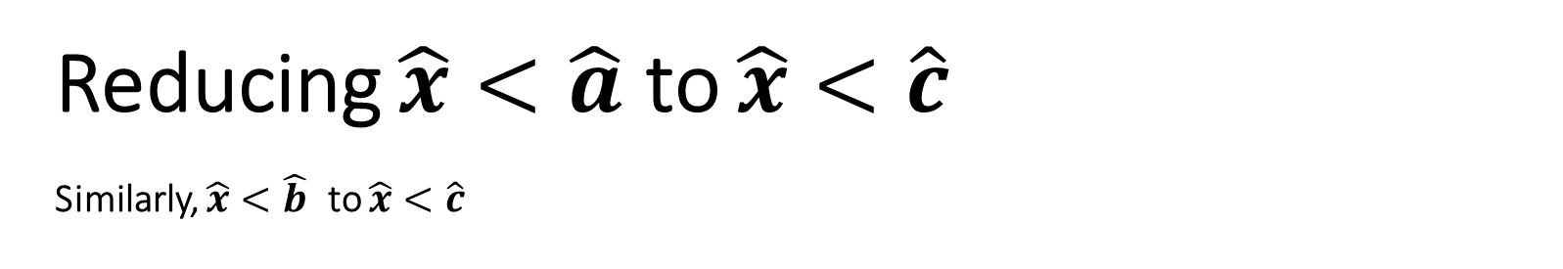


Reducing $\hat{x}<\hat{a}$ to $\hat{x}<\hat{c}$
Similarly, $\hat{x}<\hat{b}$ to $\hat{x}<\hat{c}$
Part 3: Crypto protocols
Boolean Computations
Unmasked world
Masked world
Case 1
Case 2
Correction of
0 or 1 based on case
$DCF$for $\hat{a}$
$DCF$for $\hat{c}$
Overflow
Overflow local to find
[$(\hat{x}+\left(c−a\right)>N$?]

Slide 14
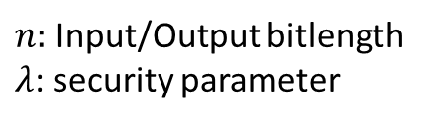
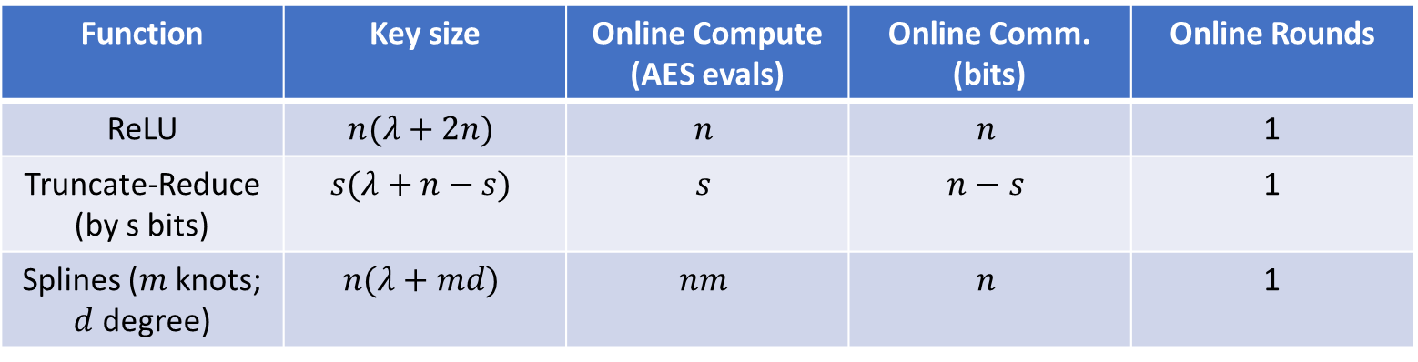
What does this give?
Part 3: Crypto protocols
$n:$ Input/Output bitlength
$λ$: security parameter
Approximate costs per party
Function | Key size | Online Compute (AES evals) | Online Comm. (bits) | Online Rounds
ReLU | $$n(λ+2n)$$ | $$n$$ | $$n$$ | 1
Truncate-Reduce (by s bits) | $$s(λ+n−s)$$ | $$s$$ | $$n−s$$ | 1
Splines ($m$knots; $d$ degree) | $$n(λ+md)$$ | $$nm$$ | $$n$$ | 1

Slide 15
Supporting Mixed-Bitwidth Computations
Part 3: Crypto protocols
Precise Low Bitwidth Computations
Low Bitwidth Splines and Math Functions (Tanh, Sigmoid)
Correct Protocols for ReLU and Truncation (No error)
E2E Inference System (CNNs, RNNs, etc.)
“LLAMA: A Low Latency Math Library”,
Gupta, Kumaraswamy, C , Gupta, PoPETS 2022

Slide 16
LLAMA: Performance
Part 3: Crypto protocols
Communication (MB)
Time (s)
Benchmark | SirNN/Delphi/CrypTFlow | LLAMA | SirNN/Delphi/CrypTFlow | LLAMA
Google-30 | 415 | 8.6 | 37.72 | 1.83
MiniONN CNN | 196 | 8.2 | 2.7 | 0.53
ResNet50 (ImageNet) | 31502 | 745 | 472 | 36
VGG16 inference on ImageNet1K using LLAMA: 32 seconds on CPUs

Slide 17
FSS based 2PC
Part 3: Crypto protocols
Online phase of 2PC in dealer model can be bottlenecked by one of:
Network Bottlenecks
Communication
e.g. Secret Sharing based 2PC
Local Bottlenecks
Computation
Key read
e.g. FSS based 2PC
Hence, FSS is an ideal candidate for hardware-based acceleration!

Slide 18
FSS on CPUs
Part 3: Crypto protocols
FSS on CPU is bottlenecked by computation!
Key Read
Computation
Communication
Iterations
Time

Slide 19
Accelerating FSS on GPUs
Part 3: Crypto protocols
We accelerate FSS computation on GPUs using several techniques:
Faster AES using scratch-pad memory
Better memory layout to get better cache-hits
“ORCA: FSS-based Secure Training with GPUs”,
Jawalkar, Gupta, Basu, C , Gupta, Sharma IEEE S&P 2024

Slide 20
FSS on GPUs
Part 3: Crypto protocols
Key read is the new bottleneck.
We make new protocols
with smaller key size!
Key Read
Computation
Communication
Iterations
Time

Slide 21
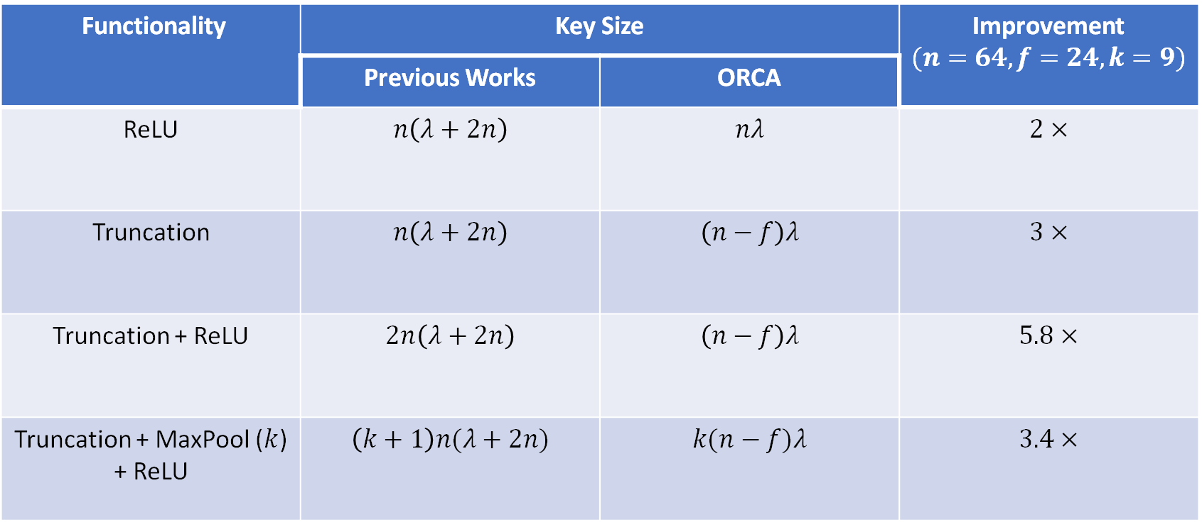
Overview of results
Part 3: Crypto protocols
Functionality | Key Size | ORCA | Improvement $$(n=64, f=24,k=9)$$
 | Previous Works | ORCA
ReLU | $$n\left(λ+2n\right)$$ | $$nλ$$ | $$2×$$
Truncation | $$n\left(λ+2n\right)$$ | $$\left(n−f\right)λ$$ | $$3×$$
Truncation + ReLU | $$2n\left(λ+2n\right)$$ | $$\left(n−f\right)λ$$ | $$5.8×$$
Truncation + MaxPool ($k$) + ReLU | $$\left(k+1\right)n(λ+2n)$$ | $$k(n−f)λ$$ | $$3.4×$$

Slide 22
Evaluation - Inference
Part 3: Crypto protocols
Dataset | Model | Time (in seconds)
 |  | PIRANHA | LLAMA | Orca
CIFAR-10 | CNN3 (100) | - | 28.2 (42x) | 0.7
 | P-VGG16 (128) | 14.1 (9.4x) | - | 1.5
ImageNet | VGG16 (1) | - | 32 (68x) | 0.33
VGG16 inference on ImageNet1K using ORCA: 330 ms on GPUs

Slide 23
Evaluation - Training
Part 3: Crypto protocols
Dataset | Accuracy |  | Time (in minutes) |  | Communication (in GB)
 | Piranha | Orca | Piranha | Orca | Piranha | Orca
MNIST | 96.8% (-0.3%) | 97.1% | 56 (4x) | 14 | 2168 (51x) | 43
CIFAR-10 | 55% (-4%) | 59% | 1179 (19x) | 63 | 65,231 (123x) | 533
 | 55% (-15%) | 70% | 1179 (7.5x) | 158 | 65,231 (49x) | 1331
Can securely train CIFAR-10 with >70% accuracy in 2.5 hours

Slide 24
Generative AI models (Transformers)?
Part 3: Crypto protocols
Challenges:
  Scale – Billions of parameters
  Heavy use of different non-linear operators – softmax, GeLU
Recent work:
  Secure inference of Generative AI models
Secure inference of GPT-Neo, LLaMA (Meta’s model) etc.
Real-time (in a few seconds)
“SIGMA: Secure GPT Inference with Function Secret Sharing”,
Gupta, Jawalkar, Mukherjee, C, Gupta, Panwar, Sharma, PoPETS 2024

Slide 25
Outline
Usability
Computation Model
Cryptographic Protocols
Libraries

Slide 26
EzPC System: ML Focus, 2PC Computation
Part 4: Case studies
Front end: TensorFlow / ONNX
Backends:
  CrypTFlow (3PC based on SecureNN)
  SCI
    CrypTFlow2 (convolutions – group, depth-wise separable etc., ReLU, Maxpool etc.)
    SiRNN (transcendental functions, mixed bitwidth)
    SecFloat (floating point arithmetic 2PC)
  LLAMA (FSS based)
  ORCA (FSS based on GPUs)
  SIGMA (FSS based on GPUs for Transformer Architectures)
https://github.com/mpc-msri/EzPC

Slide 27
MP-SPDZ: General Computation, n parties
Part 4: Case studies
Front end: Circuits, Python, TensorFlow/ONNX (through EzPC)
Backends:
  Semihonest, Malicious, (Dis)honest majority
  Computation
    Over Rings/Fields
    Binary Secret Sharing
    Garbled Circuits
https://github.com/data61/MP-SPDZ

Slide 28
Afternoon session
How to use EzPC to generate 2PC protocols for secure inference
How to use MP-SPDZ for n-PC protocols

Slide 29

Questions unanswered today
Cryptographic Secure Inference
  Preprocessing Model realization
  Better generic 2PC protocols
Limitations of Secure Inference
  Balanced Computation
  (HE become as practical/expressive as 2PC?)
  Inference outputs
  Model architecture

Slide 30
Topics not covered today
Malicious security
  2PC – based on Yao’s Garbled Circuits (cut-and-choose)
  MP-SPDZ style n-party secure computation
Private Set Intersection Techniques
  Unbalanced PSI
  Circuit PSI
  PSI-Sum/PSI-Cardinality
RAM Computation
  Binary Search
  Graph Computations/Decision Trees

