Slide 1


Applied MPC :
Practical Secure Machine Learning – Part 1
Nishanth Chandran
(Microsoft Research India)

Slide 2

Applied MPC: Areas of research
More efficient general (n,t) secure computation – semihonest, malicious, honest majority
(MP-SPDZ library)
Private Set Intersection (and friends)
Distributed Key Management
(threshold cryptography)
Sublinear computation (RAM programs, PIR etc.)
MPC for machine learning

Slide 3

Scenarios

Slide 4




Private Deployment of ML or Secure Inference (1)
Can two parties perform machine learning inference collaboratively
without revealing the model weights or input (to anyone)?
Compute Inference Results
Medical Report or Genomic Data
ML model
No information is learnt
Wants to learn prognosis
Model Weights/Prompt is IP
Patient data is sensitive

Slide 5
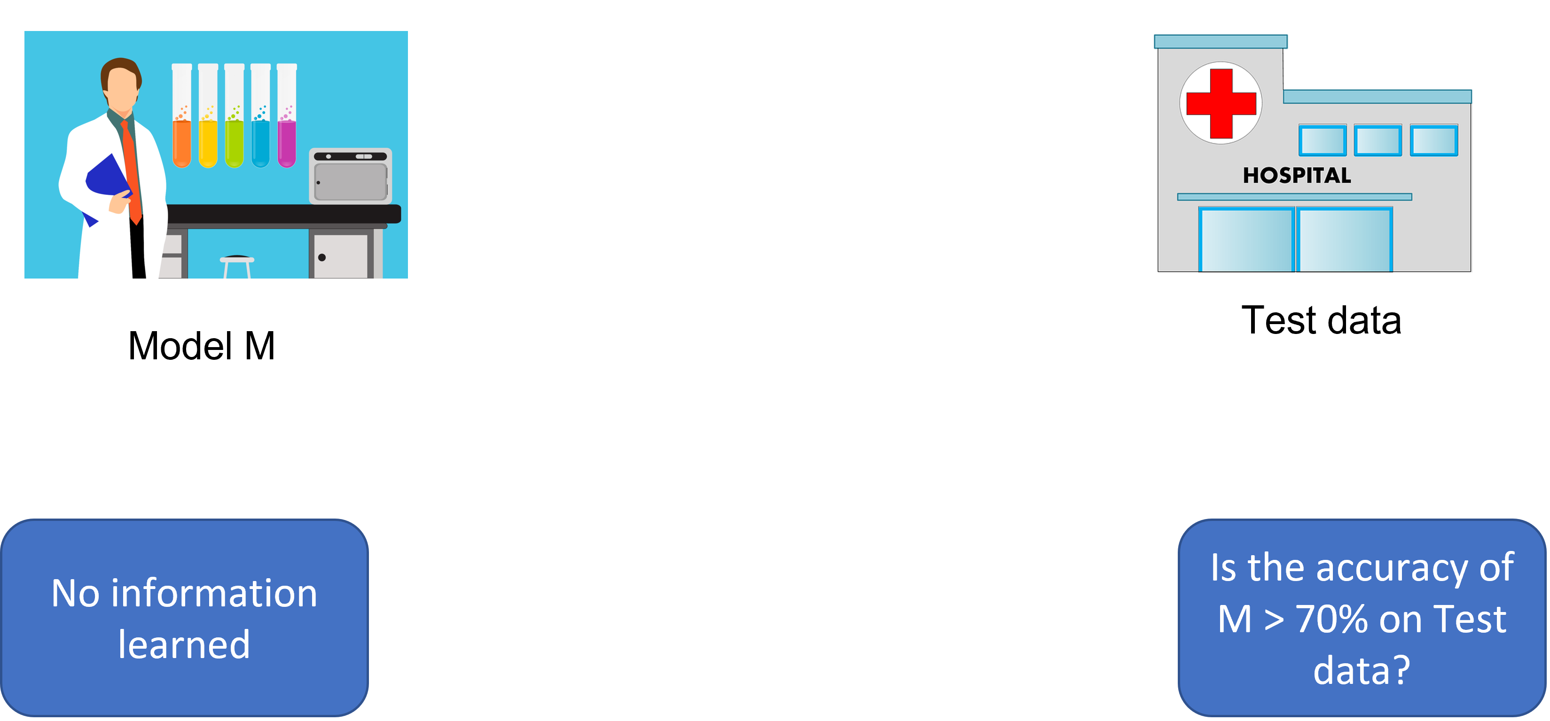
Secure AI Validation (2)
Can we determine the “goodness” of the model
without exchanging the model or test data?
AI Vendor
Hospital

Slide 6

Private Training on Joint Data (3)
Can two hospitals train an ML model on joint data
without revealing patient data to each other?
Patient Data 1
Patient Data 2

Slide 7
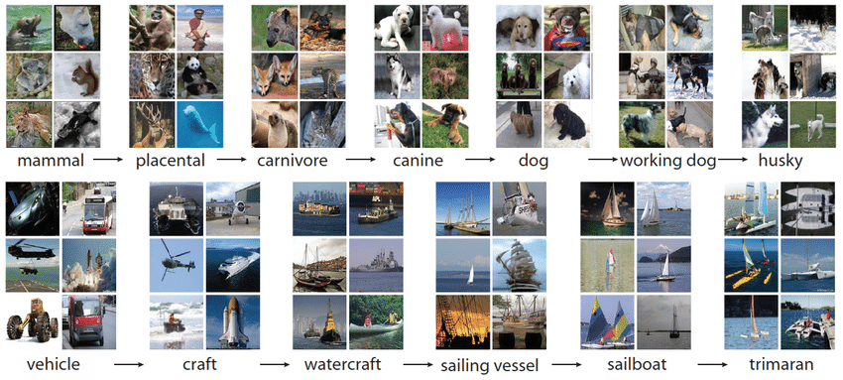
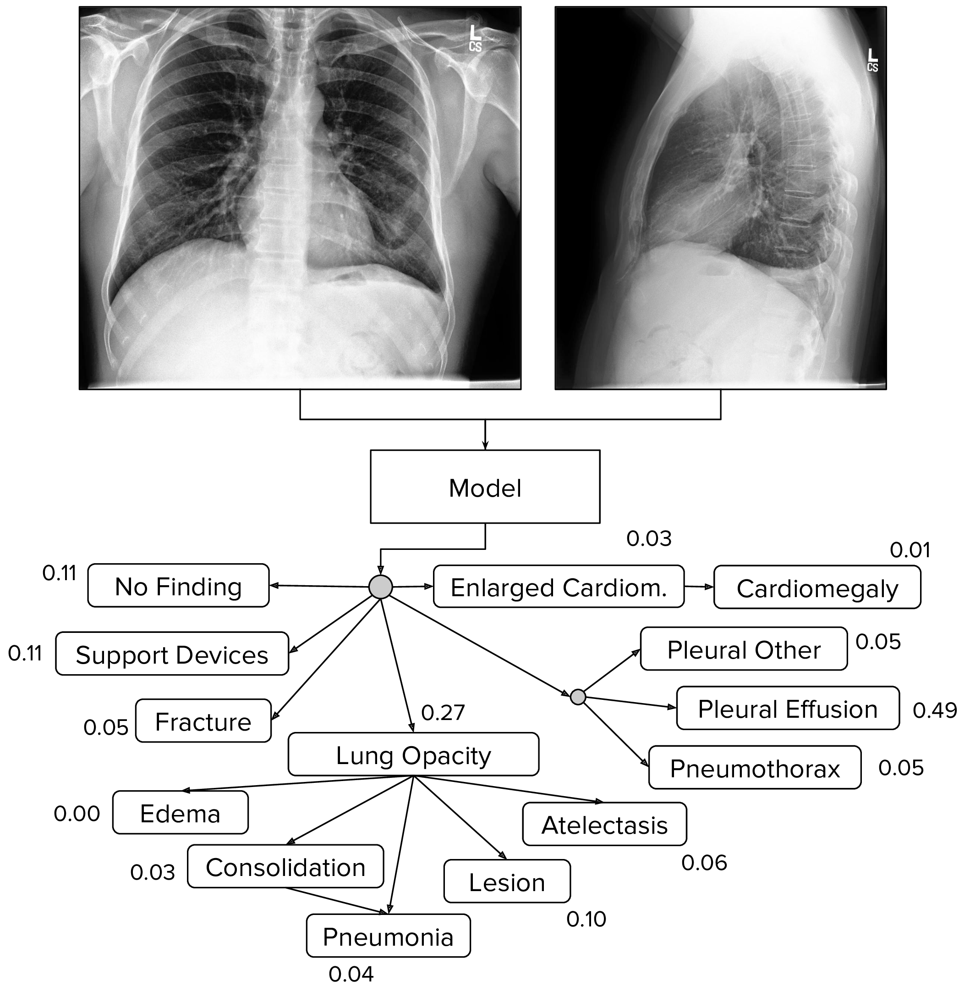
What ML tasks?
VGG16 inference on ImageNet
≈ few ms on commodity GPUs
ImageNet dataset classification (1000 classes)
E.g.: VGG16: 138 million params; 1.6x10¹⁰ flops
Chexpert dataset classification (14 classes)
E.g.: Densenet121: 8 million params; 0.3x10¹⁰ flops

Slide 8



Secure ML – with a trusted entity
Can trust in other entities be completely removed?
Outputs
Data₂
Data₁
Data₁
Data₂
OR
Trusted Third Party/ Trusted Hardware/ Confidential VMs

Slide 9












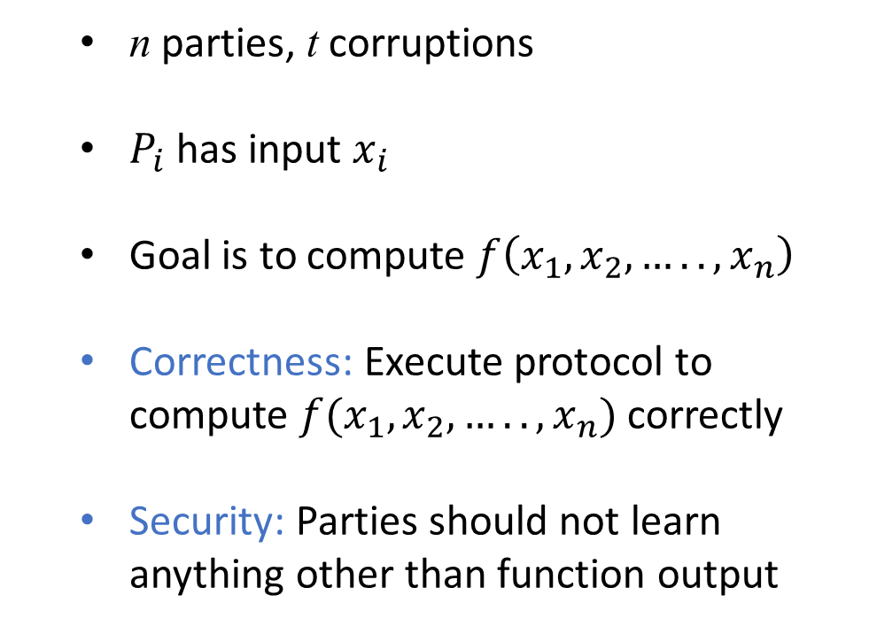
Cryptography to the rescue:
Secure Multi-party Computation (MPC)
[Yao86, GMW87, BGW88, CCD88]
  n parties, t corruptions
  $P_{i}$ has input $x_{i}$
  Goal is to compute $f\left(x_{1},x_{2},….., x_{n}\right)$
  Correctness: Execute protocol to compute $f(x_{1},x_{2},…. . ,x_{n})$ correctly
  Security: Parties should not learn anything other than function output
$$P_{1}$$
$$x_{1}$$
$$P_{2}$$
$$P_{5}$$
$$x_{5}$$
$$x_{2}$$
$$x_{4}$$
$$P_{4}$$
$$P_{3}$$
$$x_{3}$$

Slide 10
Secure Inference/Validation/Training (special case of 2PC)
M
Model Publisher
2PC to compute
M(w, x)
Model Consumer
w
x

Slide 11

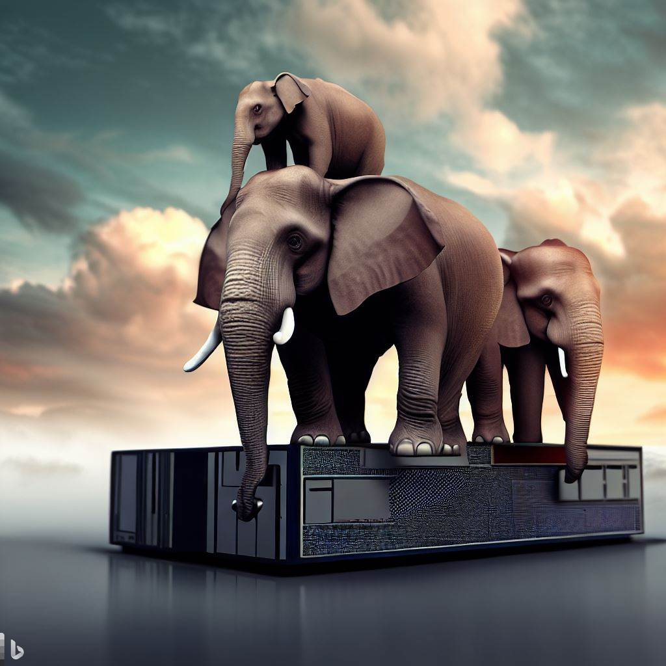

Challenges in Practical Secure ML
Usability
Scale
Performance
  ML practitioners MPC unaware
  For inference, cannot retrain
  Healthcare models large
  Trillion operations
  MPC comm. in tera/petabytes
  Hardware acceleration
EzPC: End-to-end system for practical deployment of secure machine learning

Slide 12
Outline
Usability
Usability
Computation Model
Cryptographic Protocols
Libraries

Slide 13
Hurdles in usability
Part 1: Usability
Float-to-fixed Conversion:
ML code written in floating-point (Tensorflow, ONNX, Pytorch etc.)
Expensive to emulate floating-point in MPC
Computation Nodes:
ML code has several high-level building blocks
General MPC for low-level computations
Transcendental Functions:
ML uses many transcendental functions (sigmoid, tanh etc.)
Approximations of these functions expensive or imprecise
1
2
3

Slide 14

Converting ML algorithms to fixed-point
Part 1: Usability

Slide 15
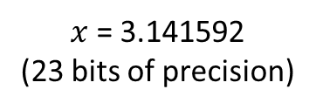



Fixed-point representation
Part 1: Usability
$$\left\lfloor x∗2^{s}\right\rfloor$$
Fixed-Point
Real value
Floating-Point
$π=$3.14159265359
$x$ = 3.141592
(23 bits of precision)
$\left(y, s\right)$where $x≈y/2^{s}$
$y$is a signed integer, higher scale $s$ implies better precision
Bitwidth | Fixed-point Number | Scale | Interpreted value | Error
16 | 25736 | 13 | 25736 / 2¹³ ≈ 3.141601 | 1x10⁻⁶
16 | 1608 | 9 | 1608 / 2⁹ ≈ 3.1406 | 1x10⁻³
16 | 101 | 5 | 101 / 2⁵ ≈ 3.156 | 1x10⁻²
16 | 25 | 3 | 25 / 2³ ≈ 3.125 | 2x10⁻²

Slide 16
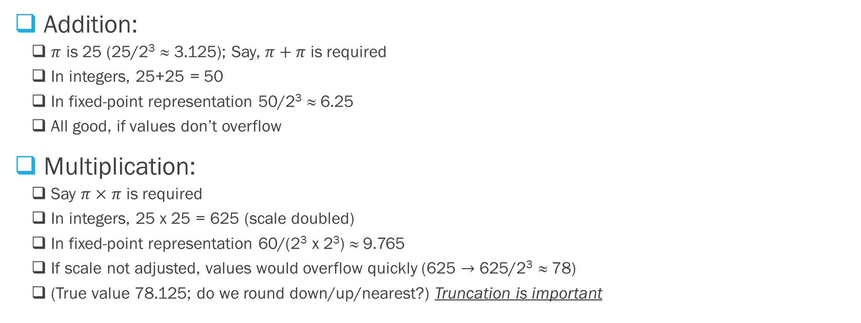
Fixed-point arithmetic
(Bitwidth = 16; scale = 3)
Part 1: Usability
Addition:
  $π$ is 25 (25/2³ ≈ 3.125); Say, $π+π$ is required
  In integers, 25+25 = 50
  In fixed-point representation 50/2³ ≈ 6.25
  All good, if values don’t overflow
Multiplication:
  Say $π×π$ is required
  In integers, 25 x 25 = 625 (scale doubled)
  In fixed-point representation 60/(2³ x 2³) ≈ 9.765
  If scale not adjusted, values would overflow quickly (625 $→$ 625/2³ ≈ 78)
  (True value 78.125; do we round down/up/nearest?) Truncation is important
Even arithmetic operations require additions, multiplications, and comparisons (for truncations)

Slide 17
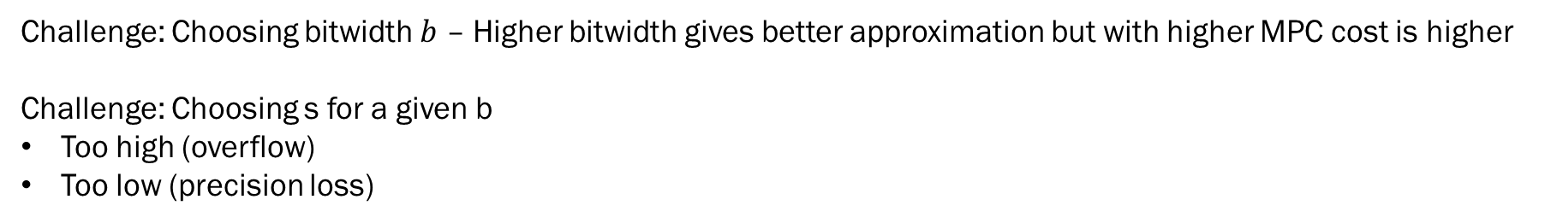
Setting bitwidth and scale (Athos)
Part 1: Usability
Kumar, Rathee, C, Gupta, Rastogi, Sharma;
“CrypTFlow: Secure TensorFlow Inference”, IEEE S&P 2020.
Challenge: Choosing bitwidth $b$ – Higher bitwidth gives better approximation but with higher MPC cost is higher
Challenge: Choosing s for a given b
Too high (overflow)
Too low (precision loss)
Compilation
Execution
(b₁,s₁)
Program - 1
Accuracy - 1
ML inference algorithm
(b₂,s₂)
Accuracy - 2
Program - 2
(b_{n},s_{n})
.
.
.
.
.
.
Program - n
Accuracy - n
Program with best classification accuracy is selected

Slide 18
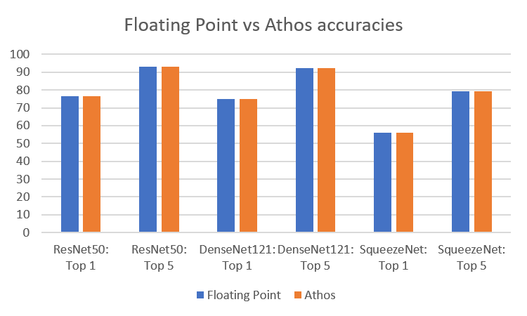
Athos: Accuracy preserving
Part 1: Usability
Kumar, Rathee, C, Gupta, Rastogi, Sharma;
“CrypTFlow: Secure TensorFlow Inference”, IEEE S&P 2020.
Compilation via Athos preserves classification accuracy of native floating-point

Slide 19
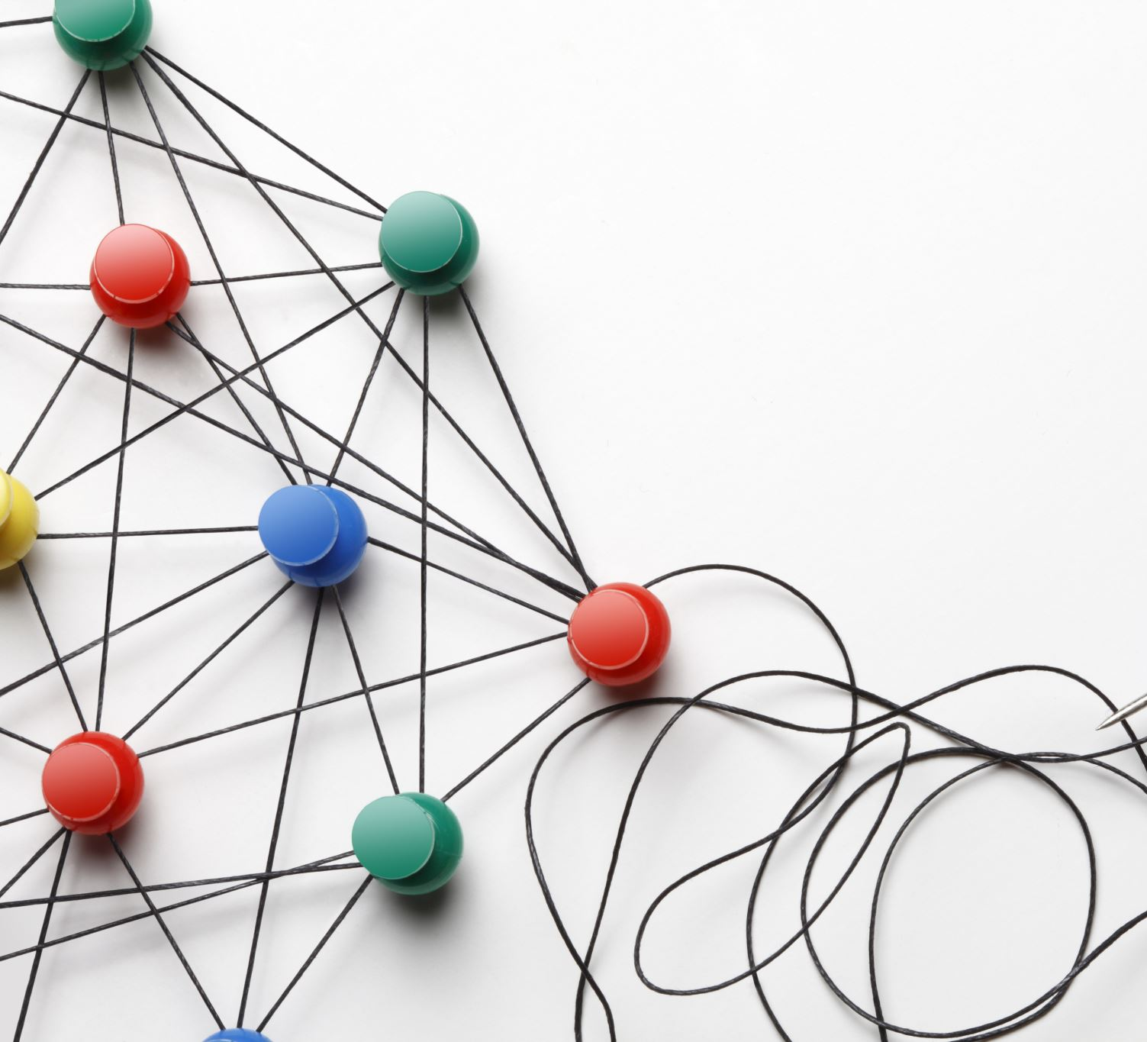
ML Compute Nodes
Part 1: Usability

Slide 20


Part 1: Usability
Kumar, Rathee, C, Gupta, Rastogi, Sharma;
“CrypTFlow: Secure TensorFlow Inference”, IEEE S&P 2020.
Usability: From TF/ONNX to MPC without crypto knowledge
ML Provider
Hospital
TF/ONNX Code
EzPC
system
Prognosis model
1
Patient data
3
3
W
x
Protocol code to securely compute F(W, x)
MPC protocol code
MPC protocol code
Protocol code to securely compute F(W, x)
2
MPC protocol execution
2
4
5
F(W, x)

Slide 21
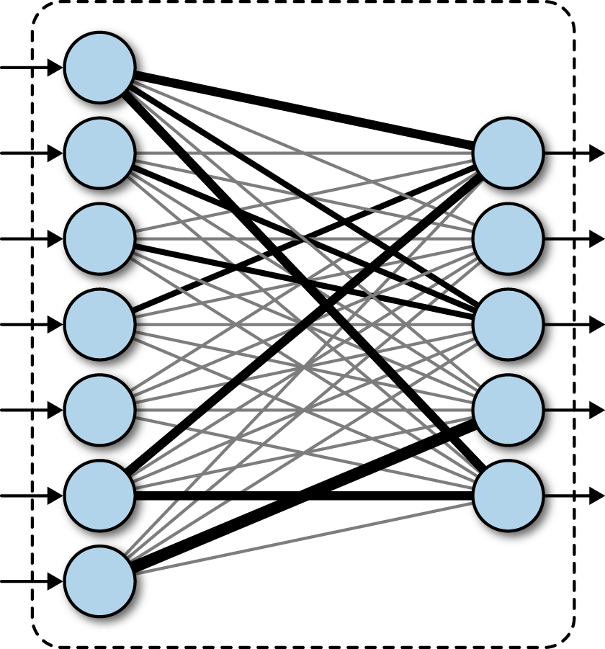
Matrix Multiplication Nodes
Part 1: Usability
Fully connected layers: Simple Matrix Multiplication
Writing as multiplications and additions inefficient
Crypto protocols must exploit structure

Slide 22
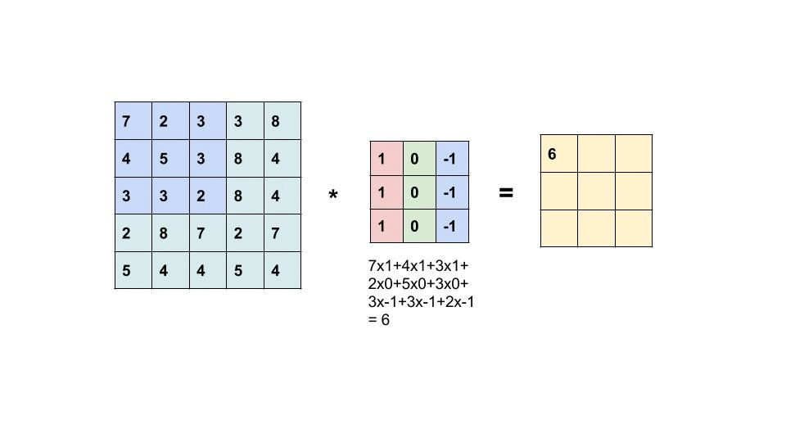
Convolutional Layer Nodes
Part 1: Usability
Convolutional layers
Writing as matrix multiplication inefficient
Specific protocols for convolutions

Slide 23
Activation/Pooling Functions
Part 1: Usability
ReLU(x) = Max(x,0)
  Requires comparison, selection
Maxpool (Max of a set of values)
  Requires set of comparisons and selections
Averagepool (Average of set of values)
  Requires addition and division/truncation
Batchnormalization
  Requires multiplications in inference
  Requires mean, variance, division in training

Slide 24

Transcendental Functions
Part 1: Usability

Slide 25
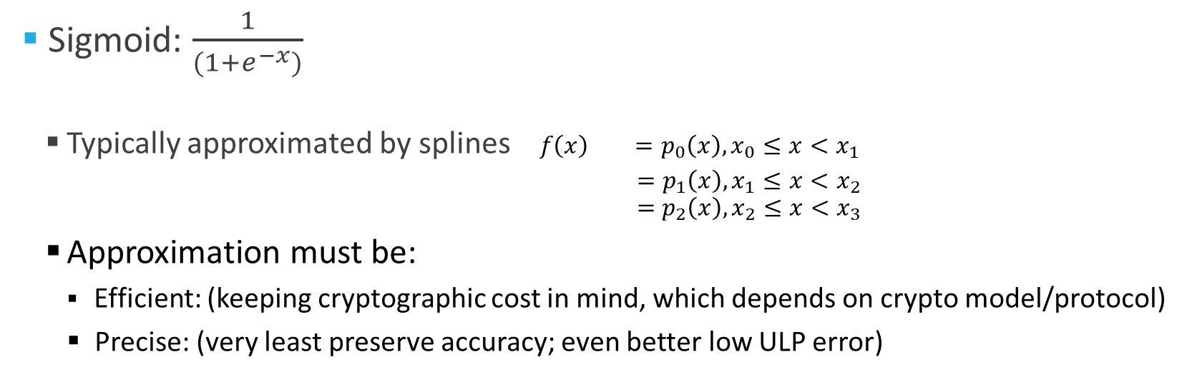
Sigmoid, Tanh etc.
Part 1: Usability
Rathee, Rathee, Kiran Goli, Gupta, Sharma, C, Rastogi;
“SIRNN: A Math Library for Secure RNN Inference”, IEEE S&P 2021
Sigmoid: $\frac{1}{(1+e^{−x})}$
  Typically approximated by splines$f\left(x\right) =p_{0}\left(x\right), x_{0}≤x<x_{1}$
$$=p_{1}\left(x\right), x_{1}≤x<x_{2}$$
$$=p_{2}\left(x\right), x_{2}≤x<x_{3}$$
  Approximation must be:
    Efficient: (keeping cryptographic cost in mind, which depends on crypto model/protocol)
    Precise: (very least preserve accuracy; even better low ULP error)

Slide 26
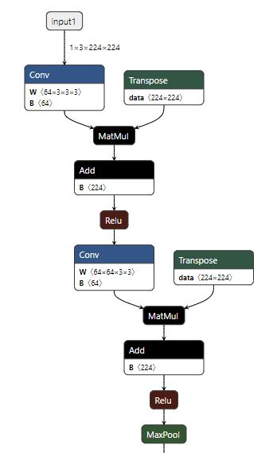
Compiling ONNX
Part 1: Usability
Compile:
  Float-point matmul/convolutions
  to fixed-point (including truncations)
  ReLU-maxpool to max+select etc.
  Transcendental functions
  with precise MPC friendly approximations
  Non-cryptographic operators
  (e.g. transpose, reshape) to local operations
Crypto-specific compiler optimizations
  ReLU+Maxpool -> Maxpool+ReLU
  Truncate+ReLU -> Fuse layers
  Backpass memory

Slide 27
Usability
Part 1: Usability
Float-to-fixed Conversion:
ML code written in floating-point (Tensorflow, ONNX, Pytorch etc.)
Expensive to emulate floating-point in MPC
Computation Nodes:
ML code has several high-level building blocks
General MPC for low-level computations
Transcendental Functions:
ML uses many transcendental functions (sigmoid, tanh etc.)
Approximations of these functions expensive or imprecise
1
Compiler that compiles:
From float-to-fixed while preserving accuracy
From TensorFlow/ONNX to Efficient crypto APIs
Approximates transcendental functions accurately
2
3

Slide 28
Outline
Usability
Computation Model
Computation Model
Cryptographic Protocols
Libraries

Slide 29






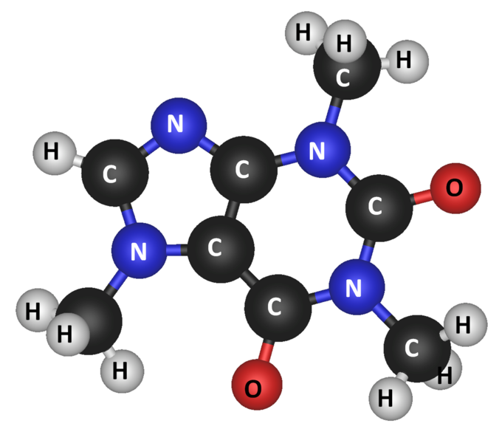
Computation Model (2PC with dealer)
Part 2: Computation Model
Enabler of Secure Inference
Generates correlated randomness
while setting up VMs
correlated
keys
correlated
keys
Model Publisher
w
Model Consumer
x

Slide 30
2PC Model and Security:
Semi-honest 2PC with Preprocessing
Part 2: Computation Model
This talk: trusted dealer, 1 semi-honest corruption

Slide 31


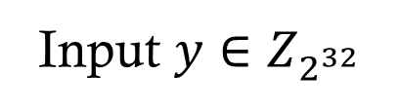
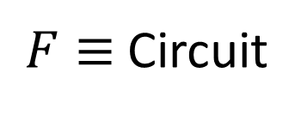
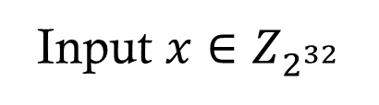
Recall: Secure computation
Part 2: Computation Model
Input $x∈Z_{2^{32}}$
Input $y∈Z_{2^{32}}$
$F≡$Circuit
Circuits over addition, multiplication, comparison, etc gates
Gates such as matrix multiplication, convolution, ReLU, etc
Protocol Summary:
Alice and Bob start with 2-out-2 secret shares of input
For a gate, given shares of input wires, run a protocol to compute shares of output wire
In the end, reconstruct/decrypt shares of final output wire

Slide 32
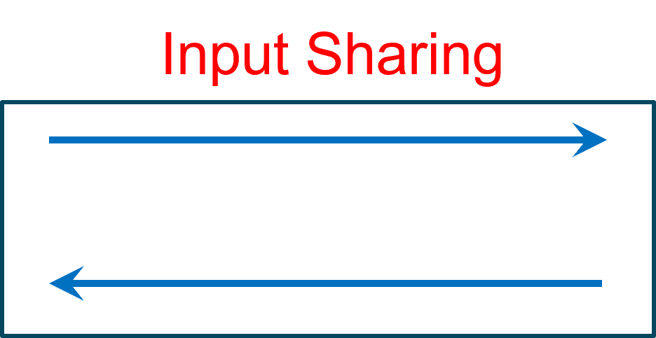
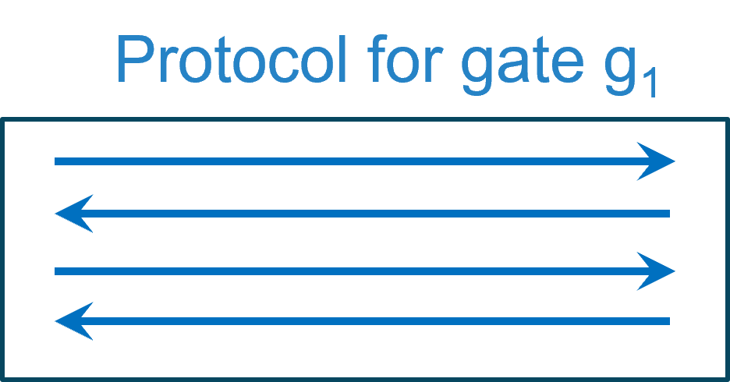
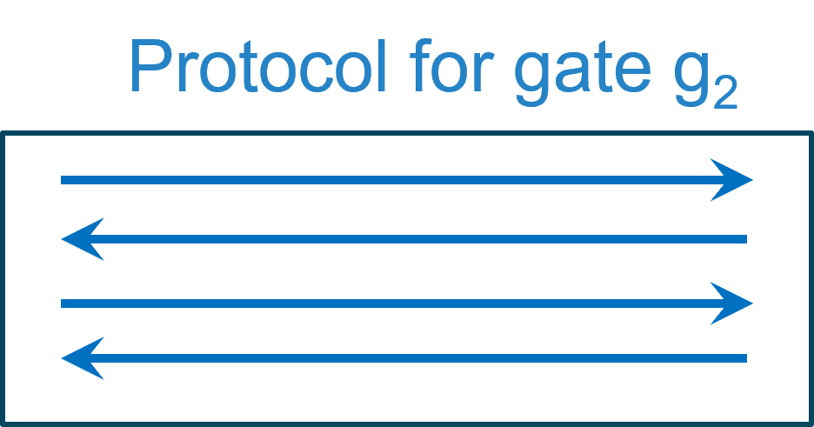




Protocol structure
Part 2: Computation Model
All protocols start with “input shares” and end with “output shares”
$$x$$
$$y$$
.
.
.
Output reconstruction
$$f(x,y)$$
$$f(x,y)$$

Slide 33
Outline
Usability
Computation Model
Cryptographic Protocols
Cryptographic Protocols
Libraries

Slide 34



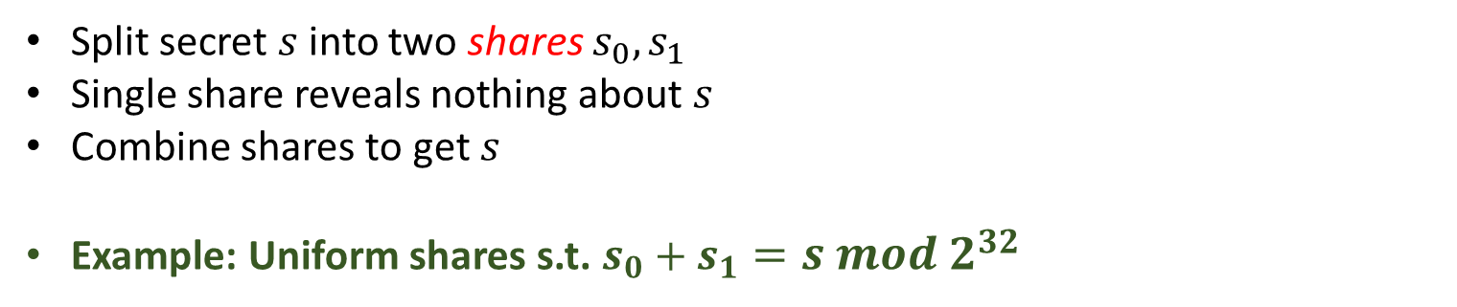

2-out-of-2 Secret sharing scheme
Part 3: Crypto protocols
$$s_{0}$$
$$s_{1}$$
Split secret $s$ into two shares $s_{0},s_{1}$
Single share reveals nothing about $s$
Combine shares to get $s$
Example: Uniform shares s.t. $s_{0}+s_{1}=s mod 2^{32}$
$$s∈2^{32}$$

Slide 35
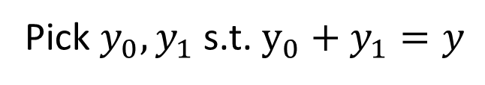
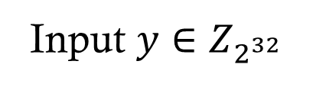
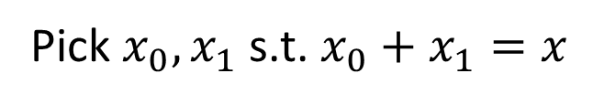



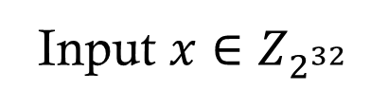

Input sharing phase
Part 3: Crypto protocols
Each party shares its input with other party
Input $x∈Z_{2^{32}}$
Input $y∈Z_{2^{32}}$
$$x_{1}$$
$$y_{0}$$
Pick $y_{0},y_{1}$ s.t. $y_{0}+y_{1}=y$
Pick $x_{0},x_{1}$ s.t. $x_{0}+x_{1}=x$
$$x_{0},y_{0}$$
$$x_{1},y_{1}$$

Slide 36
Protocols to support?
Part 3: Crypto protocols
Addition
Multiplication
Matrix Multiplication
Convolutions
Truncations
ReLU, Derivative of ReLU
Maxpool, Averagepool
Transcendental (Splines)
Arithmetic Computation:
Beaver Triples based protocols
Boolean Computation (Many options):
Garbled Circuit (GC)
Secret Sharing
Function Secret Sharing

Slide 37
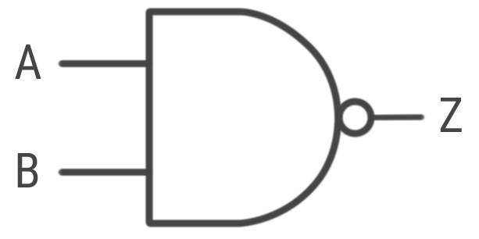





Addition gate
Part 3: Crypto protocols
Arithmetic Computations
a
$$+$$
C
c
b
Each party locally adds the shares of input wires
$a_{0},b_{0}$
$a_{1},b_{1}$
No Interaction
Compute $c_{0}=a_{0}+b_{0}$
Compute $c_{1}=a_{1}+b_{1}$
Correctness: $c_{0}+c_{1}={(a}_{0}+b_{0})+\left(a_{1}+b_{1}\right)=a+b=c$
Security: trivial

Slide 38



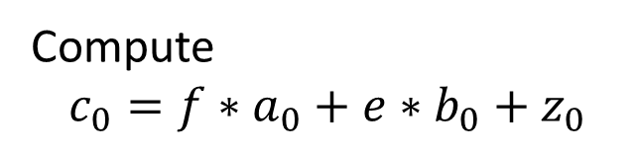





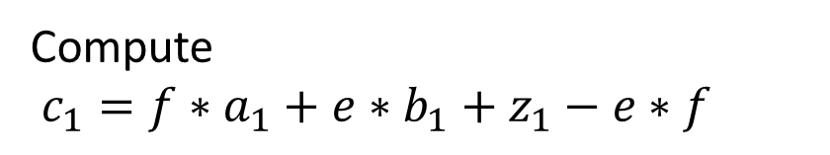
Multiplication gate
Part 3: Crypto protocols
Arithmetic Computations
a
$$∗$$
C
c
b
Dealer provides “Beaver Triplet”
Parties hold shares of random $x, y, z$with $z=x∗y$
$x_{0},y_{0}, z_{0}$
$x_{1},y_{1}, z_{1}$
$a_{0},b_{0}$
$${e_{0}=a_{0}−x_{0}, f}_{0}=b_{0}−y_{0}$$
$a_{1},b_{1}$
$${e_{1}=a_{1}−x_{1}, f}_{1}=b_{1}−y_{1}$$
Reconstruct e and f
Compute
$$c_{0}={f∗a}_{0}+{e∗b}_{0}+z_{0}$$
Compute
$c_{1}={f∗a}_{1}+{e∗b}_{1}+z_{1}−e∗f$
Correctness
Security – holds from
one-time pad security
Followed by truncation
(not covered now)

Slide 39



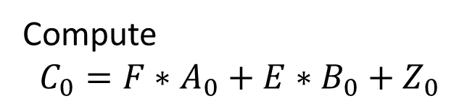




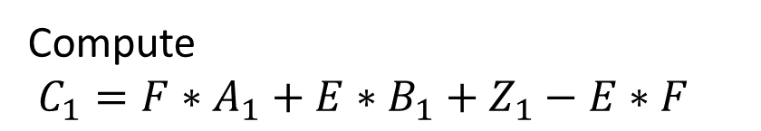
Matrix Multiplication
Part 3: Crypto protocols
Arithmetic Computations
$$∗$$
C
Dealer provides “Matrix Beaver Triplet”
Parties hold shares of random matrices $X, Y, Z$with $Z=X∗Y$
$X_{0},Y_{0}, Z_{0}$
$X_{1},Y_{1}, Z_{1}$
$A_{0},B_{0}$
$${E_{0}=A_{0}−X_{0}, F}_{0}=B_{0}−Y_{0}$$
$A_{1},B_{1}$
$${E_{1}=A_{1}−X_{1}, F}_{1}=B−Y_{1}$$
Reconstruct E and F
Compute
$$C_{0}={F∗A}_{0}+{E∗B}_{0}+Z_{0}$$
Compute
$C_{1}={F∗A}_{1}+{E∗B}_{1}+Z_{1}−E∗F$
Correctness
Security – holds from
one-time pad security
Followed by truncation
(not covered now)

Slide 40
Protocols to support?
Part 3: Crypto protocols
Addition
Multiplication
Matrix Multiplication
Convolutions
Truncations
ReLU, Derivative of ReLU
Maxpool, Averagepool
Transcendental (Splines)
Arithmetic Computation:
Beaver Triples based protocols
Boolean Computation (Many options):
Garbled Circuit (GC)
Secret Sharing
Function Secret Sharing

Slide 41
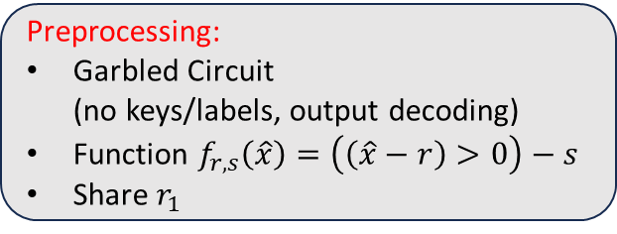



Garbled Circuits (with preprocessing)
Part 3: Crypto protocols
Boolean Computations
Input: Secret Shares of $x$
Output: Secret Shares of $y= x>0$
Preprocessing:
Keys/Labels for all inputs
Share $r_{0}, s$
Preprocessing:
Garbled Circuit
(no keys/labels, output decoding)
Function $f_{r,s}\left(\hat{x}\right)=\left(\left(\hat{x}−r\right)>0\right)−s$
Share $r_{1}$
$$x_{0}$$
$$x_{1}$$
$$x_{1}+r_{1}$$
$$\hat{x}=x+r$$
Labels for $\hat{x}$
$$y_{0}=s$$
$$y_{1}=f_{r,s}(\hat{x})$$
Preprocessing: $≈|f_{r,s}|λ$
Communication: $λn$
Rounds: 2

Slide 42


GMW-style (with preprocessing)
Part 3: Crypto protocols
Boolean Computations
Input: Secret Shares of $x$
Output: Secret Shares of $y= x>0$
Preprocessing:
AND triples for all AND gates
Secret shares of random bits $u,v,w$ with $w=u∧v$
Preprocessing:
$u_{0},v_{0},w_{0}$
$$a_{0}$$
$$a_{1}$$
Preprocessing:
$u_{1},v_{1},w_{1}$
$$b_{0}$$
$$b_{1}$$
$$e_{1}=a_{1}⊕u_{1}, f_{1}=b_{1}⊕v_{1}$$
$$e_{0}=a_{0}⊕u_{0}, f_{0}=b_{0}⊕v_{0}$$
$$c_{0}={f∧a}_{0}⊕{e∧b}_{0}⊕w_{0}$$
$$c_{1}={f∧a}_{1}⊕{e∧b}_{1}⊕w_{1}⊕e∧f$$
Preprocessing: $≈O(λ)$
Communication: $4∗|AND|$ gates
Rounds: Depth of circuit

Slide 43
Protocols to support?
Part 3: Crypto protocols
Addition
Multiplication
Matrix Multiplication
Convolutions
Truncations
ReLU, Derivative of ReLU
Maxpool, Averagepool
Transcendental (Splines)
Arithmetic Computation:
Beaver Triples based protocols
Boolean Computation (Many options):
Garbled Circuit (GC)
Secret Sharing
Function Secret Sharing

Slide 44
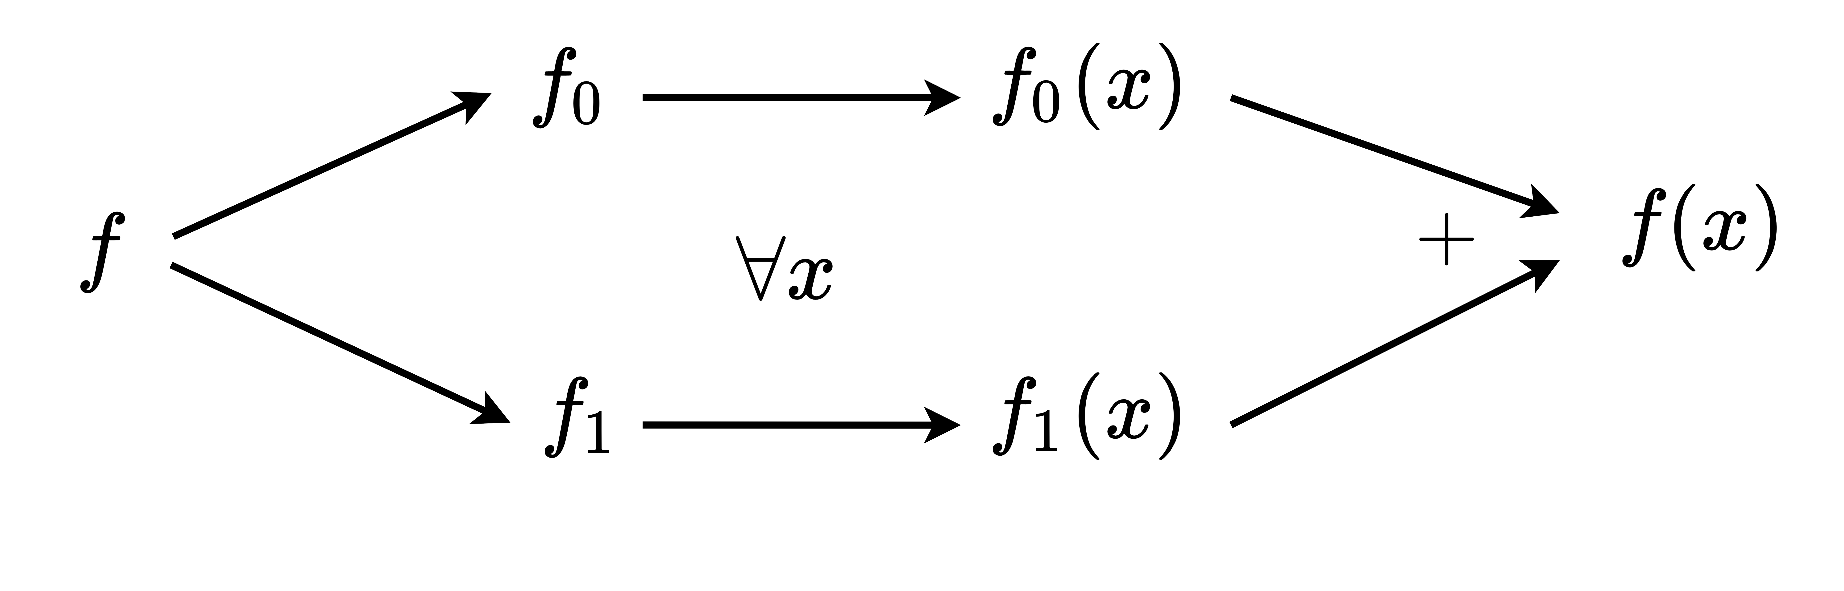
Function Secret Sharing [BGI15]
Part 3: Crypto protocols
Boolean Computations
FSS keys
Correctness
  $f_{0}\left(x\right)+f_{1}\left(x\right)=f(x)$
Security
  $f_{σ}$ (key) hides $f$
Compact
  $f_{σ}$ is compact in input, output size

Slide 45
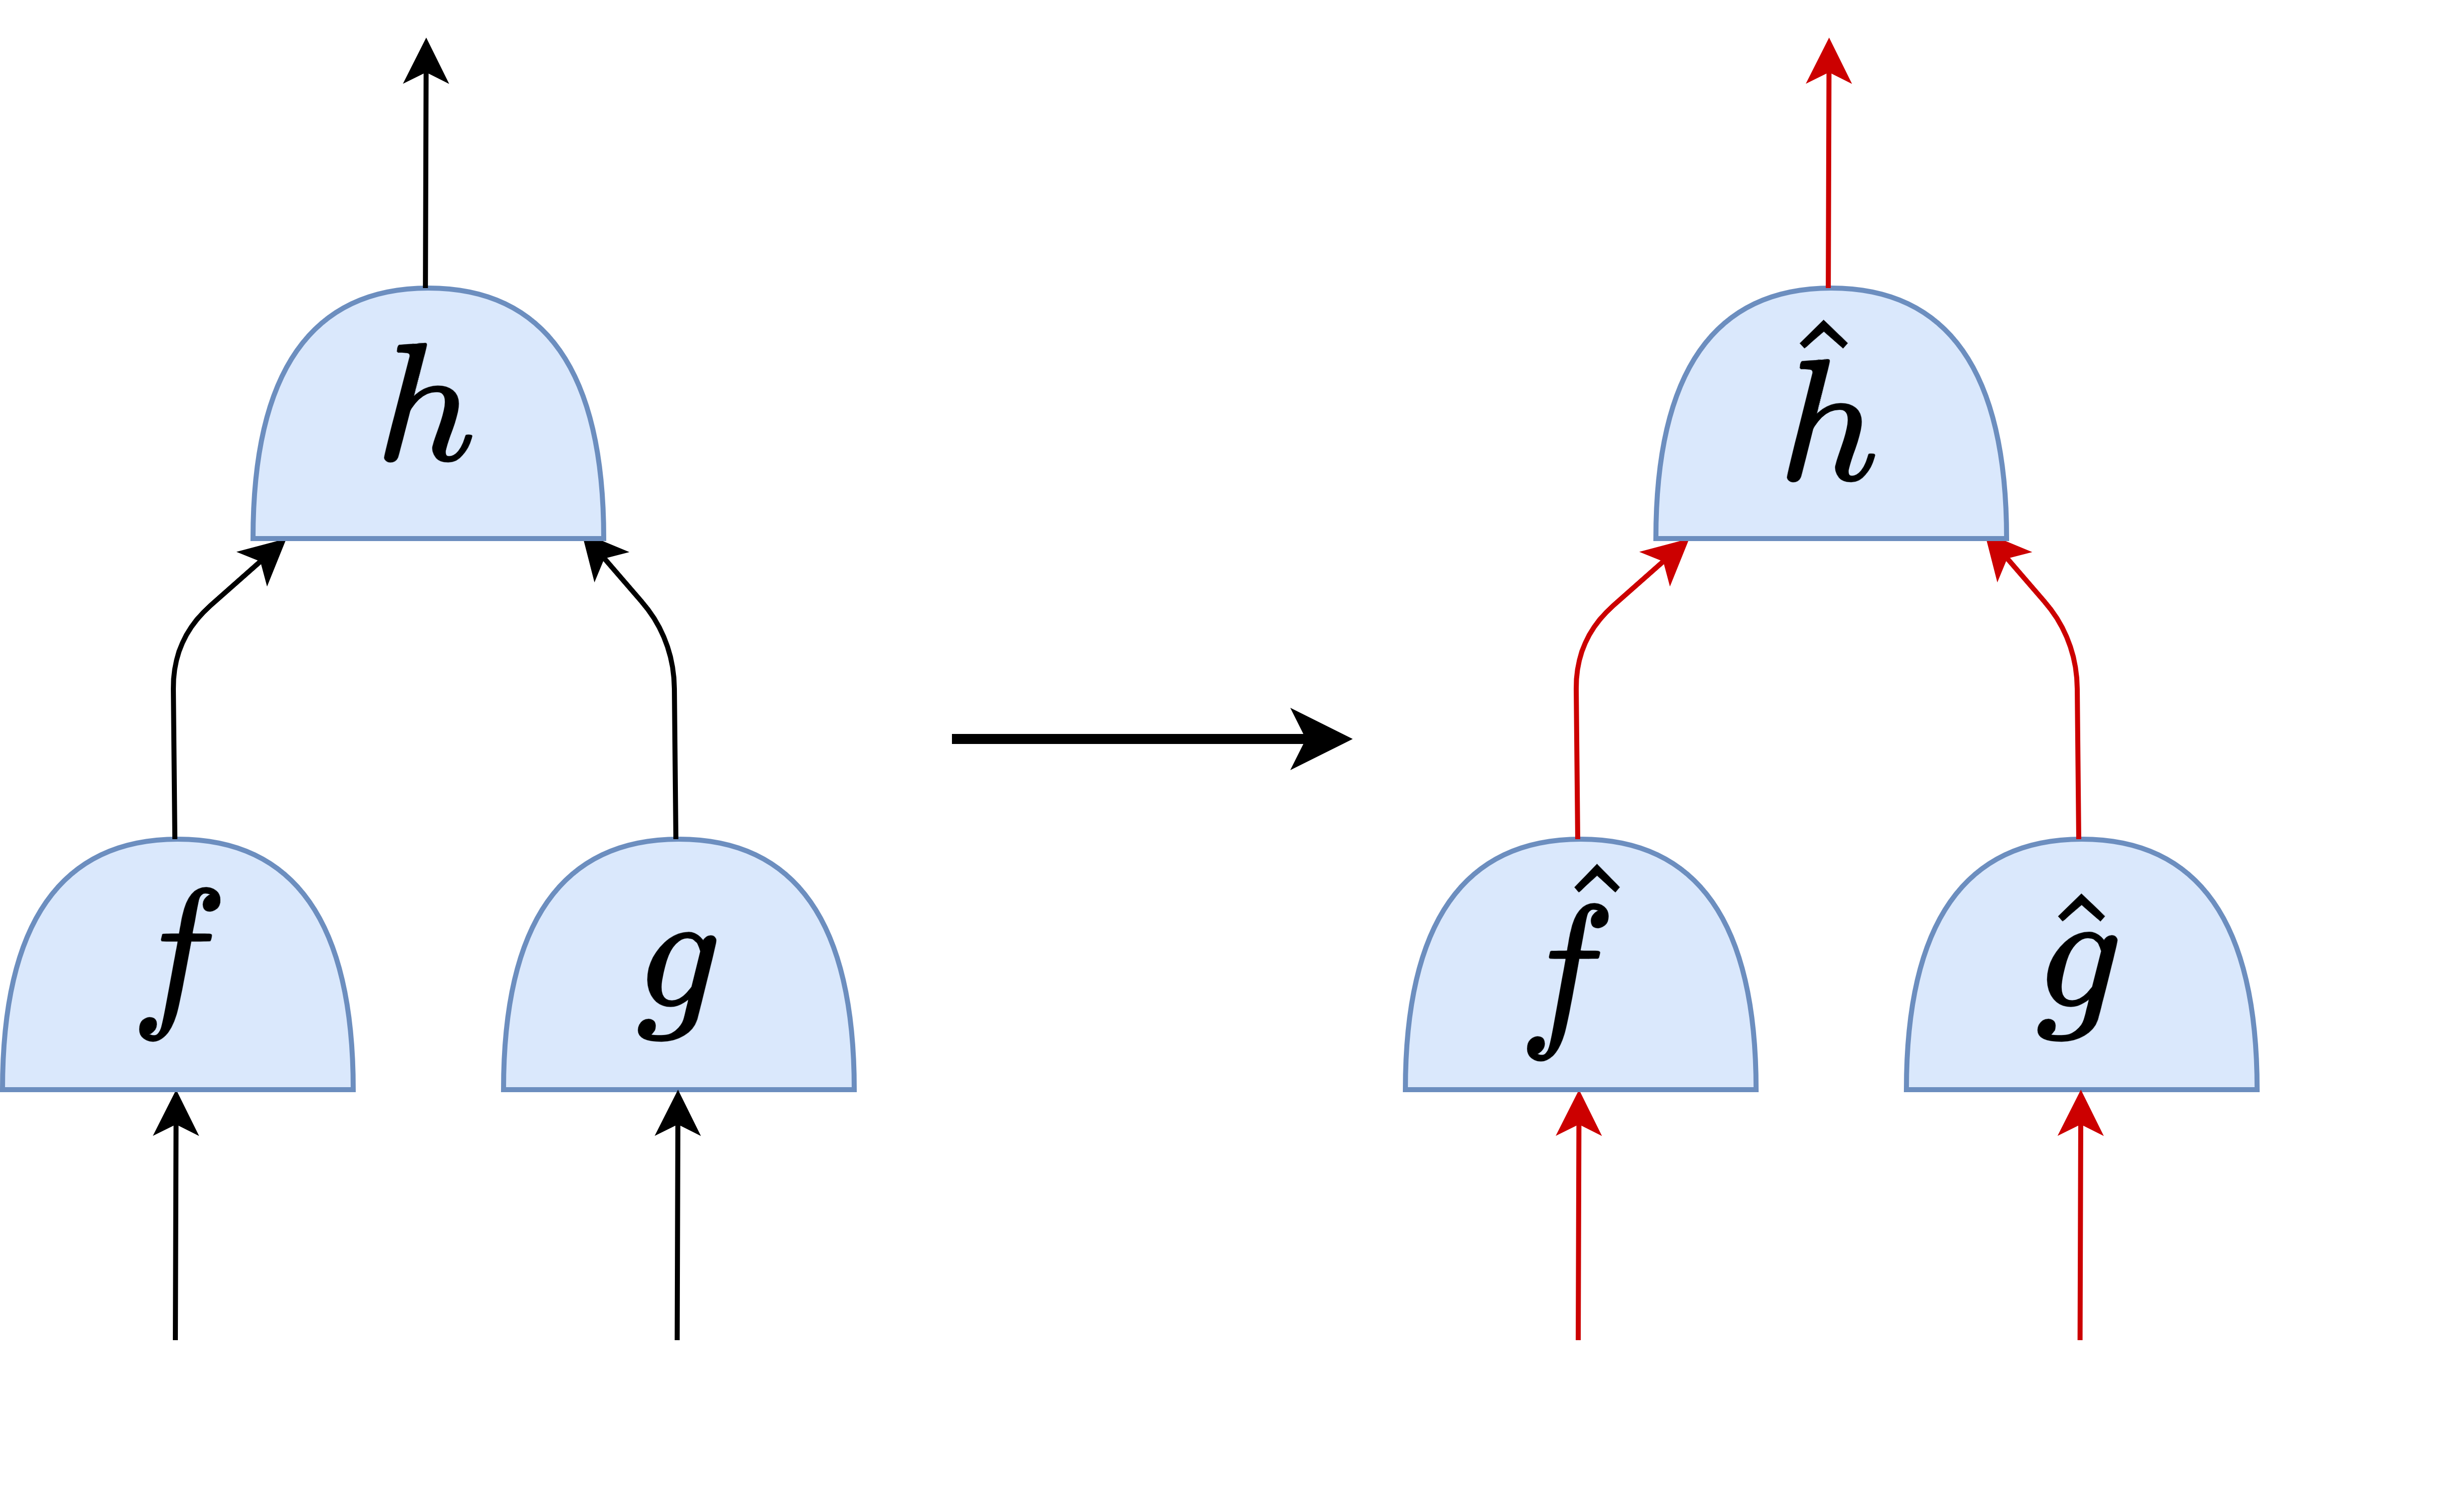
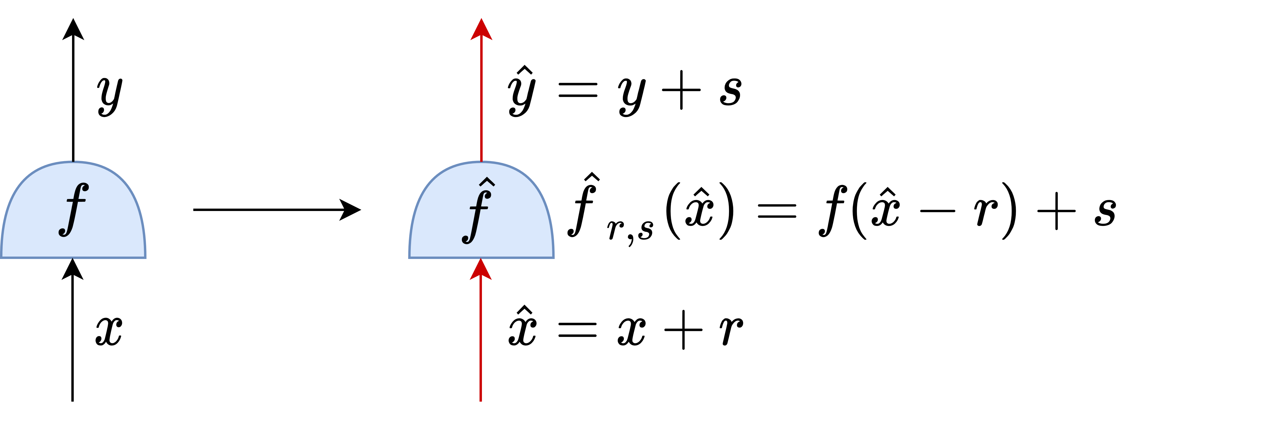
2PC with Preprocessing via FSS [BGI19]
Part 3: Crypto protocols
Boolean Computations
Wires carry elements in
Wires carry ring elements
unmasked world
masked world
FSS hides secrets

Slide 46
2PC with Preprocessing via FSS [BGI19]
Part 3: Crypto protocols
Boolean Computations
Recall: FSS keys allow P0, P1 to compute on common input to get shares of output

Slide 47
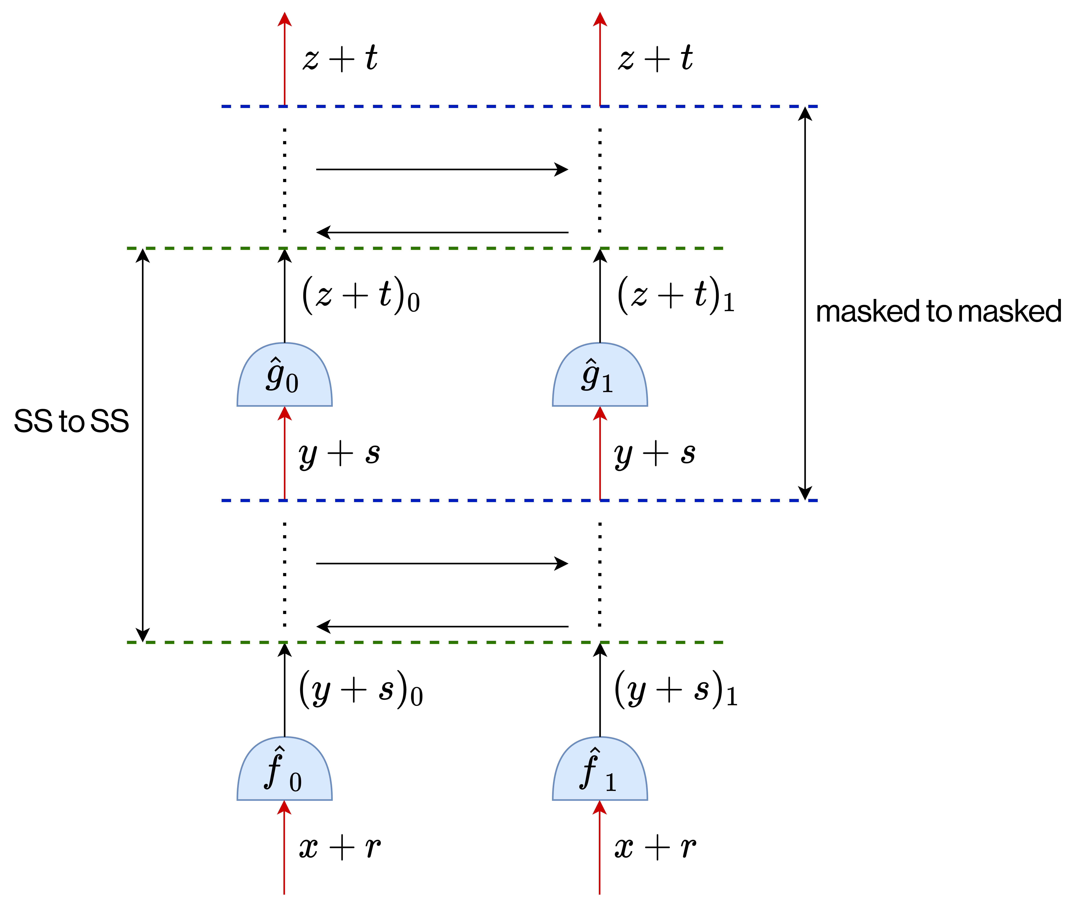
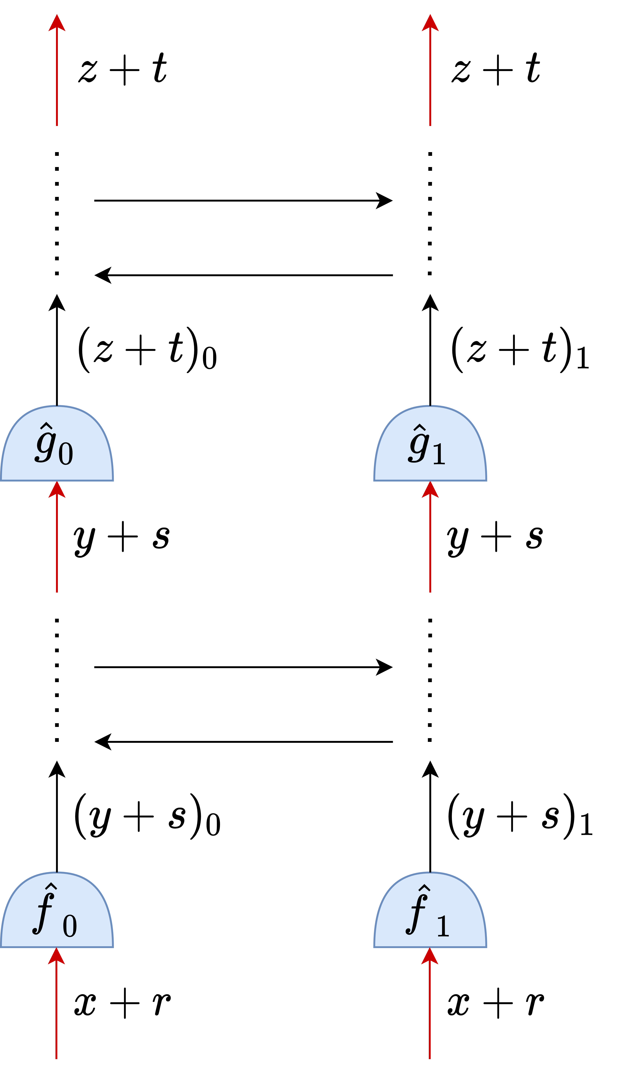
2PC with Preprocessing via FSS [BGI19]
Part 3: Crypto protocols
Arithmetic & Boolean Computations
Comm: 1 ring element per gate per party
Rounds: 1 per circuit level
Beaver Triples compatible with FSS for arithmetic computations
Modular
Use with other protocols
$$\left(x+r\right)\left(y+s\right)−r_{0}\left(y+s\right)−r_{1}\left(y+s\right)−s_{0}\left(x+r\right)−s_{1}\left(x+r\right)+{\left(rs\right)}_{0}+{\left(rs\right)}_{1}$$

Slide 48
FSS-based 2PC vs other approaches (Boolean gates)
Part 3: Crypto protocols
Boolean Computations
Approach | Online Comm. | Online Rounds | Correlation Size
GC with Dealer | High | 2 | High
GMW / SS | Low-Moderate | High | Low
FSS (BGI19) | Low | 1 | High
Per gate for commonly found non-arithmetic gates (not $+, ×$)
For online metrics: FSS clear winner
Biggest bottleneck for FSS: correlation size

Slide 49
Protocols to support?
Part 3: Crypto protocols
Addition
Multiplication
Matrix Multiplication
Convolutions
Truncations
ReLU, Derivative of ReLU
Maxpool, Averagepool
Transcendental (Splines)
Arithmetic Computation:
Beaver Triples based protocols
Today: FSS protocols for equality test and comparison
Boolean Computation (Many options):
Garbled Circuit (GC)
Secret Sharing
Function Secret Sharing

Slide 50
FSS for Equality Test/Point Functions OR
Distributed Point Functions [BGI15/BGI16]
Part 3: Crypto protocols
Boolean Computations
$1$ if $x=α$
$0$ otherwise
$$f_{α}\left(x\right)≔$$
Only using One-Way Functions (PRGs)
Give $P_{0}$and $P_{1}$FSS keys s.t.:
$Eval_{k_{0}}\left(x\right)⊕Eval_{k_{1}}\left(x\right)=f_{α}\left(x\right)$
$k_{0}$ and $k_{1}$ reveal nothing about $α$

Slide 51
DPF Construction: Tools
Part 3: Crypto protocols
Boolean Computations
Length-doubling Pseudorandom Generator (PRG)
Structure: GGM Pseudorandom Function (PRF)
[Goldreich-Goldwasser-Micali’84]
s
GGM Tree
Length-doubling PRG
s
PRG
Pseudorandom G(s)
Very long Pseudorandom G(s)
(E.g. 2 AES calls on s)

Slide 52
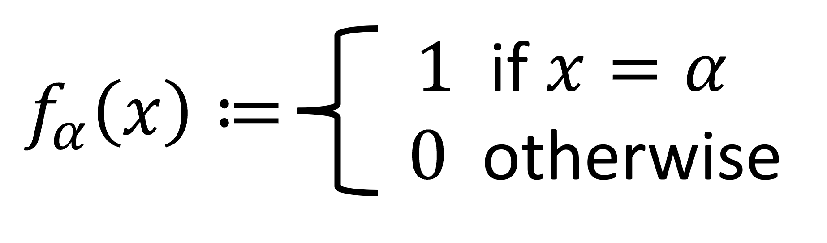

DPF Construction [BGI15/BGI16]
Part 3: Crypto protocols
Boolean Computations
Party 0
Party 1
$$x=x_{1}x_{2}….. x_{n}$$
$$α=α_{1}α_{2}… α_{n}$$
$$=10110$$
s₀₀|| b₀₀
PRG seeds
s₁₀|| b₁₀
$$α_{1}$$
$$x_{1}$$
$$x_{1}$$
s₀₁|| b₀₁
CW₁
s₁₁|| b₁₁
Invariant:
On special path:
parties hold pseudorandom
different PRG seeds & bits
Off special path:
parties hold pseudorandom
same PRG seed & bits
$$α_{2}$$
$$x_{2}$$
$$x_{2}$$
s₀₂|| b₀₂
s₁₂|| b₁₂
$$α_{3}$$
CW₂
$$α_{4}$$
$$α_{5}$$

Slide 53
DPF Construction [BGI15/BGI16]
Part 3: Crypto protocols
Boolean Computations
$$x_{1}$$
$$α_{1}$$
Party 0
Party 1
Invariant:
On special path:
parties hold pseudorandom
different PRG seeds & bits
Off special path:
parties hold pseudorandom
same PRG seed & bits
$$x_{2}$$
$$α_{2}$$
$$x=x_{1}x_{2}….. x_{n}$$
$$α=α_{1}α_{2}… α_{n}$$
$$=10110$$
$$x_{3}$$
$$α_{3}$$
s₀|| b₀
PRG seeds
s₁|| b₁
PRG
PRG
Correction Word ($α_{i}=1$)
L₀|| t₀
R₀|| v₀
L₁|| t₁
R₁|| v₁
L₀ $⊕$L₁|| t₀ $⊕$t₁
R₀ $⊕$R₁ $⊕$ s’ || v₀ $⊕$v₁ $⊕$1
Take L/R part depending on x_{i}
Add CW depending on b₀/b₁

Slide 54
DPF Construction [BGI15/BGI16]
Part 3: Crypto protocols
Boolean Computations
$$x_{1}$$
$$α_{1}$$
Party 0
Party 1
Invariant:
On special path:
parties hold pseudorandom
different PRG seeds & bits
Off special path:
parties hold pseudorandom
same PRG seed & bits
$$x_{2}$$
$$α_{2}$$
$$x=x_{1}x_{2}….. x_{n}$$
$$α=α_{1}α_{2}… α_{n}$$
$$=10110$$
$$x_{3}$$
$$α_{3}$$
s₀|| b₀
PRG seeds
s₁|| b₁
PRG
PRG
Correction Word ($α_{i}=1$)
L₀|| t₀
R₀|| v₀
L₁|| t₁
R₁|| v₁
L₀ $⊕$L₁|| t₀ $⊕$t₁
R₀ $⊕$R₁ $⊕$ s’ || v₀ $⊕$v₁ $⊕$1
Continuing
ON-path
($x_{i}=1$)
$$⊕$$
R₀ $⊕$R₁ $⊕$ s’ || v₀ $⊕$v₁ $⊕$1
Take L/R part depending on x_{i}
Add CW depending on b₀/b₁
R₀|| v₀
R₀ $⊕$ s’ || v₀ $⊕$ 1
Different PRG seeds and bits

Slide 55
DPF Construction [BGI15/BGI16]
Part 3: Crypto protocols
Boolean Computations
$$x_{1}$$
$$α_{1}$$
Party 0
Party 1
Invariant:
On special path:
parties hold pseudorandom
different PRG seeds & bits
Off special path:
parties hold pseudorandom
same PRG seed & bits
$$x_{2}$$
$$α_{2}$$
$$x=x_{1}x_{2}….. x_{n}$$
$$α=α_{1}α_{2}… α_{n}$$
$$=10110$$
$$x_{3}$$
$$α_{3}$$
s₀|| b₀
PRG seeds
s₁|| b₁
PRG
PRG
Correction Word ($α_{i}=1$)
L₀|| t₀
R₀|| v₀
L₁|| t₁
R₁|| v₁
L₀ $⊕$L₁|| t₀ $⊕$t₁
R₀ $⊕$R₁ $⊕$ s’ || v₀ $⊕$v₁ $⊕$1
Moving
OFF-path
($x_{i}=0$)
$$⊕$$
L₀ $⊕$L₁|| t₀ $⊕$t₁
Take L/R part depending on x_{i}
Add CW depending on b₀/b₁
L₀|| t₀
L₀ || t₀
Same PRG seeds and bits

Slide 56
DPF Construction [BGI15/BGI16]
Part 3: Crypto protocols
Boolean Computations
$$x_{1}$$
$$α_{1}$$
Party 0
Party 1
Invariant:
On special path:
parties hold pseudorandom
different PRG seeds & bits
Off special path:
parties hold pseudorandom
same PRG seed & bits
$$x_{2}$$
$$α_{2}$$
$$x=x_{1}x_{2}….. x_{n}$$
$$α=α_{1}α_{2}… α_{n}$$
$$=10110$$
$$x_{3}$$
$$α_{3}$$
s’|| b’
PRG seeds
s’|| b’
PRG
PRG
Correction Word ($α_{i}=1$)
L’ || t’
R’ || v’
L’ || t’
R’ || v’
L₀ $⊕$L₁|| t₀ $⊕$t₁
R₀ $⊕$R₁ $⊕$ s’ || v₀ $⊕$v₁ $⊕$1
Continuing
OFF-path
($x_{i}=0$)
$$⊕$$
$$⊕$$
L₀ $⊕$L₁|| t₀ $⊕$t₁
L₀ $⊕$L₁|| t₀ $⊕$t₁
Take L/R part depending on x_{i}
Add CW depending on b₀/b₁
s’’|| b’’
s’’ || b’’
Same PRG seeds and bits continues

Slide 57
DPF Key Structure/Size [BGI15/BGI16]
Part 3: Crypto protocols
Boolean Computations
Party 0
Party 1
s₀|| b₀
PRG seeds
s₁|| b₁
CW₁
CW₂
After optimizations
Key size: $≈(n−\log{λ) λ}$
CW_{n}

Slide 58
Protocols to support?
Part 3: Crypto protocols
Addition
Multiplication
Matrix Multiplication
Convolutions
Truncations
ReLU, Derivative of ReLU
Maxpool, Averagepool
Transcendental (Splines)
Arithmetic Computation:
Beaver Triples based protocols
Next: FSS protocols for equality test and comparison
Boolean Computation (Many options):
Garbled Circuit (GC)
Secret Sharing
Function Secret Sharing

Slide 59
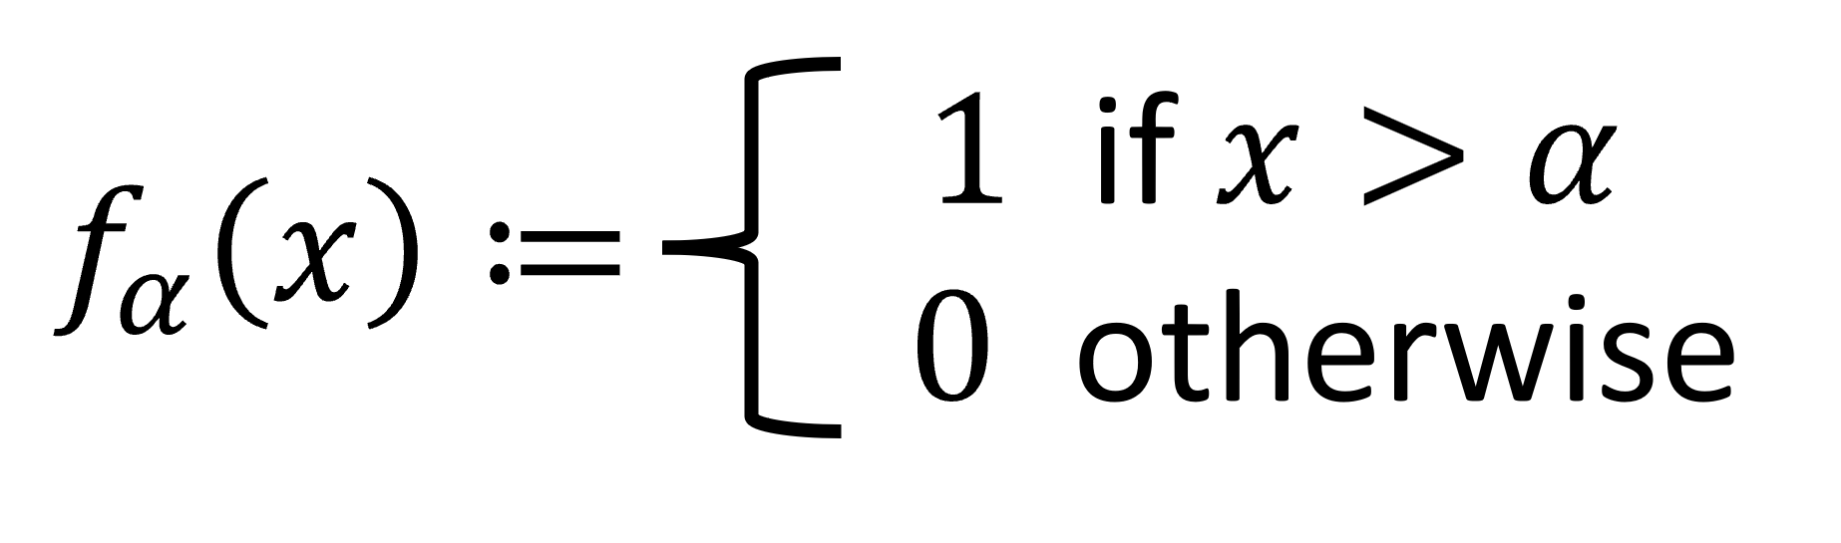
Distributed Comparison [BGI16], Grotto [SVLH22]
Part 3: Crypto protocols
Boolean Computations
Party 0
Party 1
$x=x_{1}x_{2}….. x_{n}$ $=10010$
$$α=α_{1}α_{2}… α_{n}=10110$$
s₀₀|| b₀₀
PRG seeds
s₁₀|| b₁₀
b_{i} = (b_{0i} $⊕$ b_{1i}) Eval(x) for all x in the subtree
$$α_{1}$$
$$x_{1}$$
$$x_{1}$$
s₀₁|| b₀₁
CW₁
s₁₁|| b₁₁
$$α_{2}$$
$$x_{2}$$
$$x_{2}$$
s₀₂|| b₀₂
s₁₂|| b₁₂
Eval(x) can be written as
SUM of n such values
$$x_{3}$$
$$α_{3}$$
CW₂
$$α_{4}$$
$$x_{4}$$
Invariant:
On special path:
parties hold pseudorandom
different bits
Off special path:
parties hold same bits
$$x_{5}$$
$$α_{5}$$
DCF has approx. same cost as DPF
00000000011111111

Slide 60
DCF [BGI16, BCGGIKR21, SVLH22]
Boyle, C, Gilboa, Gupta, Ishai, Kumar, Rathee;
“Function Secret Sharing for Mixed-Mode and Fixed-Point Secure Computation”, Eurocrypt 2021
Key Size
Input : $n$
Output : $ℓ$
Sec. param. : $λ$
[BGI16] | [BCGGIKR21] | [SVLH22] (only bit outputs; simpler construction)
$$≈4n(λ+ℓ)$$ | $$≈n(λ+ℓ)$$ | $$≈nλ$$

Slide 61
Protocols to support?
Part 3: Crypto protocols
Addition
Multiplication
Matrix Multiplication
Convolutions
Truncations
ReLU, Derivative of ReLU
Maxpool, Averagepool
Transcendental (Splines)
Arithmetic Computation:
Beaver Triples based protocols
After the break:
FSS protocols for splines (and ReLU)
Boolean Computation (Many options):
Garbled Circuit (GC)
Secret Sharing
Function Secret Sharing

Slide 62
Outline
Usability
Computation Model
Cryptographic Protocols
Cryptographic Protocols
After the break:
E2E inference/training system for ML (CPU/GPU)
After the break:
Libraries
Libraries

